Slide 1
Fiscal Open Data
Fiscal Transparency & Citizen Engagement in the Budget Process:
Lessons from Around the World
Ulaanbaatar, Mongolia. March 28, 2019
Lorena Rivero del Paso
Manager for Technical Cooperation and Collaboration
lorena@fiscaltransparency.net
@LorenaRDP

Slide 2
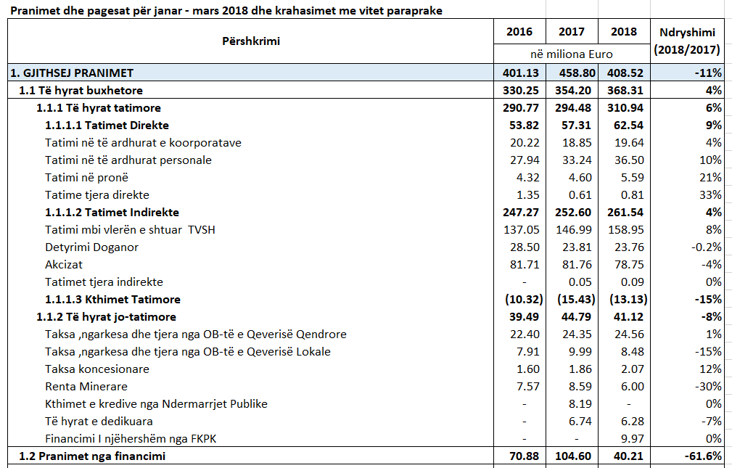
Fiscal transparency- national objectives, the institutional, legal and economic framework, policy decisions and their justification, public data and information
related to monetary and financial policies, and the way in which agencies perform their accountability, are provided to the public in an understandable, accessible and timely manner.

Slide 3
Open Data- digital data of a public nature that is accessible online and that can be used, reused or redistributed by any person.
Open data can be published either or both by private and public organizations
Croatian Open Fiscal Data Package

Slide 4
Open Data
Open data is one of the most important enablers of fiscal information use.

Slide 5
Benefits of Open Data
Increase the use of digital tools
Promote the creation of knowledge
Efficiency gains
Enabling citizen participation
Improve decision making
Economy of/with Data

Slide 6
Open Budget & Spending Data
Basis to connect other relevant data.

Slide 7
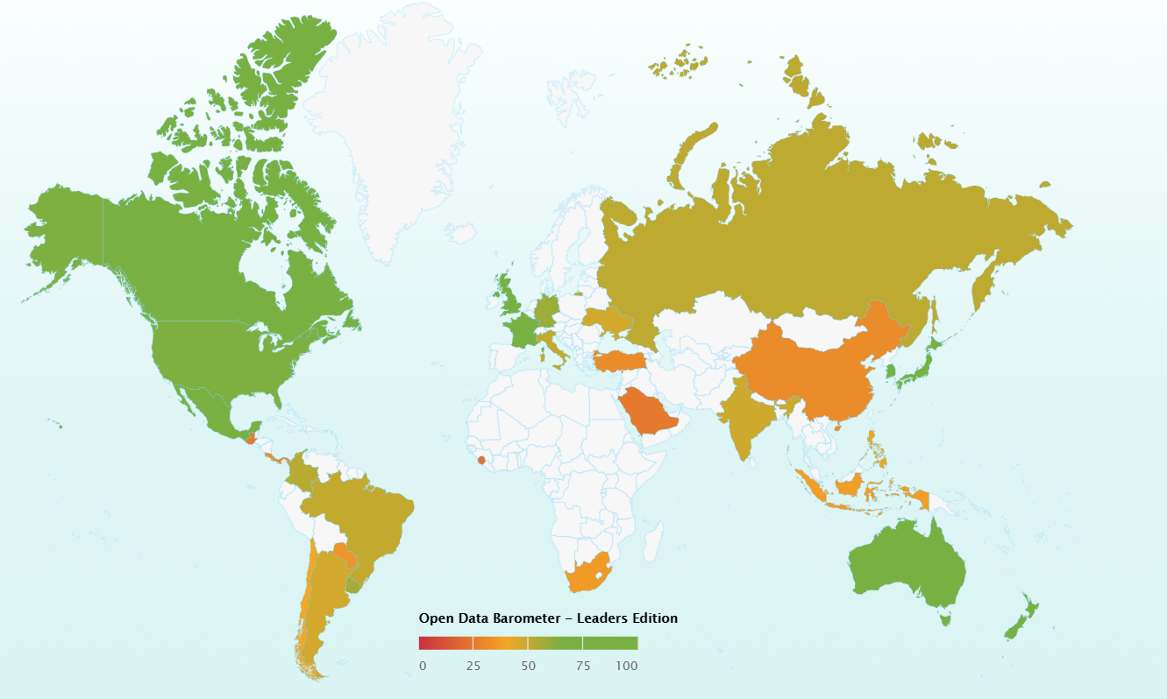
Where are we?
Open Data Barometer 2018
Open Spend only 4/35
Canada
Mexico
United Kingdom
Uruguay
Open Budget 9/35
Australia
Germany
Mexico
New Zealand
Paraguay
Russia
South Korea
United Kingdom
Uruguay

Slide 8
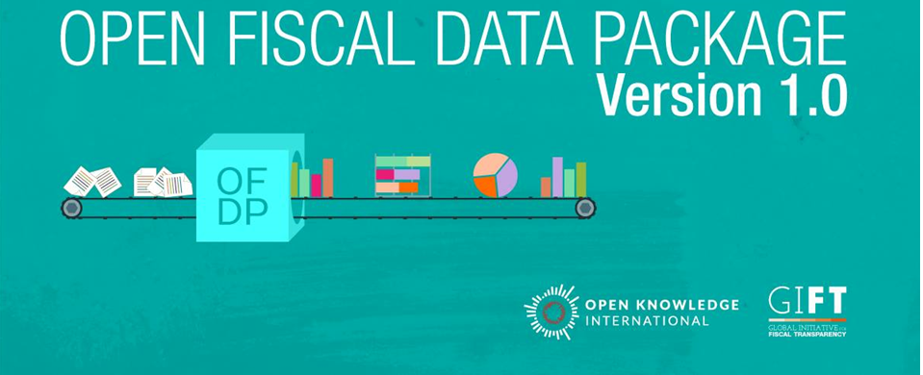
Fiscal Transparency:
Open Data
Support from GIFT to the community

Slide 9
From a standardized format of the budget and spending data…

Slide 10
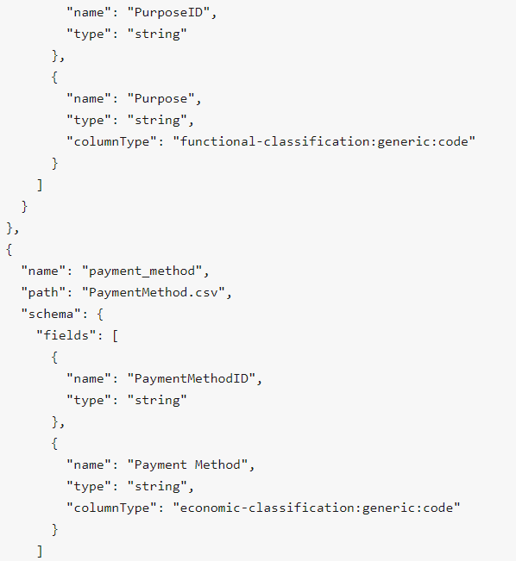
We get
A Data Specification

Slide 11
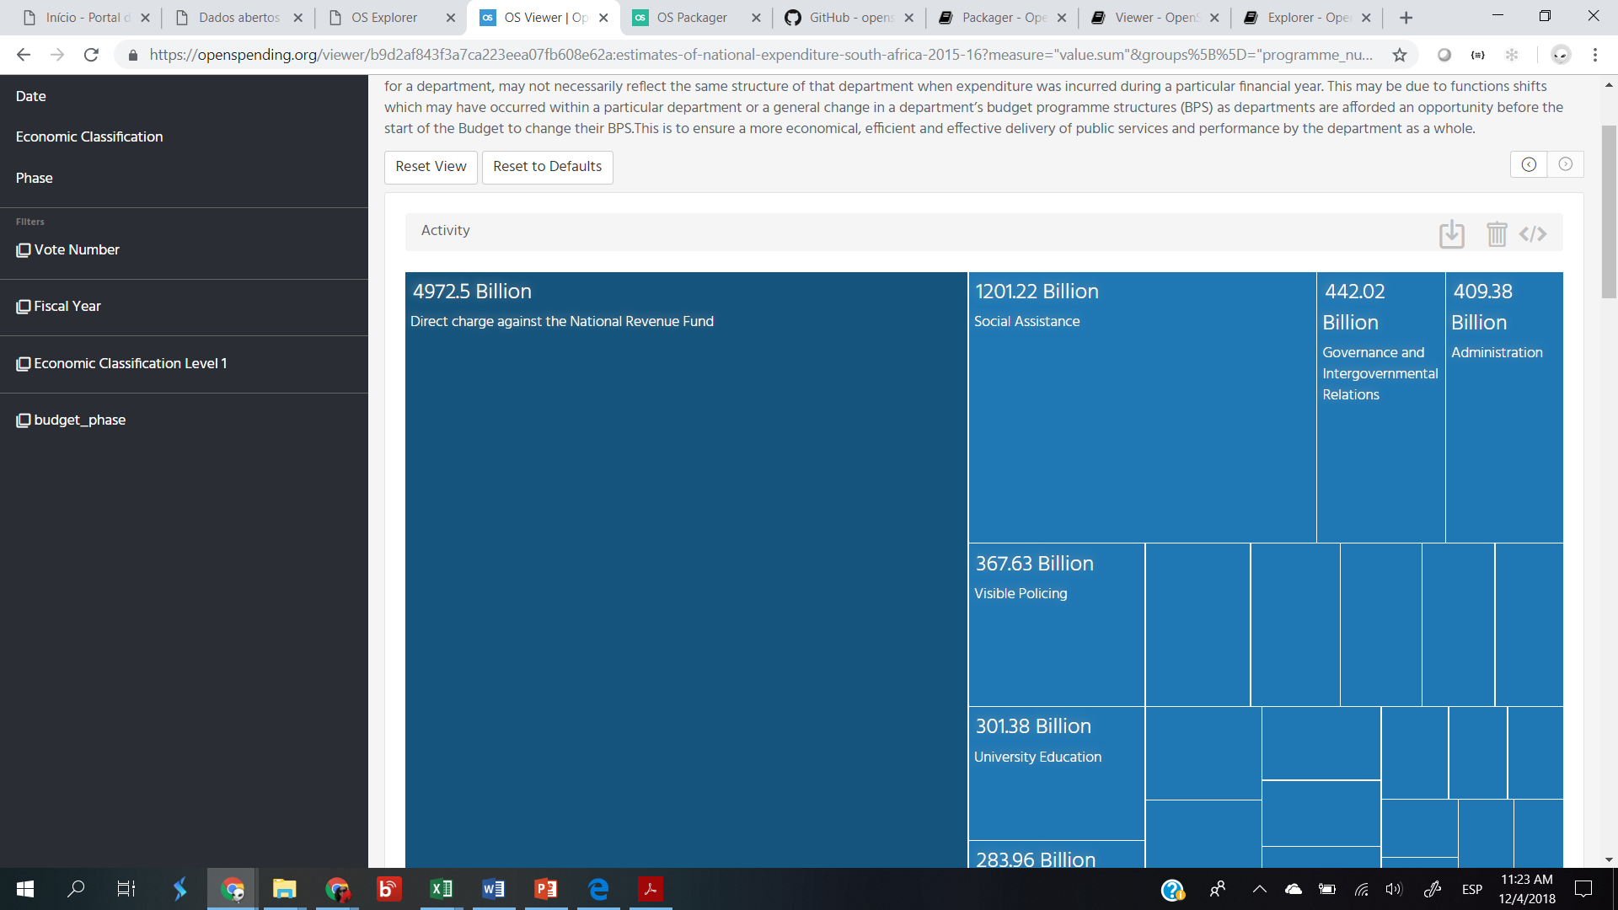
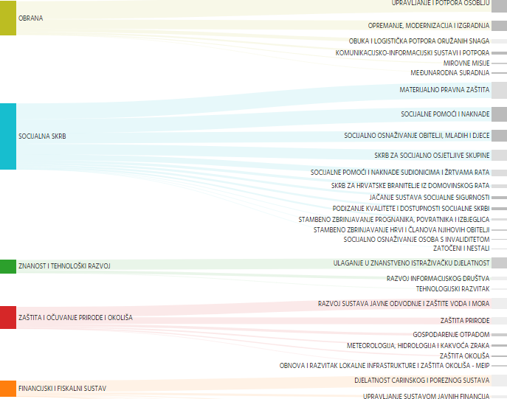
Which creates visualizations
(Embeddable, shareable, filters)

Slide 12
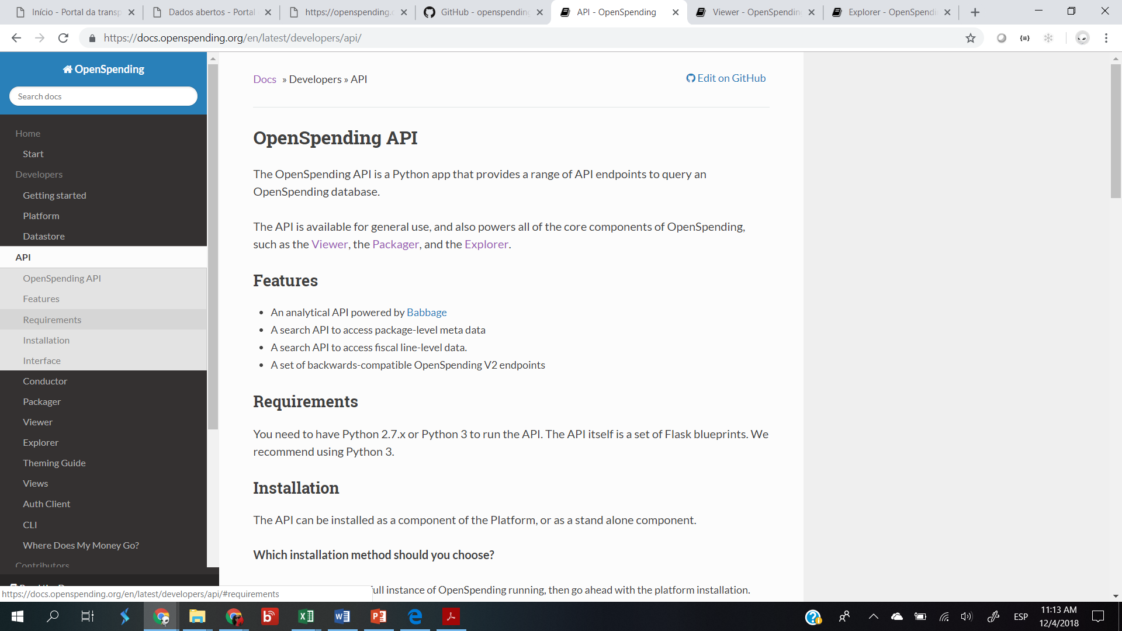
Which enables reuse

Slide 13
To communicate
AN API FOR WHAT?
…For the users
To innovate

Slide 14
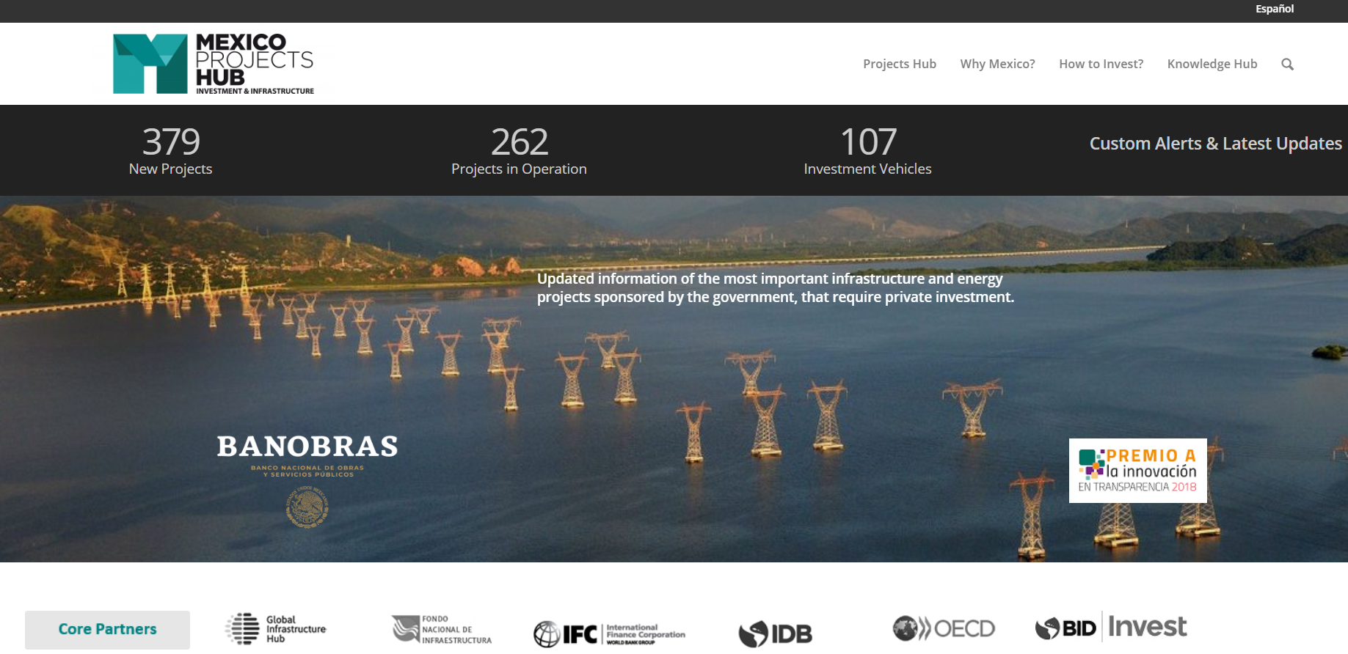
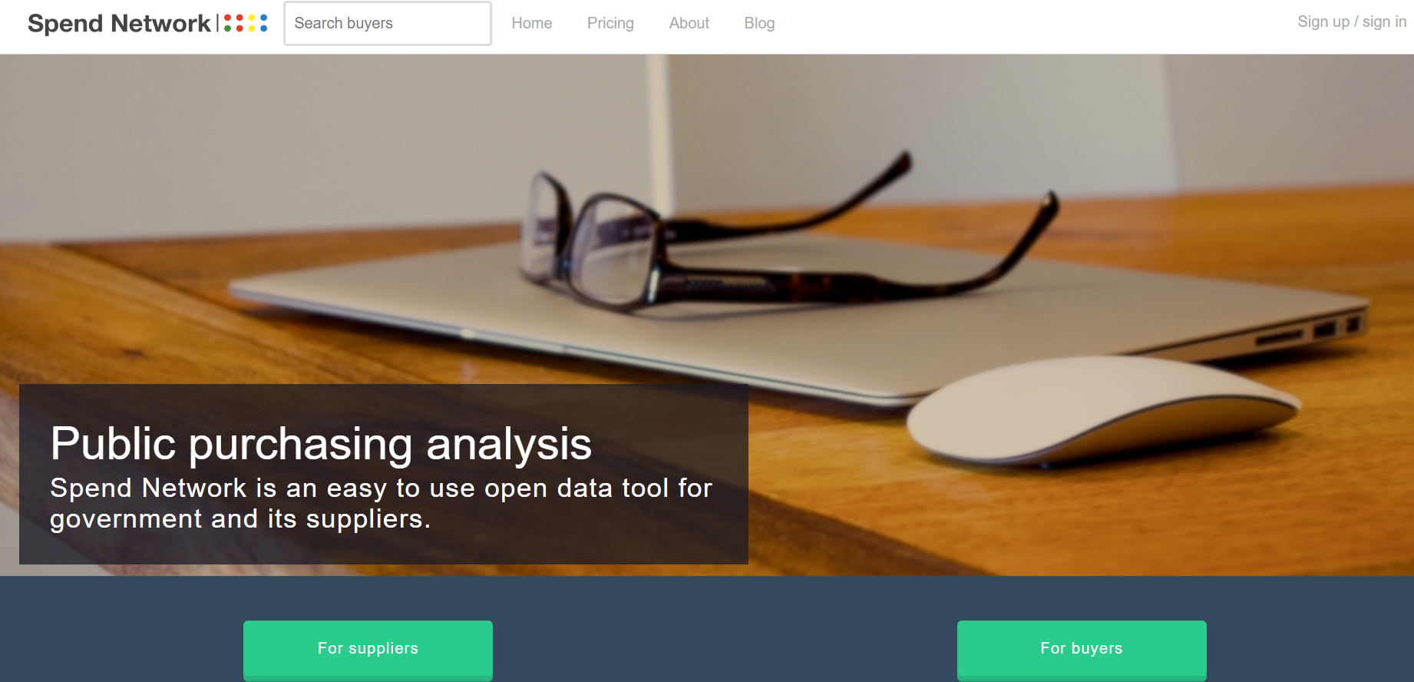
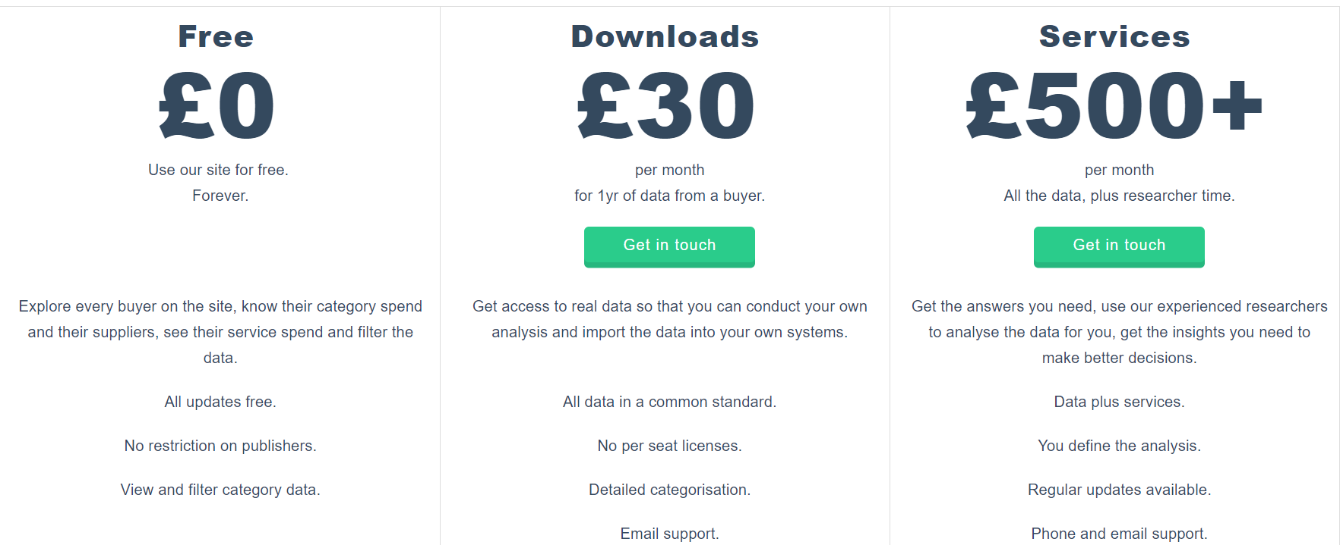
To create economy with data
AN API FOR USERS…
To te economy from data

Slide 15
Stay tuned!
@fiscaltrans
@fiscaltransparency
@fiscaltransparency
www.fiscaltransparency.net

