Slide 1
GIFT: A Fiscal Transparency & Public Participation Network
Fiscal Transparency & Public Participation in the Budget Process: Lessons from Around the World
Workshop for a constructive dialogue
Ulaanbaatar, MONGOLIA
March 28, 2019
Lorena Rivero @lorenardp
Juan Pablo Guerrero @jpga63

Slide 2
Presentation Outline
Workshop: agenda and objectives
GIFT, who we are, what we do, how we work
Fiscal Transparency, definition & measurements
Global trends on fiscal transparency
Citizen’s Input, Feedback & Engagement for increased Fiscal Transparency
2

Slide 3
Agenda for the Meeting
Introductions and Thank You (EU+WB+you)
Fiscal Transparency: Trends and Possibilities
Accessible & usable data: BOOST & Open Fiscal Data Package
Engaging Better Informed Citizens
Public Participation Mechanisms
Next Steps: Towards a Dialogue to Continue Advancing FT in Mongolia
3

Slide 4
Objectives of the Meeting
Understanding link between fiscal transparency, public awareness, participation & better use of public resources
Identifying ways to improve the quality of budget data through tools designed for disclosure
Understanding the importance of addressing the needs of information users
Exploring how governments engage CSO & examining citizen-centric focus transparency efforts
Analyzing recent Mongolia MoF efforts & exploring coordination mechanisms between authorities & CSO for improving fiscal transparency
4

Slide 5
Rule for our dialogue… a basic budget rule

Slide 6
Where is GIFT coming from?
GIFT was founded by IBP, World Bank, IMF, the Governments of Brazil and the Philippines in 2011 as a nonprofit action network to respond to the deficit of publicly available and meaningful information about public finances worldwide.
Learn more about the Network
www.fiscaltransparency.net/about/
6

Slide 7
PURPOSE
Through advocacy, high-level dialogue, peer-learning, technical collaboration, innovation and research, GIFT:
helps harmonizing the normative architecture of fiscal transparency norms and standards &
facilitates dialogue between governments, civil society organizations, international financial institutions and other stakeholders
to find, share & advance solutions to challenges
in fiscal transparency and participation.
7

Slide 8
GIFT Hosting Institution
GIFT is hosted by the International Budget Partnership, a nonprofit corporation organized under the US laws that operates for charitable, educational and scientific purposes
All coordination and administrative functions of GIFT must comply with IBP financial and administrative policies and procedures
GIFT is funded by the World Bank, Hewlett Foundation, Omidyar Network and IBP
8

Slide 9
GIFT Stewards
The 48 Champions
Government (19)
Brazil (Budget Sec)
Intl Orgs/ Networks (10)
WBG, IMF, OECD
Funders/
Foundations (4)
Civil Society Organization (15)
IFAC, MITRE, OCP
Philippines (DBM)
+ 16 budget Government agencies
Mexico (SHCP)
CABRI, IPF, Global Integrity, PEFA
IBP, Fundar, ILDA,
CBPP, INESC, Icefi,
ACIJ, Obs-Fiscal, Seknas
Funde, PSAM, Emerging M., NCDHR, Social Watch, (Fund. Solidaridad)
Hewlett F.
Omidyar
Ford F.
DfID
9

Slide 10
Budget Authorities - Stewards of GIFT
Federal Secretary of Budget and Planning of Brazil
Department of Budget and Management of the Philippines
The US Treasury Department
Ministry of Finance, Mexico
Budget Department of the National Treasury, South Africa
Technical Secretariat of Planning & Economic & Social Development, Paraguay
Ministry of Finance, Indonesia
Ministry of Finance, El Salvador
Ministry of Finance, The Dominican Republic
Ministry of Economy & Finance, Tunisia
Ministry of Finance, Guatemala
Office of the Budget & Planning, Uruguay
Ministry of Finance, Croatia
Ministry of Budget and National Planning, Nigeria
Budget Directorate of the Ministry of the Treasury, Chile
Ministry of Finance, Ukraine
Ministry of Economy & Finance, Benin
Secretariat of the Budget of the Ministry of the Treasury, Argentina
Directorate of the National Budget, Ministry of the Treasury, Colombia
+ Working closely with partners: Slovenia, Egypt, Liberia, Senegal, Ireland, Scotland

Slide 11
GIFT Bodies & Modus Operandi
Community of Practice
Partners
Stewards
Lead Stewards
GIFT Coordination Team
11

Slide 12
Fiscal Transparency + Public Participation lead to better fiscal and development outcomes
Fiscal transparency
Public disclosure of high quality fiscal data & information in budgets, forecasts, outturns etc
Public participation
Direct engagement by the public in fiscal policy design & implementation
Accountability
Public officials held effectively to account for stewardship of public resources
Improved social, economic and environmental outcomes
e.g. Improvement in SDG indicators
Improved fiscal outcomes
fairer, more efficient & effective taxation & public services, more legitimate & sustainable fiscal performance
12

Slide 13
GIFT history by looking at PP in FT International Standards
2012: GIFT High-Level Principles on FTAP & UN General Assembly
acknowledgement
12: IBP-OBS leads the way, with section on PP
2014: IMF revision of Fiscal Transparency Code
2015: OECD Principles on Budgetary Governance
15: Tax Adm Diagnostic Assessment Tool-TADAT
15: Open Contracting Partnership- OCP
15: GIFT Principles on PP and Guide on practices
2016: Revised PEFA Indicator Program
16: Extractive Industries Transparency Initiative- EITI
2017: New PP section in OBS-IBP
17: OECD Budget Transparency Toolkit
17: PEMPAL network engages systematically on topic
2018: IMF Fiscal Transparency Handbook
18: IBP/GIFT PP pilots
13

Slide 14
GIFT
What´s in it for Stewards and Partners?
Access to experience, practice & mechanisms
Access to peer learning (challenge and encourage each other to work in a coordinated way)
Access to technical collaboration for specific tools and innovative initiatives
Support & follow up for action implementation
Practitioners dialogue: officials – civil society (suppliers of fiscal information talk to the users)
A say on FT & PP Global Standards & Norms
14

Slide 15
GIFT Tools and Focus for Meaningful Fiscal Transparency
Notes:
5 minutes to write down something, they won’t share it.

Slide 16
Fiscal Transparency
Refers to the information available to the public about the government’s fiscal policymaking process.
It refers to the clarity, reliability, frequency, timeliness, relevance of public fiscal reporting and the openness (comprehensive, accessible) of such information.

Slide 17
Fiscal Transparency
Means publication of high quality information on how governments raise taxes, borrow, allocate, spend, invest, and manage public assets and liabilities
Includes past, present and future reports of public finances
Includes all public assets, liabilities and contingent obligations, stocks and flows
Includes activities undertaken outside the budget sector by autonomous government agencies or extra-budgetary funds

Slide 18
What can be measured can be improved

Slide 19
How do we know if the budget is transparent?

Slide 20
Tools for Evaluating the State of Fiscal Transparency
Fiscal Transparency Evaluation (FTE –comprehensive institutional assessment)
Open Budget Survey (from a citizen’s perspective)
Indicators Program of the Public Expenditure and Financial Accountability (PEFA) (how strong is the PFM system?)

Slide 21
Tools for fiscal openness

Slide 22
Technology for technology sake is not useful to enable public engagement, but used correctly it is our most powerful tool for fiscal openness.
Reimagining public conversations in terms of who is involved and how they can participate.

Slide 24
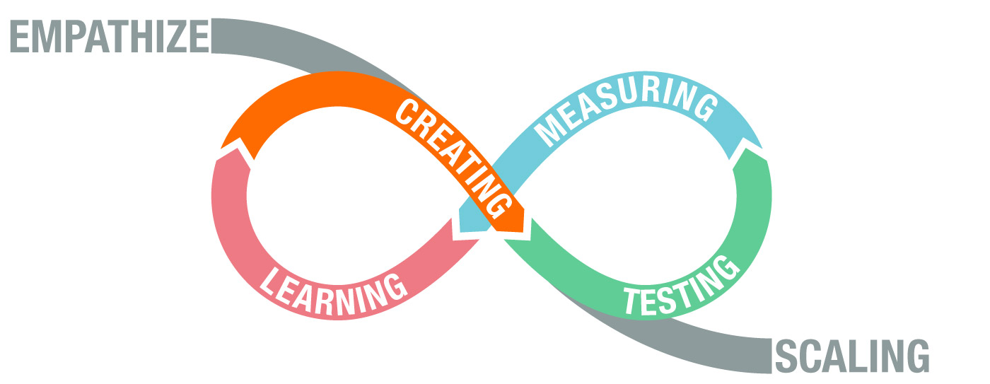
User-centered approach

Slide 25
Pillars of Fiscal Transparency Policies for Meaningful Disclosure
With purpose
User-centered
Sustainable
Objectives
Demand
Embeded in processes

Slide 26
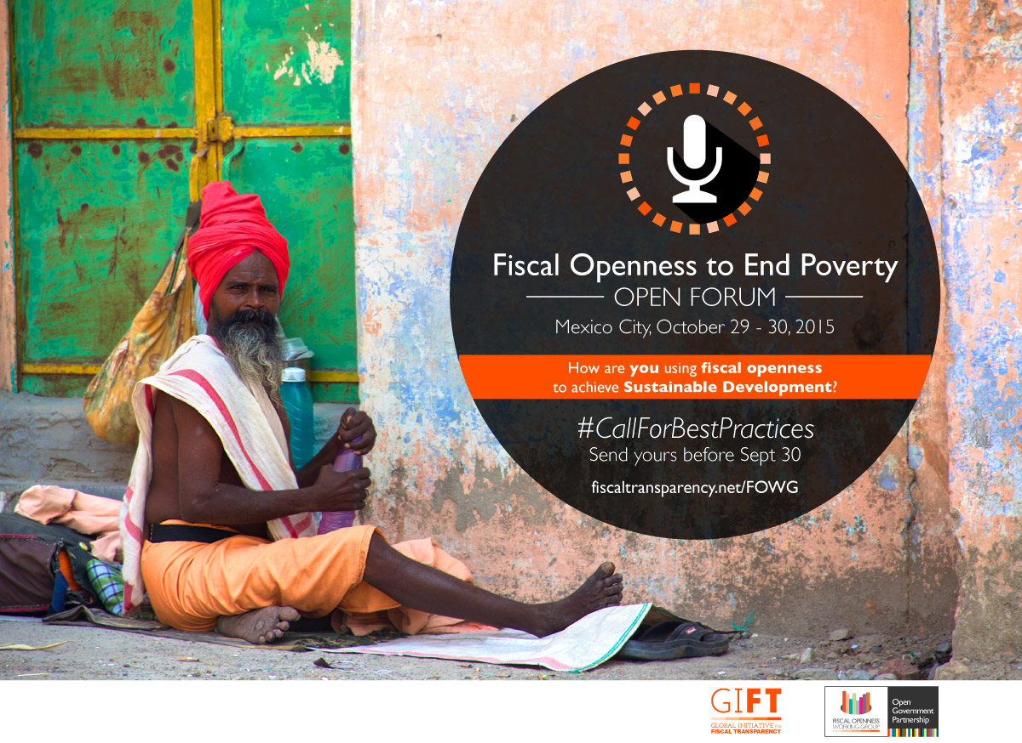
Developing a FT portal: emphasis on dialogue supply/demand & consultation on content
Single entry point to make fiscal data more accessible, simple & relevant
Work with Argentina, Brazil, Mexico, Indonesia, South Africa, Uruguay, Dominican Republic, El Salvador, Nigeria & soon… Croatia
26

Slide 27
Mongolia
Glass account and Budget Transparency Portal

Slide 28
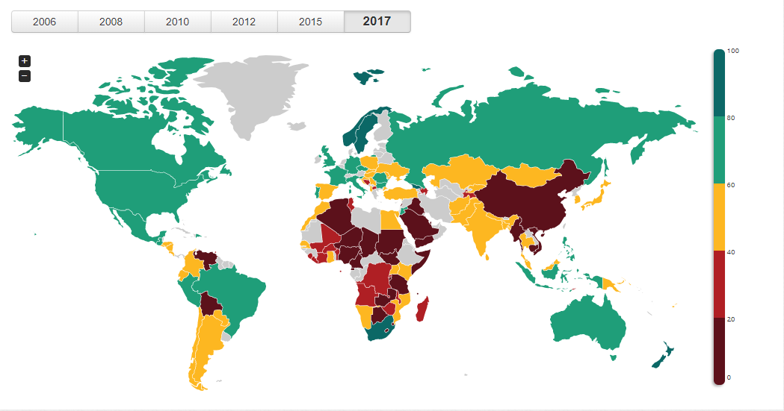
Open Budget Survey
2017 Results

Slide 29
Open Budget Survey
2017 Results
Global Average: 42

Slide 30
Open Budget Survey
Who?
International Budget Partnership
What?
Public access to key national budget information
Opportunities for public participation in budget processes
Role of formal oversight institutions
How?
Survey of 142 questions, around 8 key Budget documents
Based on international good practices developed by the IMF, OECD, INTOSAI, GIFT, and the IBP.
Survey answered by civil society; reviewed by government and peer reviewer.

Slide 31
Open Budget Survey: 8 Key Budget Documents
Pre-Budget Statement
Executive’s Budget Proposal
Enacted Budget
Citizens Budget
In-Year Reports
Mid-Year Review
Year-End Reports
Audit Report

Slide 32
Open Budget Survey
2017 Results
MONGOLIA

Slide 33
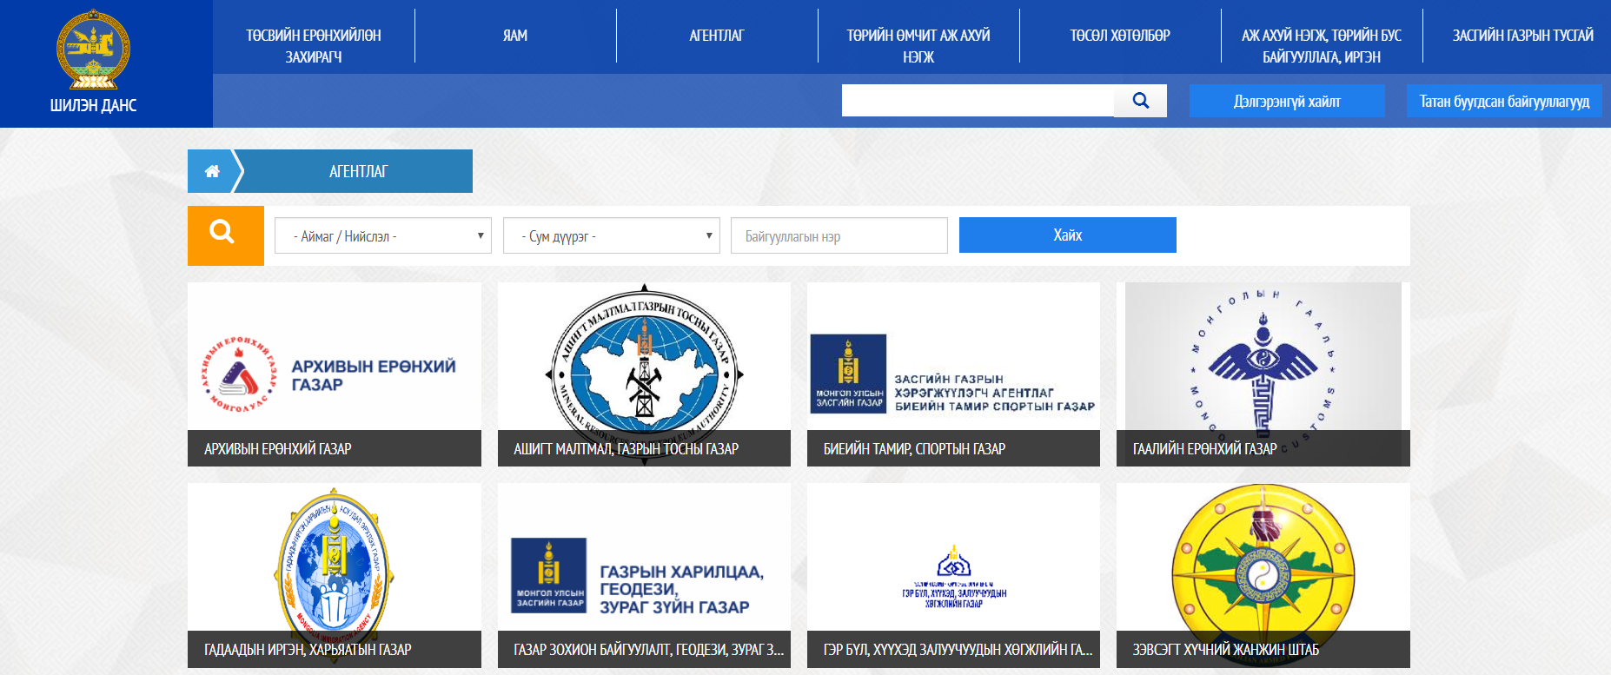
Progress in Mongolia

Slide 34
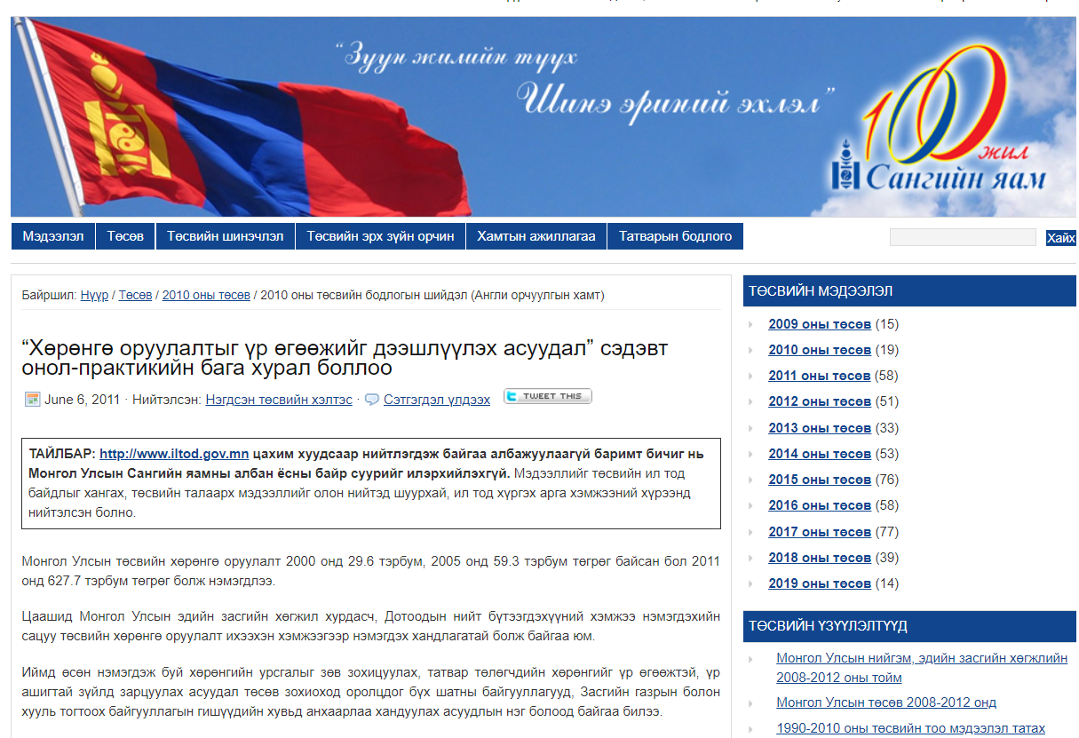
Progress in Mongolia

Slide 35
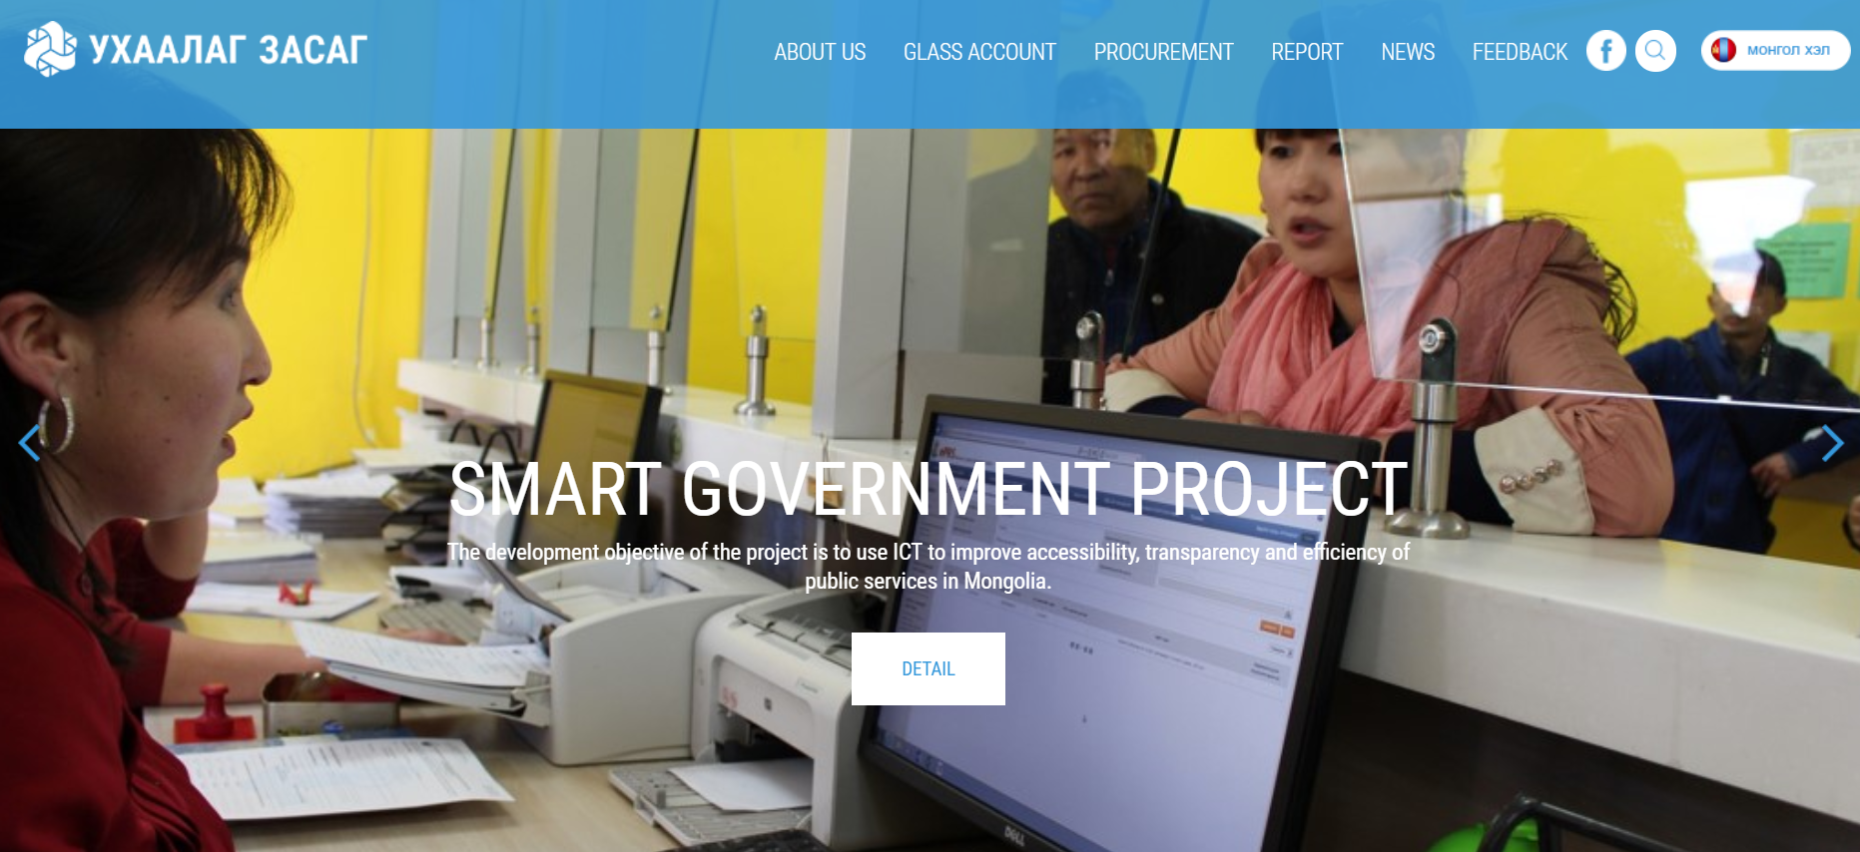
Progress in Mongolia

Slide 36
Fiscal Transparency Portals:
International Experiences

Slide 37
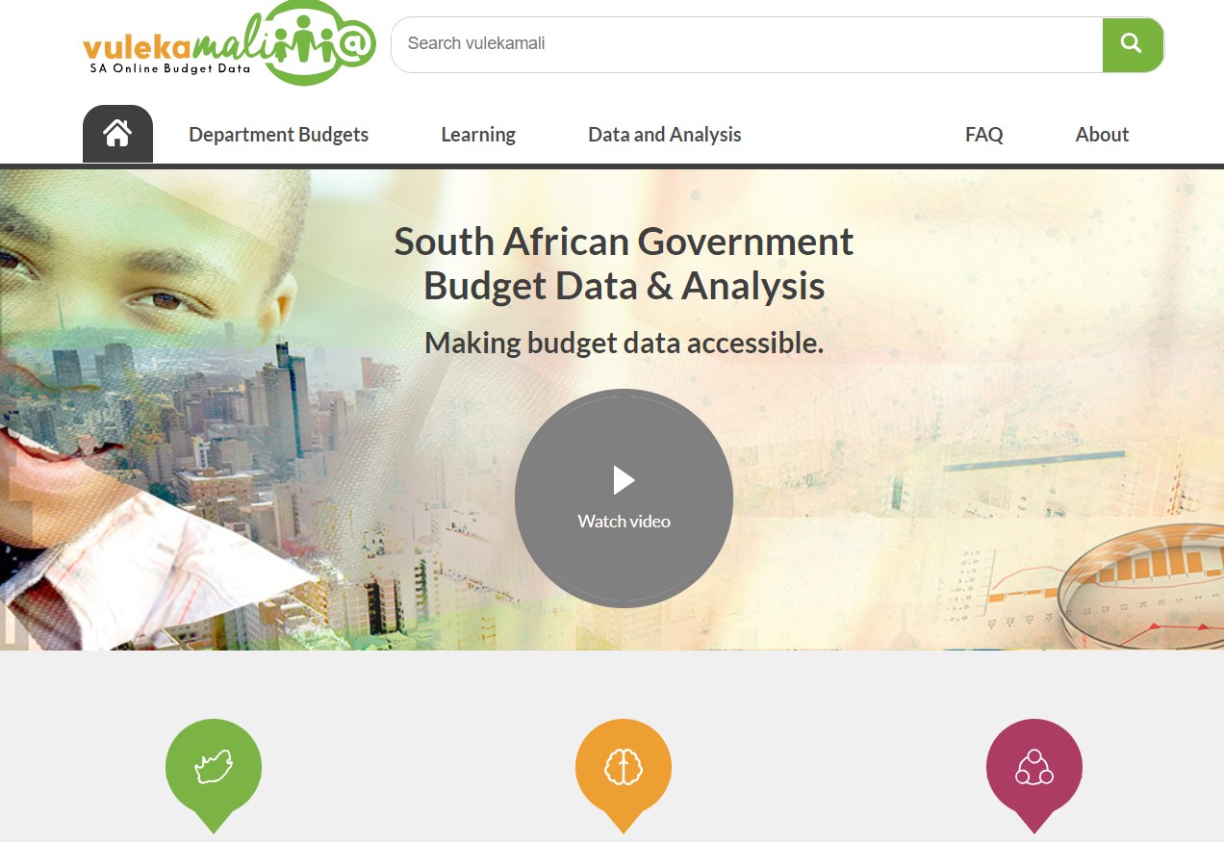
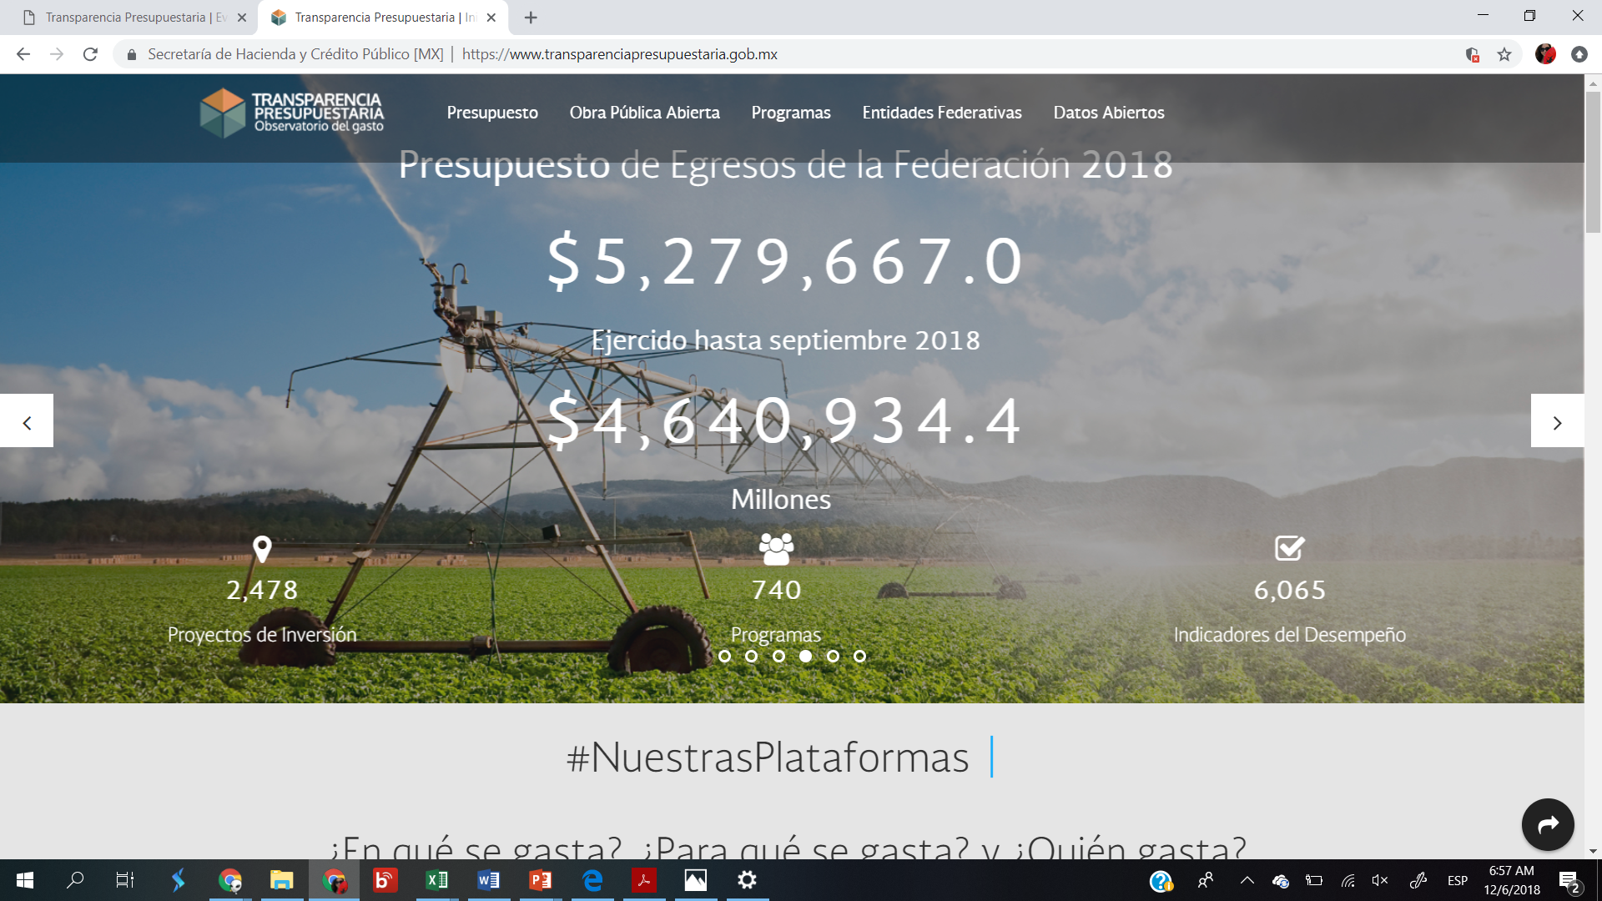
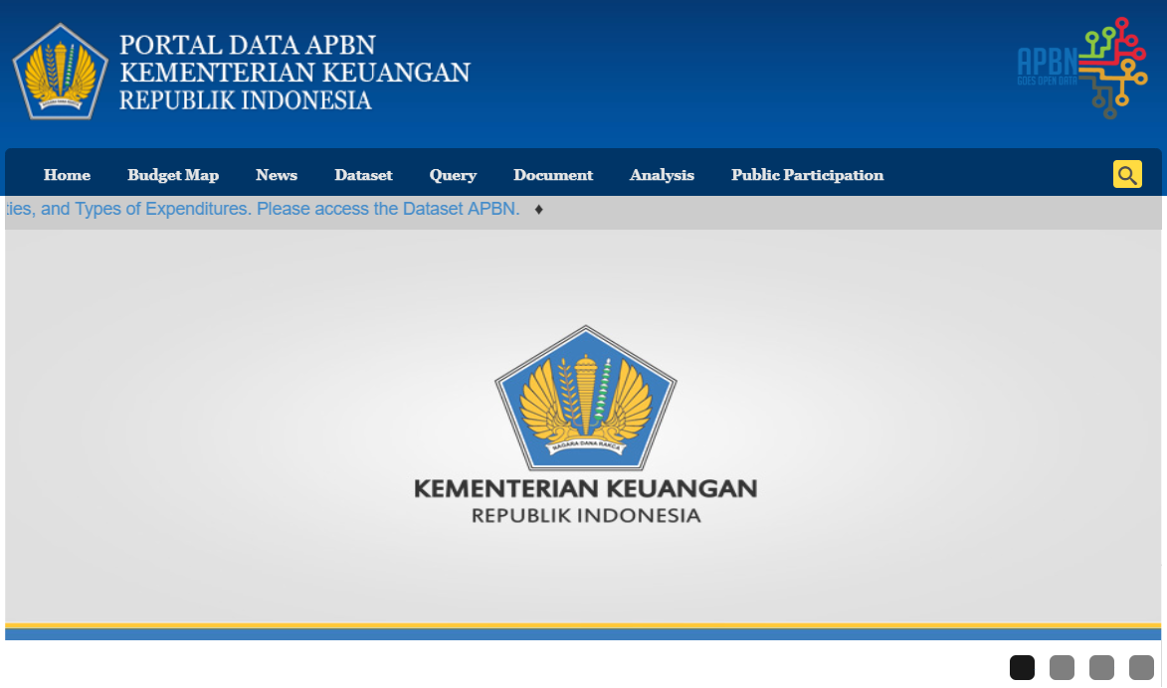
South Africa
Mexico
Indonesia

Slide 38
South Africa

Slide 39
Building a bridge through Open Data

Slide 40
Deep collaboration
Gov-Civil Society

Slide 41
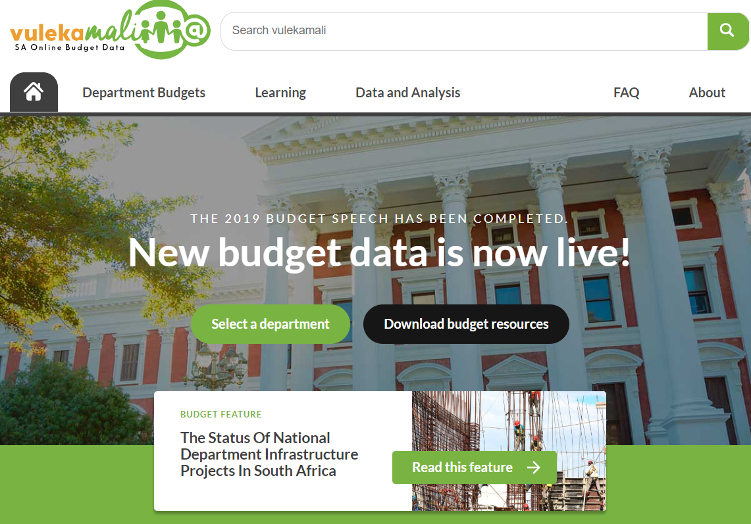
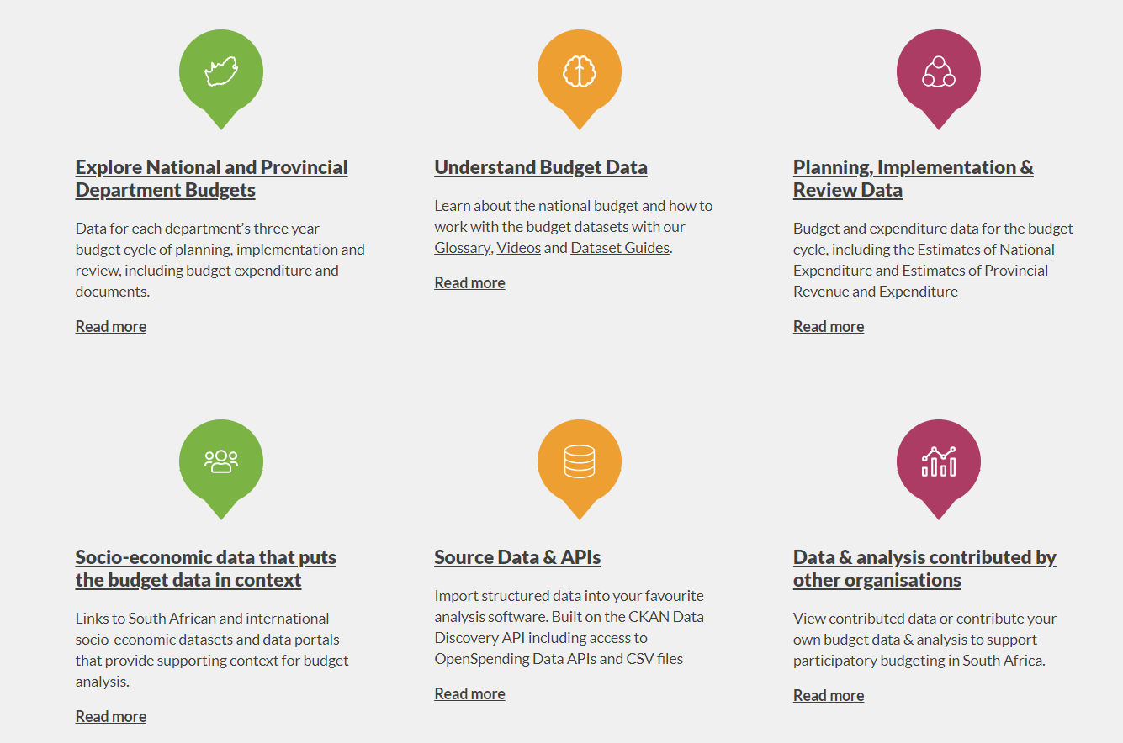
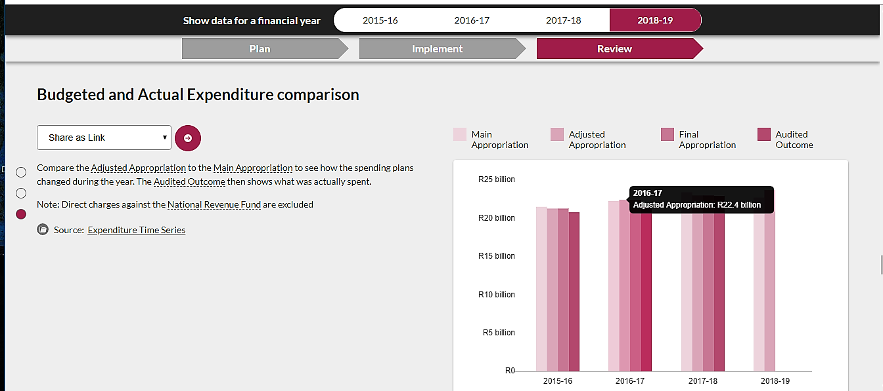
Main contents
Open Spending: Budget allocations and expenditures
Provincial data
Contributed research by civil society or academia

Slide 42
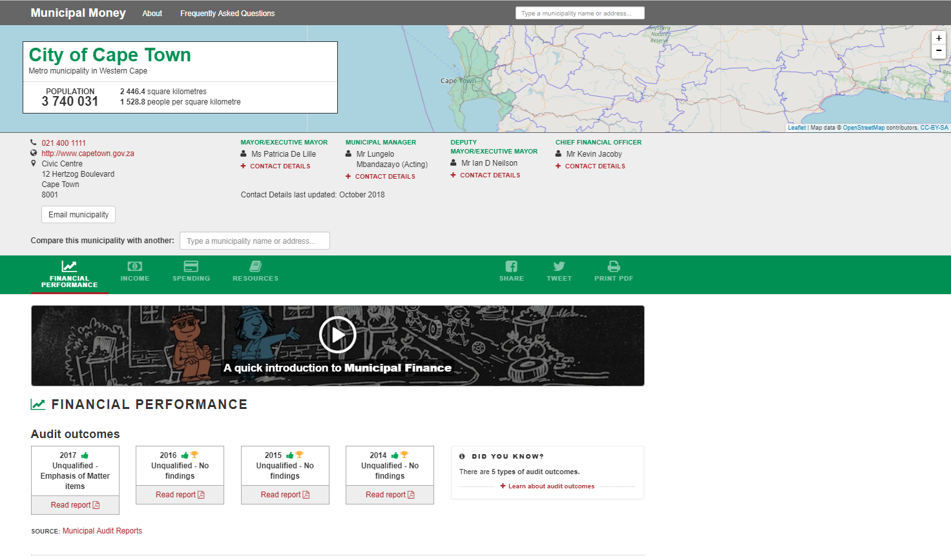
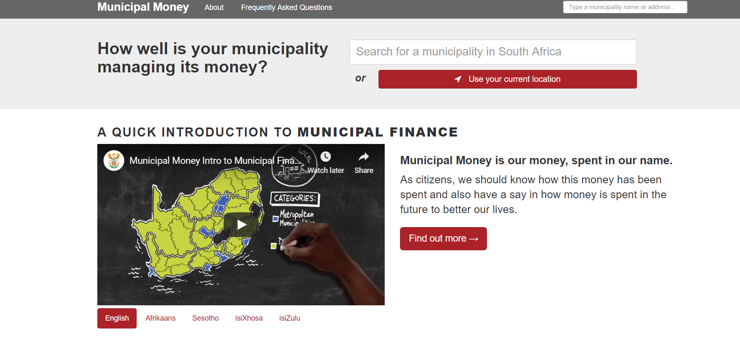
Local Governments
Municipal money
(South Africa)

Slide 43
Engagement
The Better Budget Dataquest
Teams of up to five individuals will explore the spending dataset and by contextualizing with other data they should come up with findings for one of the following categories: gender, inequality or environment.

Slide 44
Engagement

Slide 45
Mexico

Slide 46
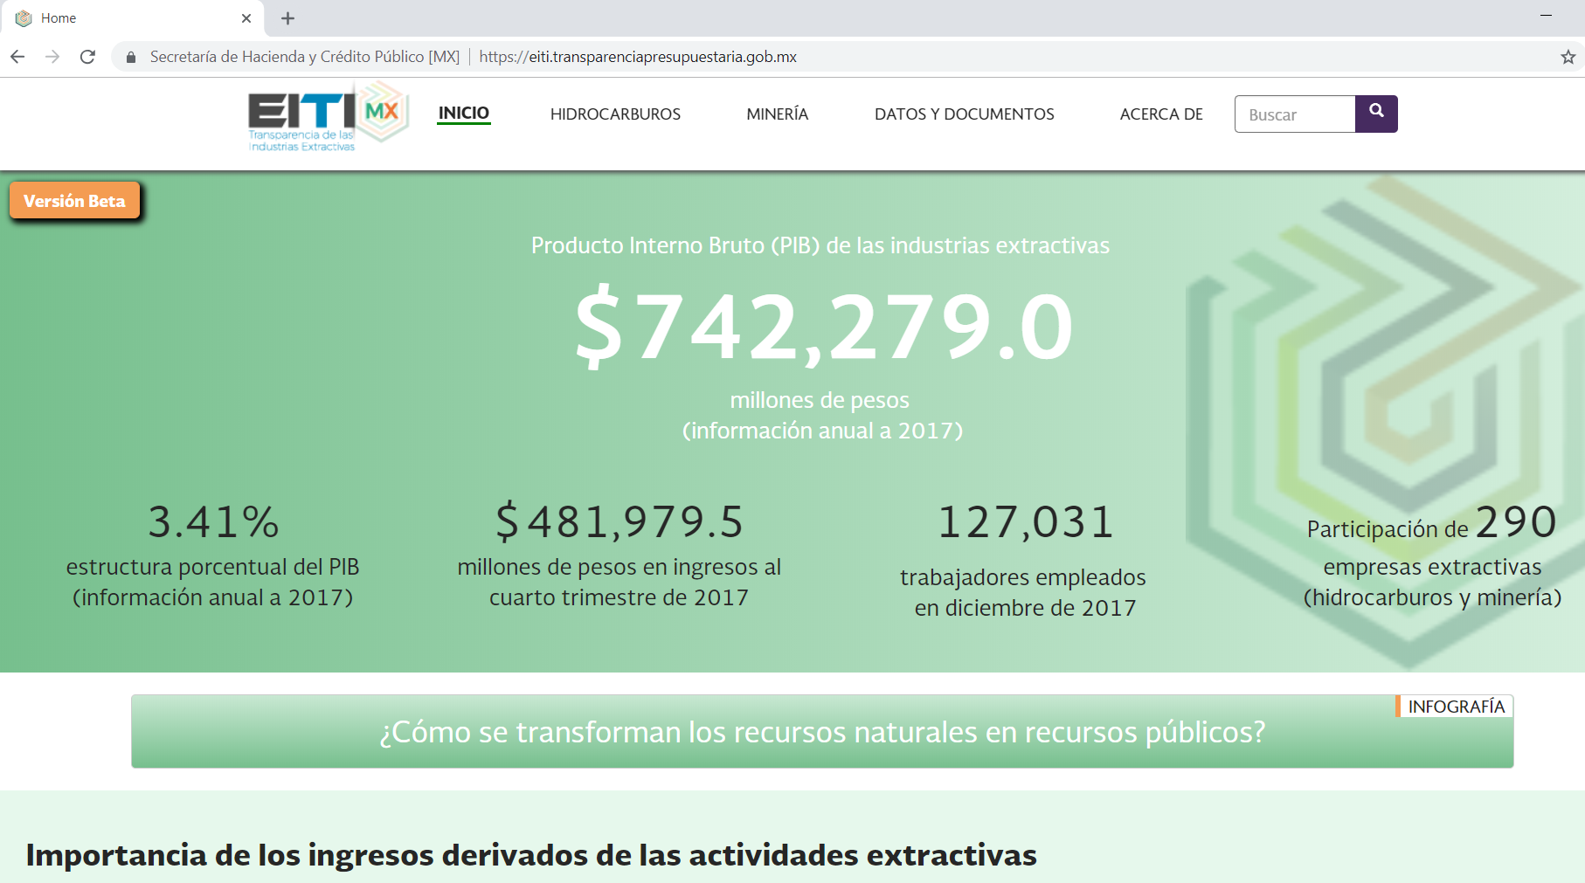
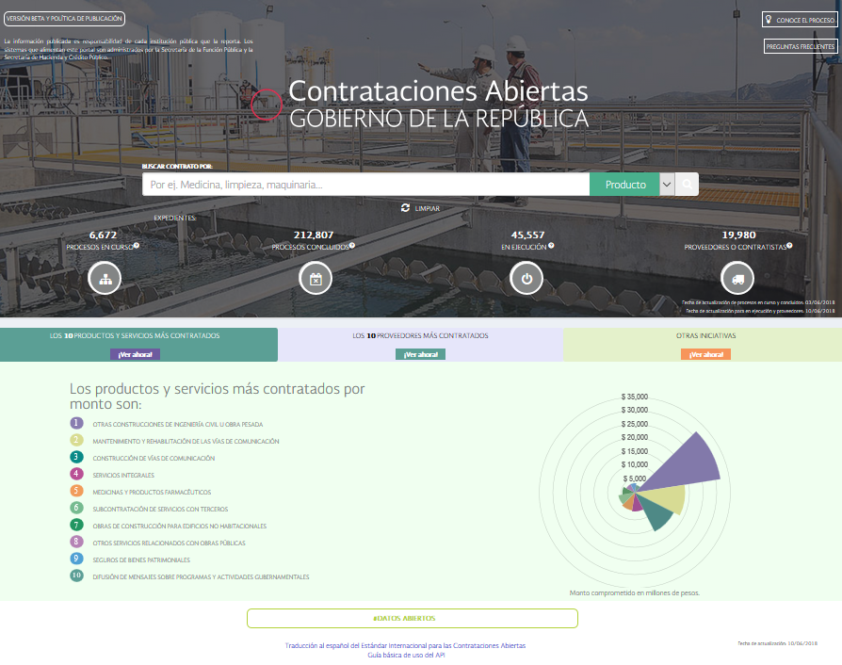
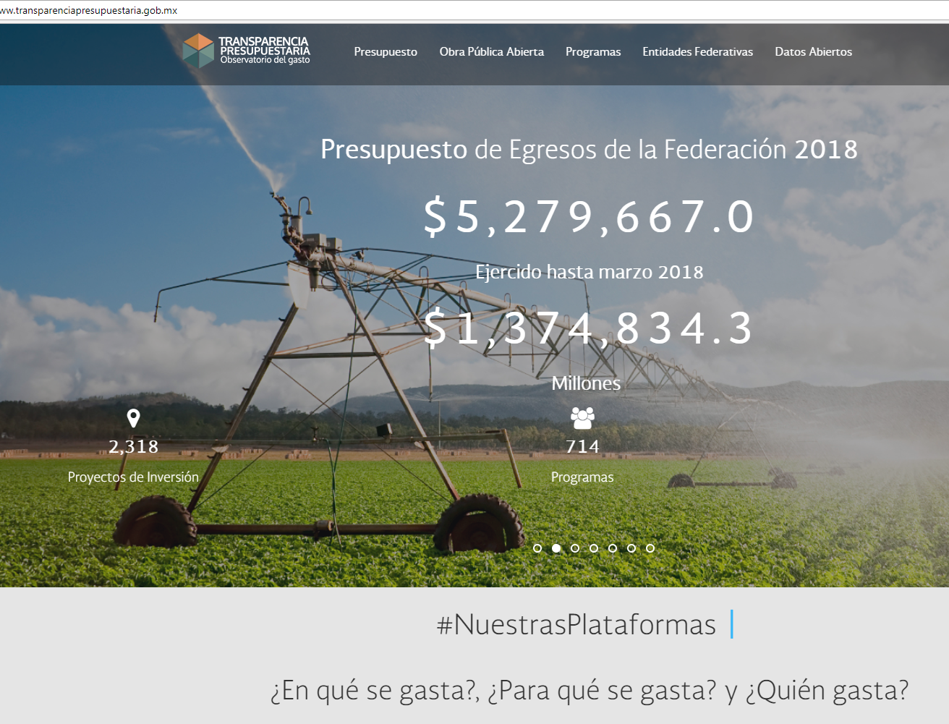
Main contents
Open Spending: Budget allocations and expenditures
Open Contracting
Extractive Industries
Performance indicators
Citizen budget (now quick guide to the budget)
Infrastructure projects
Subnational transfers
Local tax revenues
Subsidies search

Slide 47
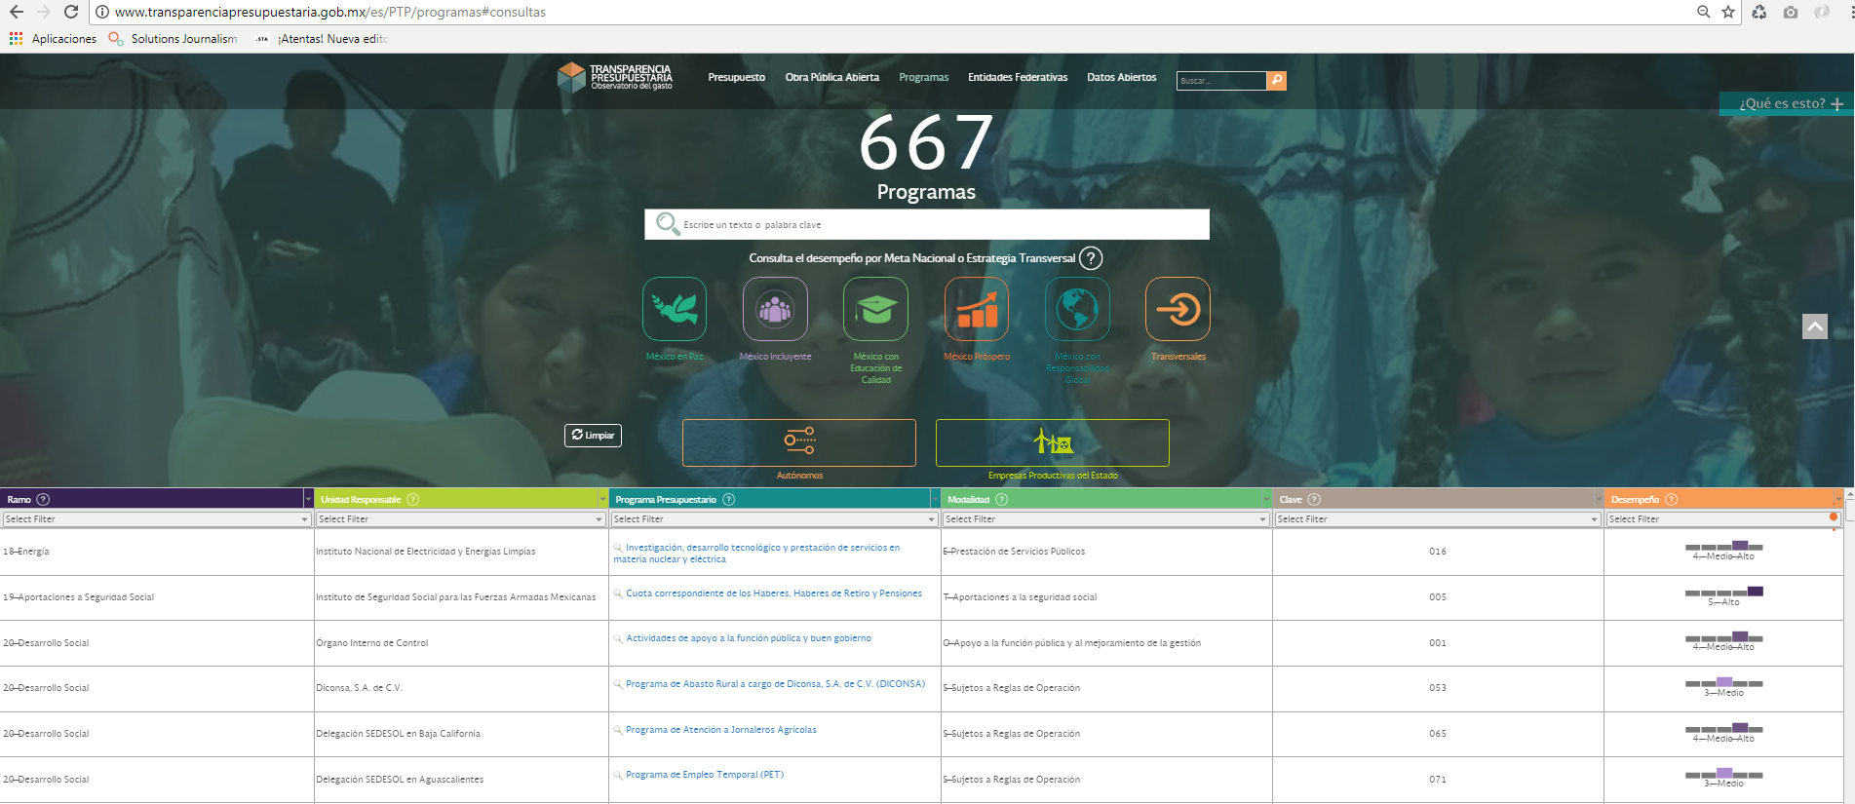
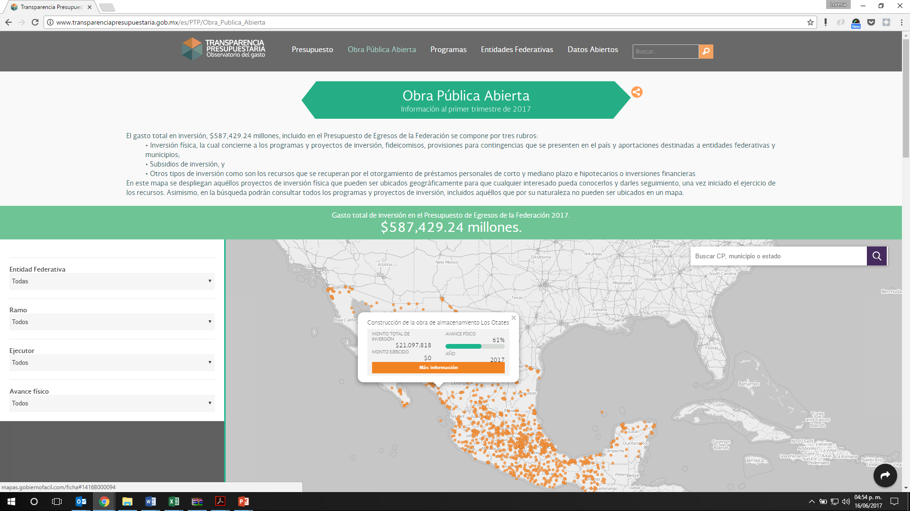
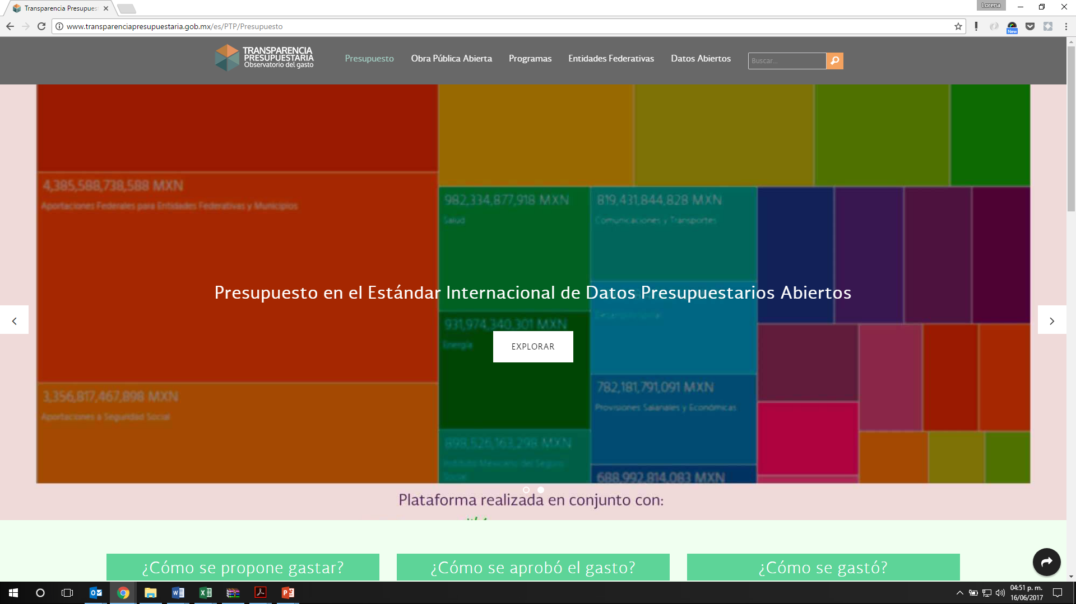
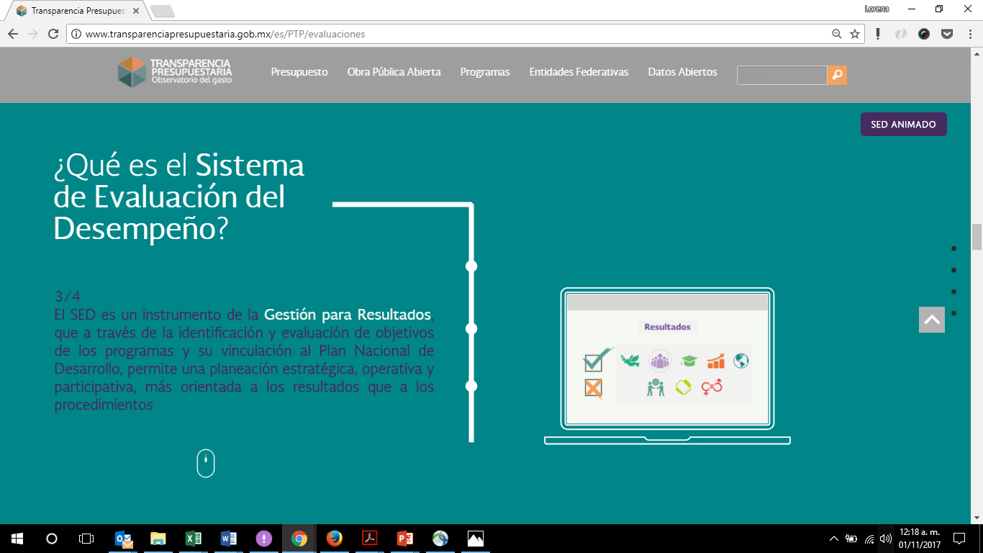
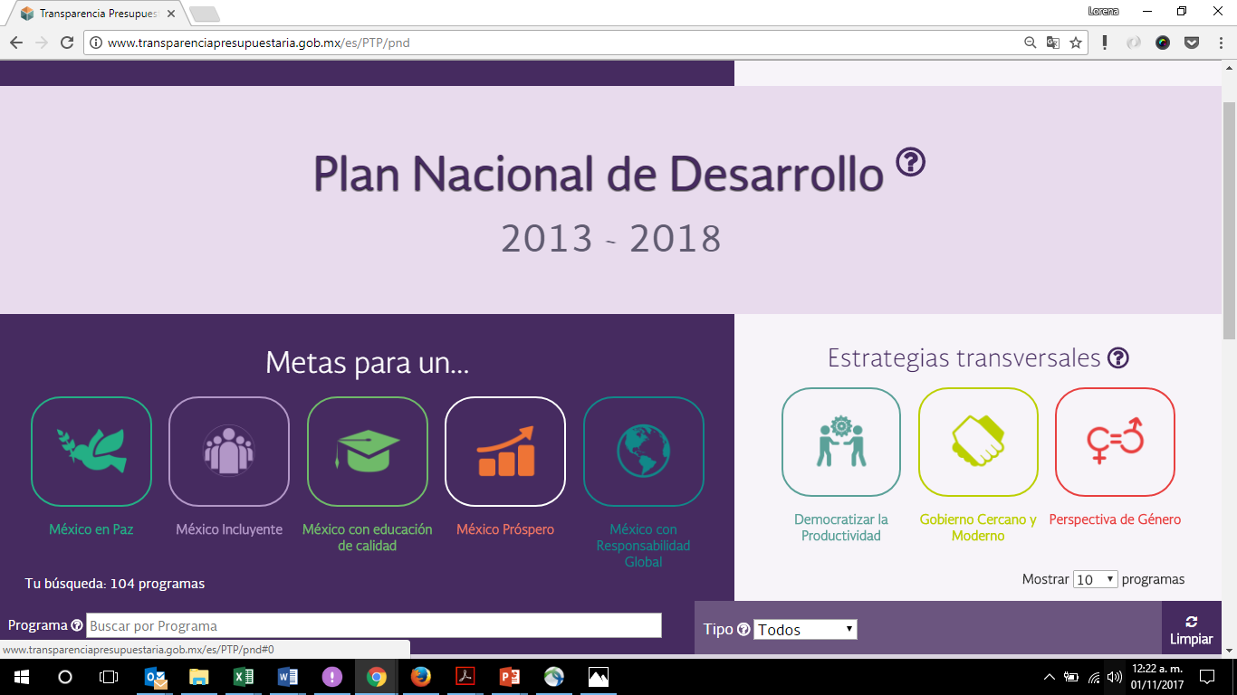
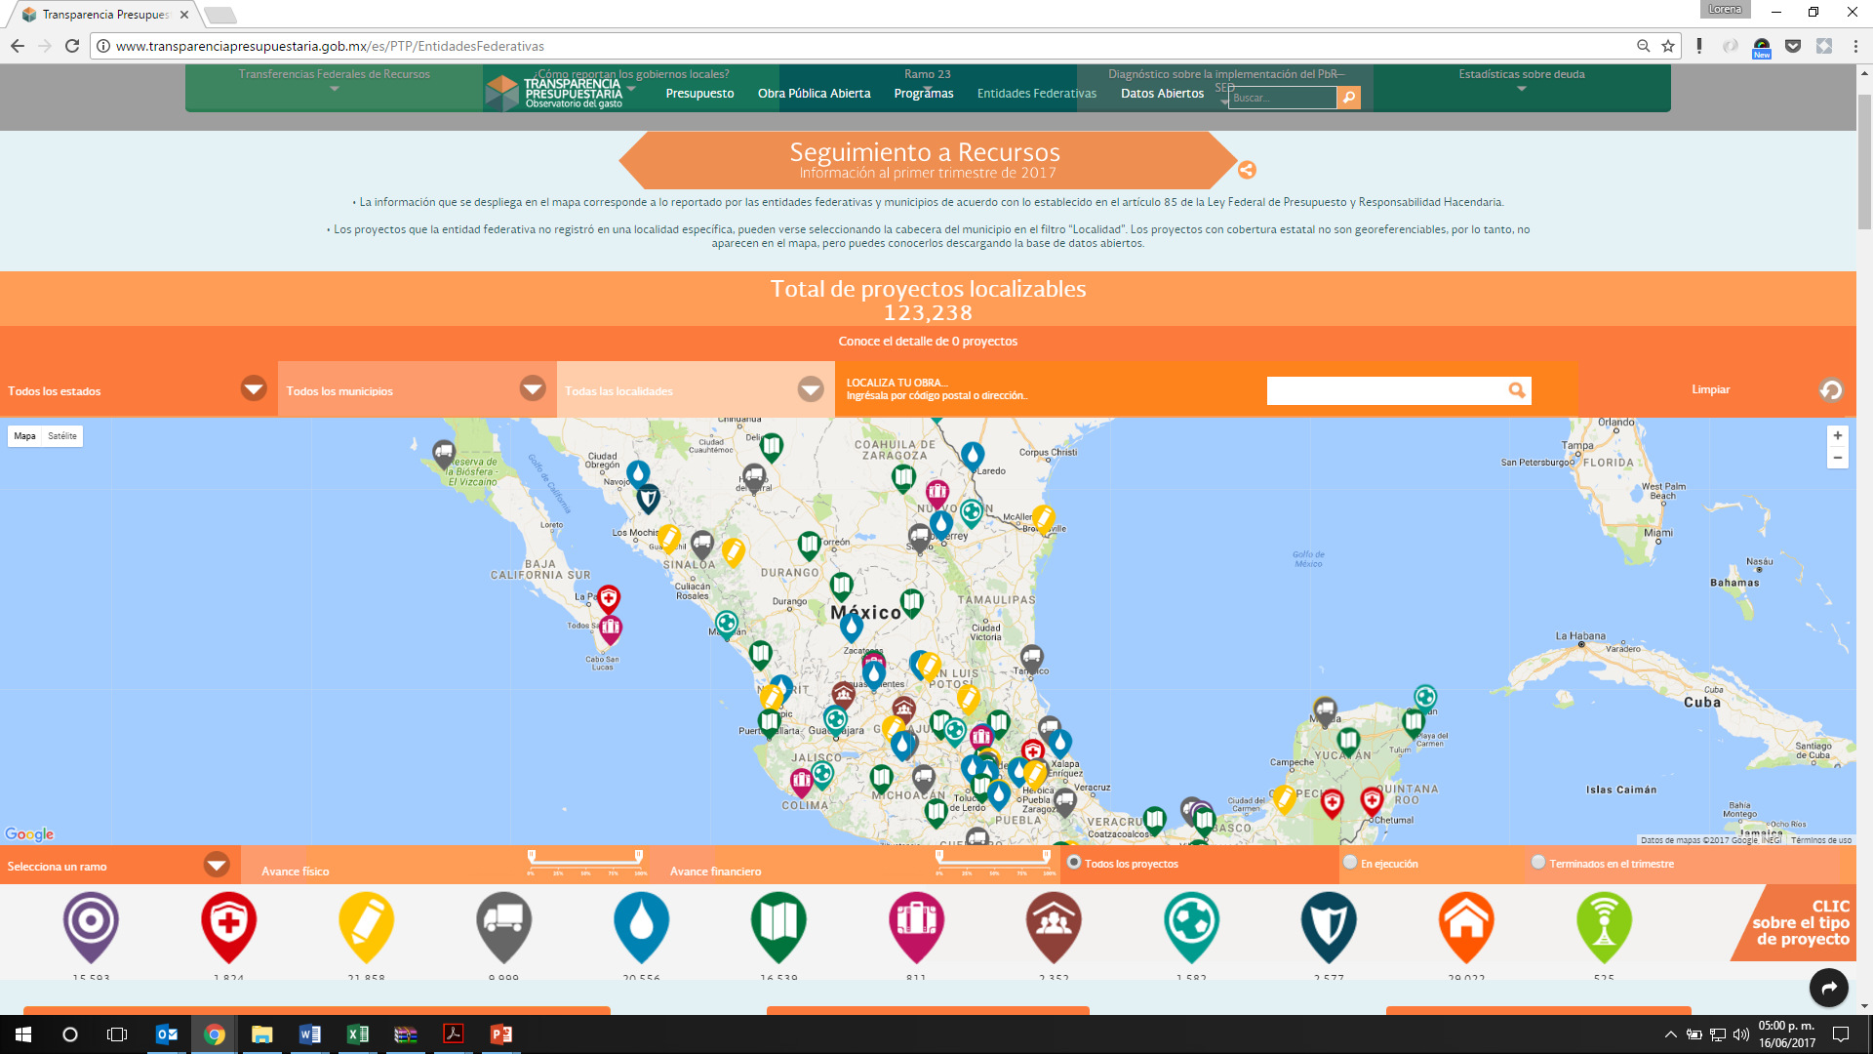
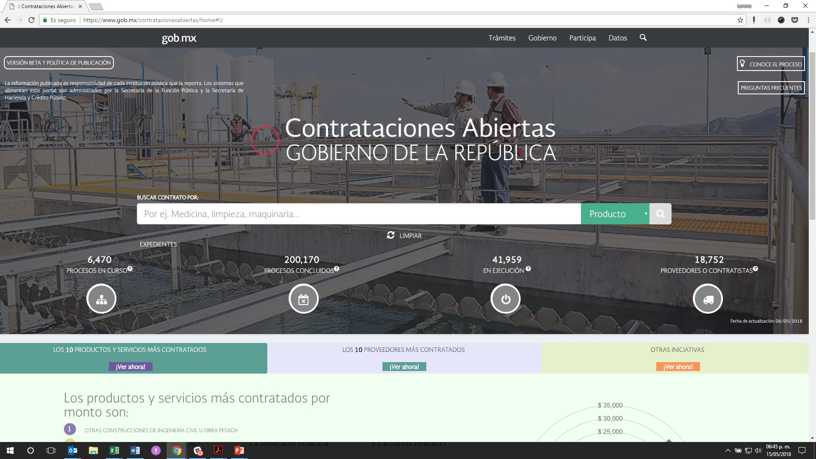
Platforms
Performance Evaluation System
Budget
Programs
Public investments
National Development Plan
Education infrastructure
Transfers to subnational governmets
Open Contracting

Slide 48
Platforms
Find your subsidy
Local tax revenue
Extractive industries
Emergency relief funds

Slide 49
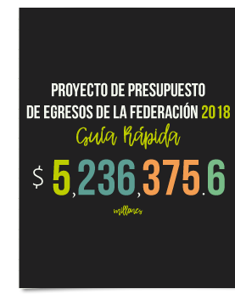
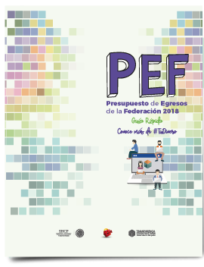
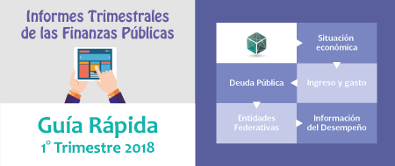
Change in the Communication of Citizen Budgets
Traditional
Today
Too aggregated
Less text, more information
Too institutional
Timeliness

Slide 50
Engagement through Public Investment Data
Deep collaboration
Gov-Civil Society

Slide 51
From Transparency to Participation

Slide 52
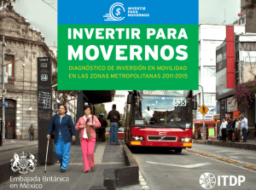
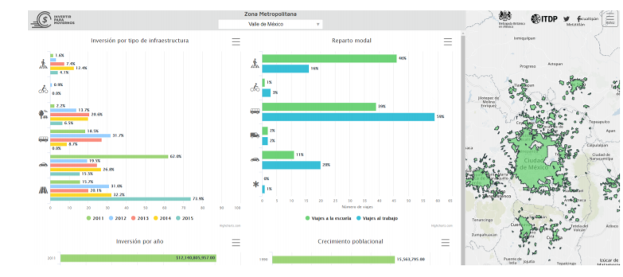
#DataOnTheStreets Results
Changes in Budget program design to incentivize sustainable urban mobility
Redisign of the subnational government investment Project reporting system

Slide 53
Indonesia

Slide 54
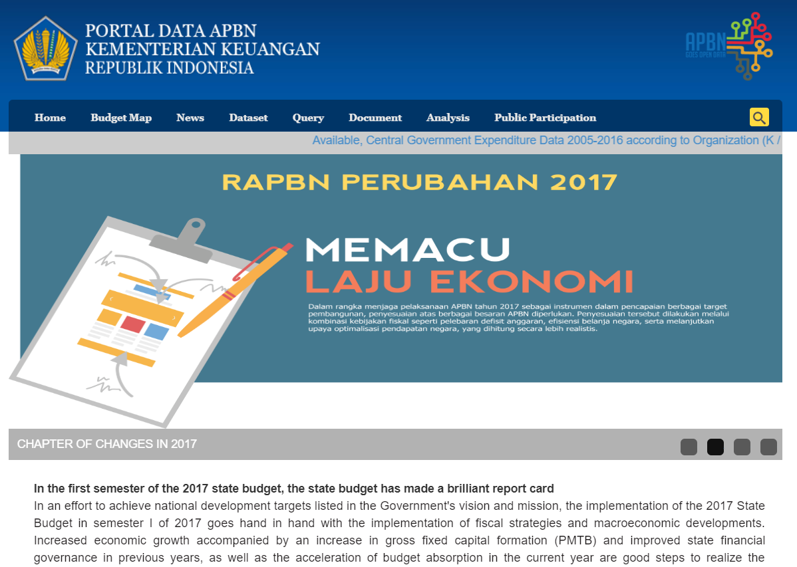
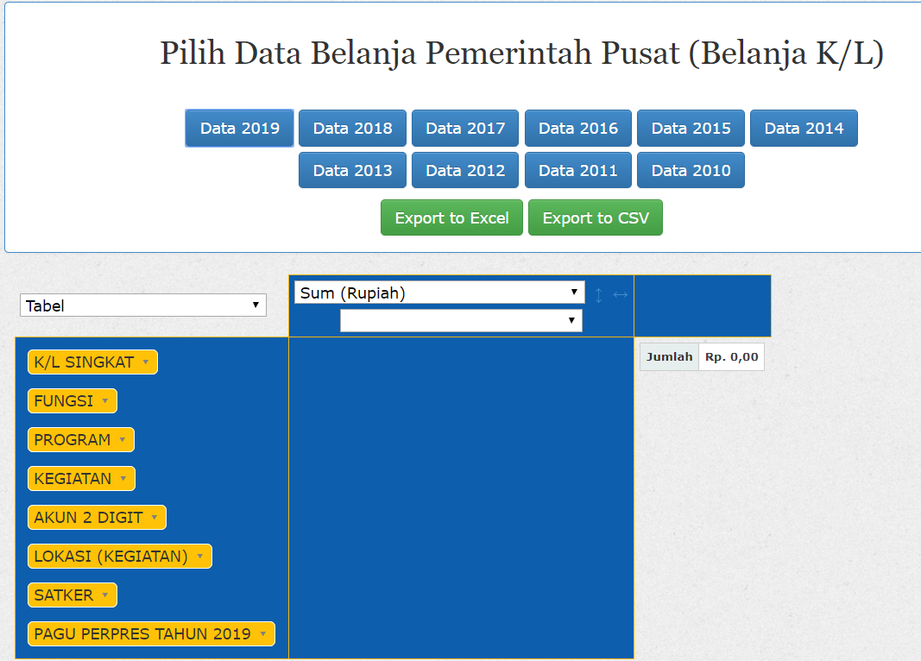
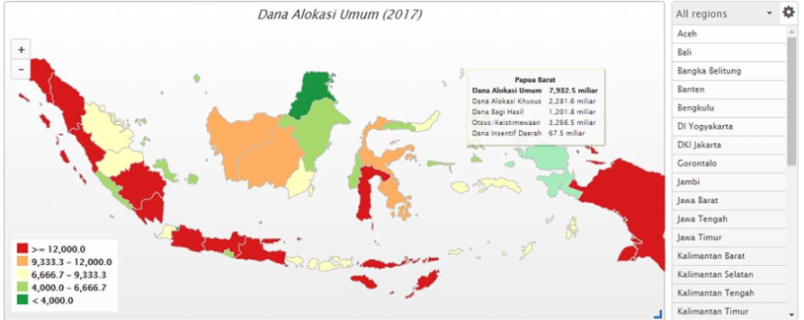
Main contents
Budget allocations in open data
Geographical distribution of budget

Slide 55
Engaging with the users
Deep collaboration
Gov-Civil Society

Slide 56
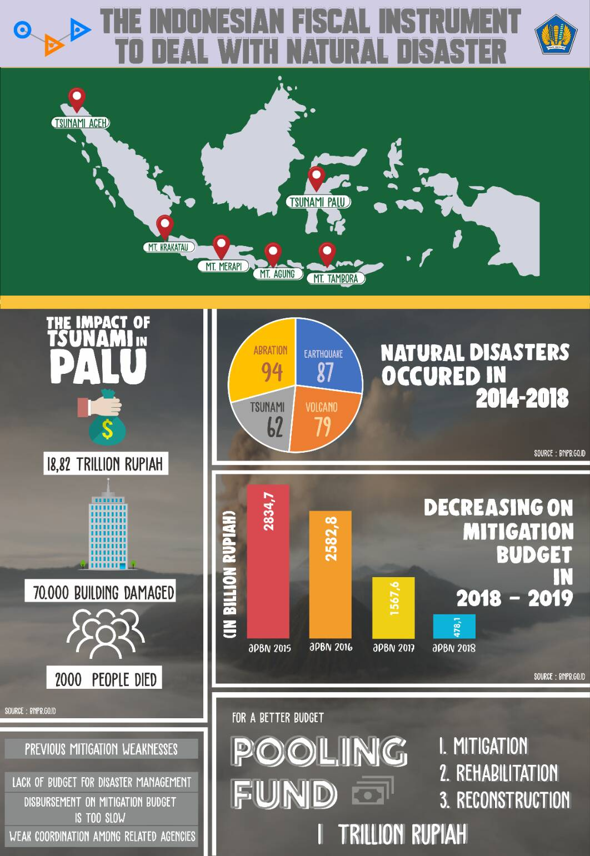
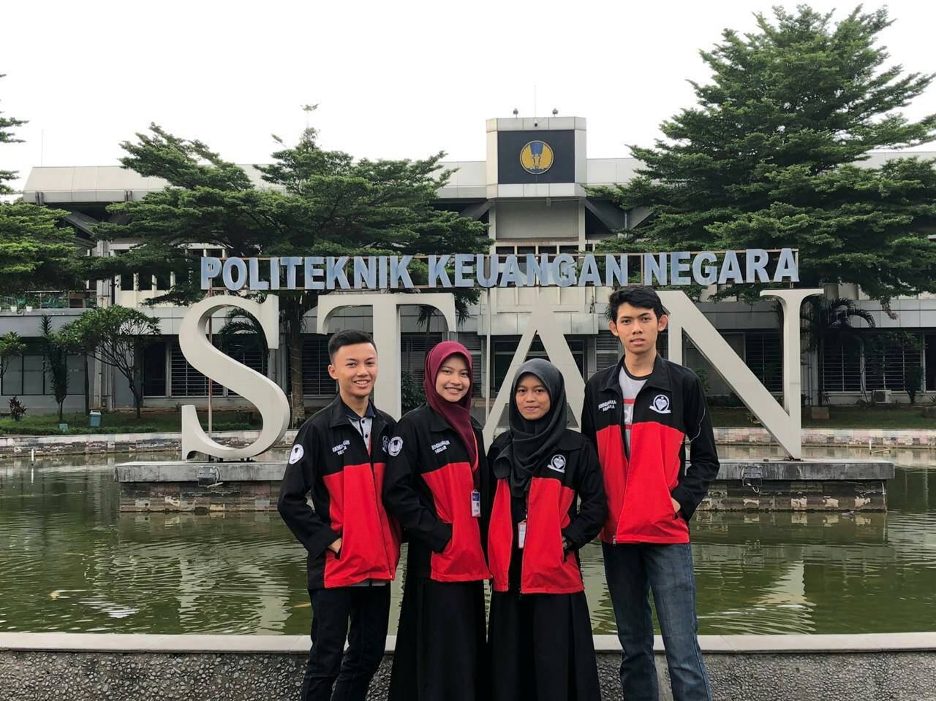
Better Budget Dataquest in Indonesia
4 universities
Infographics Videos
Analysis

Slide 57
Takeaways.

Slide 58
No unique way of publication
Collaboration among governments and civil society create more sustainable + user oriented results
Technology shouldn’t come first
Every publication should have an objective + consider the target audience (from the identification of data, development of the experience, choice of technology, analysis, engagement strategy and all in-between)
Warning: Technology can create exclusion of vulnerable groups but it can also facilitate their access
Supply doesn’t necessarily generate its own demand
Engagement strategies are important to generate impact

Slide 59
Collaborative thinking

Slide 60
How does budget information relate to your work? How do you use such information?

Slide 61
What international examples are inspiring for Mongolia?

Slide 62
How could access to budget information be improved?

Slide 63
Stay tuned!
@fiscaltrans
@fiscaltransparency
@fiscaltransparency
www.fiscaltransparency.net

