Slide 1
Strengthening Accountability through
Fiscal Transparency Practices
Public Participation in Fiscal Policies
Juan Pablo Guerrero
Port of Spain, Trinidad & Tobago
September 6, 2017
#FiscalTransparency

Slide 2
Contents
About GIFT
Why Public Participation in Fiscal Policy?
GIFT Principles of Public Participation
Examples of Public Participation in the Budget Process
Objections to Public Participation & Evidence on its Impacts
Guide on Principles and Mechanisms of Public Participation in Fiscal Policy + ParlAmericas Working Document
2

Slide 3
The Global Initiative for Fiscal Transparency
A global network that facilitates dialogue between governments, civil society organizations, international financial and specialized institutions, private sector and other stakeholders to find and share solutions to challenges
in fiscal transparency, participation and accountability.
It works through coordination on global norms, peer-learning and technical assistance, research, and use of IT.
GIFT coordinates the Fiscal Openness Working Group at the Open Government Partnership
3

Slide 4
Why a new set of principles in public participation?
2008: Global Financial Crisis, PFM Governance, disclosure of information alone is not sufficient for accountability
Government data at reach: big data, open data & information technologies
Participation is key for Sustainable Development Goals: 5, gender equality, 10, reduce inequality, 16, peace, justice & inclusive institutions
Public Participation as a the core of Open Government Partnership
4

Slide 5
But, how exactly should governments engage citizens in public spending?
A starting point for GIFT was to address the gaps in norms, as well as the lack of guidance on how governments should engage the public
5

Slide 6
SCOPE of PUBLIC PARTICIPATION in fiscal policy
Invited & autonomous participation
Covers all fiscal policy and budget making activities:
The annual budget cycle (8 documents)
Fiscal policy reviews and new policy initiatives outside the annual budget cycle (revenues, expenditures, financing, assets and liabilities)
The design and delivery of public services
The planning, appraisal & implementation of public investment projects
6

Slide 7
Accessibility
Disseminate complete fiscal information and all other relevant data, easy for all to access, understand, and to use, re-use and transform, namely in open data formats.
Openness
Provide full information on and be responsive with respect to the purpose, scope, constraints, intended outcomes, process and timelines, as well as the expected and actual results of public participation.
Inclusiveness
Proactively engage citizens and non-state actors, including excluded & vulnerable groups & individuals, & voices that are seldom heard, without discrimination & consider public inputs on an objective basis irrespective of their source.

Slide 8
Respect for self-expression
Allow articulate their interests in their own ways, and to choose means of engagement that they prefer. There may be groups that have standing to speak on behalf of others.
Timeliness
Sufficient time in the budget and policy cycles for inputs in each phase; while a range of options is still open; and, where desirable, allow for more than one round of engagement.
Depth
Provide information about key policy objectives, options, choices and trade-offs, potential impacts, and incorporate a diversity of perspectives; provide feedback on public inputs and how they have been incorporated.
Proportionality
Use a mix of engagement mechanisms proportionate to the scale and impact of the issue or policy concerned.

Slide 9
Sustainability
On-going and regular engagement to increase knowledge sharing and mutual trust over time; institutionalize public participation; feedback provided leads to revision of the fiscal policy decisions; and regularly review and evaluate experience to improve future engagement.
Complementarity
Ensure mechanisms for public participation and citizen engagement complement and increase the effectiveness of existing governance and accountability systems.
Reciprocity
All state and non-state entities should be open about their mission, the interests they seek to advance, and who they represent; respect all agreed; cooperate to achieve objectives.

Slide 10
1. Examples of Public Participation in Budget Process
Stage in budget and policy cycles | Participation mechanisms | Selected country examples
Executive budget preparation | -Participatory National Planning -Pre-budget consultations -External expert review of macro/fiscal forecasts -Independent setting of key macro assumptions -Independent fiscal policy advisory body or council -Participatory budgeting | -Brazil -Canada, Kenya, Ireland -Korea -Chile, Colombia -Ireland, Croatia -Numerous countries (Portugal)
Legislative consideration & enactment | -Budget Strategy Statement, with public submissions -Main budget with public submissions -Public submissions to legislature on money bills -Parliamentary Budget Office | -Canada -Numerous countries -Numerous countries -Australia, Croatia, Italy, USA
10

Slide 11
2. Examples of Public Participation in Budget Process
Stage in budget and policy cycles | Participation mechanisms | Selected country examples
Budget implementation | -Independent administrative review (tax, procurement) -Multi-stakeholder monitoring of revenue collection -Multi-stakeholder monitoring of public contracting -Community engagement in public investment projects -Participatory/external expert program evaluations -Participatory budgeting | -Numerous countries -EITI member countries -Open contracting partners -Mexico, Philippines -Korea -Numerous countries
Legislative review | -Committee reviews of agencies, public submissions | -USA
Supreme Audit oversight/social audit | -Citizen audit request body -Participatory performance auditing -Social audit | -Korea -Philippines -India
11

Slide 12
3. Examples of Public Participation in Fiscal Policies
Stage in budget and policy cycles | Participation mechanisms | Selected country examples
Major new fiscal policy proposals | -Consultation by executive on new revenue policies -Consultation by executive on new expenditure policies -Participatory public expenditure review | -Numerous countries -Canada and others -UK
Public service delivery | -Complaints mechanisms -Social audit -Regular published surveys of service users -Citizen involvement in delivery/co-production | -Numerous countries -Uganda and others -Some OECD countries -South Africa
Public investment projects | -Consultation on social and environmental impacts -Geo-tagging and social monitoring | -Numerous countries -Philippines
12

Slide 13
Possible Objections to Increased Public Participation
in Fiscal Policies
Costly
Undermines existing democratic institutions
Fiscal issues: too complicated for general public
Undermines decision making (& secrecy)
Slows the policy process
Influential and well-organized groups tend to dominate the process

Slide 14
Response to objections to increased public participation
in fiscal policies
Costly: not so much anymore thanks to IT
Undermines institutions: complementarity
Too complicated: Experts engage too
Undermines decision making: classification prevails when justified & openness helps policy effectiveness and efficiency
Slows process: but it improves quality & saves costs
Influential groups domination: inclusion & dissemination efforts needed

Slide 15
Access to information and public participation:
What difference does it make?
Better resource allocation & provision of public services
Improved response to the preferences of beneficiaries of services & constituencies
Opportunity for marginalized groups to exert some influence in decisions that affect them
Greater impact of actions that affect communities in social policies: health sector, community level public works, education, in a word, well-being
Increases trust and citizen compliance (rules & taxes)

Slide 16
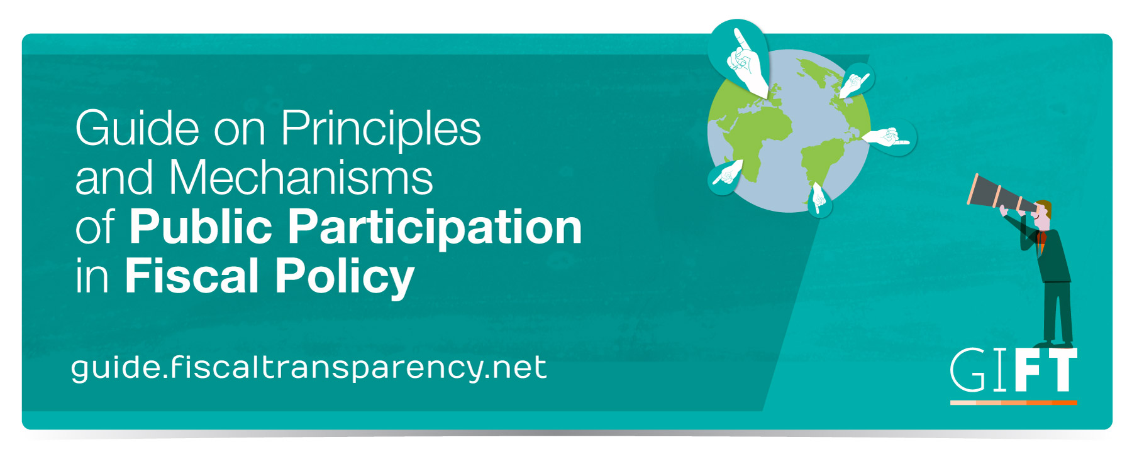

Slide 17
Working Document
Toolkit: Citizen Participation in the Legislative Process

Slide 18
THANK YOU!
Engage with us
@FiscalTrans
www.fiscaltransparency.net
guerrero@fiscaltransparency.net

