Slide 1
Innovations in Participatory Democracy
Conference, Phoenix, AZ
Panel: We The People VS. Corporate Rule
Public Participation as a Crucial Component
of Fiscal Transparency Standards at Global Level:
How and Why it happened?
Juan Pablo Guerrero
March 9, 2018
#FiscalTransparency

Slide 2
Contents
About GIFT
History of Global Fiscal Transparency (FT) Norms and Standards
High Level Principles on FT & Public Participation (PP)
Impact of Public Participation
Examples around the world (look South)
2

Slide 3
The Global Initiative for Fiscal Transparency
A global network that facilitates dialogue between governments, civil society organizations, international financial and specialized institutions, private sector and other stakeholders to find and share solutions to challenges
in fiscal transparency, participation and accountability.
45 members in March 2018. Founding members are:
The International Monetary Fund
The World Bank
The International Budget Partnership
Budget Ministries of Brazil, the Philippines, Mexico, South Africa
18 governments (including US Treasury)
3

Slide 4
1. Fiscal Transparency Norms and Standards – 21 Years of History
1997: East Asian financial crisis sets out a codification on Fiscal Transparency
1998: IMF Code of Good Practices on FT + Manual => Reports on Observance of Standards & Codes (ROSC)
2000: International Federation of Accountants (IFAC) initiated the International Public Sector Accounting Standards program (IPSAS)
2001: IMF revised Gov. Finance Statistics Manual (GFSM)
4

Slide 5
2. Global FT Norms and Standards
2001: PEFA program indicators for quality of PFM
2002: OECD issued Best Practices on Budget Transparency
2006: Open Budget Survey (OBS) + Open Budget Index (OBI) to improve governance and combat poverty, from civil society perspective
2008: US State Dept. begins FT reports in countries recipients of assistance funds
NOTHING ON PUBLIC PARTICIPATION OR CITIZEN ENGAGEMENT!
5

Slide 6
3. Global FT Norms and Standards
2008 GLOBAL FINANCIAL CRISIS
2012: IMF’s new FT Code & FT Evaluation
2012: GIFT H-L Principles on FT & Public Participation
2014-2016: New versions of the FT-Code, PEFA program, OECD Principles, OBS, PP principles and OECD Toolkit on budget transparency
2016: Principles of Public Participation in Fiscal Policies
6

Slide 7
Fiscal Transparency & Public Participation
High Level Principles on Fiscal Transparency,
Participation & Accountability
United Nations General Assembly – Dec. 2012
Preamble, plus 2 parts:
Access to Fiscal Information (principles 2-4)
The Governance of Fiscal Policy (principles 5-9)
Framed by 2 fundamental rights principles:
A public right to fiscal information (from UDHR Art. 19)
A right to participate directly in fiscal policy design & implementation (from ICCPR Art. 25)
7

Slide 8
Definition of Public Participation in Fiscal Policies
Variety of ways in which individuals + the general public + CSO + NGO interact directly with budget authorities
Any means: face-to-face communications, deliberation or decision-­making, or by written forms of communication using electronic or paper media
Ranging from one-­off consultations to ongoing and institutionalized relationships that leave records subject to access to information
8

Slide 9
Why public participation in the budget cycle?
2008: PFM Governance revisited, disclosure of information alone is not sufficient for accountability
Participation is key for Sustainable Development Goals: 1-poverty, 5-gender equality, 10-reduce inequality, 16-peace, justice & inclusive institutions
Public Participation as a the core of Open Government Partnership
Government data at reach: big data, open data & digital tools
9

Slide 10
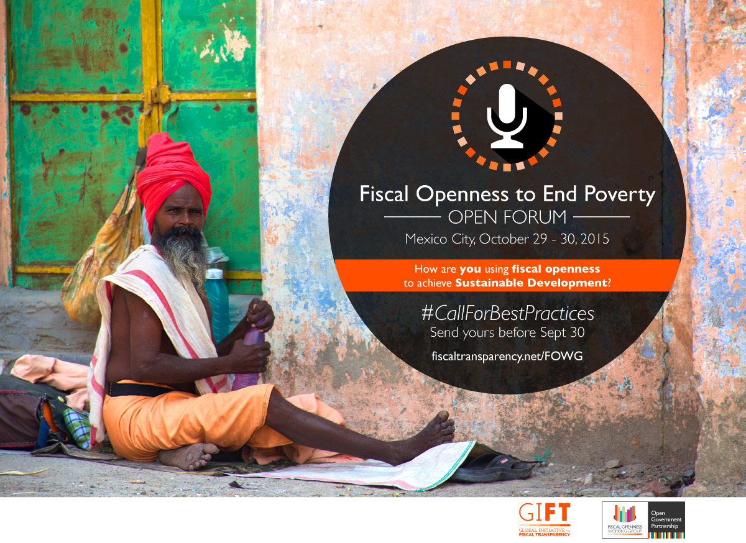
Access to information and public participation:
What is the difference?
Better resource allocation & provision of public services
Improved response to the preferences of beneficiaries of services & constituencies
Opportunity for marginalized groups to exert some influence in decisions that affect them

Slide 11
Access to Information + PP: Evidence of IMPACT
Greater impact of actions that affect communities in social policies: health sector, community level public works, education, in a word, well-being
Increases trust and citizen compliance (rules & taxes)

Slide 12
But, how exactly should governments engage citizens in public spending at the national level?
A starting point for GIFT was to address the gaps in norms, as well as the lack of guidance on how governments should engage the public
12

Slide 13
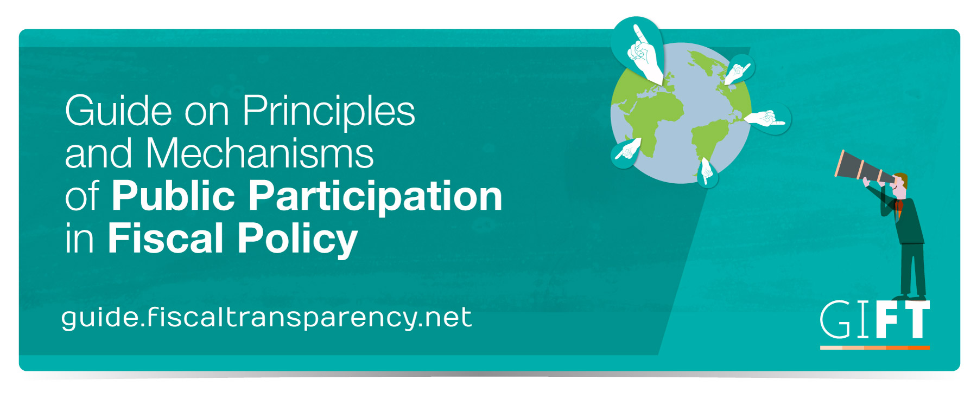

Slide 14
Accessibility
Disseminate complete fiscal information and all other relevant data, easy for all to access, understand, and to use, re-use and transform, namely in open data formats.
Openness
Provide full information on and be responsive with respect to the purpose, scope, constraints, intended outcomes, process and timelines, as well as the expected and actual results of public participation.
Inclusiveness
Proactively engage citizens and non-state actors, including excluded & vulnerable groups & individuals, & voices that are seldom heard, without discrimination & consider public inputs on an objective basis irrespective of their source.

Slide 15
Respect for self-expression
Allow articulate their interests in their own ways, and to choose means of engagement that they prefer. There may be groups that have standing to speak on behalf of others.
Timeliness
Sufficient time in the budget and policy cycles for inputs in each phase; while a range of options is still open; and, where desirable, allow for more than one round of engagement.
Depth
Provide information about key policy objectives, options, choices and trade-offs, potential impacts, and incorporate a diversity of perspectives; provide feedback on public inputs and how they have been incorporated.
Proportionality
Use a mix of engagement mechanisms proportionate to the scale and impact of the issue or policy concerned.

Slide 16
Sustainability
On-going and regular engagement to increase knowledge sharing and mutual trust over time; institutionalize public participation; feedback provided leads to revision of the fiscal policy decisions; and regularly review and evaluate experience to improve future engagement.
Complementarity
Ensure mechanisms for public participation and citizen engagement complement and increase the effectiveness of existing governance and accountability systems.
Reciprocity
All state and non-state entities should be open about their mission, the interests they seek to advance, and who they represent; respect all agreed; cooperate to achieve objectives.

Slide 17
BETTER ALLOCATION + PROVISION
Bottom Up Budgeting in the Philippines
Primary objective (2012): deliver basic social services to the poor, reduce the influence of local elites and empower the citizenry
Local poverty reduction action team (LPRAT) determines local priority projects (based on national guidelines)
A general assembly is established: 50% members are from government and 50% from CSOs
The assembly recommends projects to the LPRAT
Suggested projects are submitted for incorporation in the budget of the participating national agencies
CSOs can engage in the monitoring of the BuB projects
In 2016: BuB included 1,514 cities and municipalities and a budget 3 times bigger than in 2012
BASIC FACTS
Executive Branch Lead
Formulation& Implementation budget stage
Local & National level
Principles of Complementarity, Depth, Inclusiveness, Openness, Reciprocity, Sustainability &Timeliness
17

Slide 18
MARGINALIZED GROUPS HAVE INFLUENCE FOR THEIR BENEFIT
Education Reform Program in Mexico
BASIC FACTS
Executive Branch Lead
Enactment & Formulation budget stage
National level
Principles of Accessibility, Complementarity, Depth, Inclusiveness, Openness, Reciprocity, Respect for self-expression, Sustainability, Timeliness
Aiming to improve the infrastructure and equipment of the most vulnerable basic schools
Parents, teachers and directors form a committee and decide how to prioritize federal funds that have been allocated for their schools
Public engagement takes place at all stages of the process, from allocation of resources, to implementation and monitoring
Interactive website allows users to monitor project status
The program has benefited over 20 thousand schools and has been renewed for 2016
18

Slide 19
BETTER DEVELOPMENT OUTCOMES
Public Policy Councils in Brazil
Permanent collegiate bodies creating, implementing, and monitoring public policies
Operate at all three levels of government (federal, state, municipal), in various thematic areas
Membership is based on parity (government and CSOs)
Councils must approve the budget in their policy area
In 2012 municipals councils in health, social care, and rights of children fully operational in 99% of municipalities
75% of national council members consider they have a significant impact on policy
Number of councils grown exponentially over the past 20 years
BASIC FACTS
Executive Branch Lead
Formulation budget stage
Local/ Regional/National level
Principles of Complementarity, Depth, Proportionality, Reciprocity, Respect for self-expression, Sustainability &Timeliness
19

Slide 20
THANK YOU!
Engage with us
@FiscalTrans
www.fiscaltransparency.net
guerrero@fiscaltransparency.net

