Slide 1
The Open Fiscal Data Package
Mexico City, March 8th-9th, 2017
PRESENTED BY Diana Krebs diana.krebs@okfn.org

Slide 2
Open Knowledge International
Non-profit founded in 2004
NGO that cares about open data
runs numerous projects around different aspects of open data
We mostly collaborate with CSOs and a dedicated community
Our work includes policy making & advocacy as well as hands-on-projects
We are a worldwide network of people passionate about openness, using advocacy, technology and training to unlock information and enable people to work with it to create and share knowledge.
Notes:
https://okfn.org/about/

Slide 3
OpenSpending
A project by Open Knowledge International
OpenSpending is a community-driven project that comes with a platform that offers an extensive quality database of public finances, allows upload, analysis and visualisation and search of fiscal datasets
Notes:
https://okfn.org/about/

Slide 4
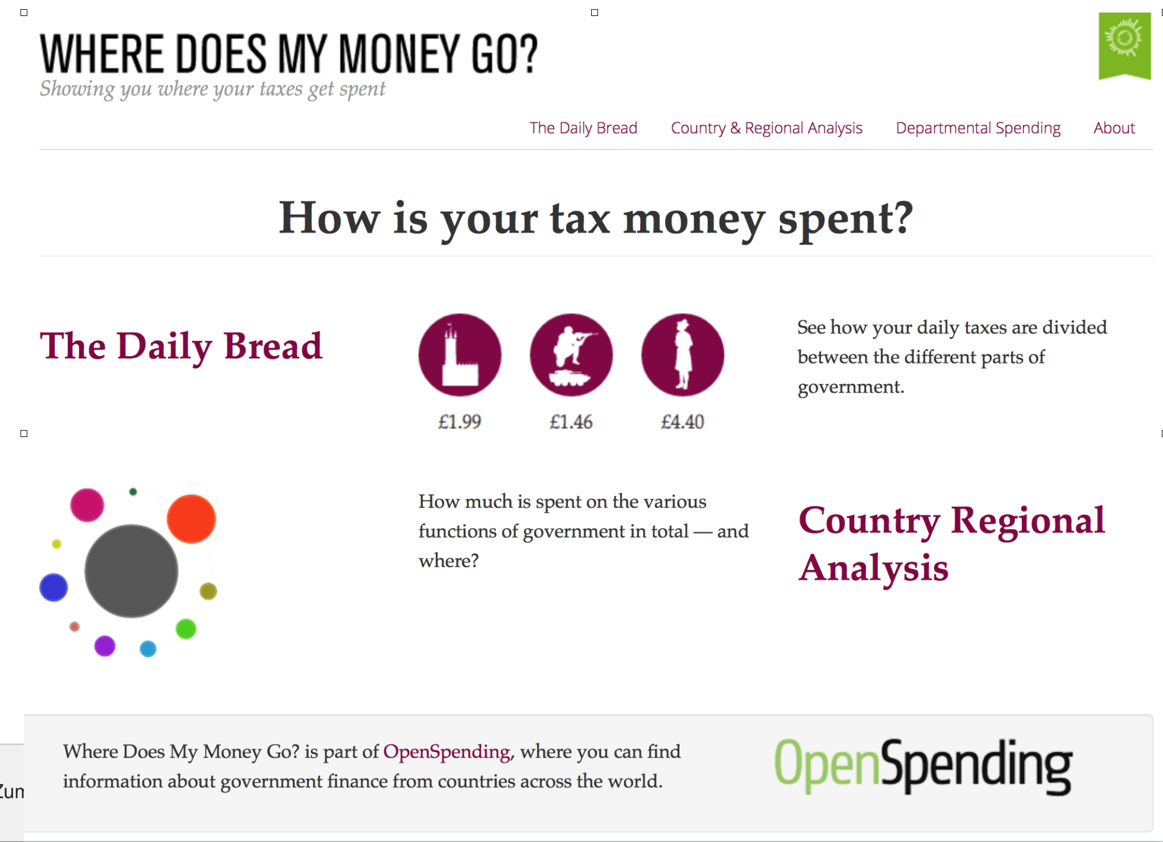

Slide 5
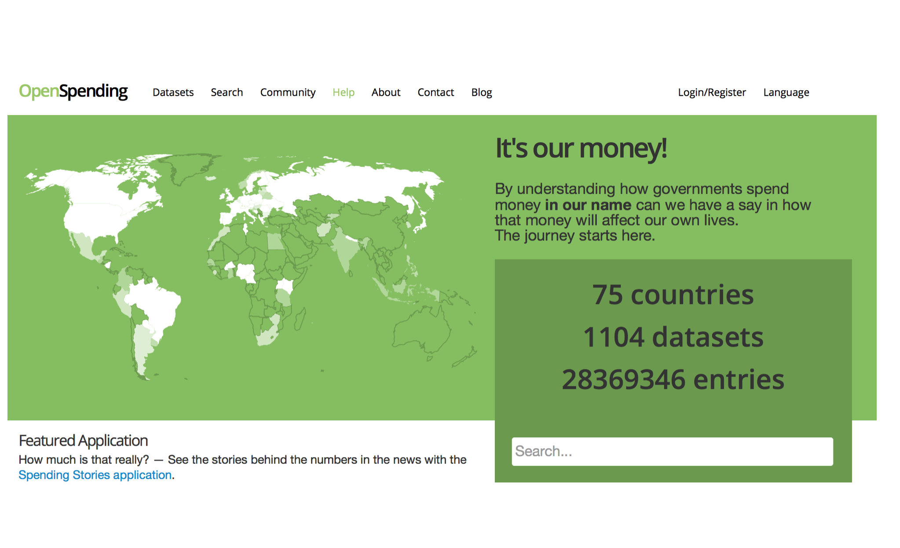
Where do we want to go from here?
“Centralise data, and decentralise views on data”

Slide 6
The solution
A solid core platform and a Budget Data Model specification
core platform with a large, centralised database that allows for deep analysis across a range of datasets,
while decentralising views acknowledges that an ecosystem around fiscal data needs to be tailored to specific, local contexts, not a one size fits all approach.

Slide 7
OpenSpending Next
During 2015-2016 the OpenSpending platform has been revamped to be based on the OFDP
http://next.openspending.org

Slide 8
OFDP at the core of OpenSpending

Slide 9
As a result of a collaboration with the Global Initiative for Fiscal Transparency (GIFT) and the World Bank (BOOST platform)
we developed the Open Fiscal Data Package as a Fiscal Data Standard to be used at a broader scale, as a global tool for publishing budget information in open data formats
OFDP is now an open specification at the centre of a new set of tools and workflows for fiscal data

Slide 10
The Open Fiscal Data Package serves two main purposes
To standardize the structure and the content of data so that tools and services can be built over it for visualization, analysis or comparison
To improve data quality and make it consistent by providing a solid framework of publication

Slide 11
How do we develop the OFDP? By trailing as we develop it:
1 - Improving our prototype, integrating suggestions and comments as we trial
2 - Updating the specification based on that feedback and learning
3 - Improving existing tools based on the specification (aggregation, visualization and comparison)

Slide 12
App for visualising Fiscal Data Packages
OpenSpending Packager
OpenSpending Viewer
OS Admin
Notes:
In order to provide publishers with immediate benefits by publishing to Fiscal Data Package, we needed a visualisation app that allows the user to explore the data. This app should be able to run directly from a Fiscal Data Package for small datasets (small enough to load directly into a web browser), and from an API for large datasets (data too large to load directly into a web browser).

Slide 13
OS Packager
A tool to upload so far any Fiscal (Budget/Expenditures/Both) CSV file
http://next.openspending.org/packager

Slide 14
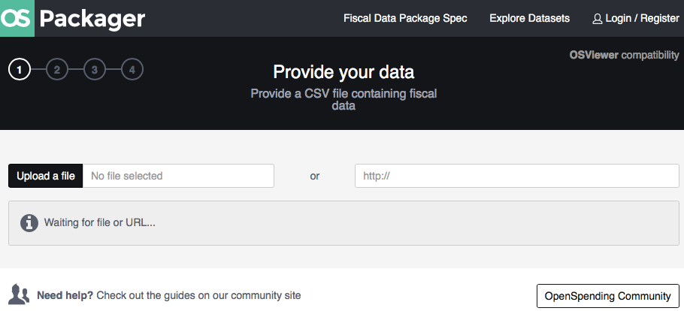
OS Packager
Step 1: Upload a CSV file

Slide 15
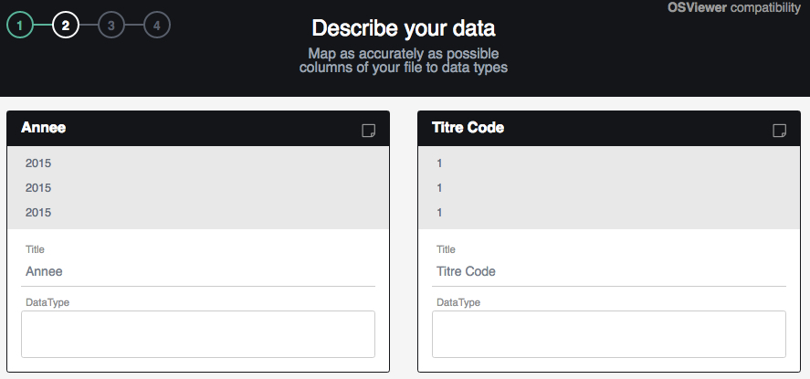
OS Packager
Step 2: Map the budget data with the model

Slide 16
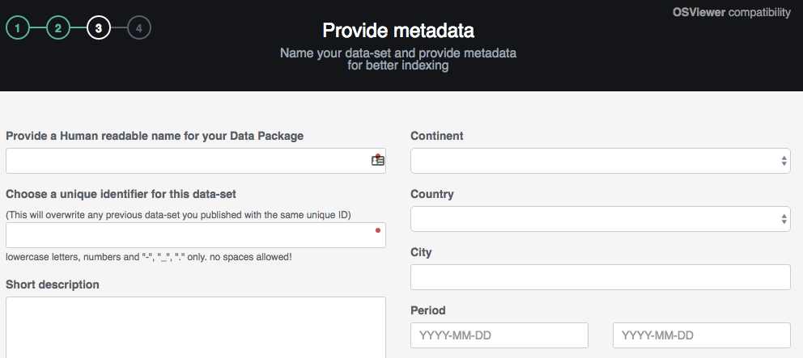
OS Packager
Step 3: Provide metadata

Slide 17
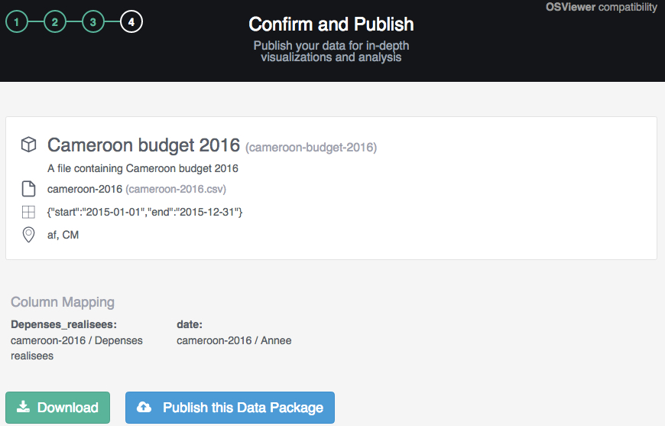
OS Packager
Step 4: Publish the data

Slide 18
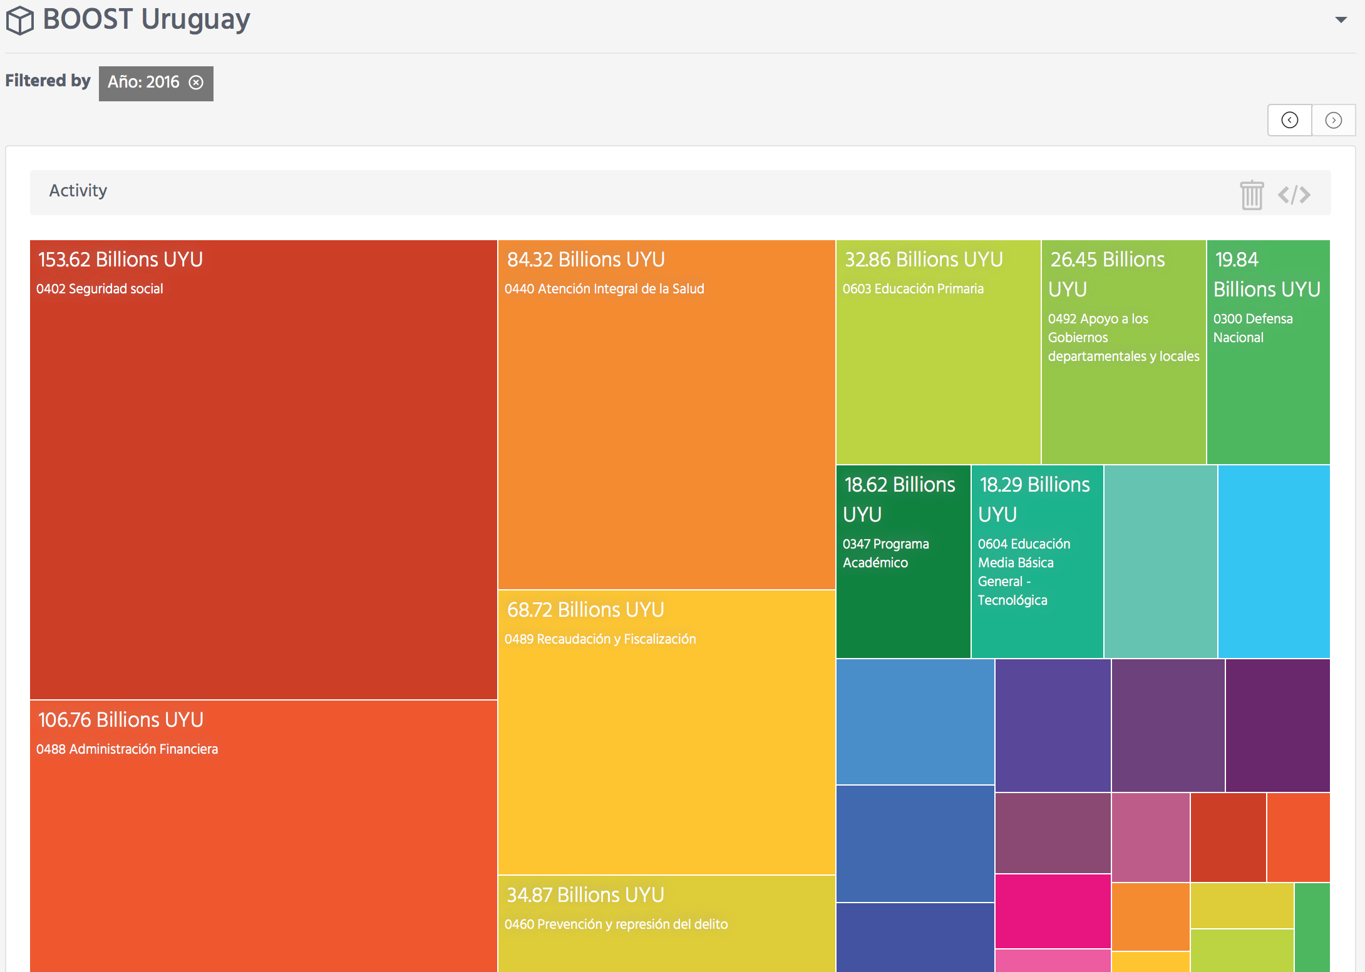
OS Viewer
A tool to visualise the uploaded Fiscal Datasets
http://next.openspending.org/viewer/

Slide 19
OS Viewer Features
Set of Data Visualisations:
Tree Map - Pie Chart - Bubble Tree - Bar Chart - Sankey Diagram - Tables - Radar Chart - Line Chart - Pivot Table

Slide 21
Next steps
Proof of concept to demonstrate the functionality of transactional spending data to be integrated into OpenSpending
Improve stability and availability of the OpenSpending platform as a whole
Work on OS Viewer enhancements suggested during phase II
Enhancement of the OFDP
Supporting GIFT in getting more governments interested in investing in the cause of fiscal transparency
OKI will look into the possibility to link OpenContracting standard to its fiscal specification

Slide 22
Useful Links What is the Open Fiscal Data Package: https://blog.okfn.org/2016/10/20/what-is-the-open-fiscal-data-package/
Open Fiscal Data Package Documentation :
http://fiscal.dataprotocols.org/ OpenSpending Documentation: http://docs.openspending.org/en/latest/ What you also can do with OpenSpending: www. subsidystories.eu
Also: The code is Open Source and open to the public Twitter: @openspending
Notes:
Open Knowledge International team engaging in all discussions and issues raised

Slide 23
Thank you

