Slide 1
Public Participation & Meaningful Transparency in Fiscal Policy Planning
Public Expenditure Management Network in Asia
Seoul, Korea
March 19, 2019
Juan Pablo Guerrero
Network Director
@fiscaltrans

Slide 2
GIFT Network Presentation: Outline
The GIFT network
Why Public Participation has become part of PFM Governance?
Public Participation in Fiscal Policies: Principles, Practices and Impact
2

Slide 3
GIFT Stewards - The 48 Champions
Government (19)
Brazil (Budget Sec)
Intl Orgs/ Networks (10)
WBG, IMF, OECD
Funders/
Foundations (4)
Civil Society Organization (15)
IFAC, MITRE, OCP
Philippines (DBM)
+ 16 budget Government agencies
Mexico (SHCP)
CABRI, IPF, Global Integrity, PEFA
IBP, Fundar, ILDA,
CBPP, INESC, Icefi,
ACIJ, Obs-Fiscal, Seknas
Funde, PSAM, Emerging M., NCDHR, Social Watch, (Fund. Solidaridad)
Hewlett F.
Omidyar
Ford F.
DfID
3

Slide 4
Budget Authorities - Stewards of GIFT
Federal Secretary of Budget and Planning of Brazil
Department of Budget and Management of the Philippines
The US Treasury Department
Ministry of Finance, Mexico
Budget Department of the National Treasury, South Africa
Technical Secretariat of Planning & Economic & Social Development, Paraguay
Ministry of Finance, Indonesia
Ministry of Finance, El Salvador
Ministry of Finance, The Dominican Republic
Ministry of Economy & Finance, Tunisia
Ministry of Finance, Guatemala
Office of the Budget & Planning, Uruguay
Ministry of Finance, Croatia
Ministry of Budget and National Planning, Nigeria
Budget Directorate of the Ministry of the Treasury, Chile
Ministry of Finance, Ukraine
Ministry of Economy & Finance, Benin
Secretariat of the Budget of the Ministry of the Treasury, Argentina
Directorate of the National Budget, Ministry of the Treasury, Colombia
+ Working closely with partners: Slovenia, Egypt, Liberia, Senegal, Ireland, Scotland

Slide 5
The bodies of GIFT
Community of Practice
Partners
Stewards
Lead Stewards
GIFT Coordination Team
5

Slide 6
Fiscal Transparency (FT) + Public Participation (PP) lead to better fiscal and development outcomes
Fiscal transparency
Public disclosure of high quality fiscal data & information in budgets, forecasts, outturns etc
Public participation
Direct engagement by the public in fiscal policy design & implementation
Accountability
Public officials held effectively to account for stewardship of public resources
Improved social, economic and environmental outcomes
e.g. Improvement in SDG indicators
Improved fiscal outcomes
fairer, more efficient & effective taxation & public services, more legitimate & sustainable fiscal performance
6

Slide 7
Why public participation in the budget cycle?
2008: Global Financial Crisis, PFM Governance, disclosure of information alone is not sufficient for accountability
Participation is key for Sustainable Development Goals: 1-poverty, 5-gender equality, 10-reduce inequality, 16-peace, justice & inclusive institutions
Public Participation as a the core of Open Government Partnership
Government data at reach: big data, open data & digital technologies
7

Slide 8
GIFT history reflects PP in FT International Standards
2012: GIFT High-Level Principles on FTAP & UN General Assembly
acknowledgement
12: IBP-OBS leads the way, with section on PP
2014: IMF revision of Fiscal Transparency Code
2015: OECD Principles on Budgetary Governance
15: Tax Administration Diagnostic Assessment Tool-TADAT
15: Open Contracting Partnership- OCP
15: GIFT Principles on PP and Guide on practices
2016: Revised PEFA Indicator Program
16: Extractive Industries Transparency Initiative- EITI
2017: New PP section in OBS-IBP
17: OECD Budget Transparency Toolkit
17: PEMPAL network engages systematically on topic
2018: IMF Fiscal Transparency Handbook
2019: IBP/GIFT PP pilots
8

Slide 9
How Do CSOs Use Budget Information?
(De Renzio-Mastruzzi 2016)
Mismatch between Government efforts & CSO needs
Aggregate budget information is available, BUT Agency/facility level data, performance, off budget is much less available
Need for information linked to service delivery & population needs: linking budget with outcomes
Quality is a big issue: comprehensiveness, accessibility, timeliness and usability
9

Slide 10
Missing: Budget Data on Public Service Delivery
The length and complexity of the funding chain + the different data sets involved
Budgets and fiscal reports show spending by ministry, citizens cannot see the budgets or performance information down to their local service delivery units
Lack of transparency of spending of individual service delivery units e.g. schools, hospitals
10

Slide 11
Accessibility
Depth /
Relevance
Openness
Proportionality
Inclusiveness
Sustainability
Respect for self-expression
Complementarity
Timeliness
Reciprocity
11

Slide 12
Core considerations
Publish information accessibly + meaningfully (address demand)
Clarity on the rules of engagement in order to ensure clear expectations
Add value & relevance to the process: inform well, on time, get feedback (speak to users), try to institutionalize, ensure a fair engagement
Reach out to those usually quiet (INCLUSION)
Seek that public participation complement what government institutions do

Slide 13
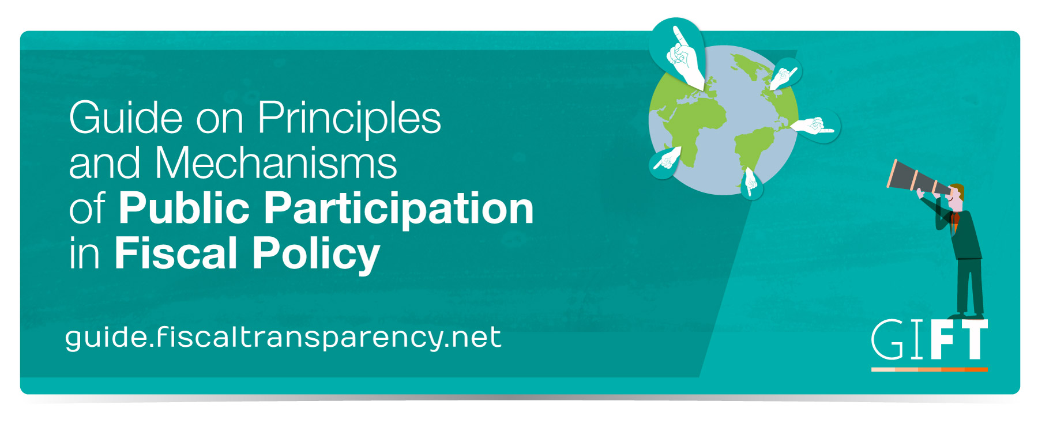
13

Slide 14
PP mechanisms across the budget cycle
Audit and oversight
- SAI engagement on audit planning, and conduct of performance audits (budget monitor)
Executive Budget Preparation
- Pre-budget hearings / consultations / submissions
Legislative
approval
- Consultation on Policy Statement, and annual proposal
Budget Implementation
- Public hearings +Submissions on money Bills
- Complaint mechanisms & feedback
- Independent Fiscal Institutions
- Public Councils
- Tax policy reviews & consultations
- Online mechanisms
- Citizen engaging & monitoring online
- Bottom Up budgeting / Participatory Budgeting
- Legislative consultation on departmental reviews
- Social audits of revenues +expenditures
- Bottom-Up consultations
14

Slide 15
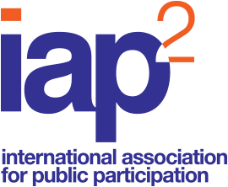
Online tools in the Public participation spectrum
EXAMPLE Tools -Multiple audiences -Multiple tools -Multiple objectives | Inform | Consult | Involve | Collaborate | Empower
 | -Newsletter -Email -Video -Website -Social Media -Live Stream meetings | -Social media discussions -Polls -Blogs -Workbook Surveys | -Ideation -Surveys -Polls -Serious games -Social media discussions | -Online fora -Document co-creation -Mapping -Twitter chat -Video meetings | -Decision making: Online voting Participatory budgeting -Community actions (discussion fora)
15

Slide 16
1. Policy Objectives of Public Participation
Better resource allocation (e.g. subnational transfers in Mexico, with the role of the media and CSOs leading to changes in the criteria for investment projects approval to observe urban sustainable mobility)
Improvement in the provision of public services (e.g. social accountability / monitoring experiences of sanitation in South Africa or social audits in India)
Better response to the preferences of beneficiaries of services (i.e. Kenya devolution experiences and refining gender subsidies beneficiaries in Mexico)
16

Slide 17
2. Public participation for what?
Opportunity for marginalized groups to exert some influence in decisions that affect them (i.e. i-monitor in Nigeria which invites citizens to report budget waste, South Korea open consultations for budget implementation and in Indonesia, LAPOR, complaints on-line systems)
Greater impact of social policies in development sectors: health sector, education, community level public works, etc. (participatory budgeting and social audits)
Increases trust & citizen compliance (participatory budgeting)
17

Slide 18
Examples of PP mechanisms in the 2017
Open Budget Survey (Executive)
Pre-budget hearings: usually open to all unless the mechanism is ad-hoc (Kyrgyz Rep., Malawi, Fiji, Ukraine, Sierra Leone, Benin)
Pre-budget consultations: by invitation w/ key stakeholders (India, Bangladesh, Malaysia, Botswana, Liberia, Mali, Benin, Nigeria, Guatemala, Ireland)
Pre-budget submissions: MoF invites to submit proposals; can be open to all, but not always feedback mechanisms (Canada, Australia, Tanzania, Ghana, South Africa, Zambia –tax-, DRC, Tanzania –tax-)
18

Slide 19
2. Examples of PP mechanisms in OBS 2017
(Executive)
Public councils: elected representatives from civil society; some councils include reviewing policies & draft bills that feed into the budget, including investment projects or service delivery (Kyrgyz Rep., Kazakhstan, Georgia, Croatia, Bulgaria, Japan, Brazil)
Policy consultations on specific issues: issues that may or may not affect the annual national budget (Moldova –tax, Croatia, Czech Republic, UK, Ghana)
Sector Working groups: convened for budget preparation; MoF + agencies & stakeholders discuss sector and cross- sector planning and prioritization (Kazakhstan, Russia, Kenya)
19

Slide 20
3. Examples of PP mechanisms in OBS 2017
(Executive)
Online reporting mechanism: websites to provide a platform for registering complaints/ provide feedback/ report waste/ respond to surveys (S-Korea, Malaysia, Indonesia, Mexico)
Bottom up consultations approach: consultations at the local level are used to inform agency budget proposals, subsequently submitted to the MoF (Philippines, Indonesia, Botswana)
Participatory budgeting mechanisms: community members directly decide how to spend part of a budget, enabling taxpayers to make the budget decisions that affect them (Philippines, Mexico, Portugal, South Korea)
20

Slide 21
Main Takeaways .
PFM governance frameworks now put citizens at the center of reforms
Information disclosure that responds to needs of users & engaging the public on public services are growing practices around the world
Use of digital tools provides opportunity to reach a much broader audience, playing a potentially crucial role in tackling trust deficits and in supporting better outcomes
21

Slide 22
Stay tuned!
@fiscaltrans
@fiscaltransparency
@fiscaltransparency
www.fiscaltransparency.net

