Slide 1
Make your PB dream come true
Ivan Shulga
Task Team Leader Strengthening PB in the Russian Federation, The World Bank
October 16, Cascais, Portugal

Slide 2
SCALING UP OF PARTICIPATORY BUDGETING IN RUSSIA
2007: first Russia PB - WB LISP* started in Stavropol region
WB LISP in Stavropol and Kirov regions
WB LISP in 8 regions, EU SpB PB in 3 regions
National level MoF - WB project has started
Various methodologies; WB LISP prevailing (25 regions)

Slide 3
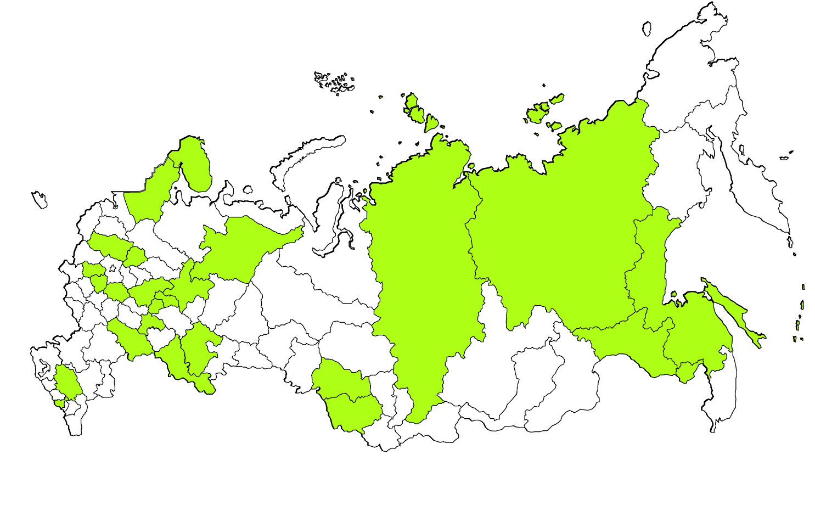
LOCAL INITIATIVES SUPPORT PROGRAM (LISP)
29 regions
Small and medium size municipalities, mainly rural
Small projects (20-30K USD) aimed at improvement of local level social infrastructure and territorial improvement

Slide 4
LISP SPECIFIC DESIGN FEATURES
Awareness campaign;
Training
Receiving of municipal proposals by regional-level competition committee
Competitive selection
Implementation
community meetings and citizens’ direct voting
Two-stage approach to project selection
Voting in municipalities
Competition of proposals – based on a set of formal criteria
75-80% of municipal proposals voted by people are finally approved
Co-financing by population and business (cash and in-kind)
1.5 year
cycle

Slide 5
Competition Criteria
People participation in public discussions (40%)
in preliminarily events to identify project ideas
in final community meetings to vote for projects
Cash and in-kind contribution of local stakeholders (40%)
population
local business
settlement budget
Positive effects on the development of settlement (15%)
% of beneficiaries among the local population
# of newly created and/or preserved jobs
…
Efforts to promote PB at the local level (5%)
media use for informing the population

Slide 6
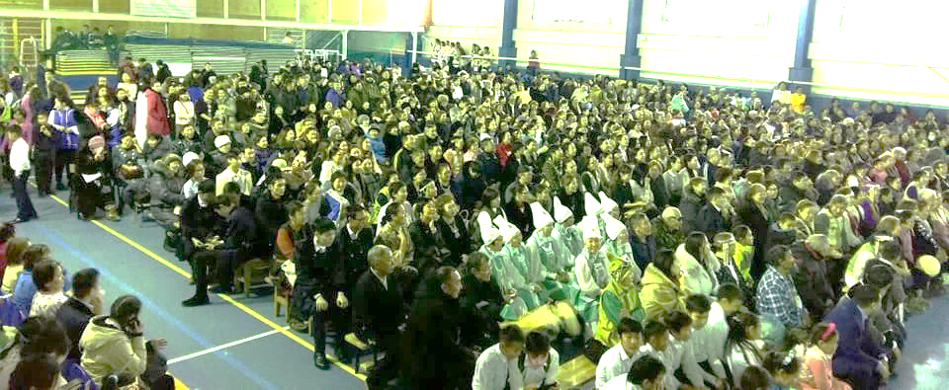
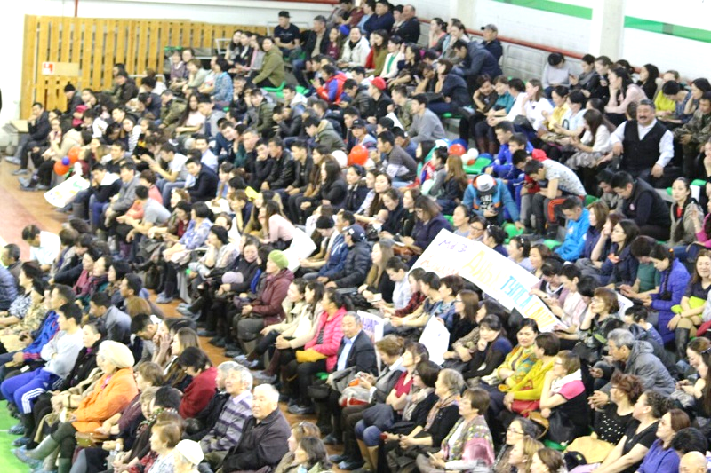
LISP IN SAKHA (YAKUTIA) REPUBLIC

Slide 7
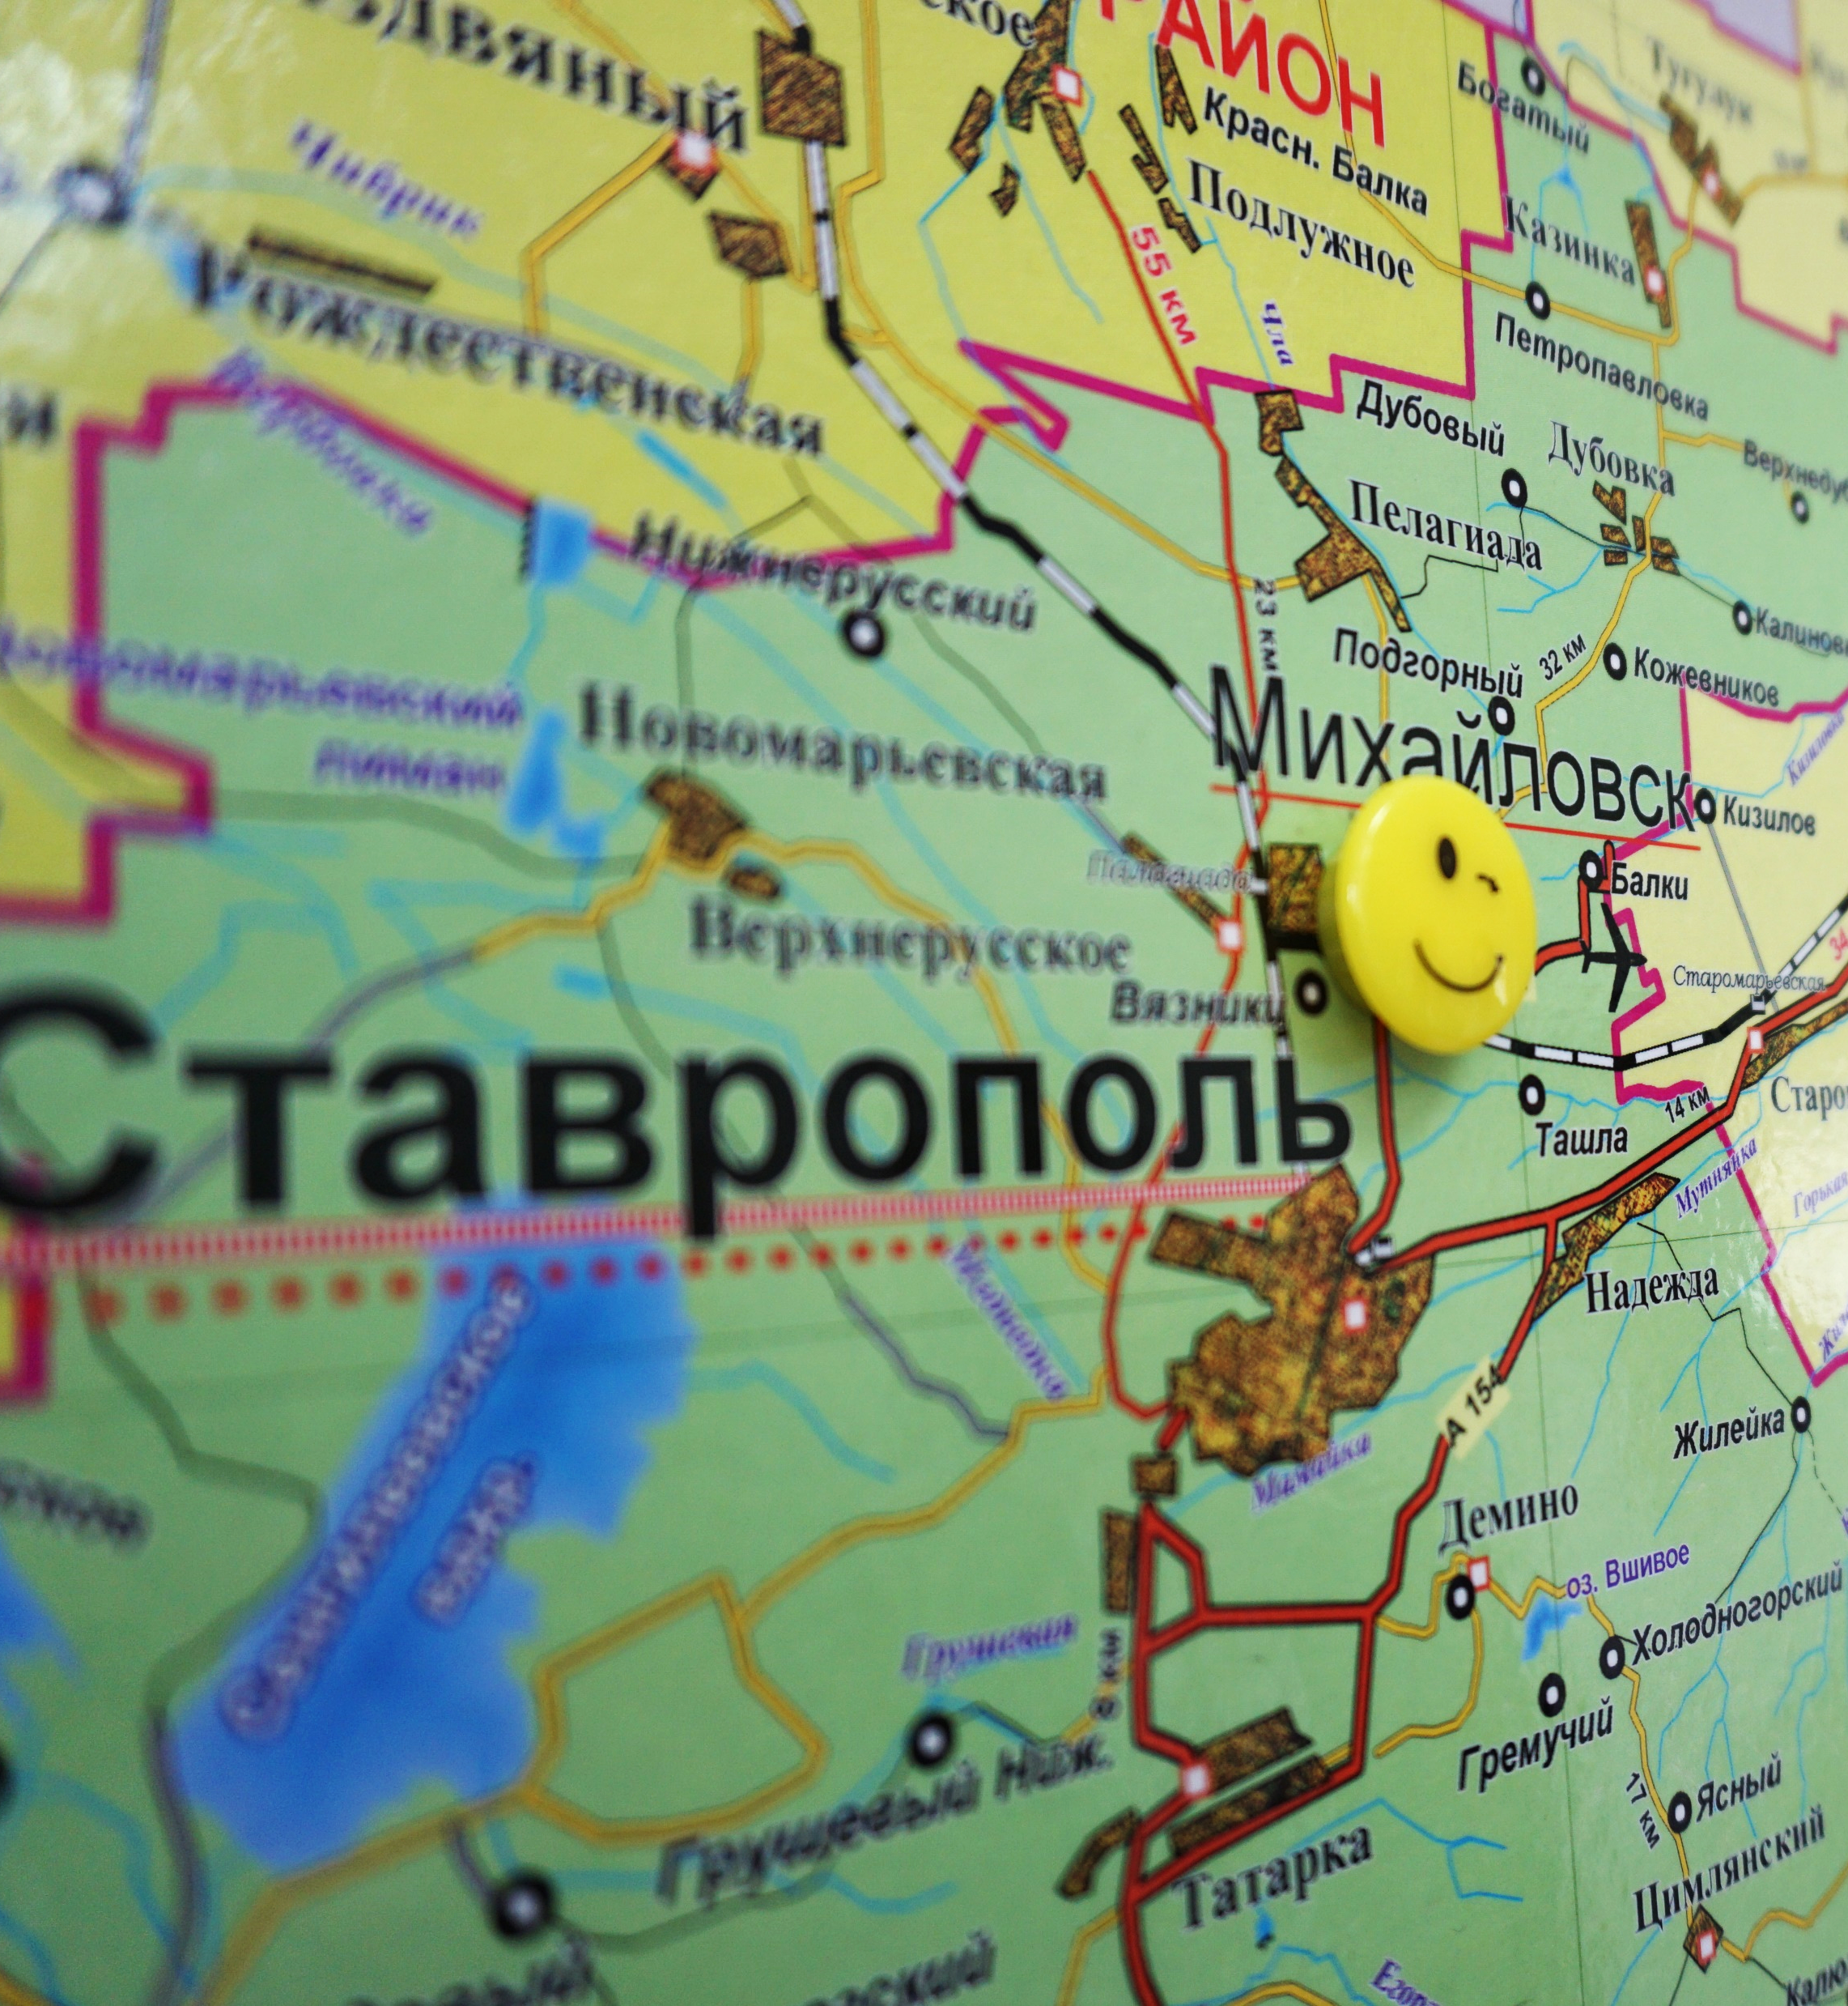
NEED FOR IMPROVEMENT
A model more relevant to urban municipalities (including big cities)
New format of public discussions
New format of voting (beyond direct physical voting)
New types of projects (beyond basic social infrastructure)
New participants

Slide 8
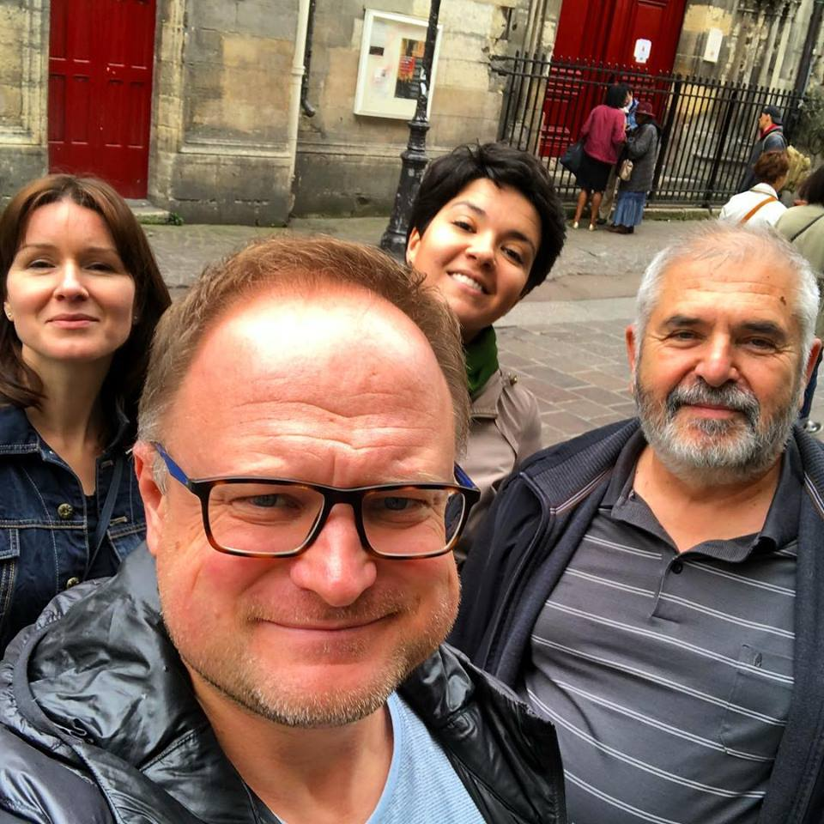
EXPERIENCES WE LOOKED AT
Brazil, Argentina
USA
Italy, France
PBs in big cities (Paris, Milan, Lisbon)
Cascais

Slide 9
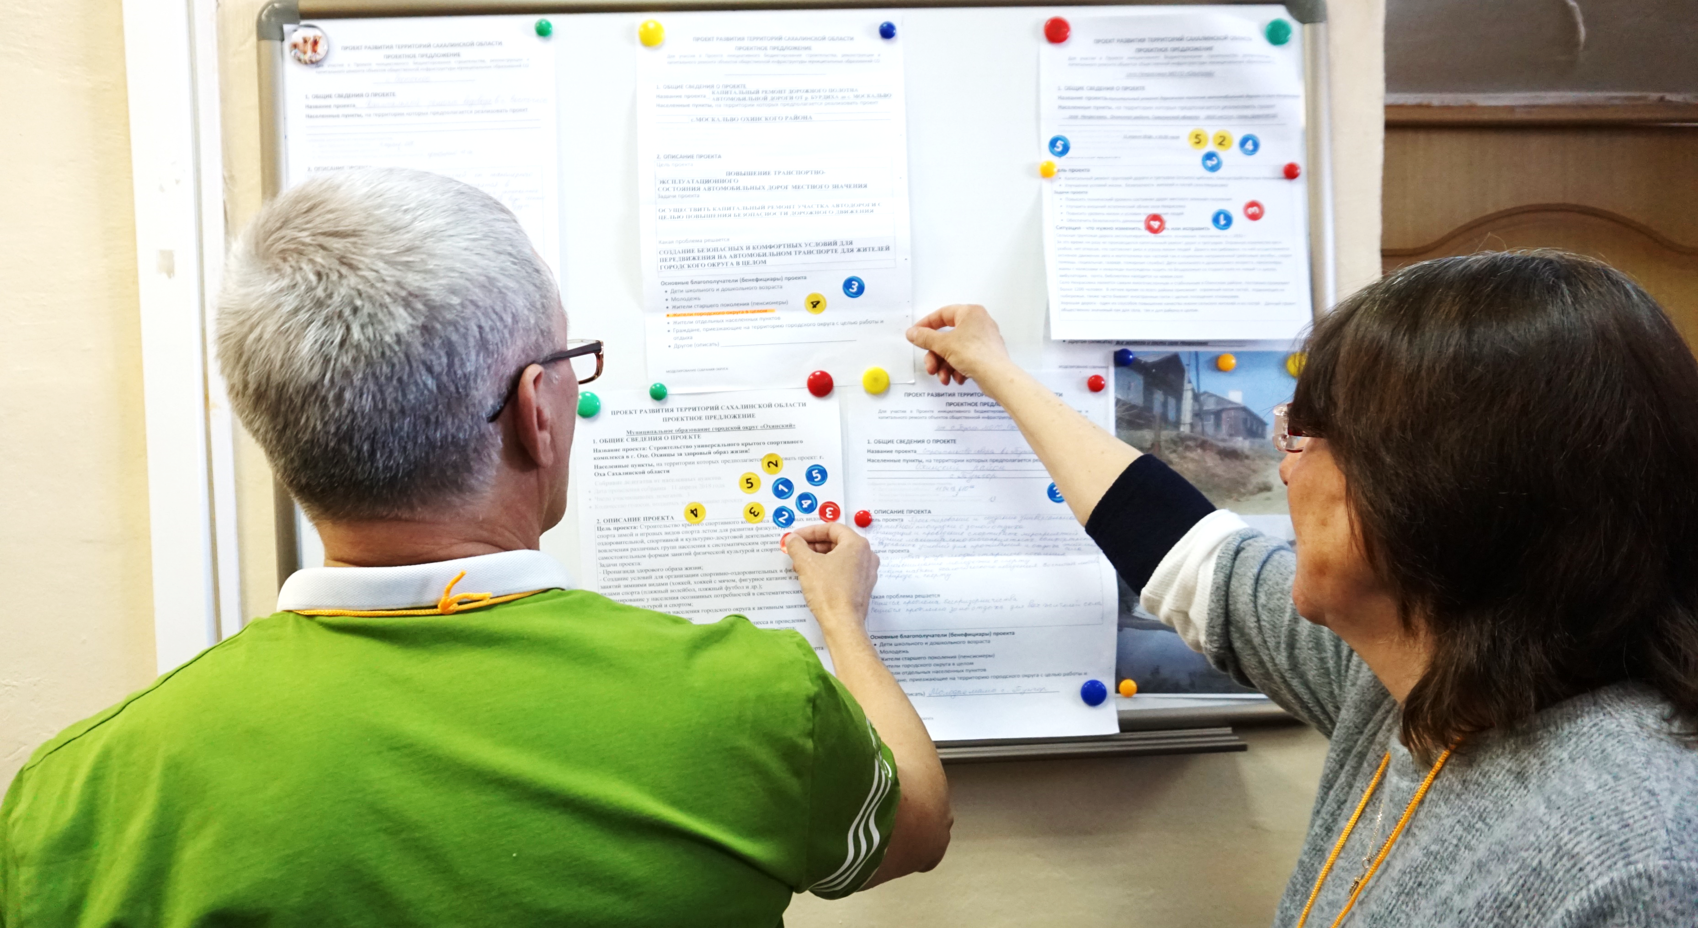
MAIN THINGS WE LEARNT FROM CASCAIS
Awareness campaign (including participatory bus)
New format of public discussions
Online voting
Engaging volunteers
Engaging NGOs

Slide 10
WHAT DOES RUSSIA HAVE
Regional model (with municipalities subsidized from the regional budget)
Competition based on formal criteria aimed to:
prioritize the projects most supported by communities
mobilize community resources
Co-financing by population and business
Initiative groups (delegates)

Slide 11
FOCUS IN OUR FUTURE WORK
Inclusive PB (focus on engaging disadvantaged groups)
School PB (focus on soft projects and developing skills of school students)
Comprehensive capacity developing system

Slide 12
November 13-14, Moscow: SAKHALIN PORT PB model presentation

Slide 13
THANK YOU!

