Slide 1
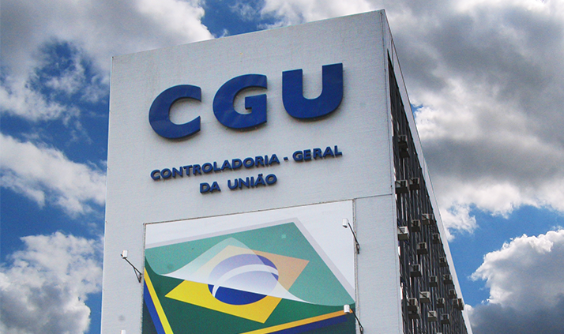
TRANSPARENCY AGAINST CORRUPTION
The Brazilian experience
MINISTRY OF TRANSPARENCY AND OFFICE OF THE COMPTROLLER GENERAL OF BRAZIL - CGU

Slide 2
PRINCIPLE
POLICY
Symmetry of information
Constitutional right
Result-oriented
SMART actions
TRANSPARENCY?

Slide 3
NATIONAL POLICY FOR TRANSPARENCY
Rules and regulation
Networking and engagement
Tools and instruments
Support and sustainability
Monitoring
Communication and exposure
Capacity building
Reaction and feedback

Slide 4
LEGAL FRAMEWORK
Regulation IDs
Fiscal Responsibility (and reports)
Transparency of Spending and Revenues
Access to Information
Conflict of Interests
Acquisition (biddings and contracts)
Open Data
Budget Guidelines
Several others for specific topics
LC 101, 131, 156
LC 131
Law 12.527
Law 12.813
Law 8.666, 12.527
Decree 8.777
Yearly law

Slide 5
TOOLS AND INSTRUMENTS
Where to find
Transparency Portal
Transparency pages
Electronic System for Information to Citizens (eSIC)
Open Data Portal
Purchasing Panel
Prices Panel
Municipalities Panel
Standards for government website
transparencia.gov.br
transparenciapublica.gov.br
esic.gov.br
dados.gov.br
paineldecompras.planejamento
paineldeprecos.planejamento
paineis.cgu.gov.br
informacao.gov.br

Slide 6
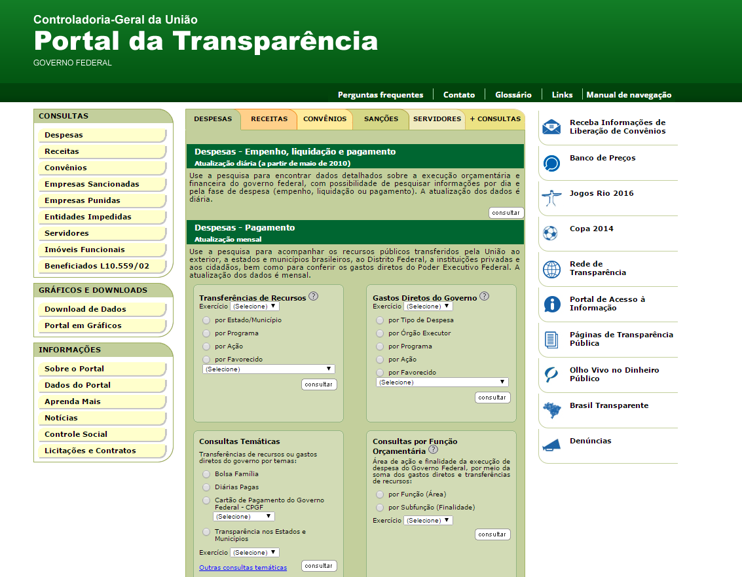
TRANSPARENCY PORTAL
The Transparency Portal provides information on how the government uses its resources
It had 21 million visits last year alone
It generated savings, improvements in regulations and more efficient policies

Slide 7
TRANSPARENCY PORTAL
The Federal Government spends 25% less with government credit cards when compared to 2007
The rules for education financing programs changed after analysis done with Portal`s data
Cuts were made in several initiatives where flaws were reported
Spending (by theme, agency, program and more)
Transfers
Revenues
Public servants
Debarment lists and sanctions
Social programs
Suppliers
And much more

Slide 8
CREDIT CARD SPENDING (R$)
2007
2008-2016
2017
76.254.492
61.464.326
49.961.582
BETTER SPENDING

Slide 9
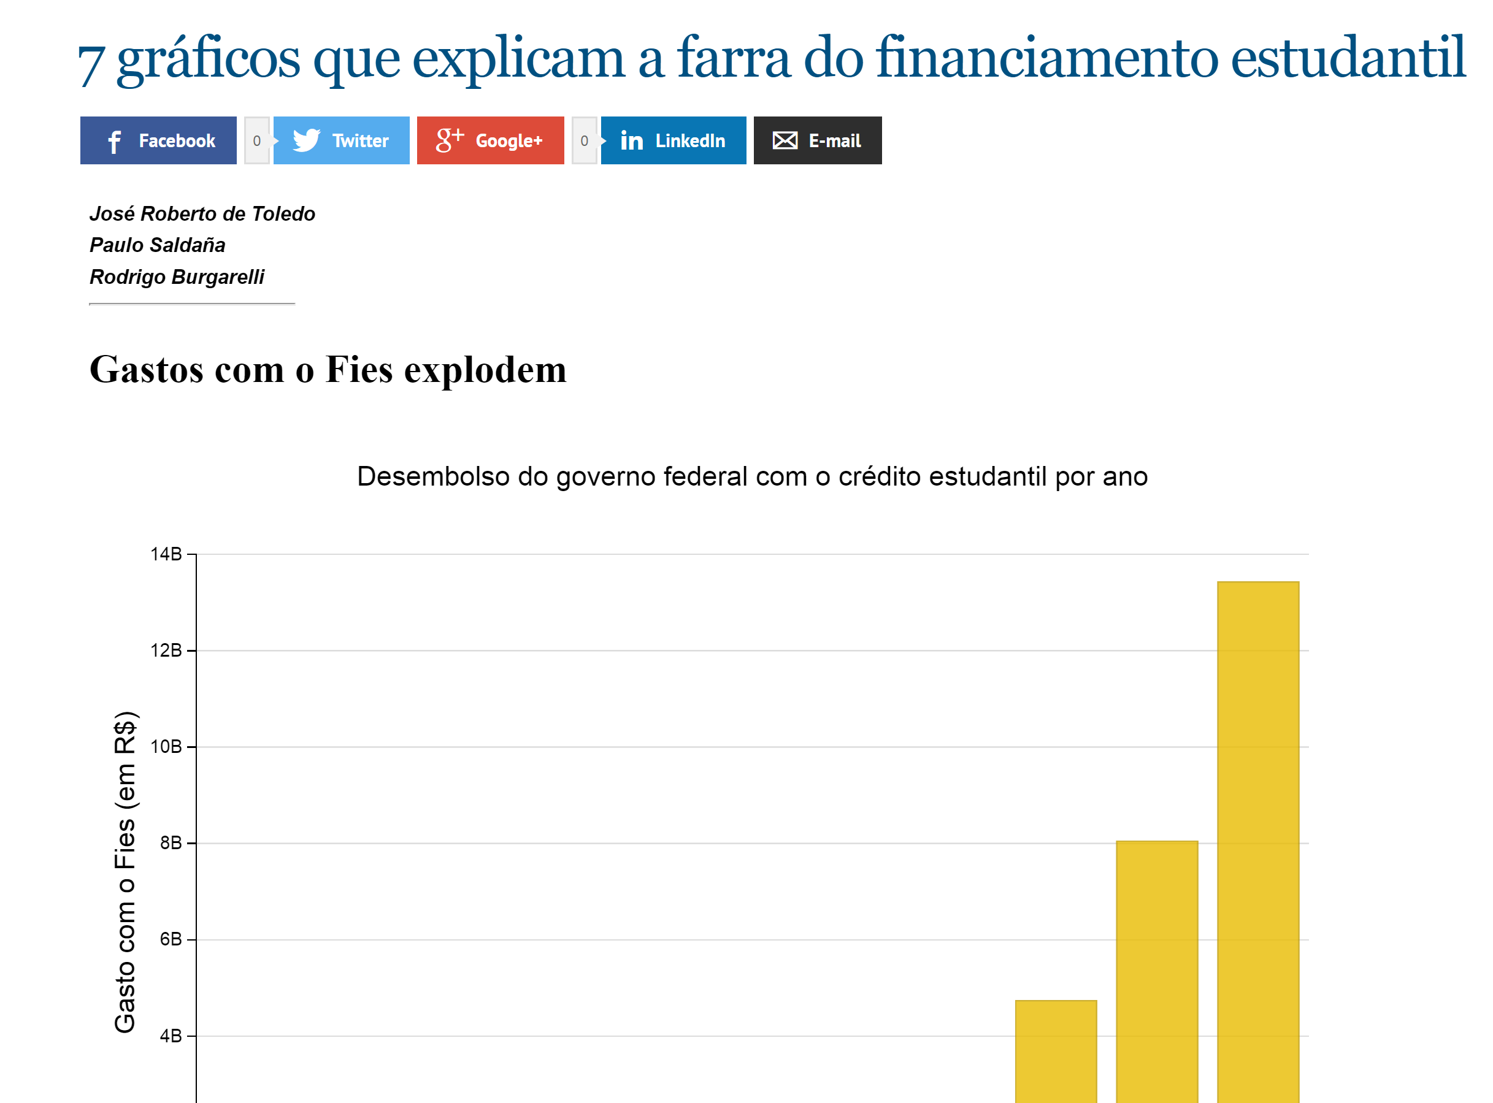
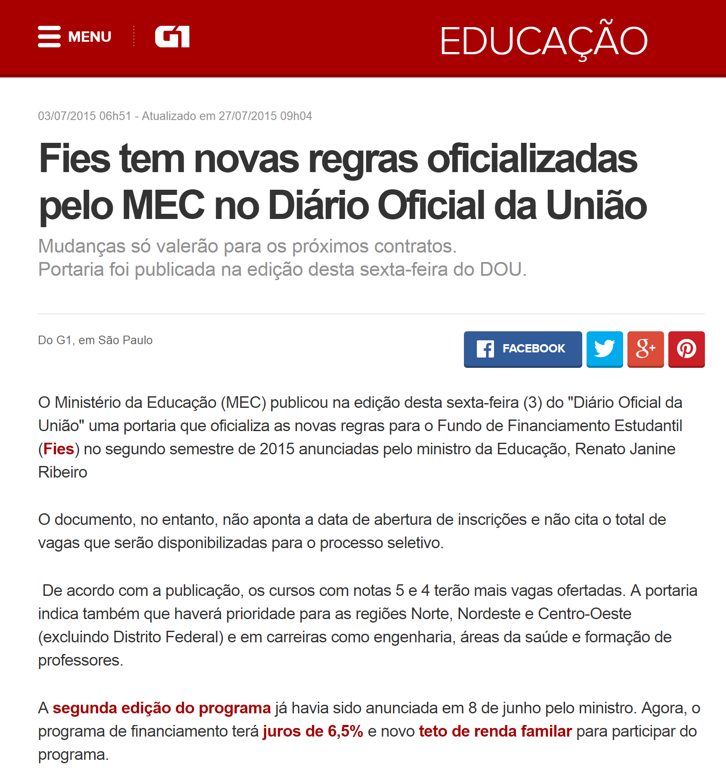
BETTER POLICYMAKING

Slide 10
THE NEW TRANSPARENCY PORTAL
Better usability
More data (contracts, biddings and more)
Improved interactivity
Upgraded open data solutions
Data visualization tools
Crowdsourcing
Learning resources
And much more
Launching June 28th

Slide 11
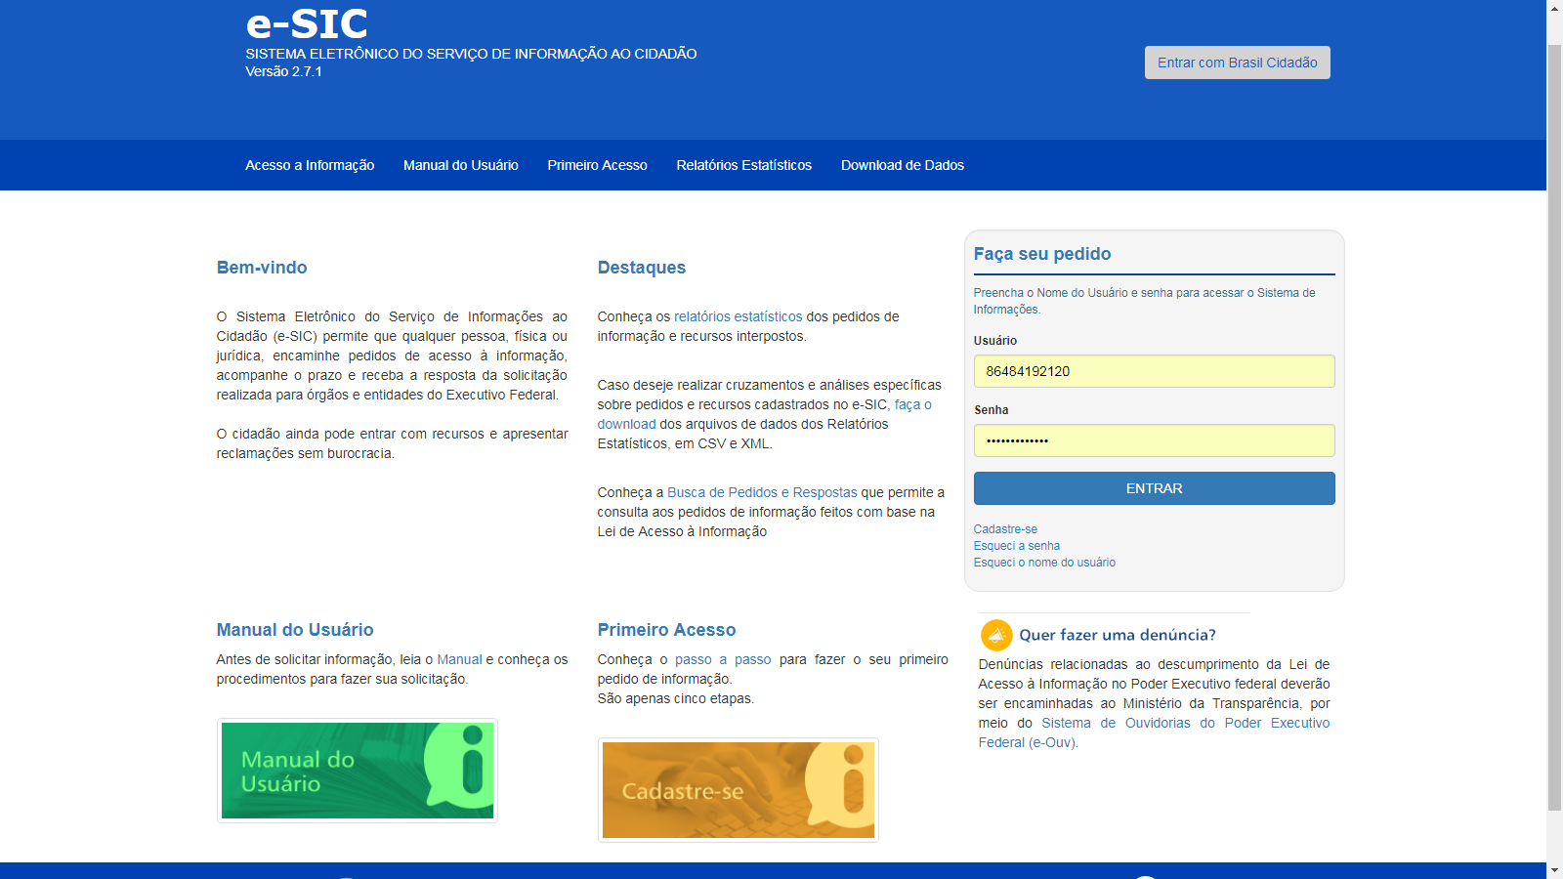
e-SIC
Official channel for requests of information to the Federal Government
More than 99% of the 600 thousand request were answered
Appeals and requests for datasets can be made online with the tool

Slide 12
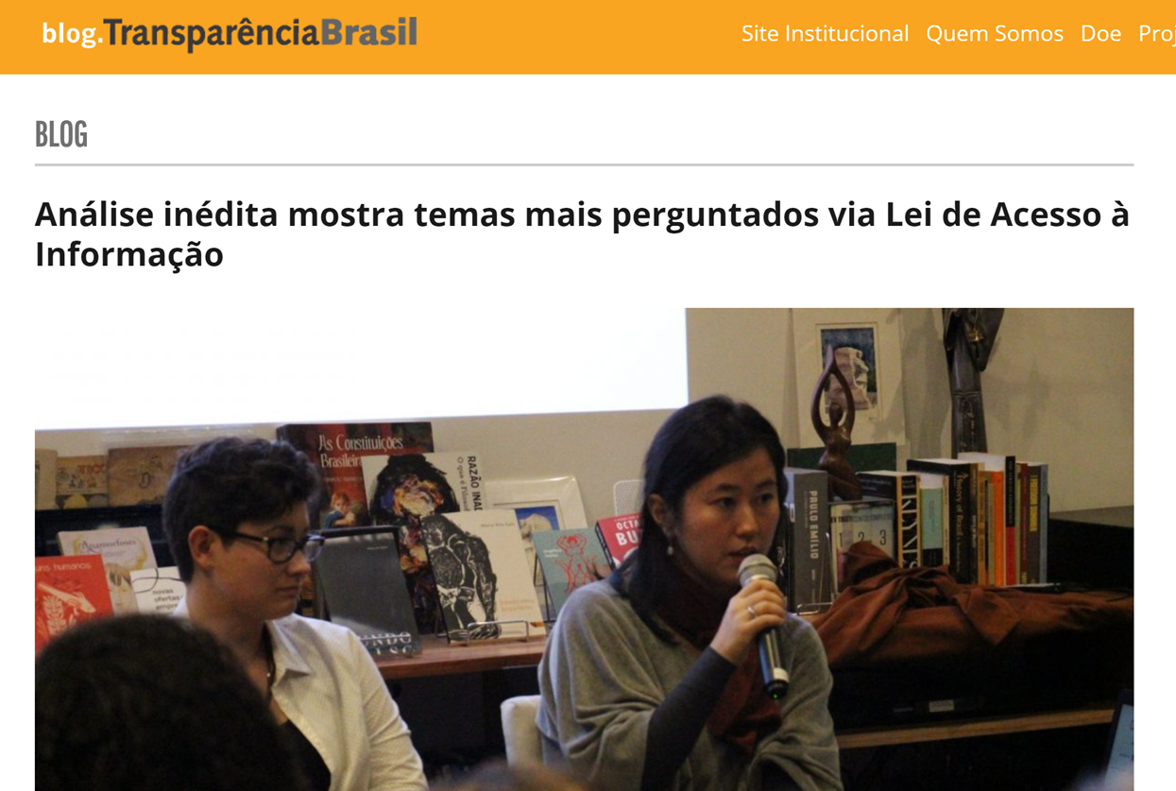
ACCESS TO INFORMATION

Slide 13
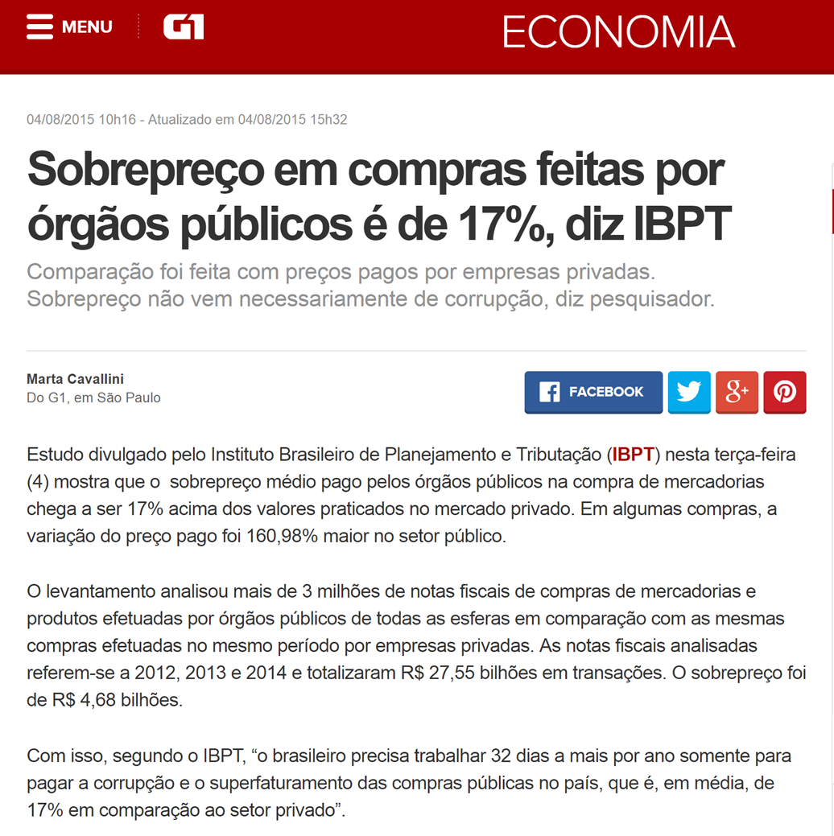
ACCESS TO INFORMATION

Slide 14
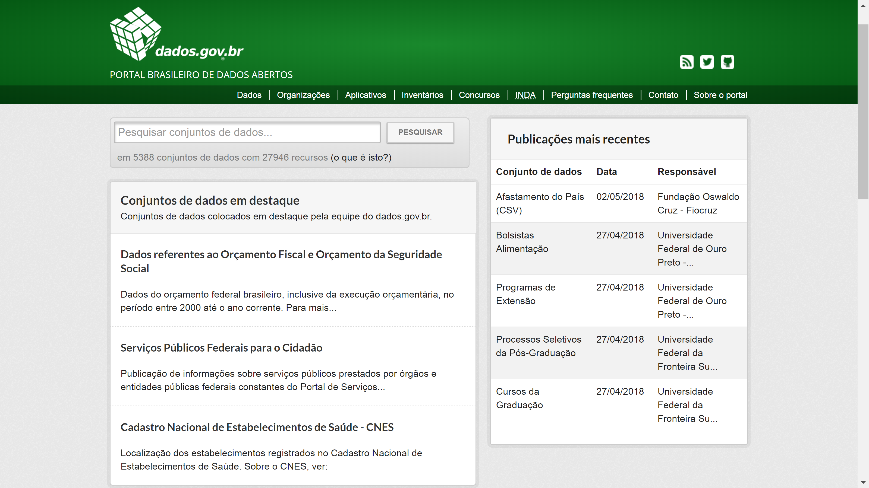
OPEN DATA PORTAL
Official catalogue for government open data
A decree mandates the continuous opening of data
Over 5300 datasets are already available

Slide 15
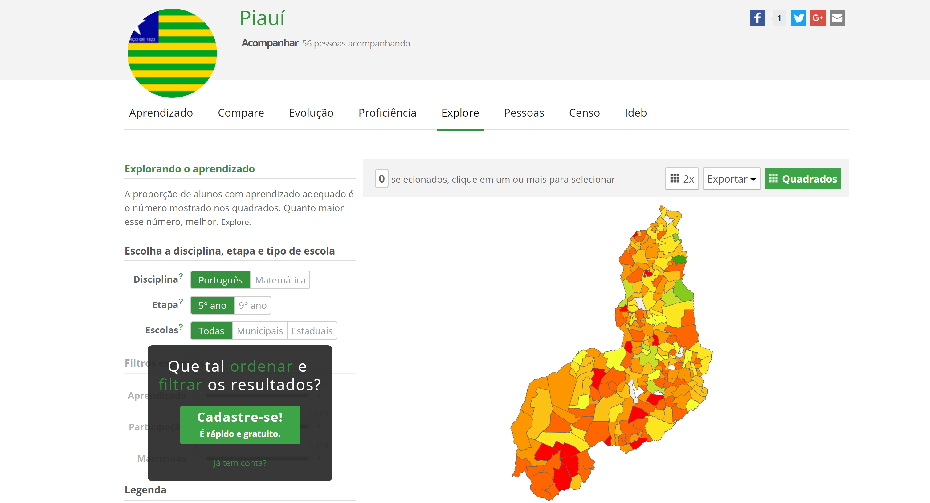
IMPROVING EDUCATION

Slide 16
MONITORING
Monitoring systems and tools
Open reports and panels
Continuous processes from CGU
Civil society engagement
Mystery consumer rounds
Transparency authority
Processes include quantitative and qualitative reviews

Slide 17
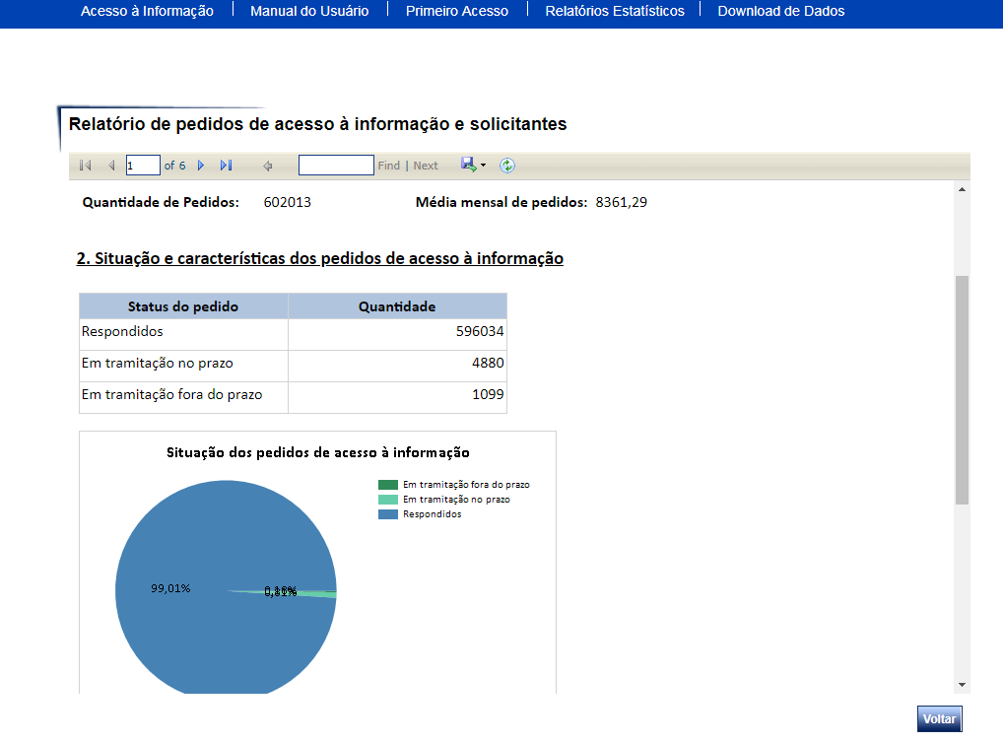
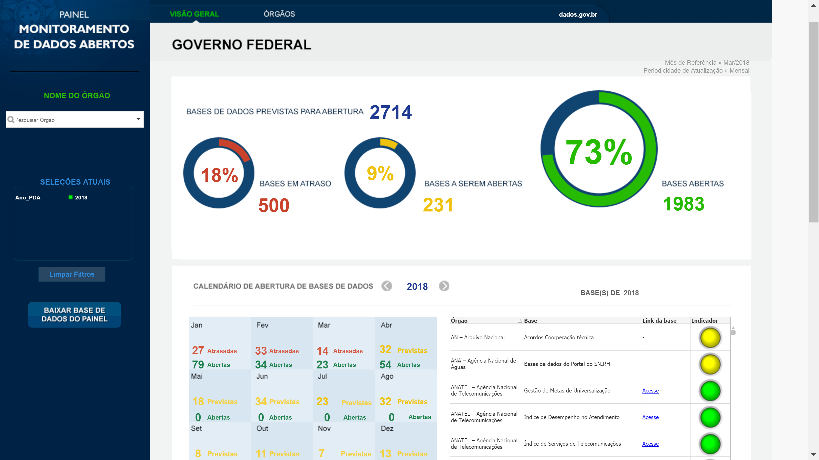
Monitoring tools are open for anyone to follow up

Slide 18
CAPACITY BUILDING
You should know
Workshops and seminars
Guides, manuals and videos
In-agency training
Annual meetings
Thematic discussions
Online courses
Online resources such as the databases of previous requests and decisions
Through e-SIC you can reach over 300 pubic organizations, including public companies
Over 3000 public servants are engaged in answering access to information requests
Citizens and civil society organizations also have opportunities to learn how to use the available tools

Slide 19
NETWORK AND ENGAGEMENT
Get journalists and CSOs to use available tools and work together
Get states and municipalities to share experiences and solutions
Exchange of best practices with the international community
Improve the policy with civic participation
Keep in mind:
One finding by one actor might start the chain reaction that will make the government better

Slide 20
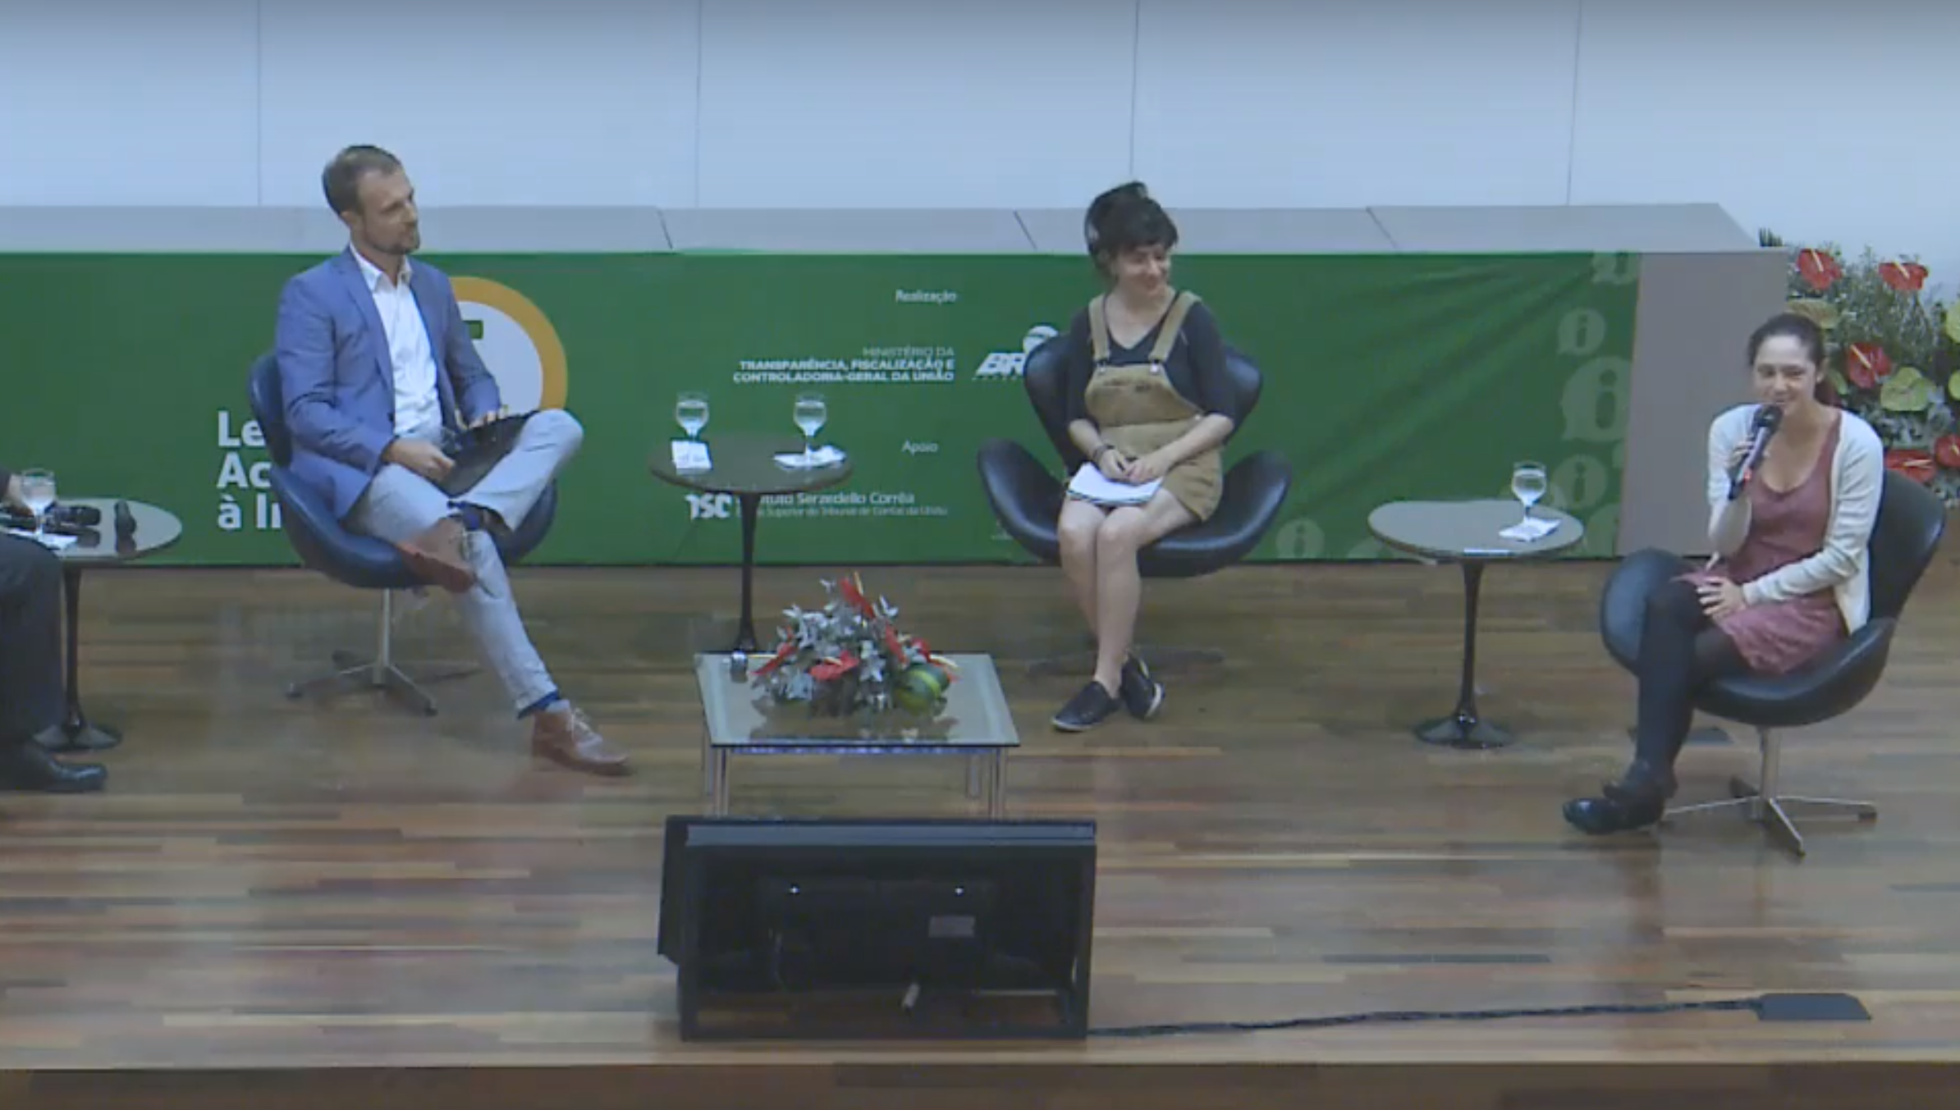
Civil society sharing experiences in an event for 300 public organizations

Slide 21
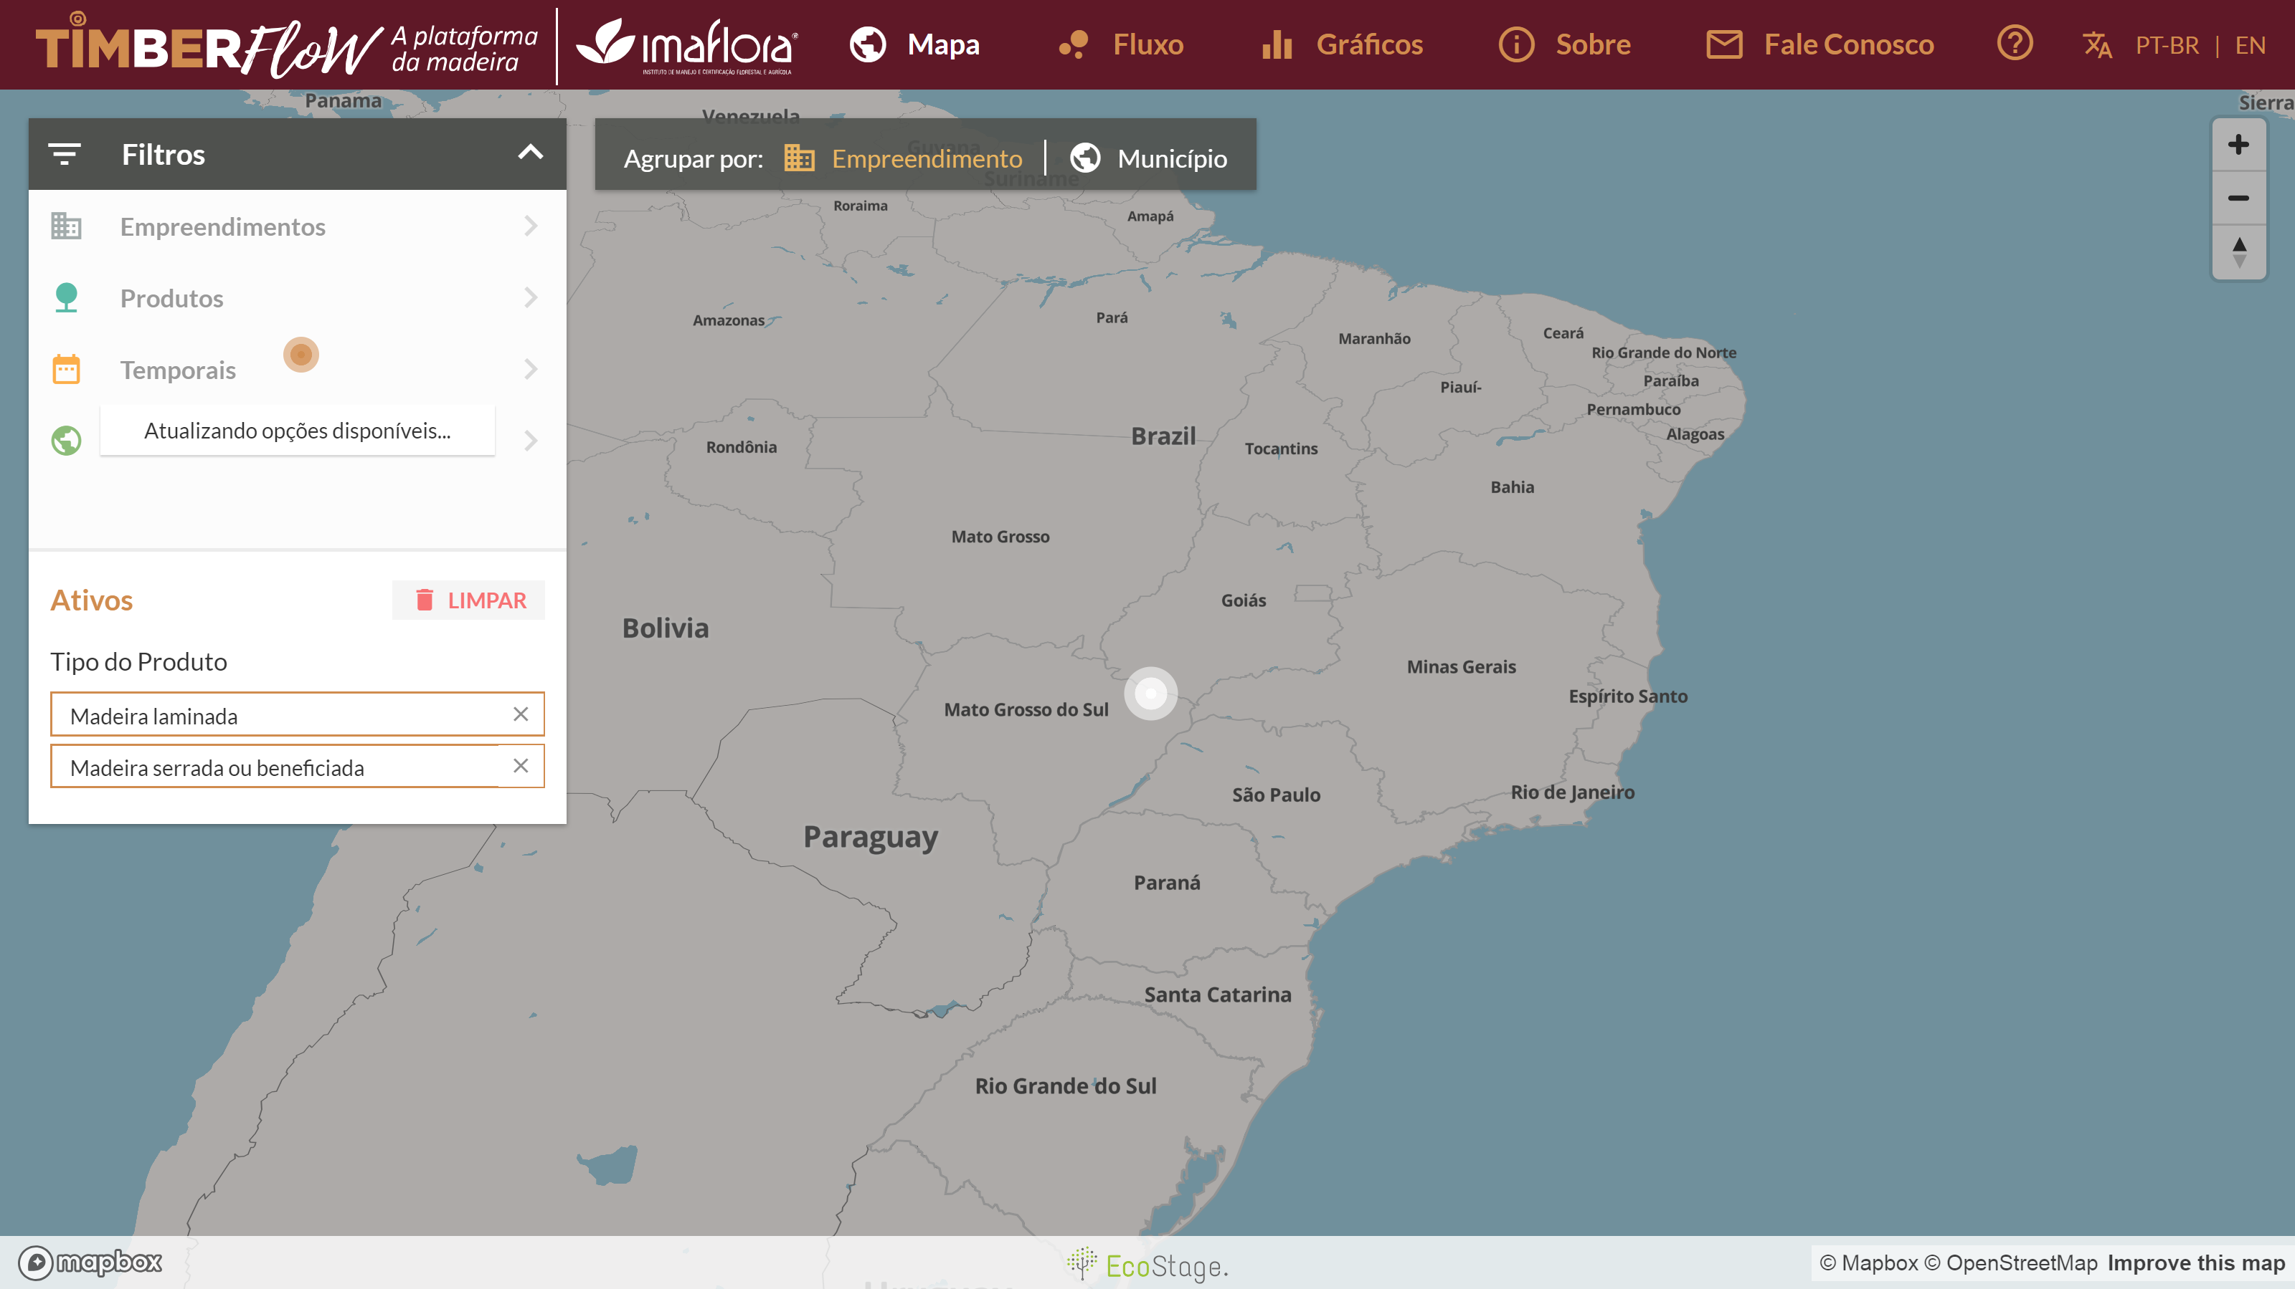
TimberFlow: showing how wood related products flow in the territory

Slide 22
SUPPORT AND SUSTAINABILITY
The legal framework in Brazil demands transparency in all levels of governments
Smaller structures of government sometimes struggle to implement and maintain their solutions
Shared solutions for subnational governments
Support program for voluntary subnational govts
Permanent engagement with civil society
Transparency authority in each body
Support and Sanctions balanced system

Slide 23
SHARING e-SIC
Distrito Federal
Olinda - PE
Juiz de Fora - MG
Amapá
Rondônia
Maranhão
Resende - RJ
Rio Branco - AC
Acre
Cacaulândia - RO
Fortaleza – CE
Câmara Municipal de Bauru – SP
Três Coroas – RS
Campo Novo – RO
Contagem – MG
Vargem Grande Paulista – SP
Potengi – CE
Angicos - RN
Búzios – RJ
Minas Gerais
Berilo – MG
Rio Preto - MG
e-SIC code has been shared freely with other governments and is used in different states and municipalities
Starting next year CGU will also offer a free online platform for municipalities with difficulties to support one

Slide 24
COMMUNICATION AND EXPOSURE
Name and praise / Name and shame initiatives
Open monitoring
Specific channels of communications for transparency
Approach in different levels of hierarchy
Support and sanction balance

Slide 25
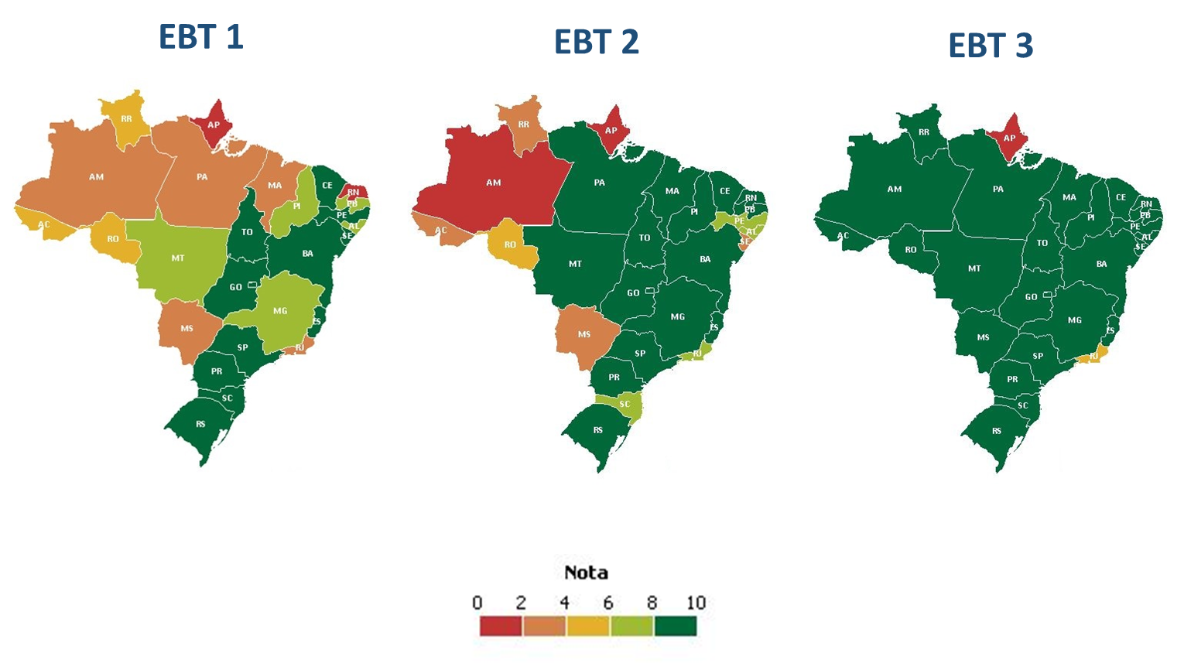
TRANSPARENT BRAZIL INDEX
Using a mystery customer approach, states and municipalities have been ranked in their implementation of the Access to Information Law since 2015

Slide 26
REACTION AND FEEDBACK
Findings resulting for transparency must have consequences
Improve regulations
Punishment of misconducts
Upgrade information and data
Review policies

Slide 27
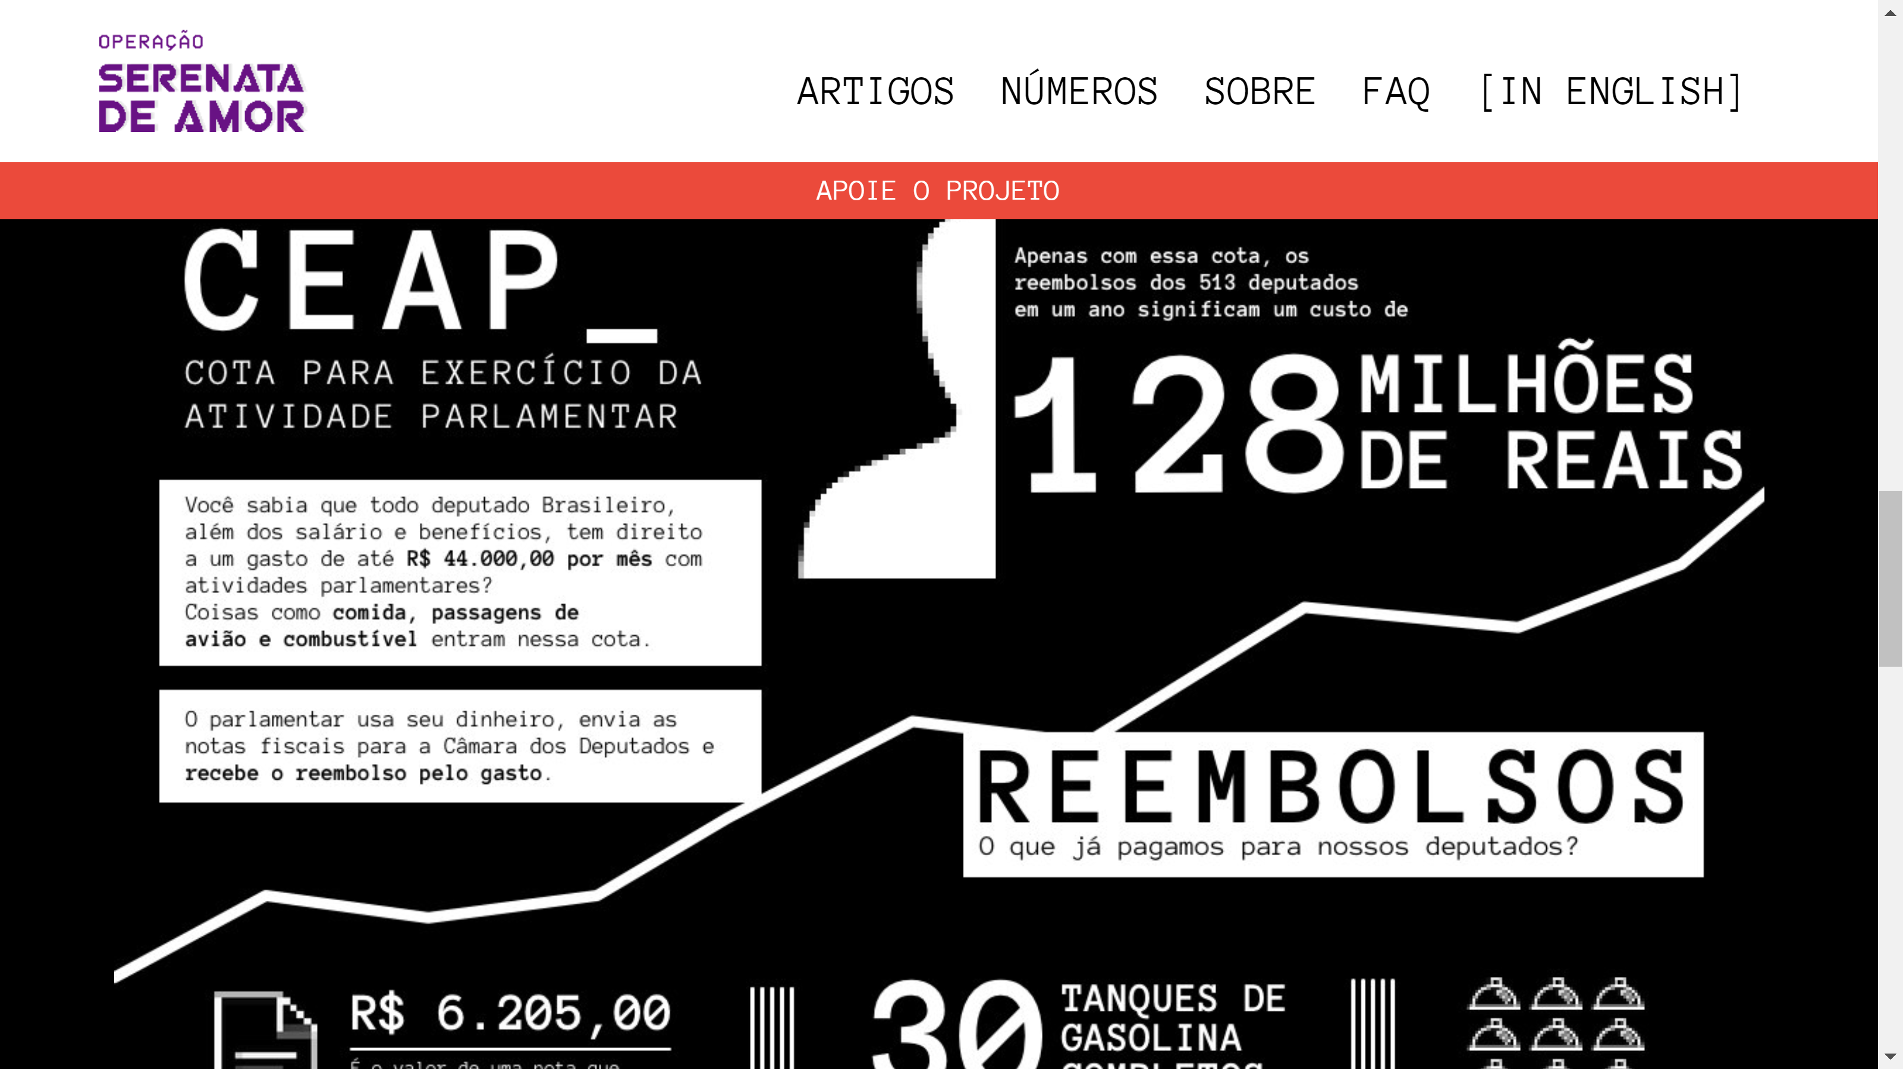
Serenata de Amor: representatives refunding the government

Slide 28
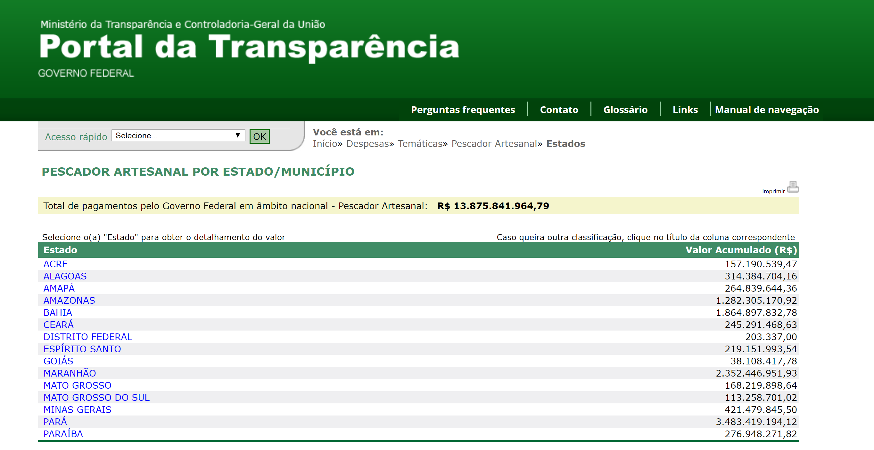
Oversight on environmental policy resulted in the program’s suspension

Slide 29
TRANSPARENCY AS A SOLUTION
Transparency on spending
Transparency on Public servants
Transparency on transfers
Transparent sanctions
Transparent bidding process
Transparency on fiscal credits
Transparency on Gov`t Credit Cards
Better spending, less embezzlement
Inhibits nepotism, conflict of interest
Public oversight on works
Less risks on hiring
Less frauds
Better competitiveness
Better spending, less misuse

Slide 30
ENGAGEMENT AGAINST CORRUPTION

Slide 31
FOSTERING TRANSPARENCY
CGU pushes for more transparency even where it is not legally binded to do so

Slide 32
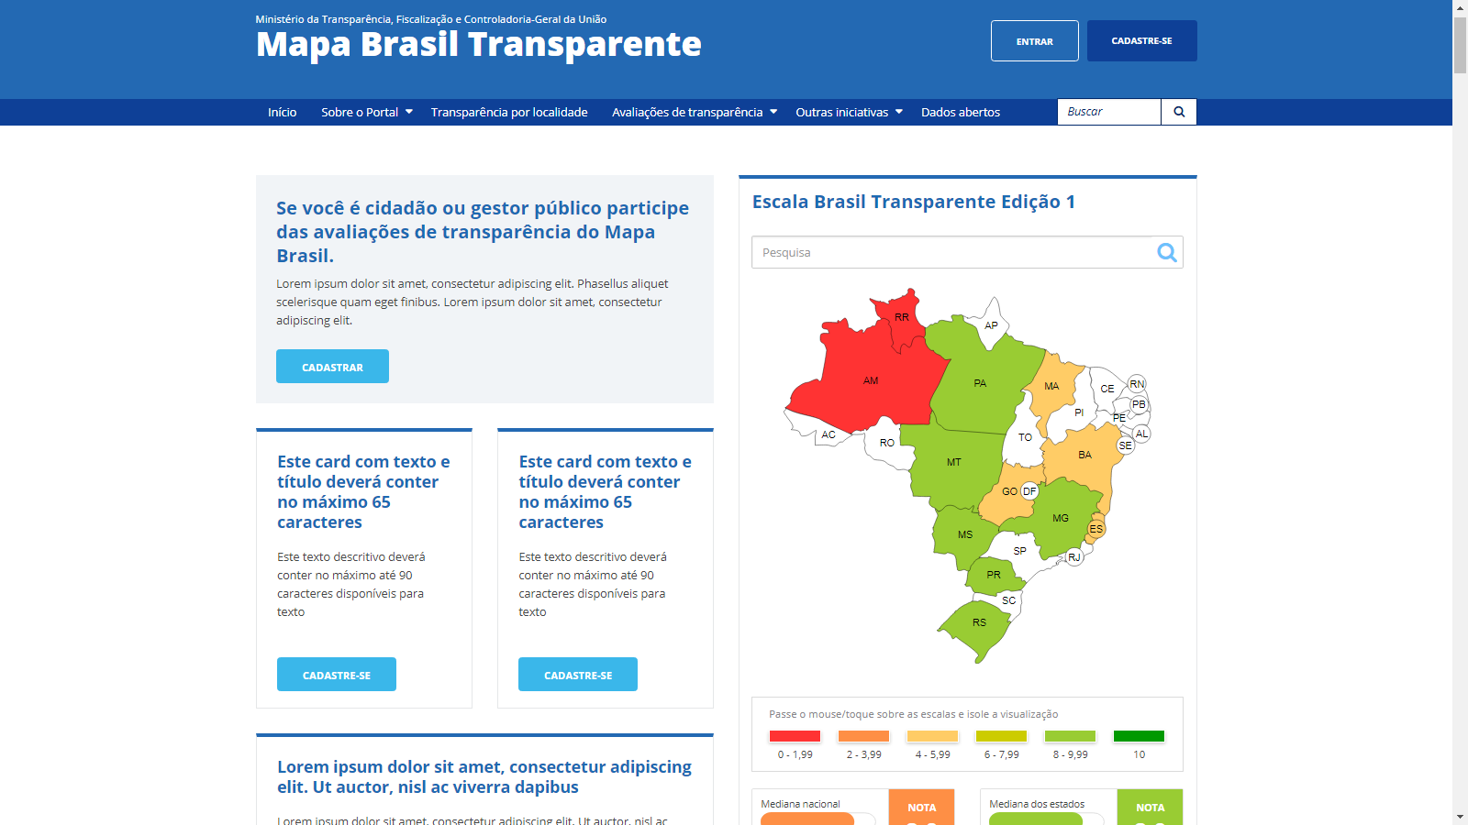

Slide 33
EDUCATION AGAINST CORRUPTION

Slide 34
BRINGING ETHICAL DISCUSSIONS TO THE CLASSROOM
High tolerance to misconducts is a cultural barrier to change how the country deals with corruption.

Slide 35
ESSAYS AND DRAWINGS CONTEST
A national contest that inspire over 500 000 candiates each year

Slide 36
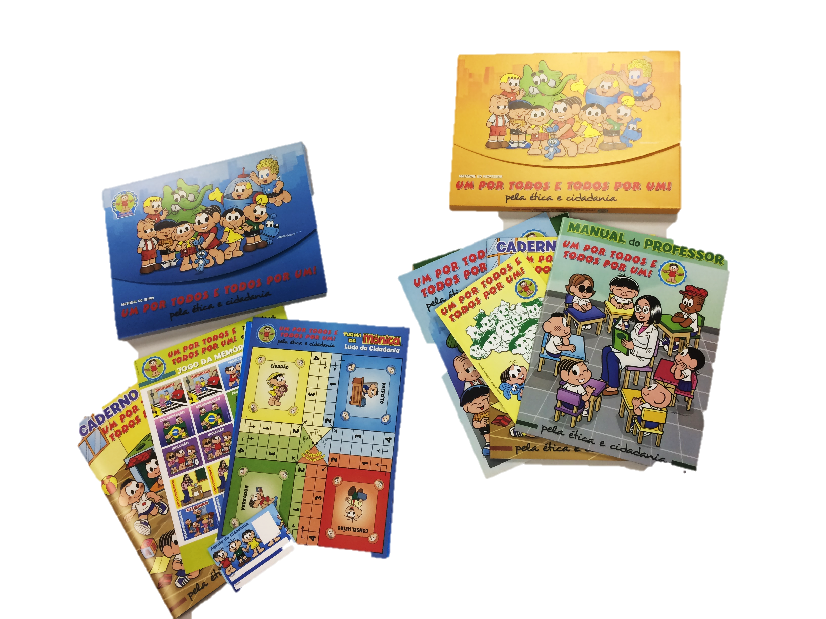
UM POR TODOS E TODOS POR UM
CGU develops contents for ethical discussions with teachers and the famous studio Maurício de Sousa, developer of Monica’s Gang

Slide 37
DIRECTOR FOR TRANSPARENCY AND PUBLIC OVERSIGHT
OTAVIO NEVES
otavio.neves@cgu.gov.br

