Slide 1
We decided to spice it up…
Open Fiscal Data Package in Mexico

Slide 2
How does it look like?

Slide 3
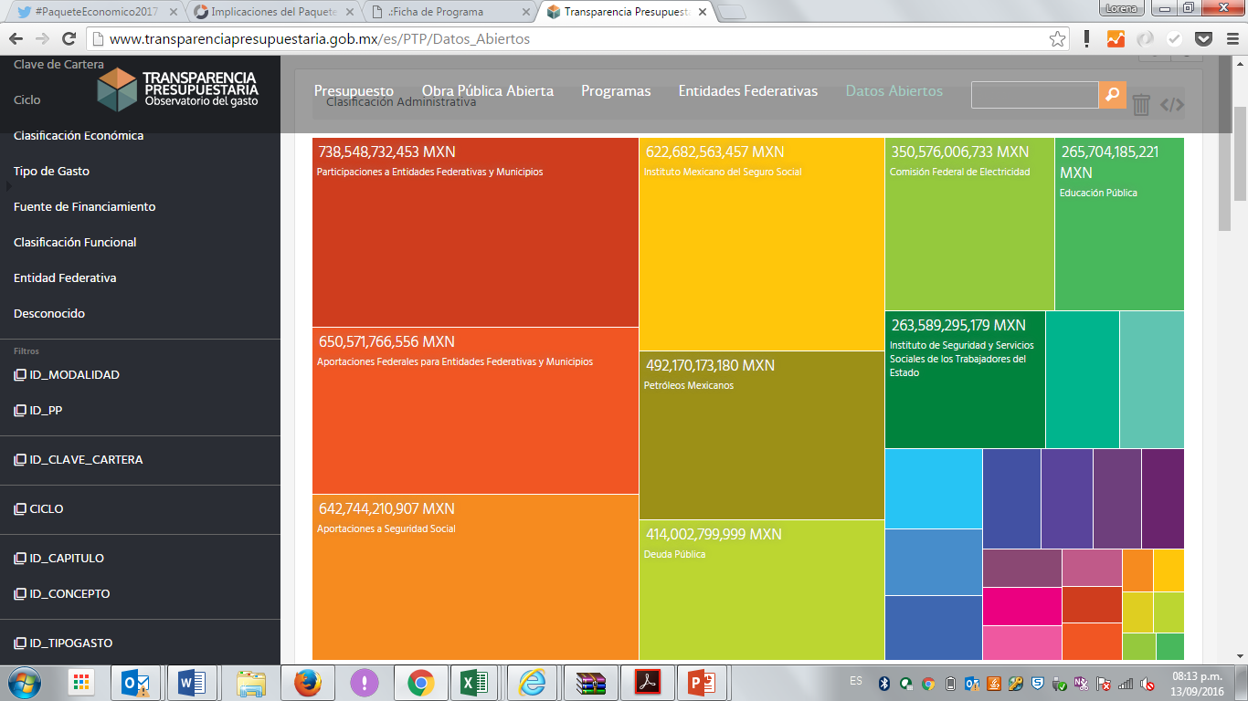
Embeded

Slide 4
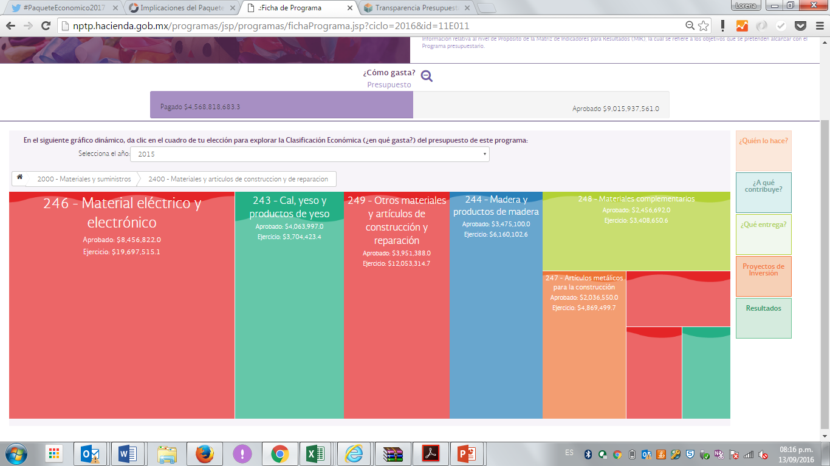
From the API

Slide 5
Connection with
Performance Evaluation Information for all federal programs (indicators, independent evaluations, etc.)
Sub-national information of federal transfers:
Investment proyects
Indicators
And coming soon:

Slide 6
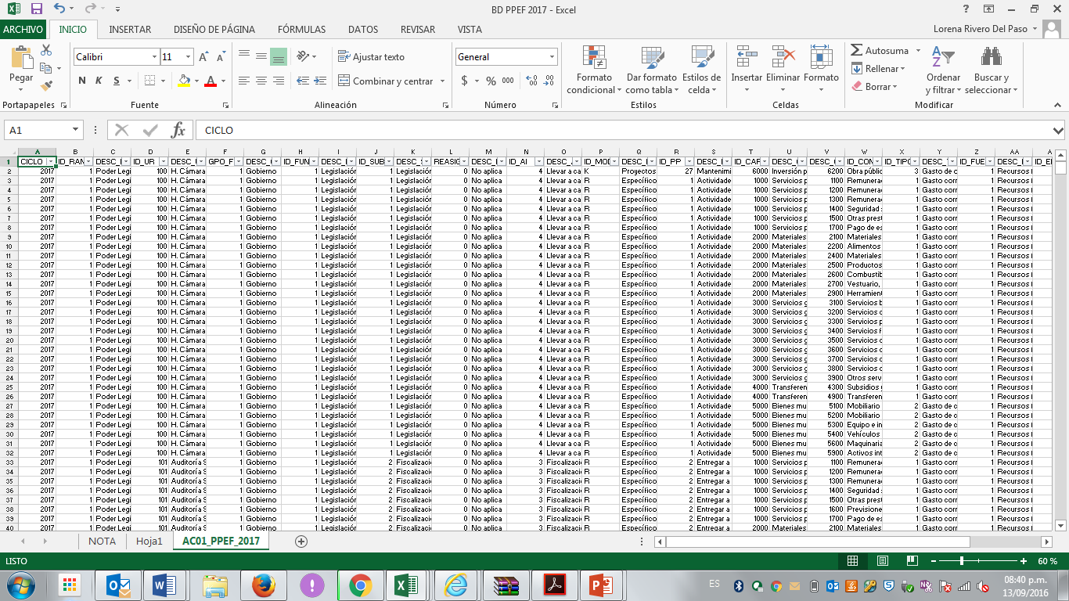
Key concept: Budgetary program

Slide 7
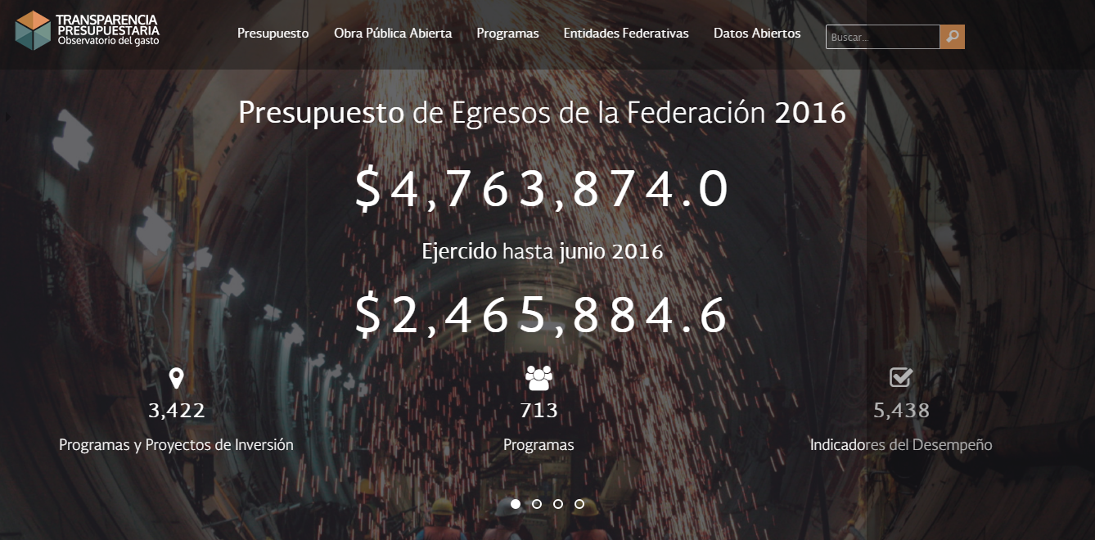
The OFDP went viral
The users…

Slide 10
And the team…

Slide 12
Challenges
Autonomous usage
Partial downloads
Security of information testing

Slide 13
We decided to spice it up…
Thank you!

