Slide 1
Budget Transparency The New Global Toolkit
Sean Dougherty
Senior Advisor and Head of Secretariat, OECD Fiscal Network
Launch of New Transparency Portal – Brasilia, 28-29 June 2018

Slide 2
Transparency – a simple concept…

Slide 3
Transparency – a complex concept
Of what?
Revenues
Expenditures
Processes
Plans
Performance
Risks
To whom?
Citizens
Peers
Int’l bodies
Markets
For what?
Trust
Confidence
Participation
Better decisions
Impacts
Notes:
[translation notes: “of what” means “what are we being transaprenct about? What is the subject matter”
“to whom” i.e. to whom are we being transparent”
“for what” i.e. “for what purpose, why?”
“int’l bodies” means international bodies]

Slide 4
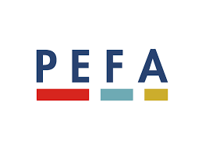
A wealth of official standards and guidance…
Notes:
[no need for translation except for Slide Title]

Slide 5
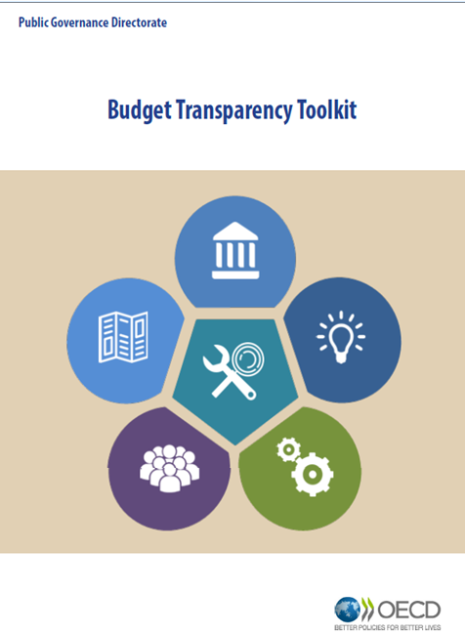

Slide 6
3 useful roles for a “toolkit”
Provide a gateway to resources that are already available across the international community
Help to self-assess level of budget transparency, and to plan and implement transparency-focused reforms
Reinforce key messages by bringing together the insights of the international community of budget transparency
In two parts, Part 1:

Slide 7
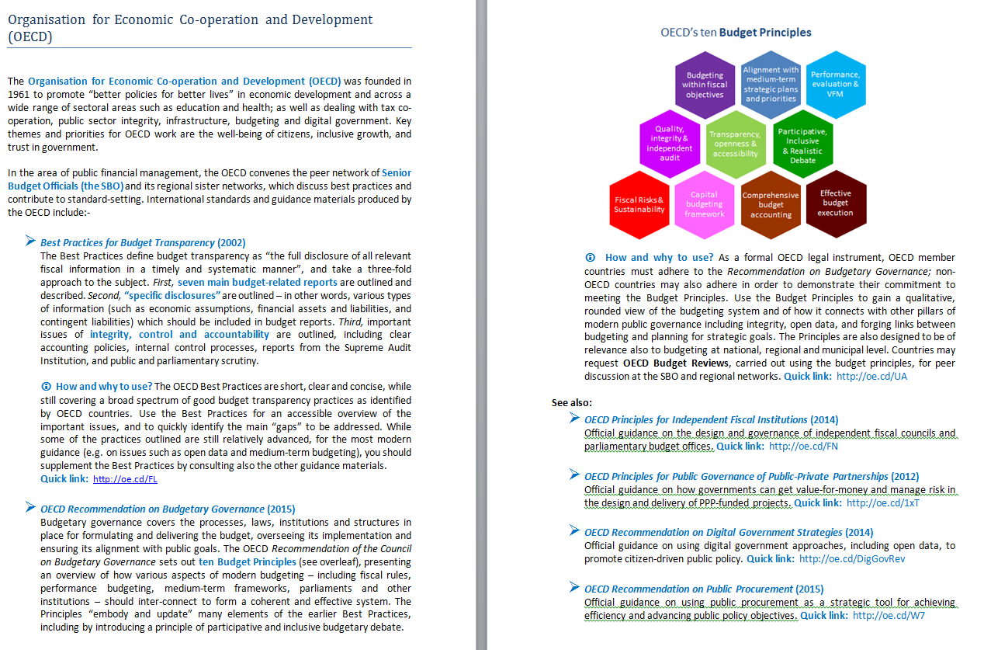
Notes:
[no need for translation – this slide is for “illustrative” purposes, it is not intended to be read]

Slide 8
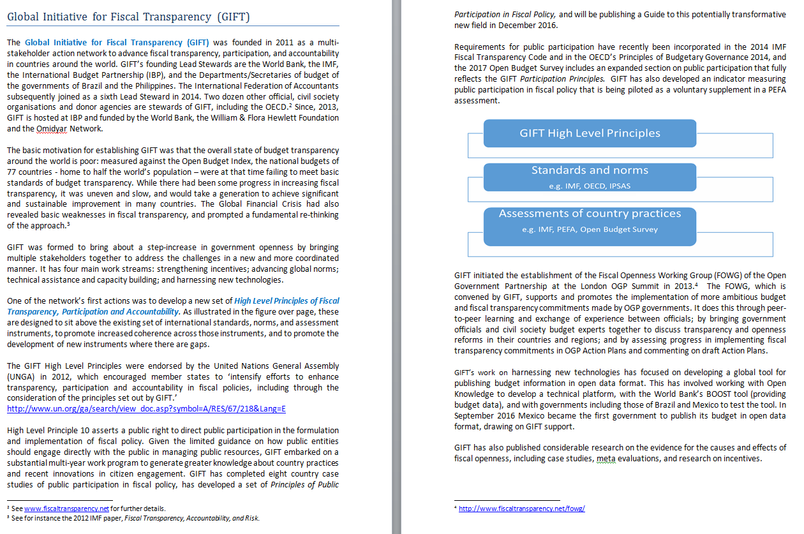
Notes:
[no need for translation – this slide is for “illustrative” purposes, it is not intended to be read]

Slide 9
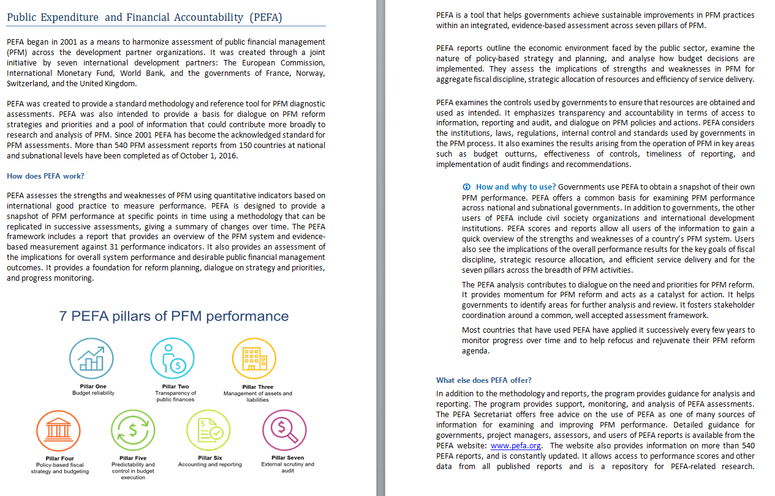
Notes:
[no need for translation – this slide is for “illustrative” purposes, it is not intended to be read]

Slide 10
Part 2: five institutional spheres
C
Benefiting from parliamentary engagement and scrutiny
D
Supporting parliamentary capacity
Parliamentary
Involvement
E
Management and internal control of public money
A
Providing useful budget reports
during the annual cycle
F
Supporting the role of the Supreme Audit Institution
B
Including the right financial information in budget reports
Government
Reporting
Independent
Oversight
G
Designing effective Independent Fiscal Institutions
Budget Transparency
Toolkit
H
Making the budget accessible to the public
K
Opening up public contracting and procurement
I
Using open data to support budget transparency
L
Revenues and expenditures in resource endowments
Openness and
Civic Engagement
Interaction with the
Private Sector
M
Infrastructure governance for integrity, VFM and transparency
J
Making the budget more inclusive and participative

Slide 11
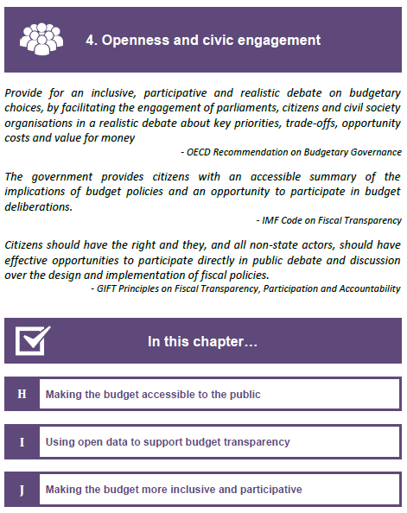
Structure of Part 2 navigation
Colours and icons for easy navigation within the document.
Key points from institutional recommendations to highlight the relevance of the topic
Overview of the chapters content with summaries and country examples
Notes:
[only the green text needs to be translated]

Slide 12
Some benefits of this approach?
simple and user-friendly
comprehensive coverage
practical guidance to put transparency into practice
Informal and easy-to-update
Supports our collective efforts to promote the benefits of BUDGET TRANSPARENCY

Slide 13
New horizons in budget transparency?
Are budgets yet fully transparent?
IMPACTS -- income distribution -- gender equality -- climate
FISCAL RISKS -- State corporations -- Long-term “holes”
What are the different models and limits of “participation?”
“THIS IS PARLIAMENT’S ROLE” – so get them more involved
“LET CITIZENS DECIDE ON PRIORITIES” – municipal model
“CSOs CAN MEDIATE CITIZENS’ CONCERNS” – Social partnership
“OPEN GOVERNMENT MEANS OPEN DATA” – let citizens and CSOs find their own way – make their own paths
Are budgets yet fully accessible?
OPEN DATA -- Portals -- civil-society use and re-use
Notes:
[translation notes: “mediate” here means “channel, convey, represent” citizens views
CSOs – civil society organisations]

