Slide 1
Measuring Fiscal Transparency
PEMNA Budget CoP
Seoul, South Korea. March 19, 2019
Lorena Rivero del Paso
Manager for Technical Cooperation and Collaboration
lorena@fiscaltransparency.net
@LorenaRDP

Slide 2
What can be measured can be improved.

Slide 3
How do we know if the budget is transparent?

Slide 4
Tools for Evaluating the State of Fiscal Transparency
Fiscal Transparency Evaluation (FTE)
Open Budget Survey
Public Expenditure and Financial Accountability (PEFA)

Slide 5
How do we know if the Budget is transparent?
Fiscal Transparency Evaluation

Slide 6
Fiscal Transparency Evaluation
Who?
International Monetary Fund
What?
Comprehensiveness, Universality, Specificity and Unity
How?
Public finance management experts in interviews and review of publications

Slide 7
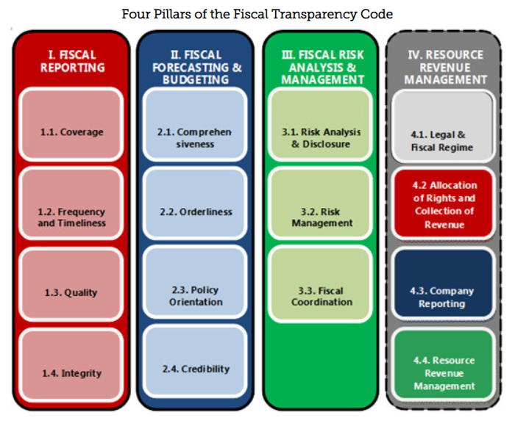
Fiscal Transparency Evaluation

Slide 8
Fiscal Transparency Evaluation: In PEMNA Countries
Country | Year
Philippines | 2014 (published 2015)

Slide 9
How do we know if the Budget is transparent?
Open Budget Survey

Slide 10
Open Budget Survey
Who?
International Budget Partnership
What?
Public access to key national budget information
Opportunities for public participation in budget processes
Role of formal oversight institutions
How?
Survey of 142 questions,around 8 key Budget documents
Based on international good practices developed by the IMF, OECD, INTOSAI, GIFT, and the IBP.
Survey answered by civil society. Reviewed by government and peer reviewer.

Slide 11
Open Budget Survey: Eight Key Budget Documents
Pre-Budget Statement
Executive’s Budget Proposal
Enacted Budget
Citizens Budget
In-Year Reports
Mid-Year Review
Year-End Reports
Audit Report

Slide 12
Contents of the Budget documents:
Budget classifications
On what?
Economic classification of expense- The types of expense incurred according to the economic process involved
For what?
Functional classification of expense- Provides information on the purpose for which an expense was incurred.
Administrative classification of expense- Provides information on what government entity, being institution, organization or department incurred on the expense.
Who?

Slide 13
Contents of the Budget documents:
Key Areas
In addition to detailed information on revenues and expenditures, the budget documents should provide detailed financial information in three key areas:
1
Macro-fiscal information: macroeconomic assumptions, information on the fiscal deficit and levels of debt.
Information on budget and outturns for the current year and the previous year. This should be presented in the same format as the budget proposal.
Explanations of budgeting policies and fiscal risks, for example, implications of new policy initiatives, and data on contingent liabilities, and fiscal risks.
2
3

Slide 14
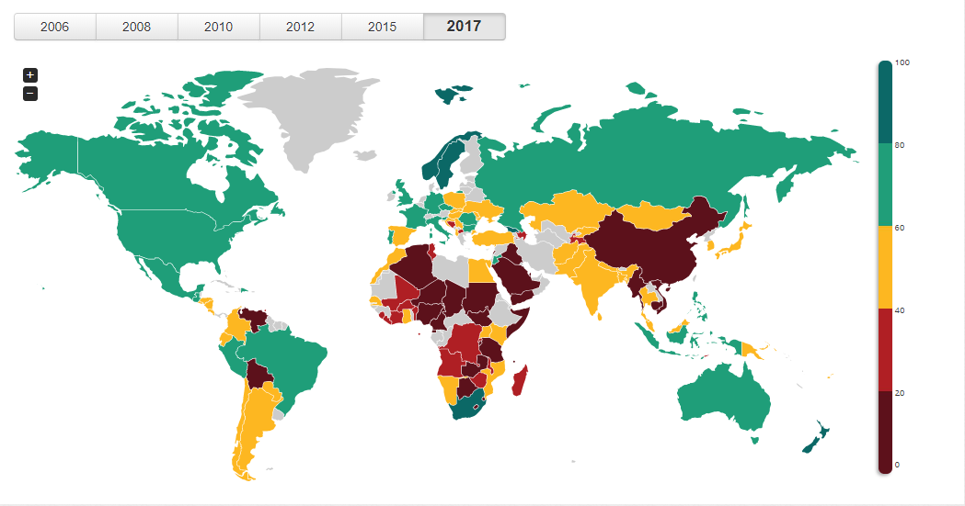
Open Budget Survey:
2017 Results

Slide 15
Open Budget Survey:
2017 Results
Global Average: 42

Slide 16
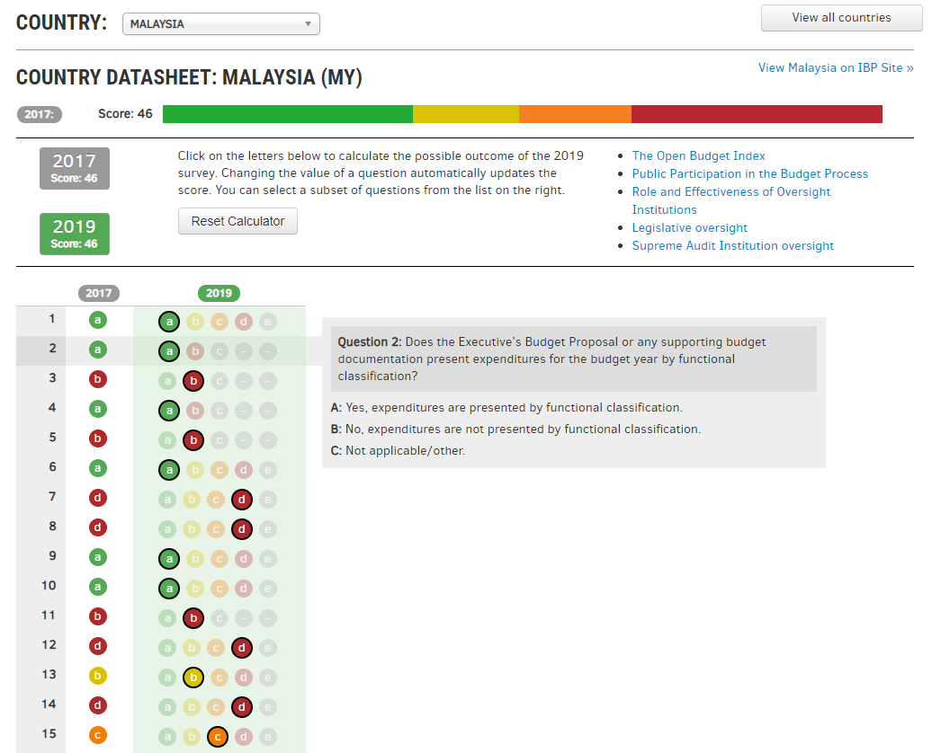
Open Budget Survey:
Open Budget Index Calculator

Slide 17
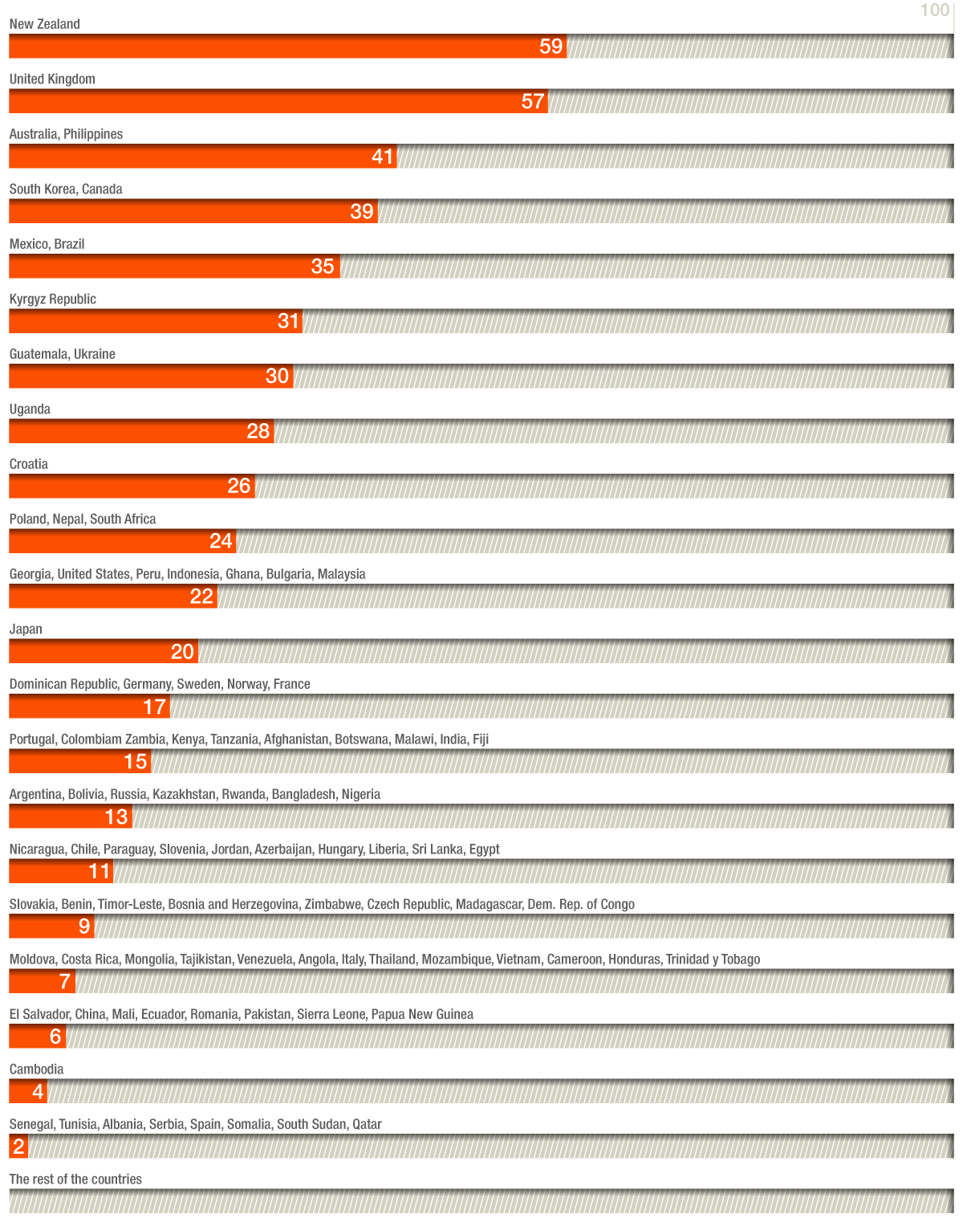
Additionally:
Open Budget Survey
2017 measured public participation in the budget cycle

Slide 18
Main findings on Public Participation
Scores are low overall: global average score is 12 (out of 100)
More than 80% of the countries surveyed (94 out of 115) have some form of participatory mechanism in place
Few countries are engaging the public across the whole budget cycle, exhibiting many innovative practices
Australia, New Zealand, the Philippines, the United Kingdom
A much more diverse group of countries perform well in aspects of public engagement by the executive branch
New Zealand, United Kingdom, Philippines, Mexico, Malaysia, Kyrgyz Republic, Ghana, Australia, South Korea, Canada, Ukraine, Japan

Slide 19
Most countries are:
Not making effort to engage with diverse set of citizens and interests, marginalized and vulnerable communities
Not providing feedback to the public on how their inputs were considered or used

Slide 20
How do we know if the Budget is transparent?
Public Expenditure and Financial Accountability (PEFA)

Slide 21
Public Expenditure and Financial Accountability
Who?
PEFA Secretariat
What?
Tool for assessing the status of public financial management and track changes over time. Version 2016 places greater emphasis on transparency and openness.
How?
31 performance indicators that are further disaggregated into 94 dimensions.

Slide 22
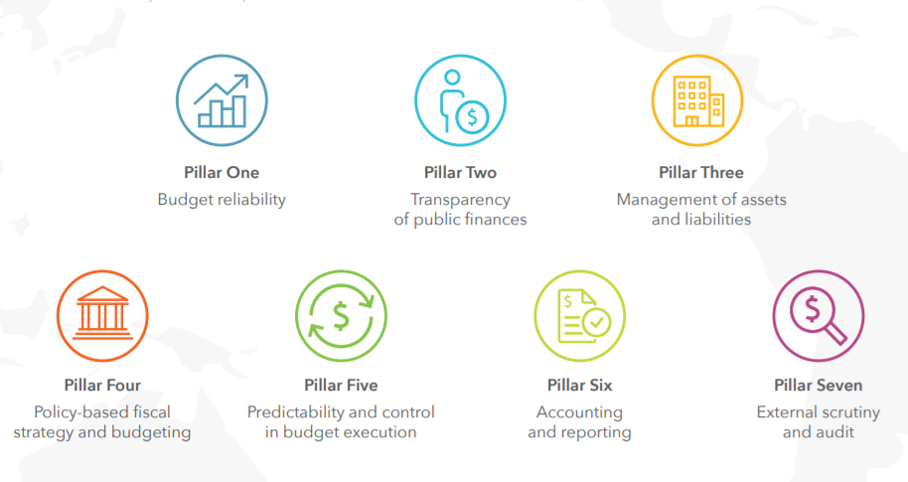
Public Expenditure and Financial Accountability: Pillars

Slide 23
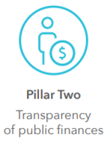
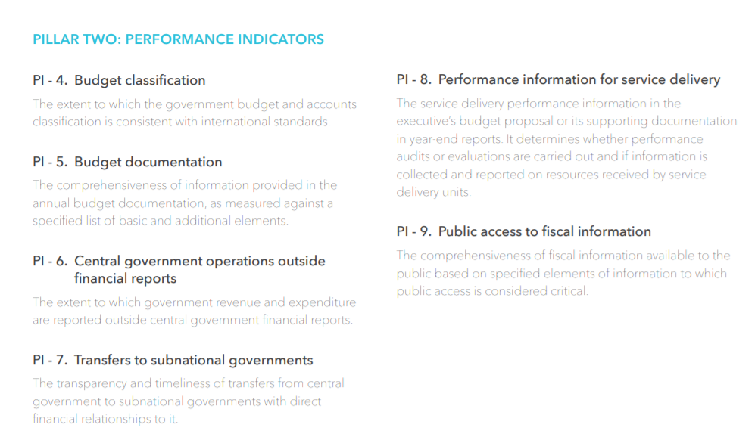

Slide 24
Public Expenditure and Financial Accountability: In PEMNA Countries
Country | Year
Cambodia | 2011, 2015
Indonesia | 2007, 2012, 2017
Lao PDR | 2006, 2010, 2019 (Draft)
Mongolia | 2015
Myanmar | 2012 and Planned
Philippines | 2010, 2016
Thailand | 2009
Timor-Leste | 2007, 2010, 2014 and Planned
Vietnam | 2013, 2017

Slide 25
Stay tuned!
@fiscaltrans
@fiscaltransparency
@fiscaltransparency
www.fiscaltransparency.net

