Slide 1
Plain language as communication policy
Communicating the Budget Effectively to Citizens & Media
PEMNA Budget CoP Seoul Meeting
March 19-20, 2019 | Seoul, Korea
Tarick Gracida | @TarickGracida
GIFT Communications & Technology Coordinator
@fiscaltrans

Slide 2
10,000,000,000

Slide 3
100,000,000,000

Slide 4
HOW
to communicate
the budget?

Slide 5
GENERATING
GRAPHIC
DESIGN
IS NOT TO
CITIZENIZE

Slide 6
100,000,000,000

Slide 9
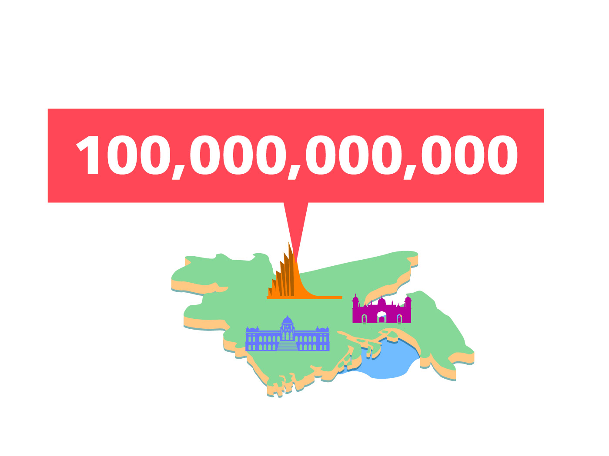

Slide 12
IT IS NOT ONLY
CREATING FORMS,
BUT CREATING
COMMUNICATIONS
Frascara

Slide 13
HOW
to communicate
the budget?

Slide 14
DISAGGREGATING

Slide 15
D I S A G G R E G A T I N G

Slide 16
D I S A G G R E G A T I N G

Slide 17
D I S A G G R E G A T I N G
INFORMATION TO
MAKE IT DIGESTIBLE

Slide 19
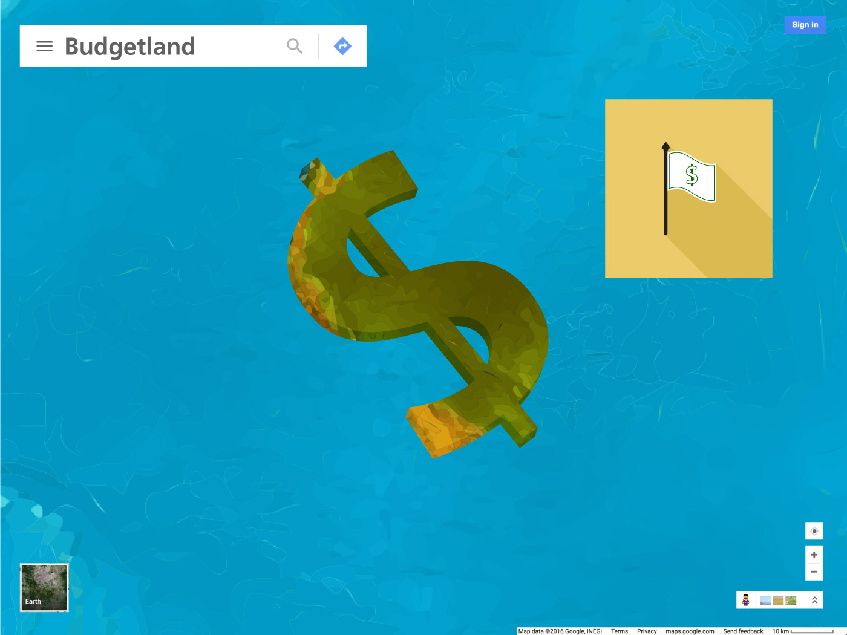

Slide 20
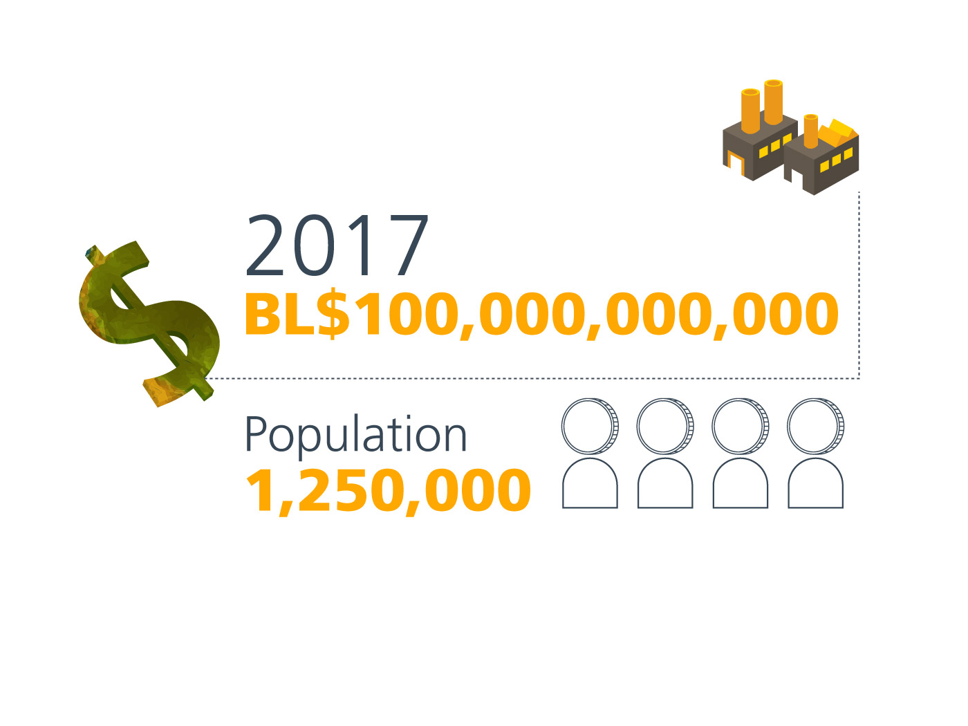
2018
BL$ 100,000,000,000

Slide 21
2018
BL$ 100,000,000,000
Bill Understood

Slide 22
2018
BL$ 100,000,000,000
Population
1,250,000

Slide 23
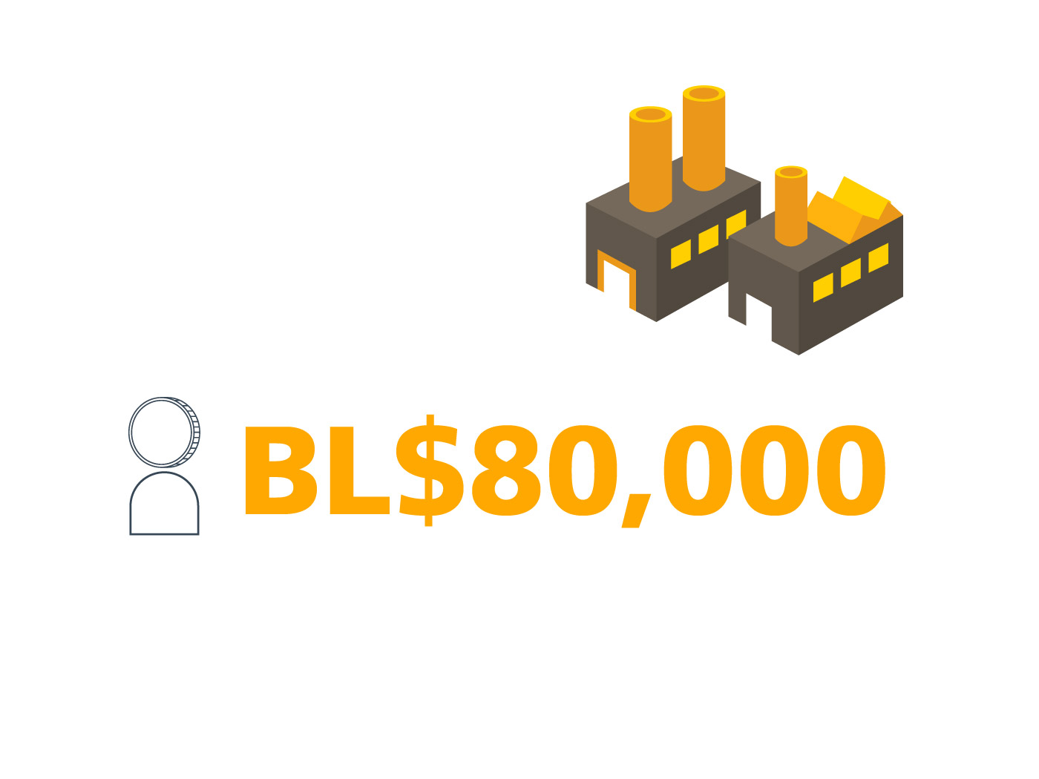
BL$ 80,000

Slide 24
INFORMATION
MUST BE
DESIGNED TO
GENERATE CITIZEN
UNDERSTANDING

Slide 25
INFORMATION
MUST BE
DESIGN TO
GENERATE CITIZEN
UNDERSTANDING
simplicity

Slide 26
INFORMATION
MUST BE
DESIGN TO
GENERATE CITIZEN
UNDERSTANDING
text saturation?

Slide 27
INFORMATION
MUST BE
DESIGN TO
GENERATE CITIZEN
UNDERSTANDING
text saturation

Slide 28
70%
INFORMATION
MUST BE
DESIGN TO
GENERATE CITIZEN
UNDERSTANDING
30%

Slide 29
FACED WITH SO MUCH GRAPHIC ON THE STREETS,
WE LOOK THE LEAST.

Slide 30
FACED WITH SO MUCH GRAPHIC ON THE STREETS,
WE LOOK THE LEAST.
WE MUST DISAGGREGATE AND DESIGN THE INFORMATION

Slide 31
FACED WITH SO MUCH GRAPHIC ON THE STREETS,
WE LOOK THE LEAST.
WE MUST DISAGGREGATE AND DESIGN THE INFORMATION
• THE INFORMATION WILL BE INVISIBLE FOR INTERESTED PUBLIC IF GRAPHICS ARE NOT RELATED TO THE TOPIC

Slide 32
FACED WITH SO MUCH GRAPHIC ON THE STREETS,
WE LOOK THE LEAST.
WE MUST DISAGGREGATE AND DESIGN THE INFORMATION
• THE INFORMATION WILL BE INVISIBLE FOR INTERESTED PUBLIC IF GRAPHICS ARE NOT RELATED TO THE TOPIC
• UNINTERESTED PUBLIC THAT GOT HOOKED BY GRAPHICS WILL LOSE INTEREST IF THE INFORMATION IS NOT DISAGGREGATED

Slide 33
INFORMATION
MUST BE
DESIGN TO
GENERATE CITIZEN
UNDERSTANDING
visual simplicity

Slide 34
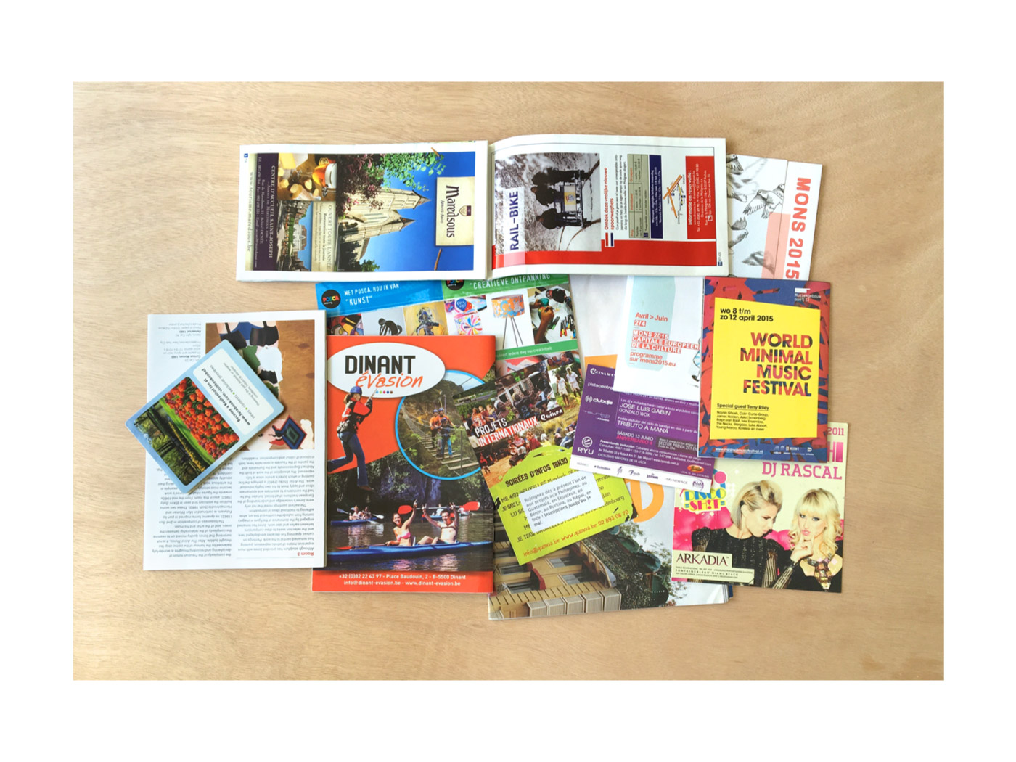

Slide 35
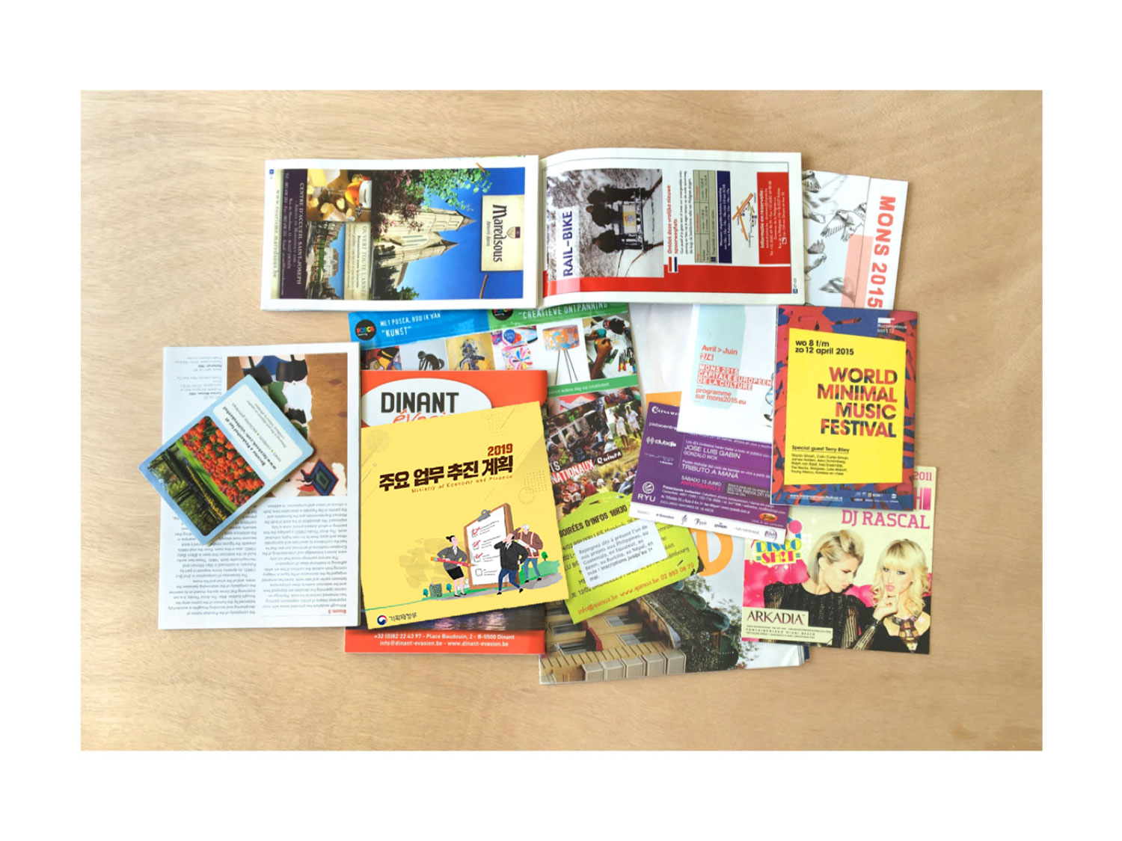

Slide 37
DO NOT
COPY

Slide 41
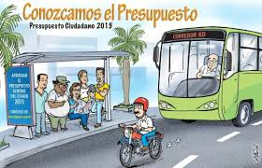
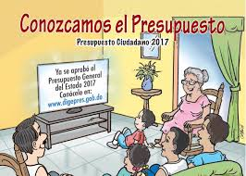
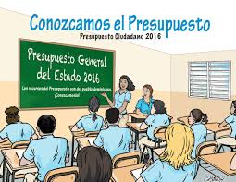

Slide 42
LET’S TALK
POSITIVE

Slide 43
Studies have shown that negative words like
INFORMATION
MUST BE
DESIGN TO
GENERATE CITIZEN
UNDERSTANDING
war
death
are processed slower by our brain

Slide 45
THE FORMAT
SPEAKS
VOLUMES

Slide 46
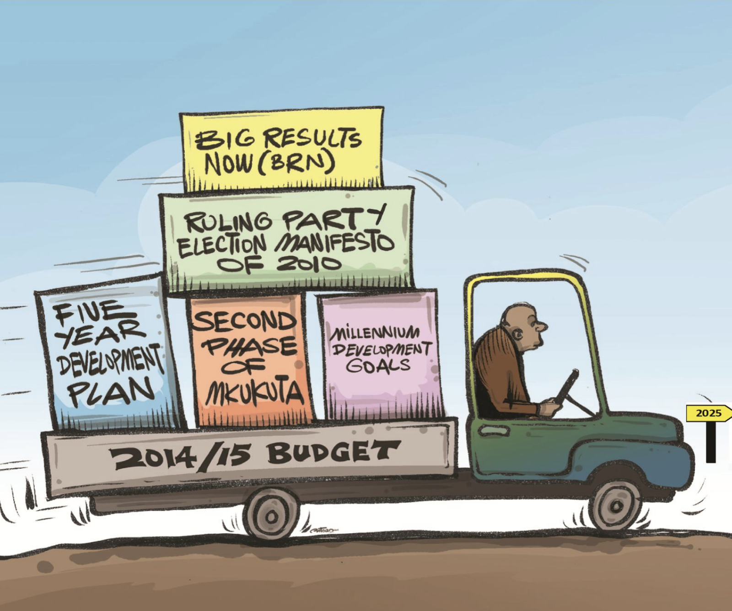
Which type of citizens’ budget represents a modern and solid government?

Slide 47
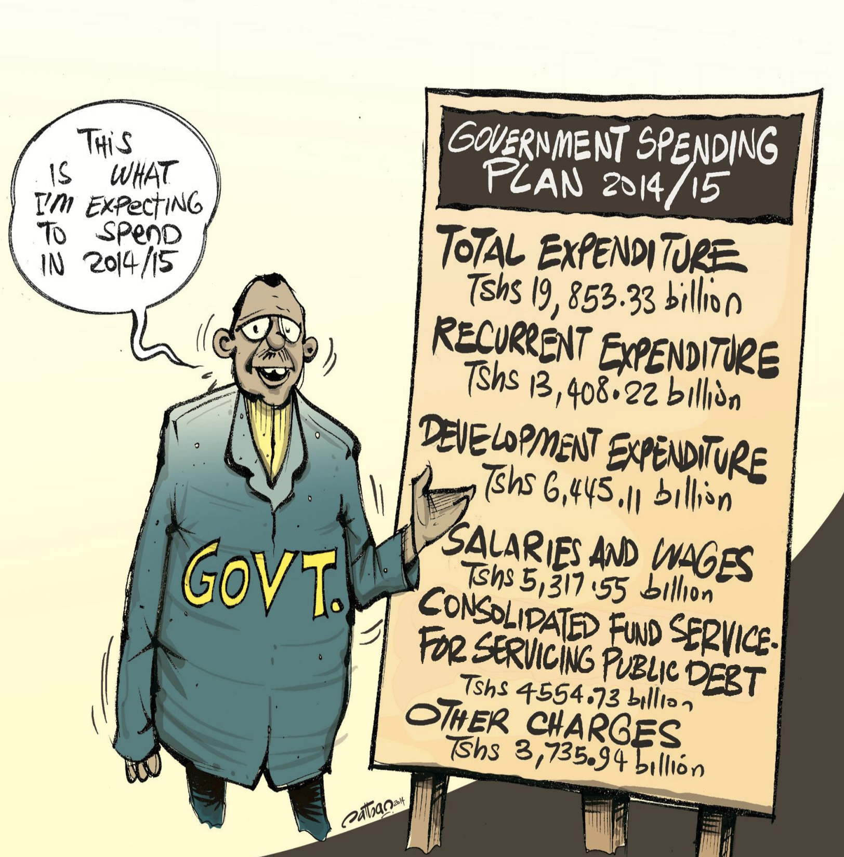
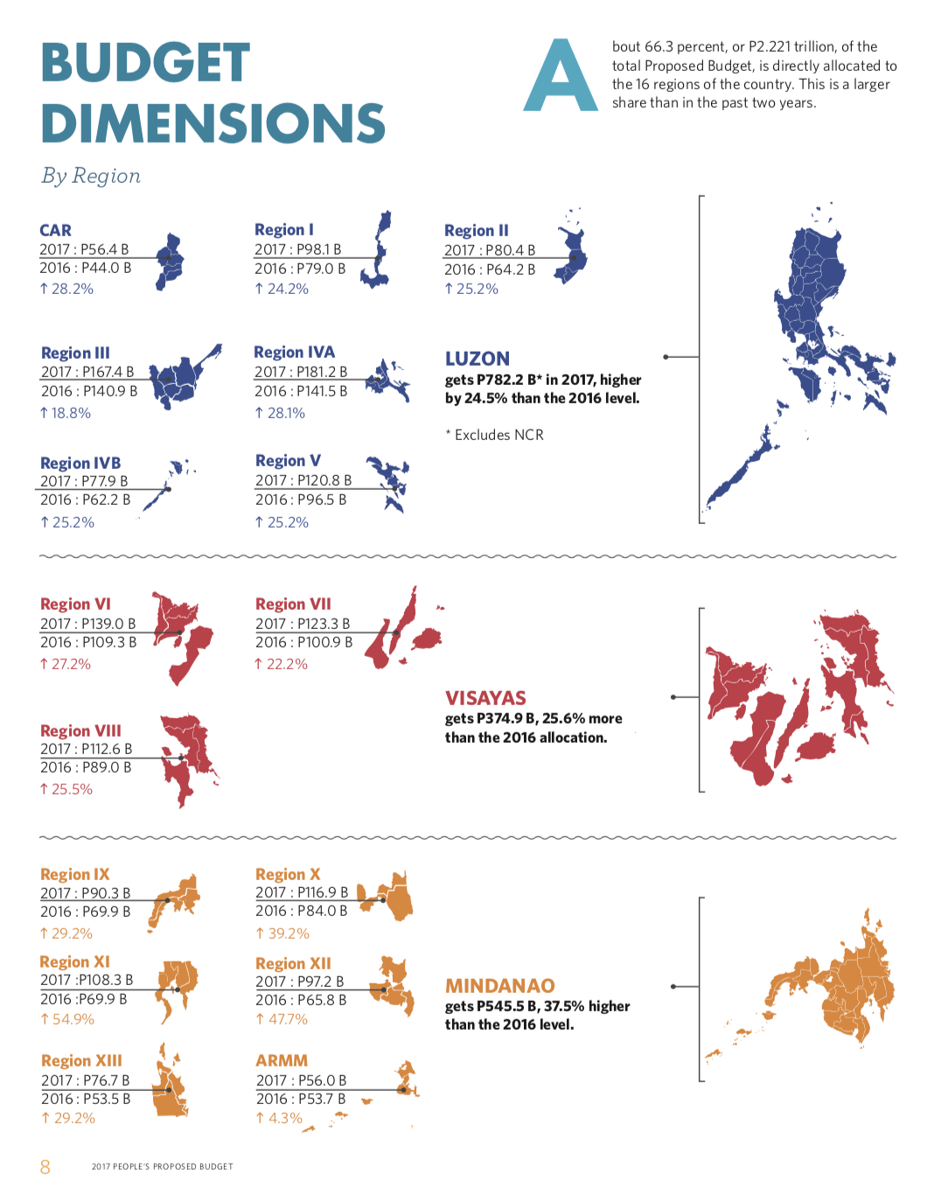
Which type of citizens’ budget represents a modern and solid government?

Slide 48
PROFESIONAL
TRANSPARENCY PORTALS,
WITH GRAPHIC DESIGN
THAT DON’T GENERATE
SUSPICION ON THE
NUMBERS

Slide 49
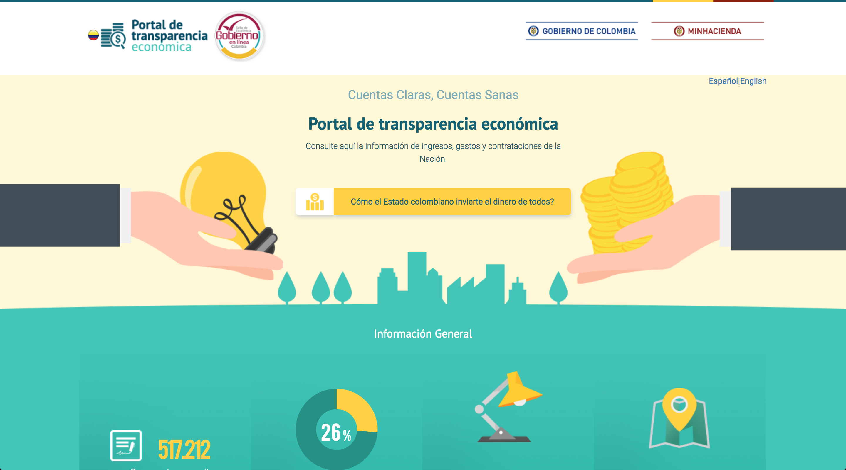

Slide 50
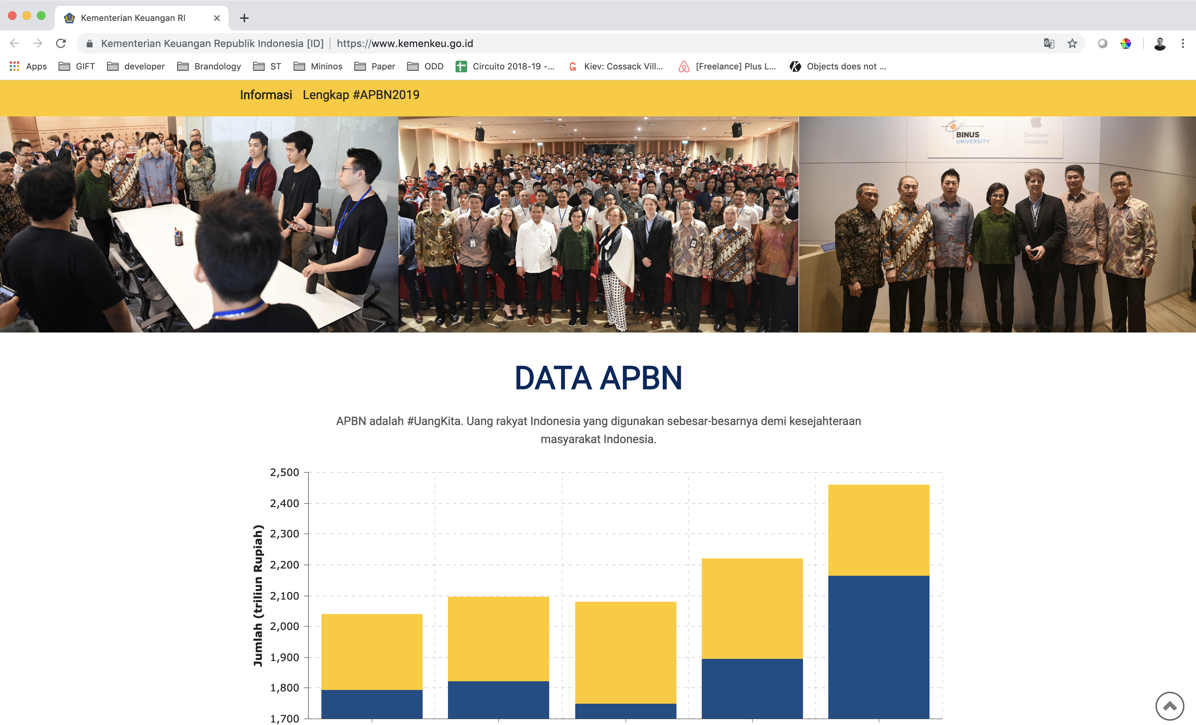

Slide 52
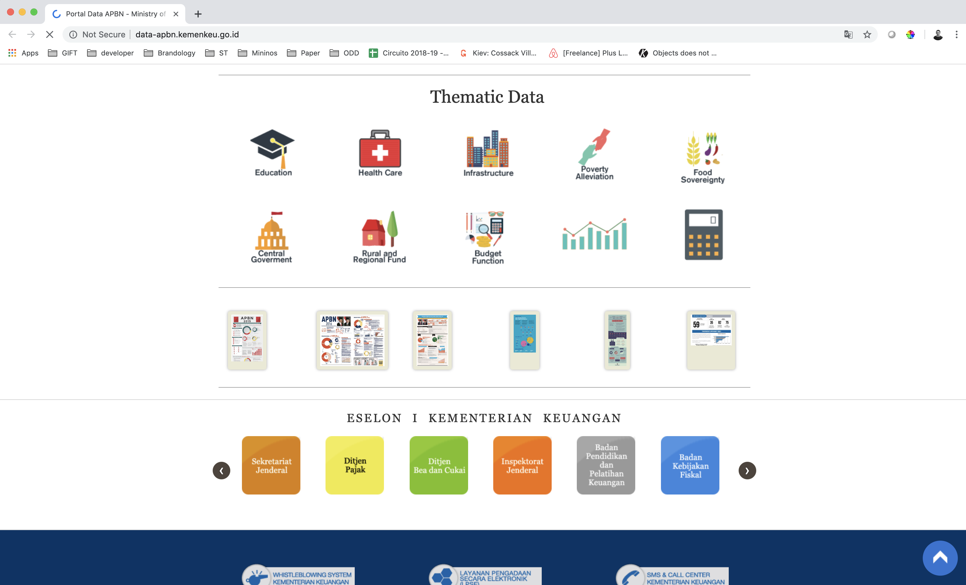

Slide 53
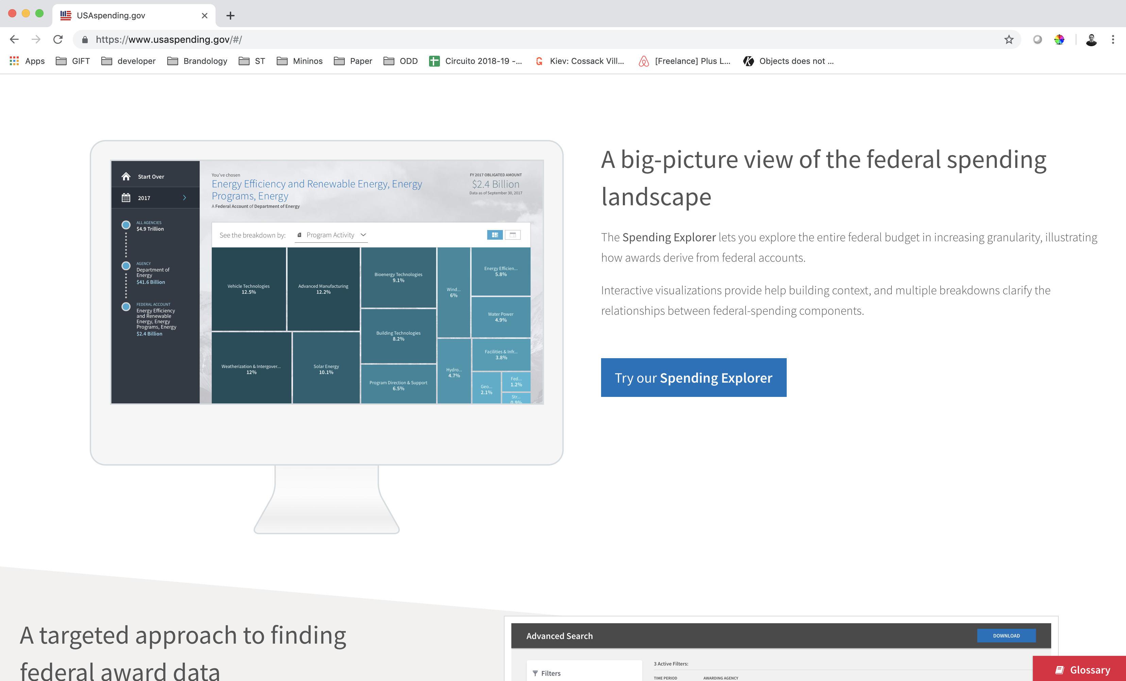

Slide 55
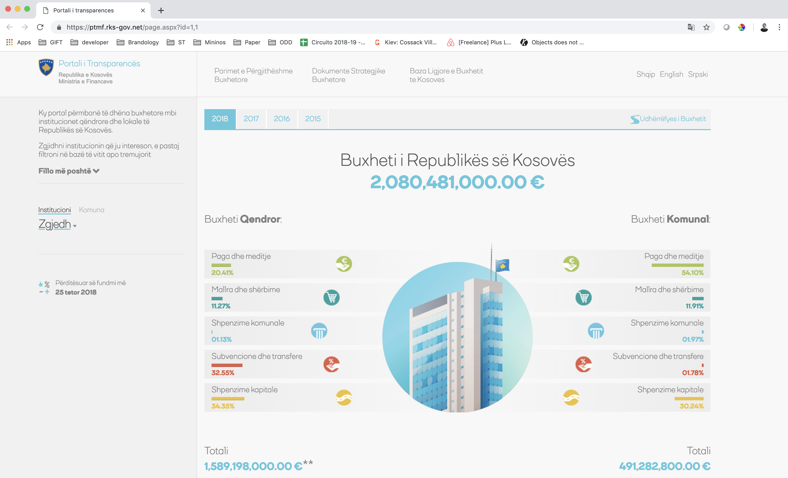

Slide 56
RESPECT THE
INSTITUTIONAL IDENTITY

Slide 62
ORDER
=
TRUST

Slide 64
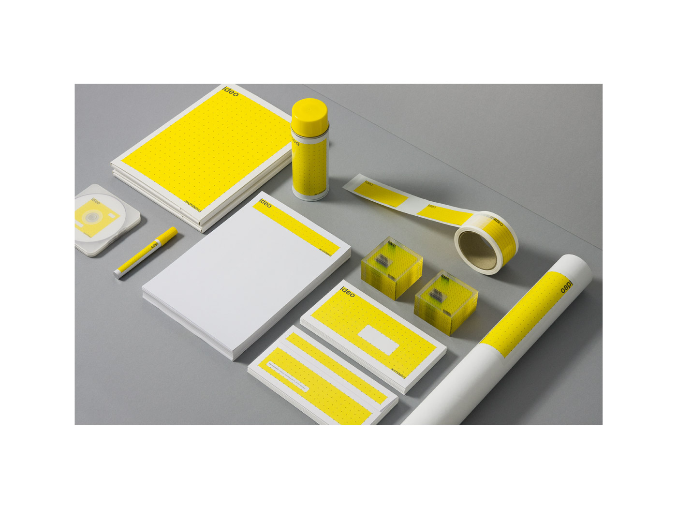

Slide 65
LISTEN TO THE
DEMAND

Slide 66
INTERNAL USERS
DEMAND

Slide 67
INTERNAL
COMMUNICATION
FOR EXTERNAL
COMMUNICATION

Slide 68
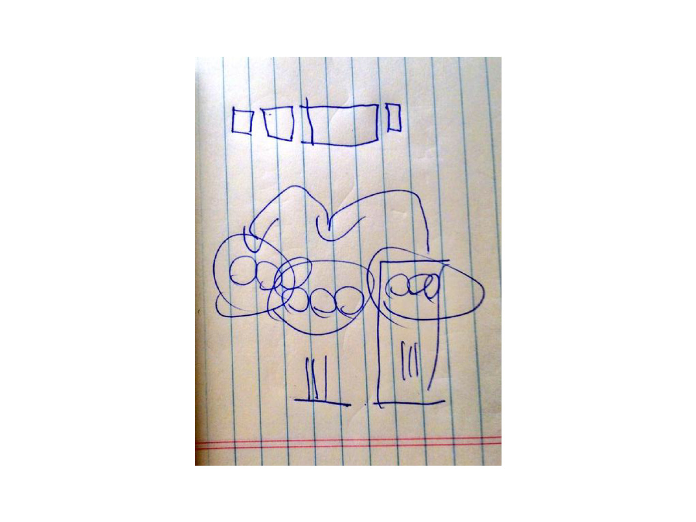

Slide 69
EXTERNAL USERS
DEMAND

Slide 70
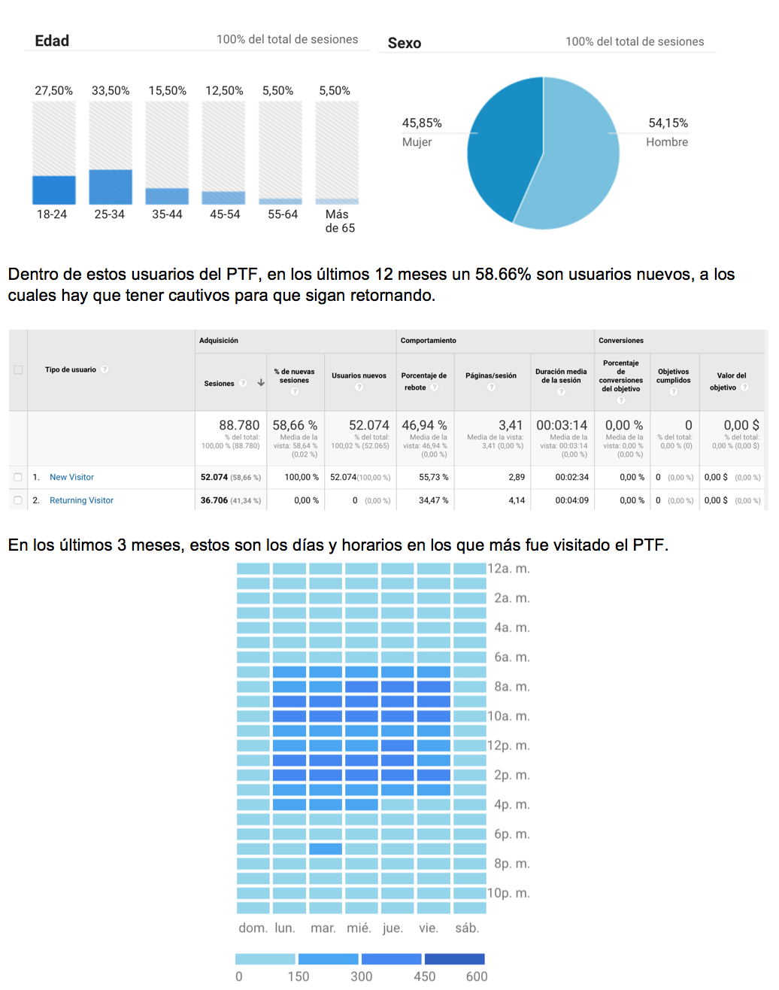

Slide 71
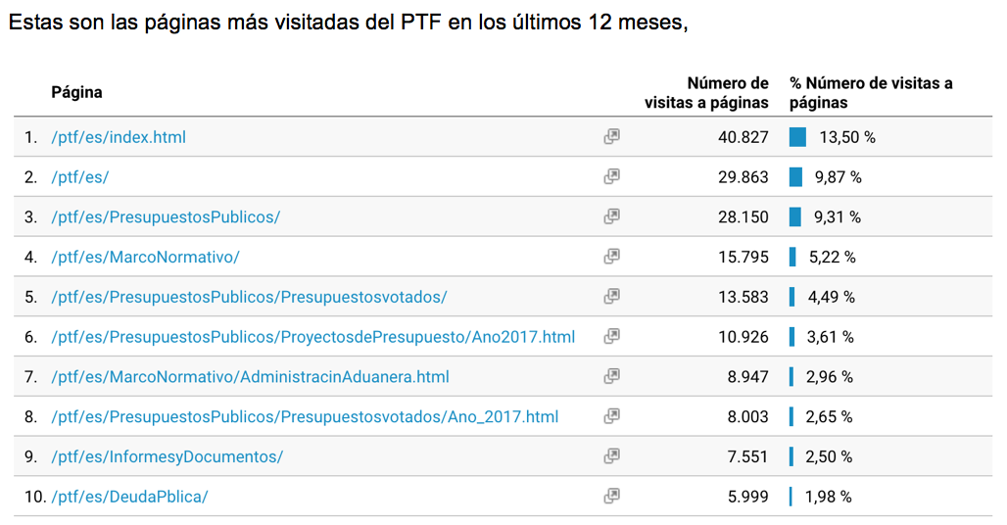

Slide 72
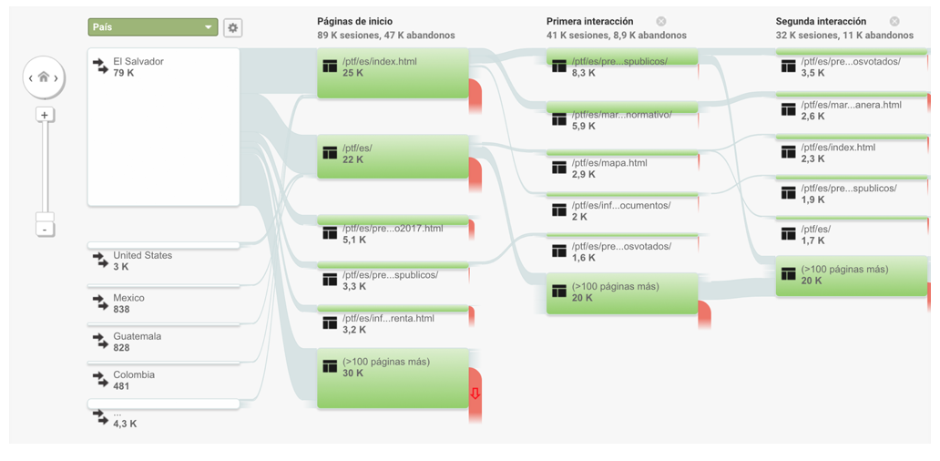

Slide 73
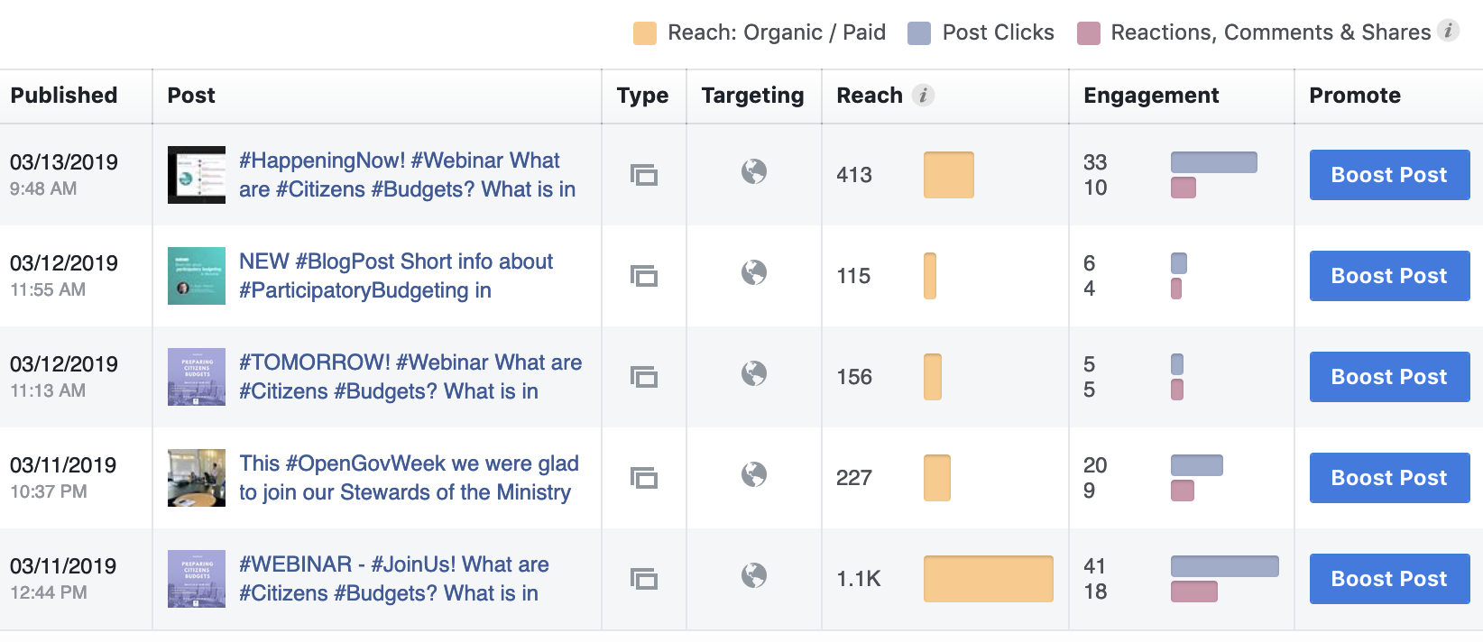
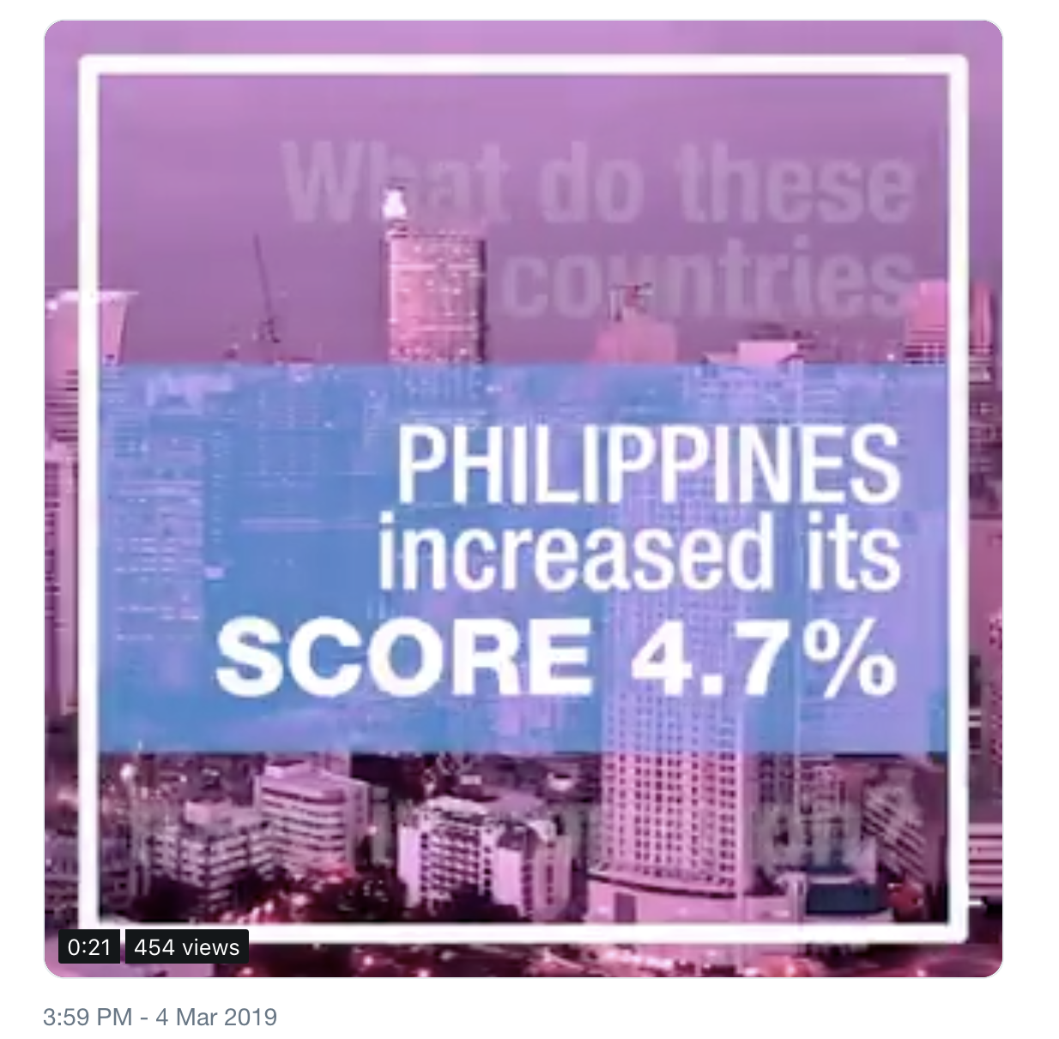
Social media insights of the users

Slide 74
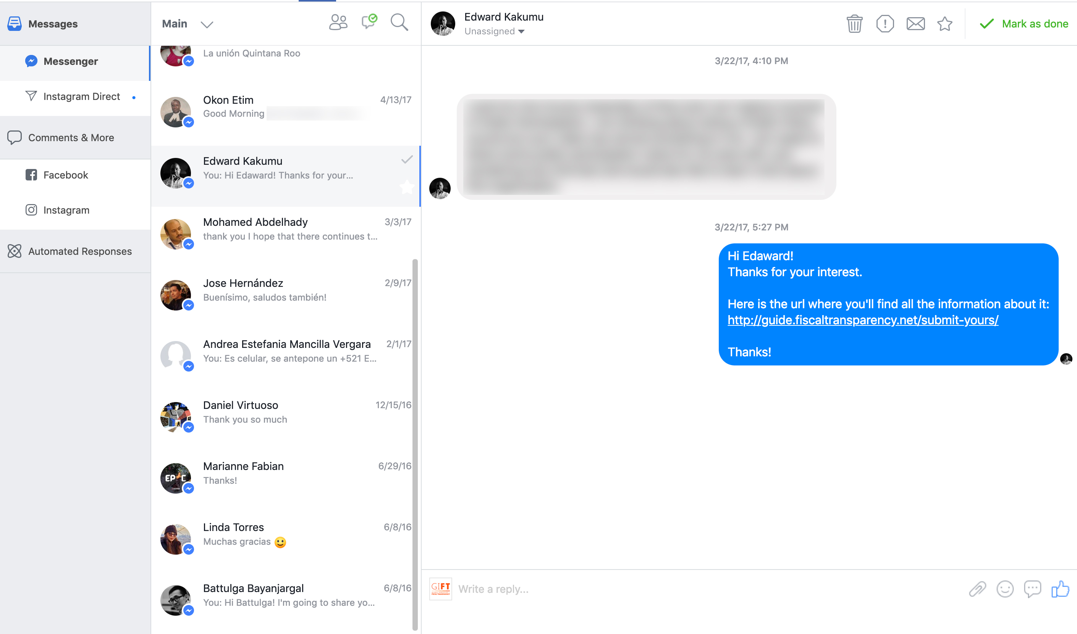
Chats with the users

Slide 75
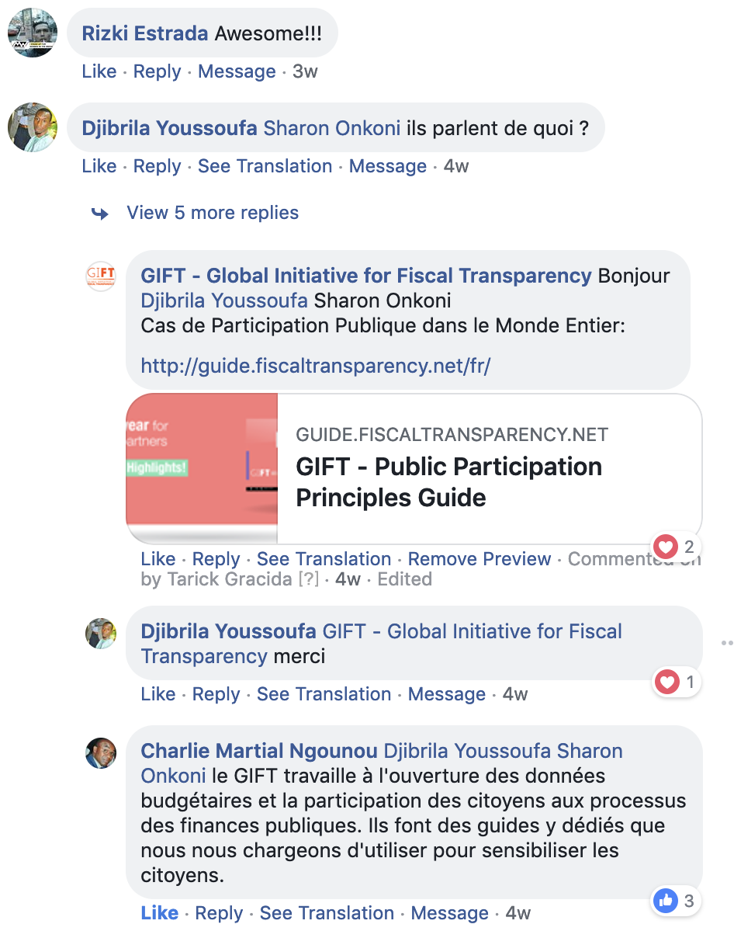
Attending users’ comments

Slide 76
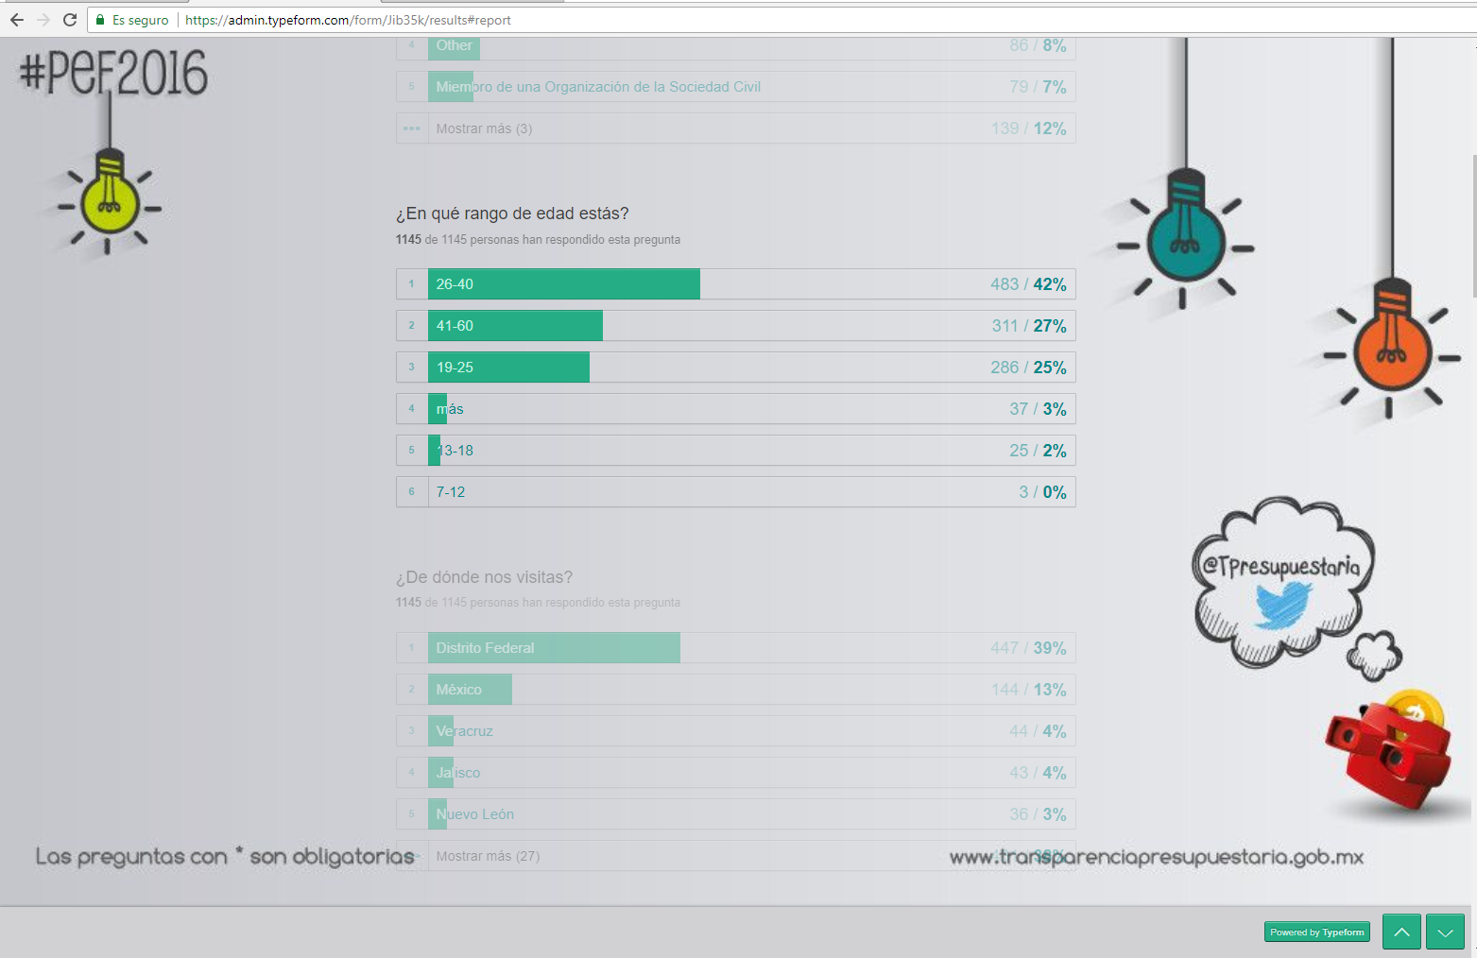
Consultations, surveys and polls for the users

Slide 77
Webinars with the users

Slide 78
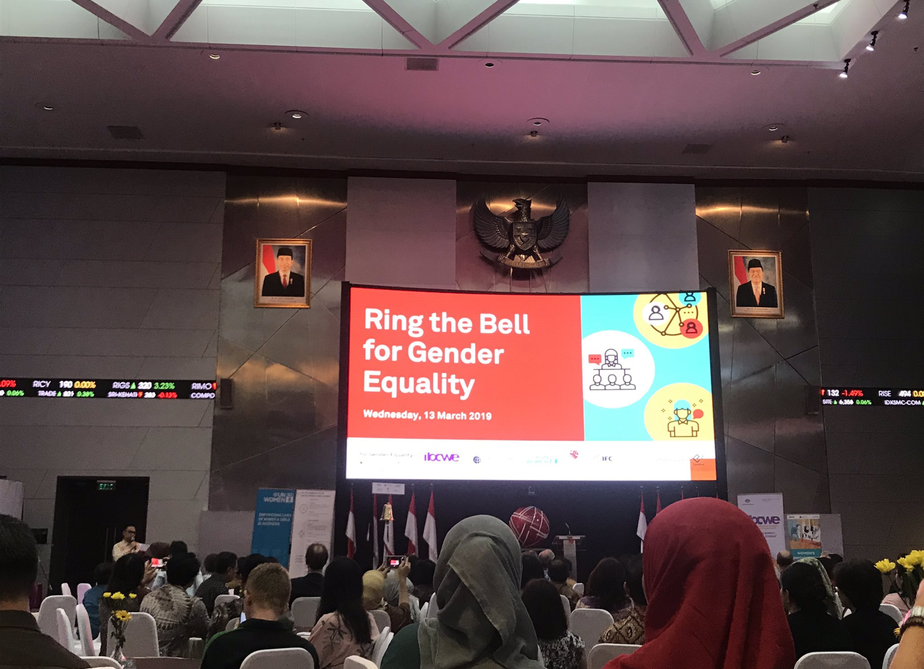
Attending users’ events

Slide 79
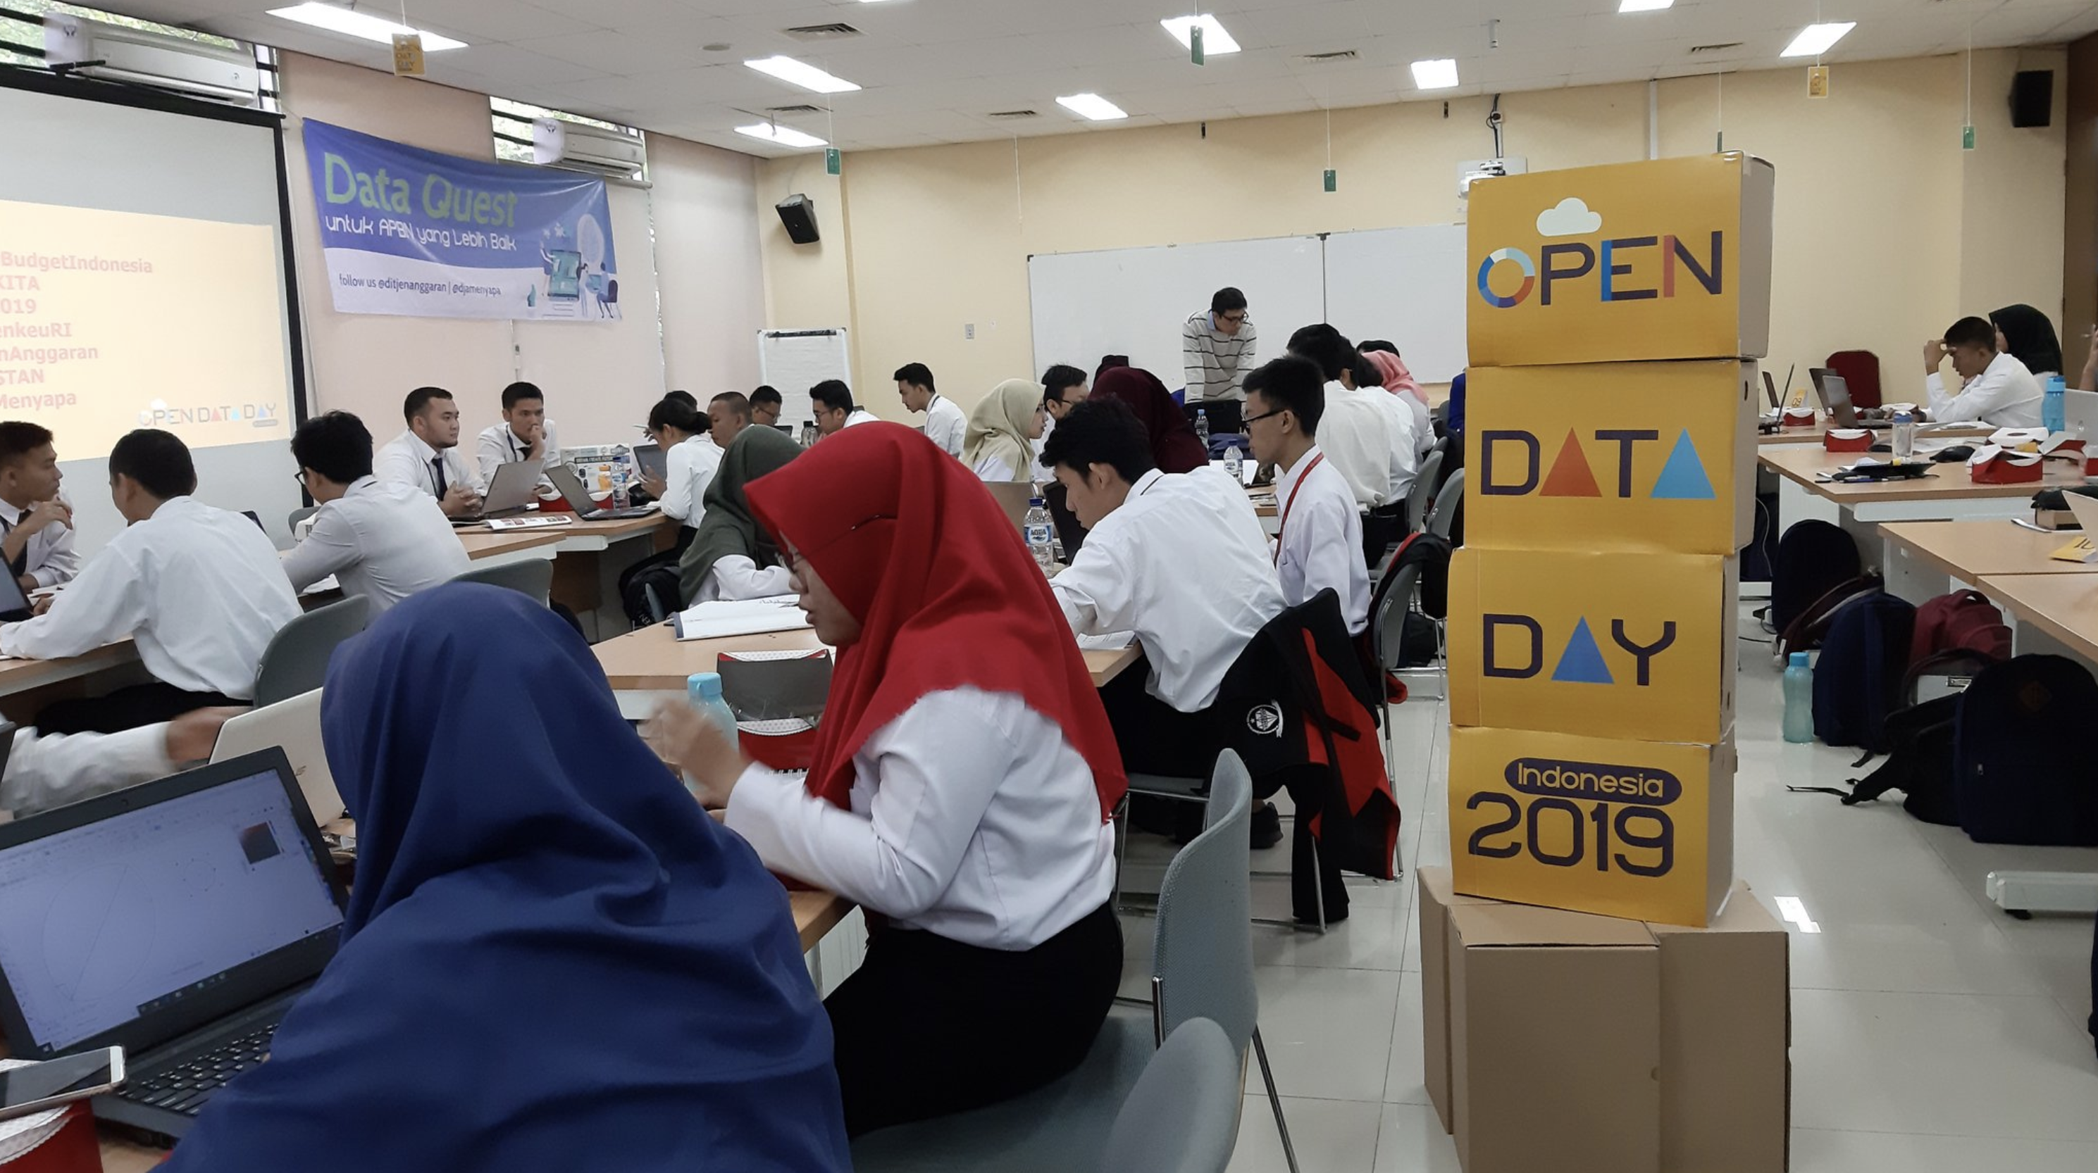
Creating events/forums for the users

Slide 80
TESTING

Slide 81
AUDIENCE

Slide 82
Focalization
The
Expert
The Not so Expert
The Tourist

Slide 83
INFORMATION
MUST BE
DESIGN TO
GENERATE CITIZEN
UNDERSTANDING
You never know…

Slide 84
PLAIN LANGUAGE

Slide 85
To talk about
_ _ _ _ _ _ ,
we have to stop talking about
_ _ _ _ _ _
INFORMATION
MUST BE
DESIGN TO
GENERATE CITIZEN
UNDERSTANDING

Slide 86
Budget
stories
examples

Slide 87
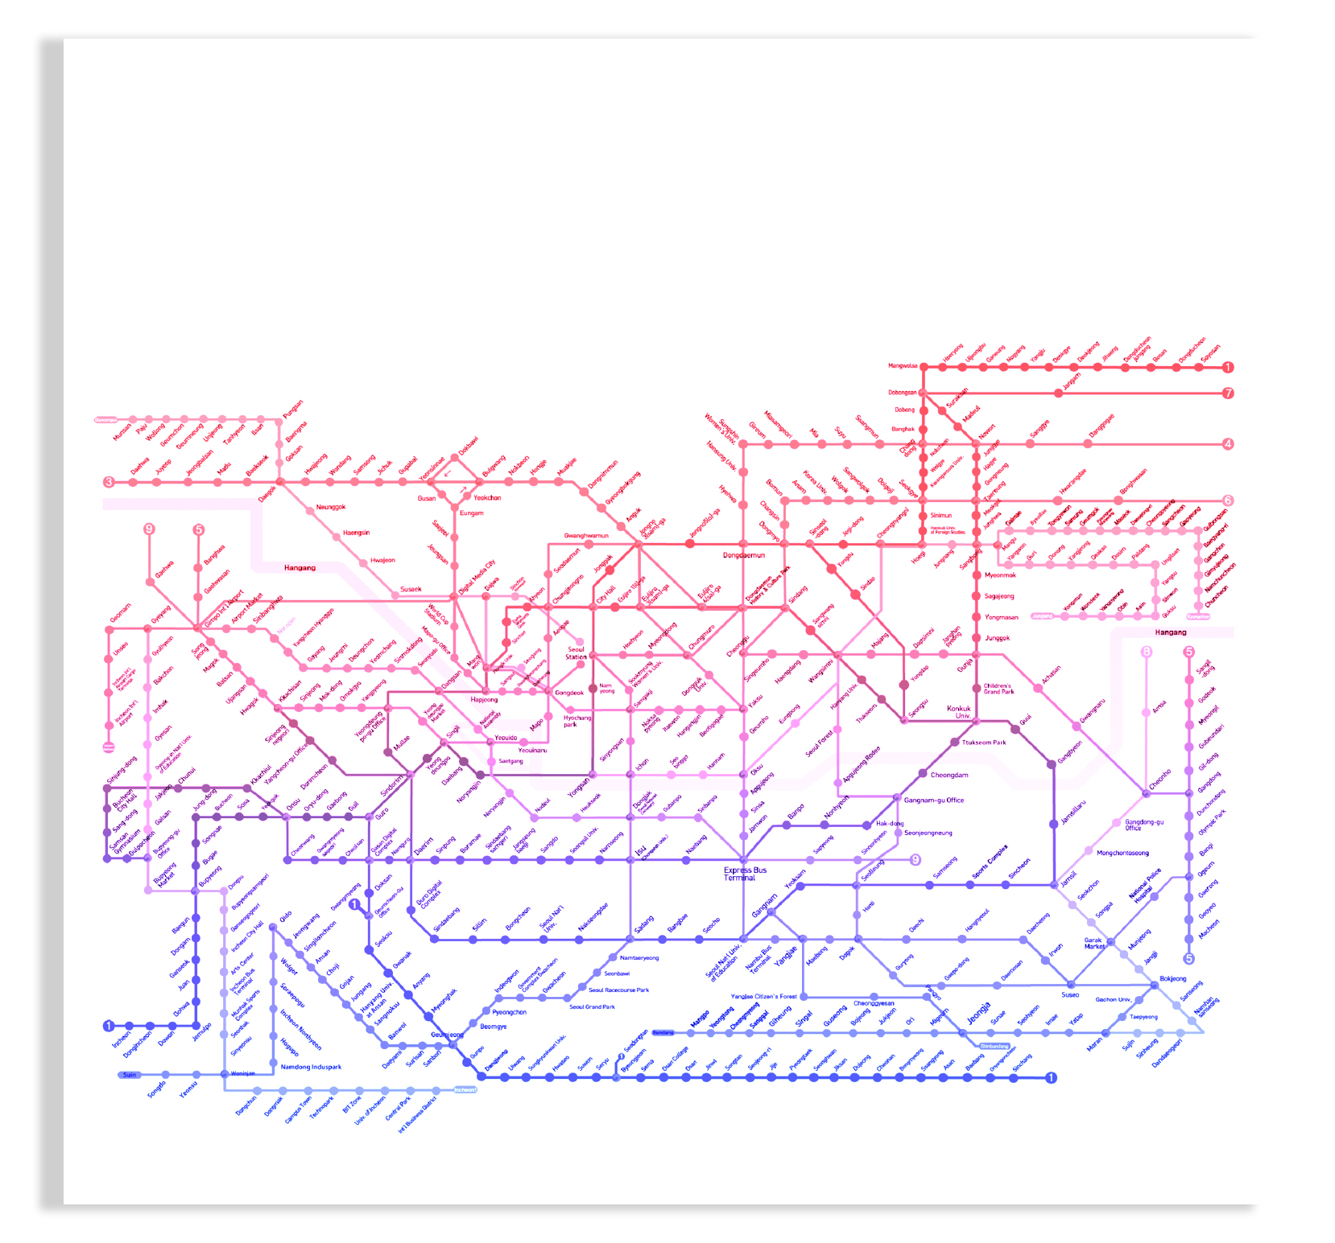
Infrastructure budget example
Did you know
that the #Seoul subway lines cover
a total of 331.5 km?
How much will be invested in 2020?
Find out!

Slide 88
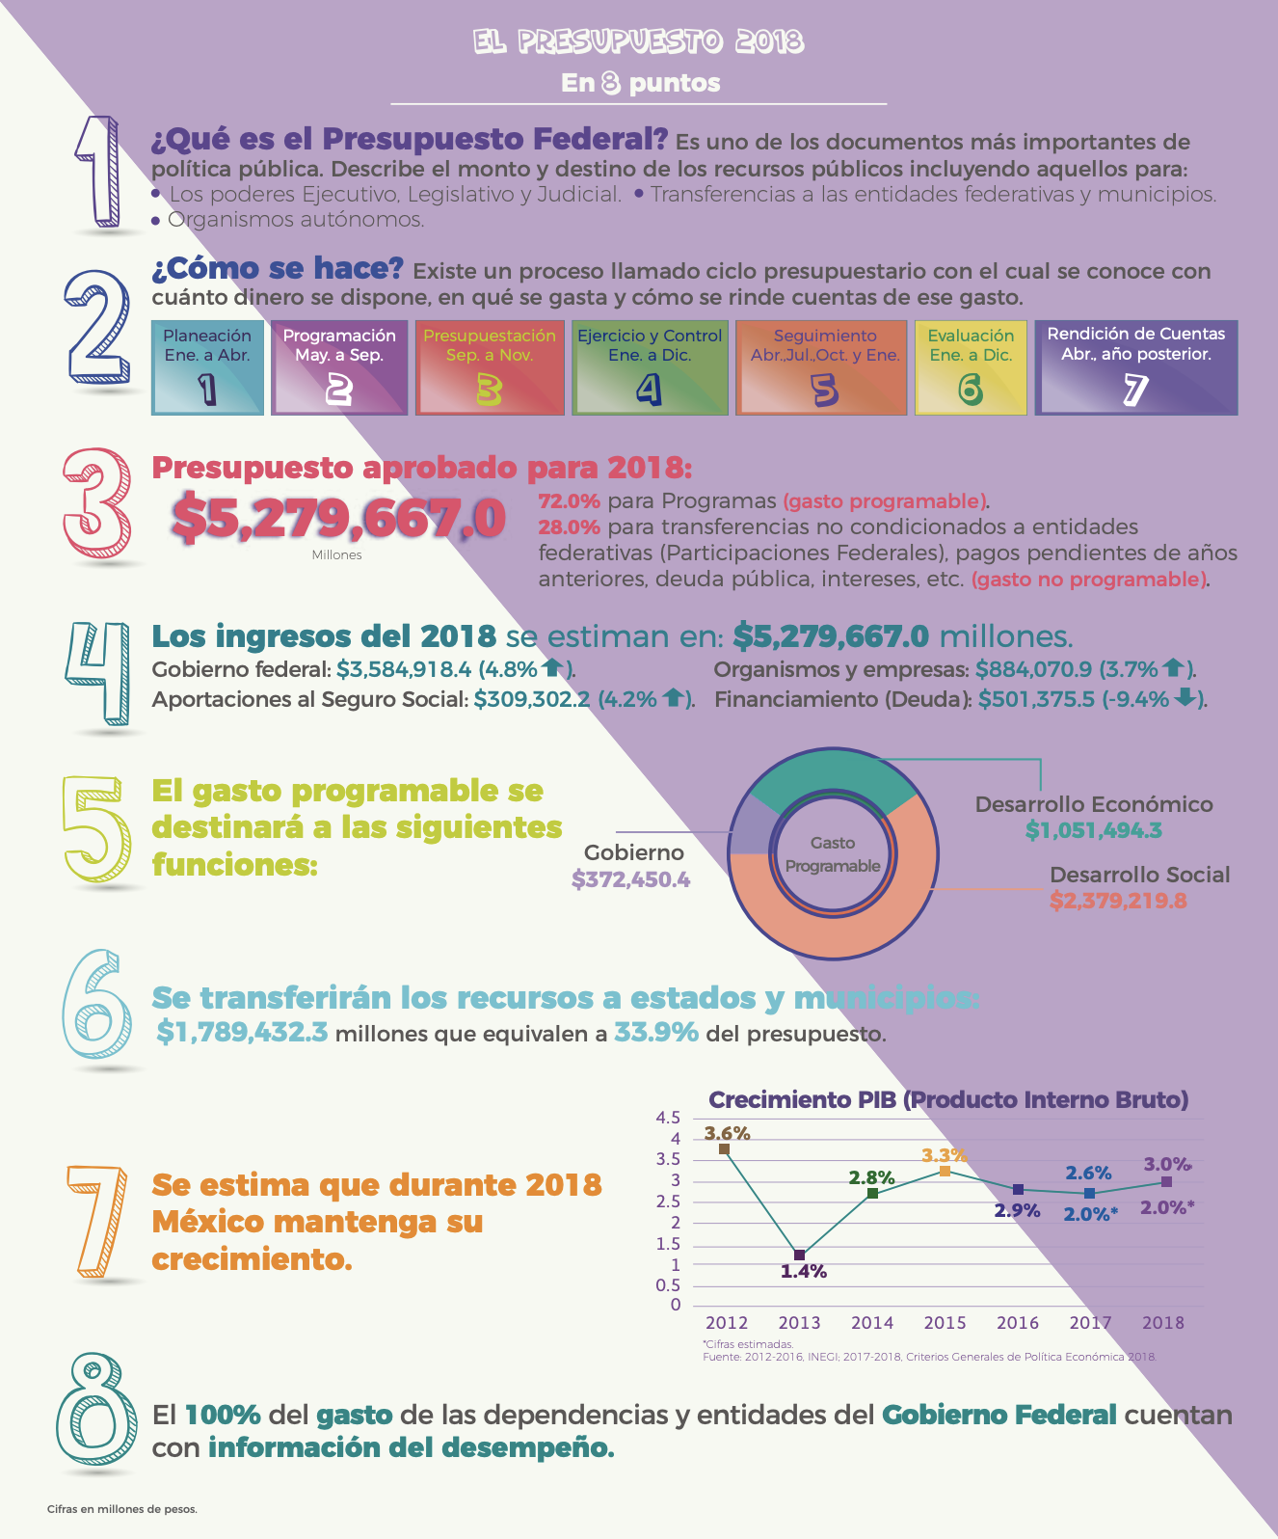
Annual budget example
2020 budget in 8 points

Slide 89
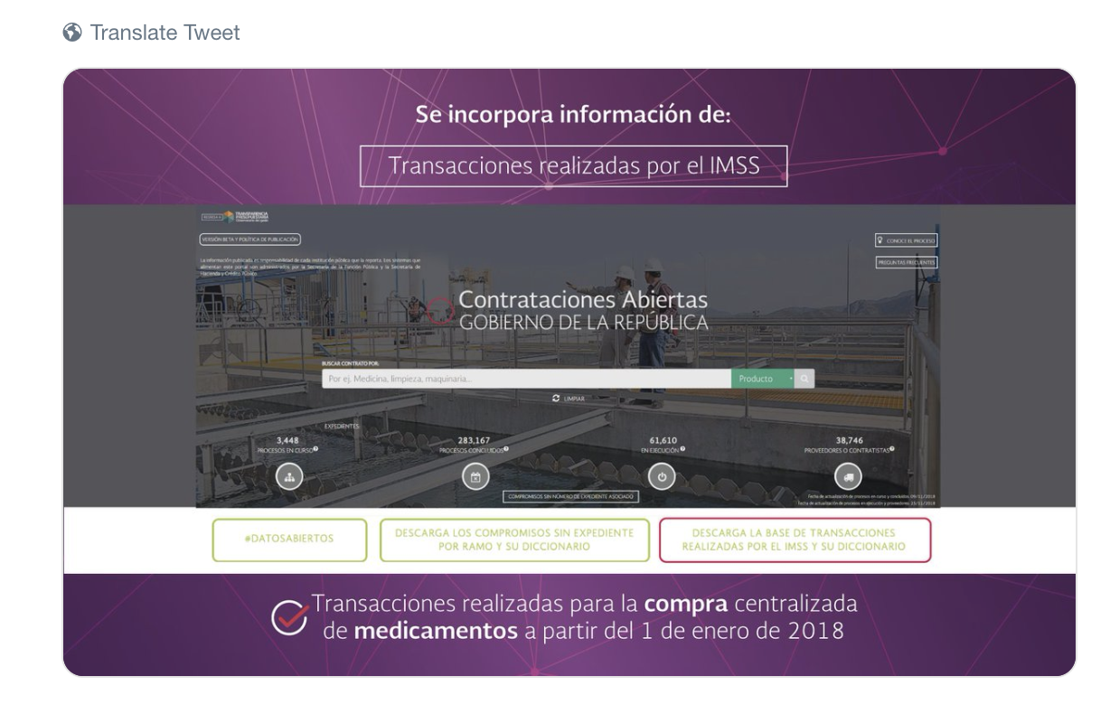
Health budget example
In what year was it necessary to buy more vaccines
2017, 2018 or 2019?
FIND IT OUT!
#OpenContracting

Slide 90
Budget
formats
examples

Slide 91
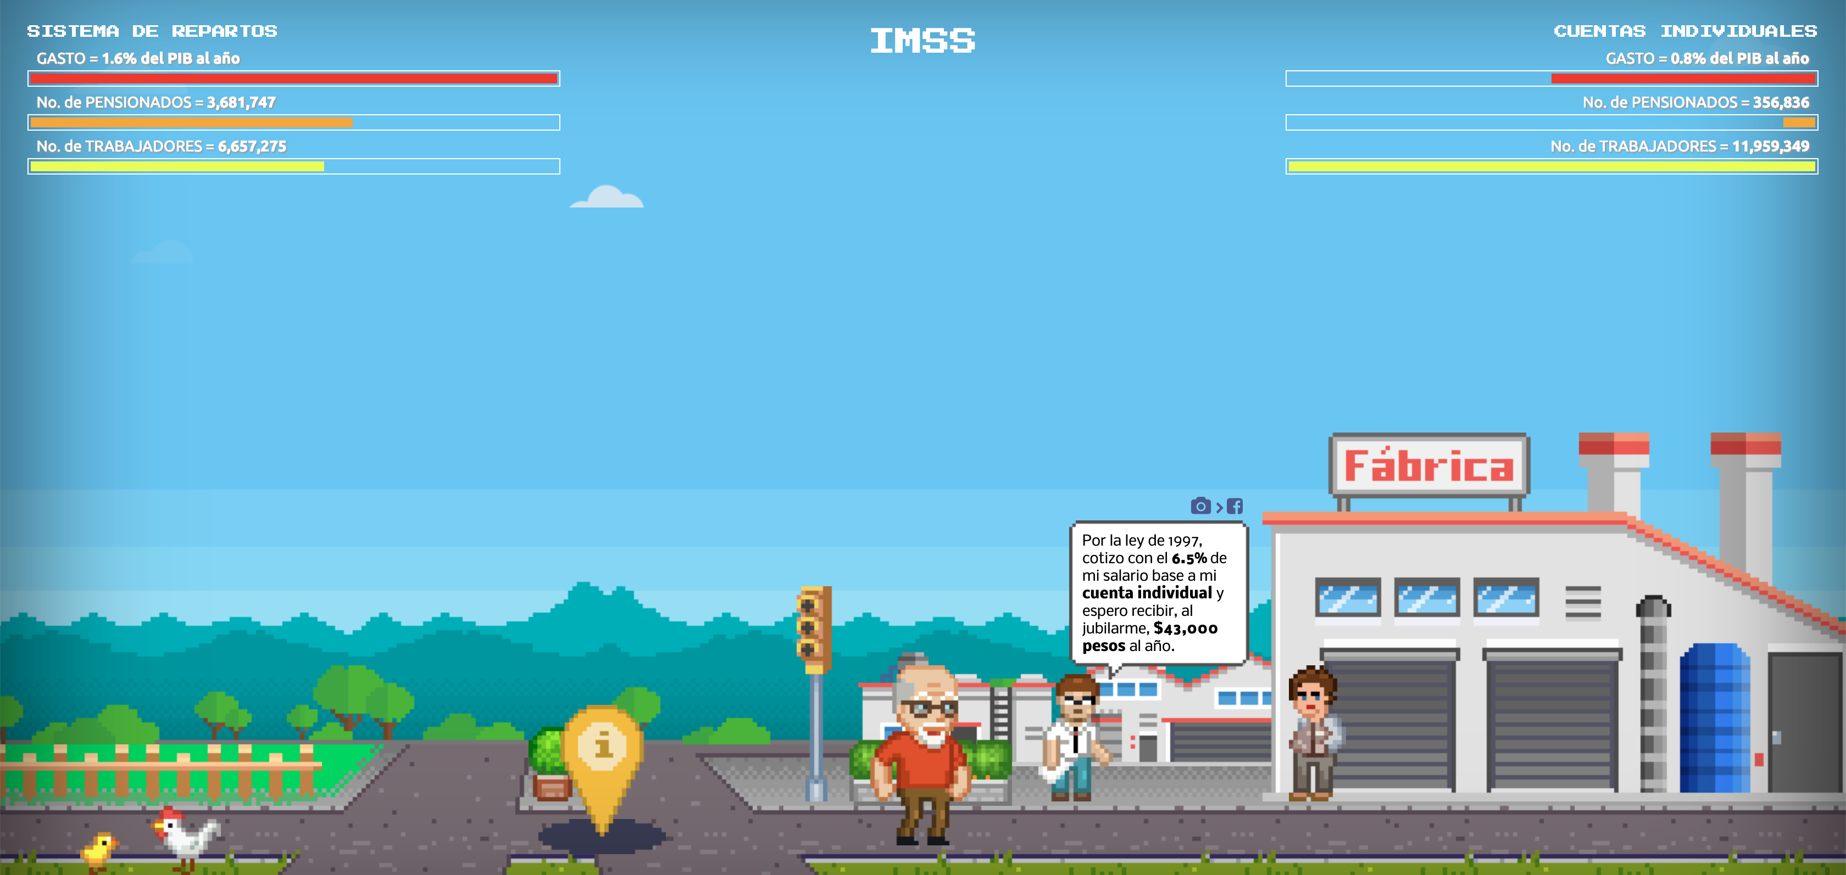
Digital animation
INFORMATION
MUST BE
DESIGN TO
GENERATE CITIZEN
UNDERSTANDING

Slide 92
Static visualization
INFORMATION
MUST BE
DESIGN TO
GENERATE CITIZEN
UNDERSTANDING

Slide 93
Infographic

Slide 94
Short video explanations
What is revenue, how it is calculated and collected?
Find out in 60 seconds!
INFORMATION
MUST BE
DESIGN TO
GENERATE CITIZEN
UNDERSTANDING

Slide 95
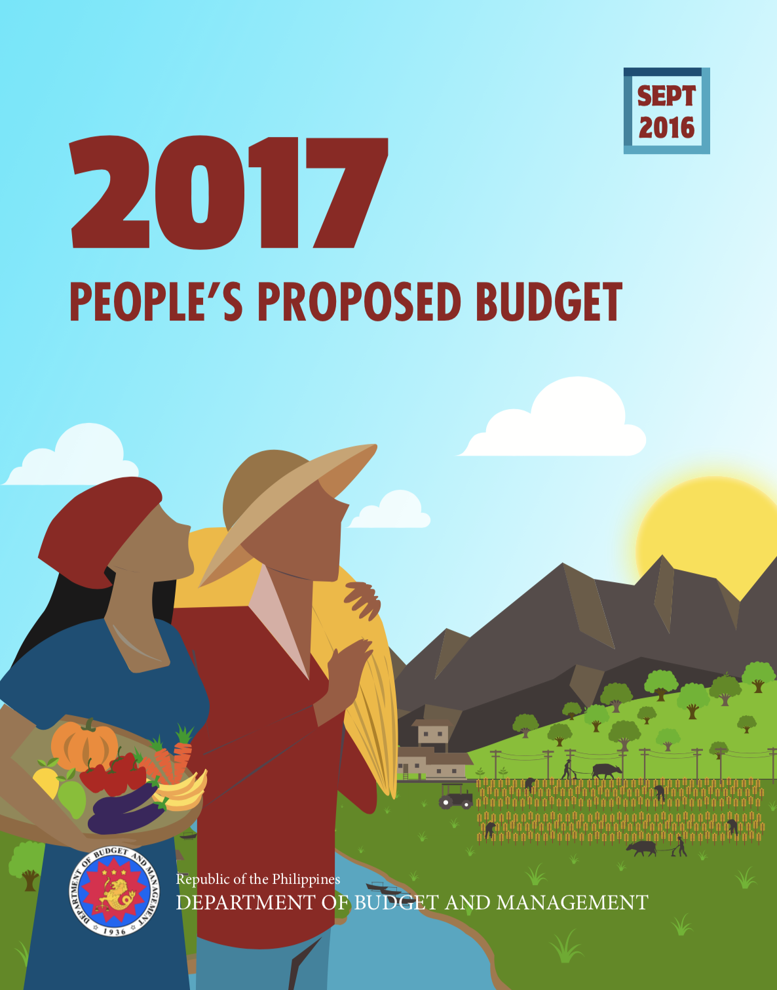
Booklets

Slide 96
INFORMATION
MUST BE
DESIGN TO
GENERATE CITIZEN
UNDERSTANDING
Only text?

Slide 97
We live in a
VISUAL SOCIETY
where photo,
video, illustration,
etc. overtake
speed transmission
over text

Slide 98
Research has shown
that the brain
processes graphics
60,000
times faster
than text

Slide 99
8 MAIN TAKEAWAYs
Putting numbers in graphic designs is not translating them in plain language
Publishing non disaggregated information is wasting it
Do not copy, but seek to be inspired
The format speaks volumes
Respect YOUR institution’s identity (Institutional Identity)
Listen the users’ demand
Test everything constantly
Plain language as communication policy
11?

Slide 100
9?

Slide 101
PEOPLE LOVE
COUNTING

Slide 102
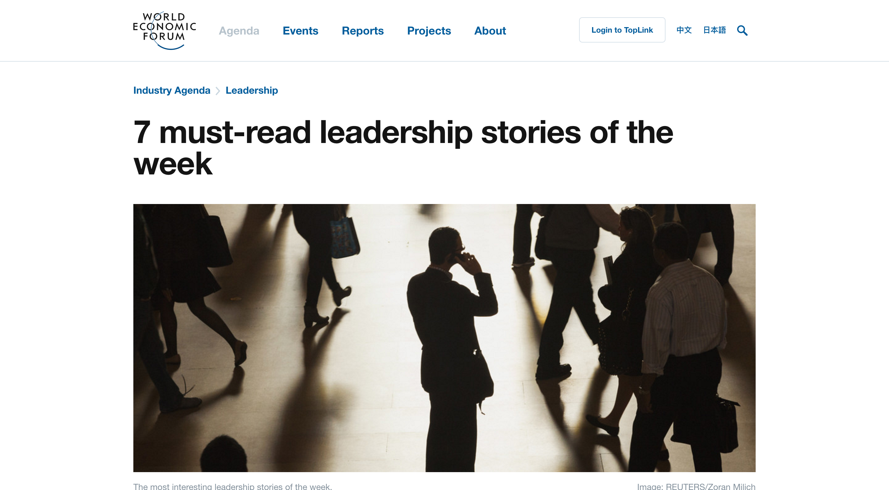

Slide 103
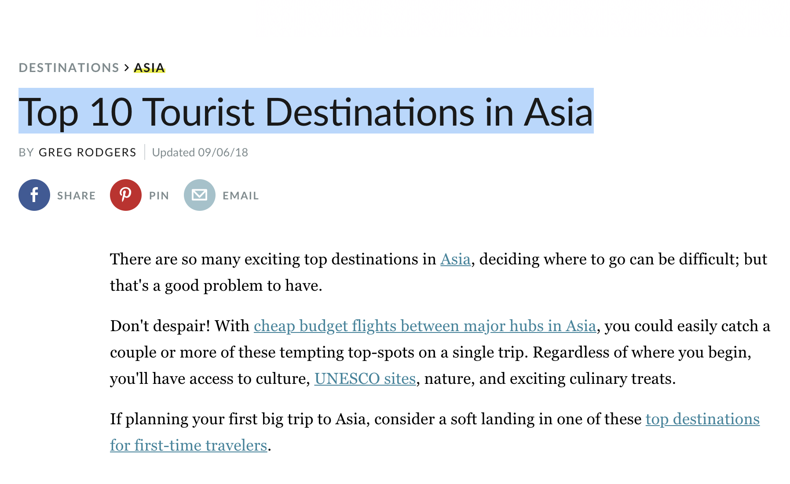

Slide 104
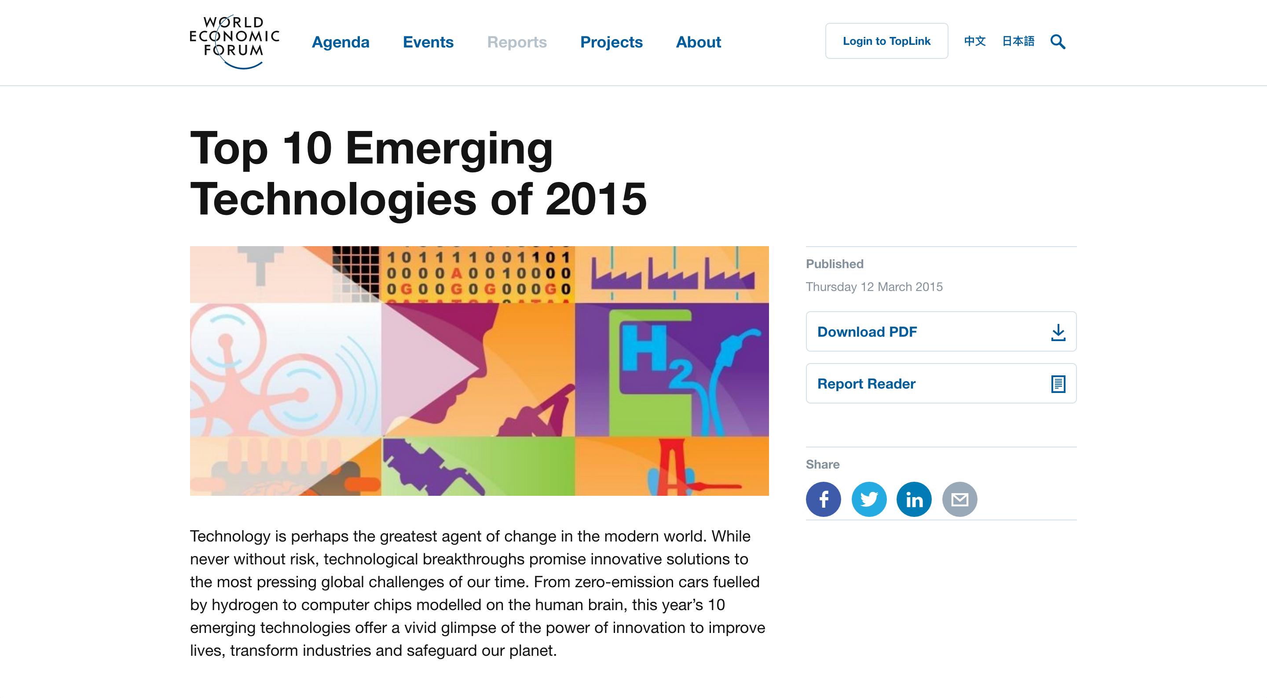

Slide 105
Let’s make the
information
digestible…

Slide 106
remember this?

Slide 107
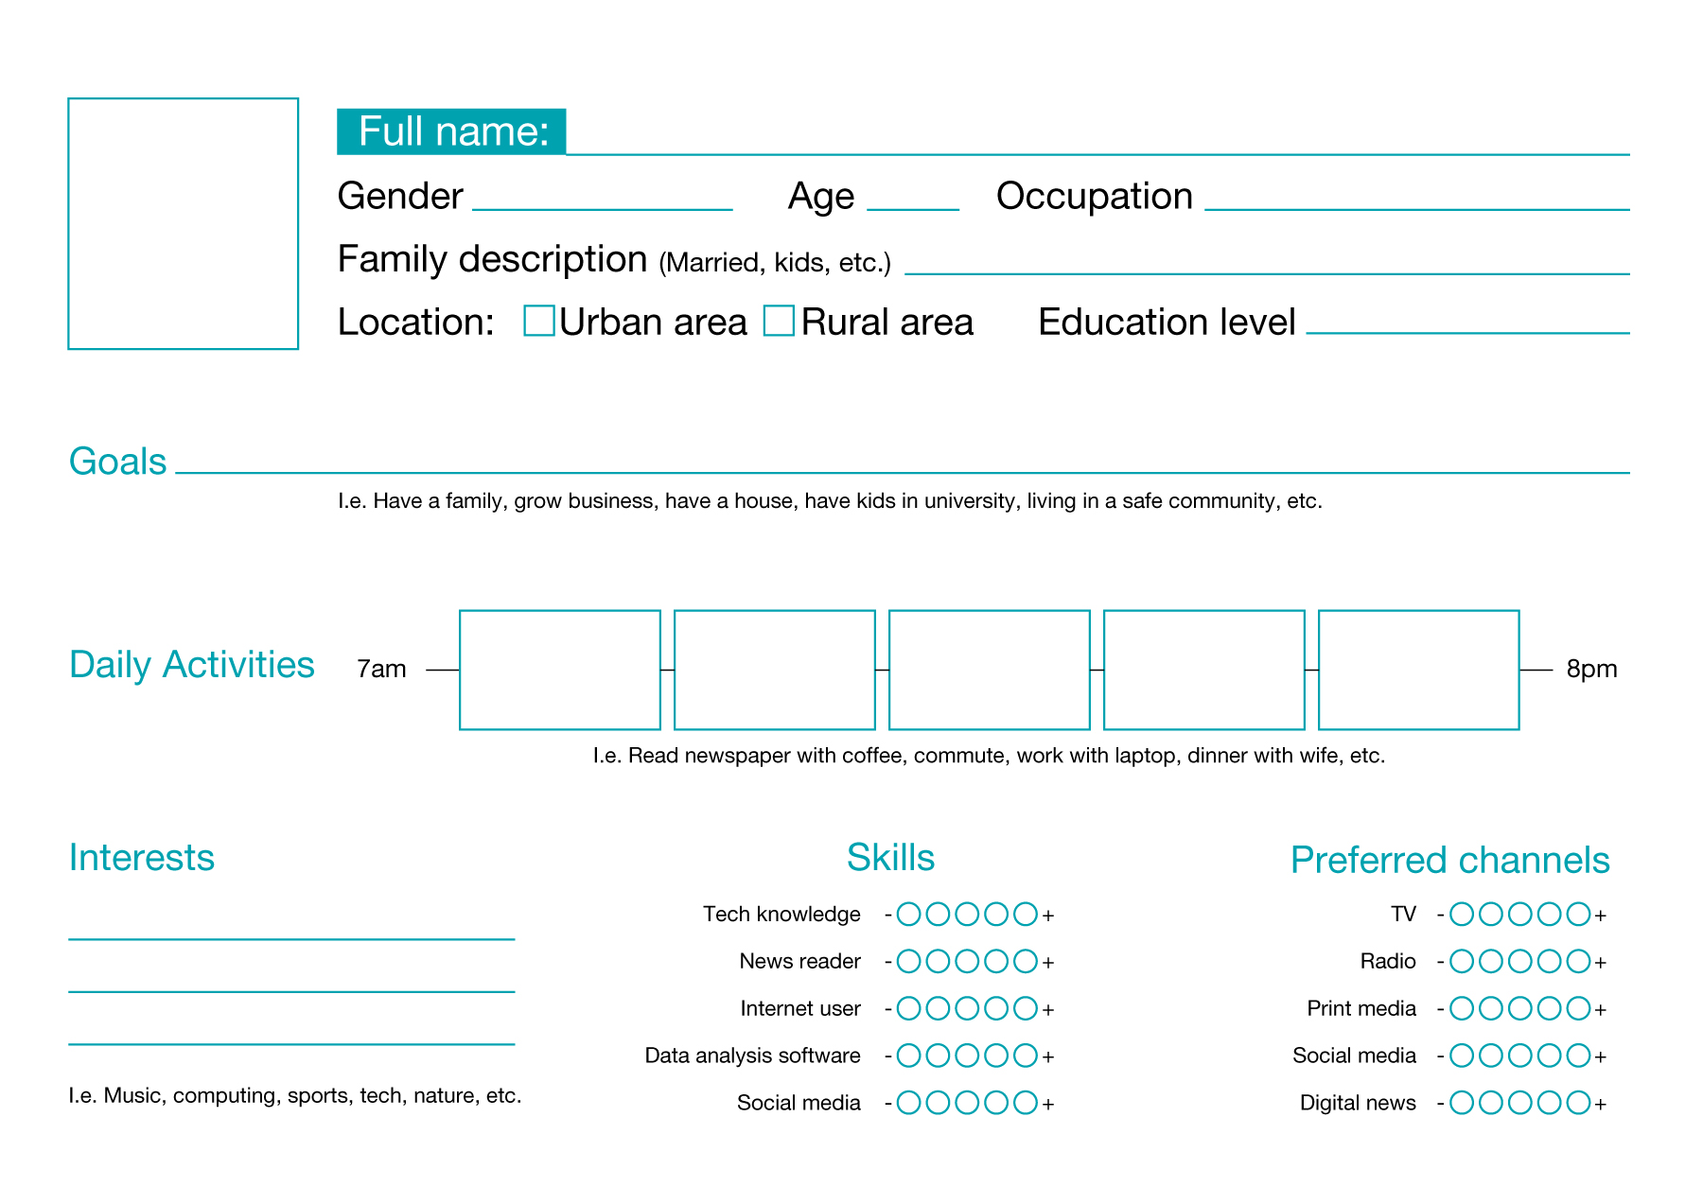
Group thinking about communications to reach those personas…

Slide 108
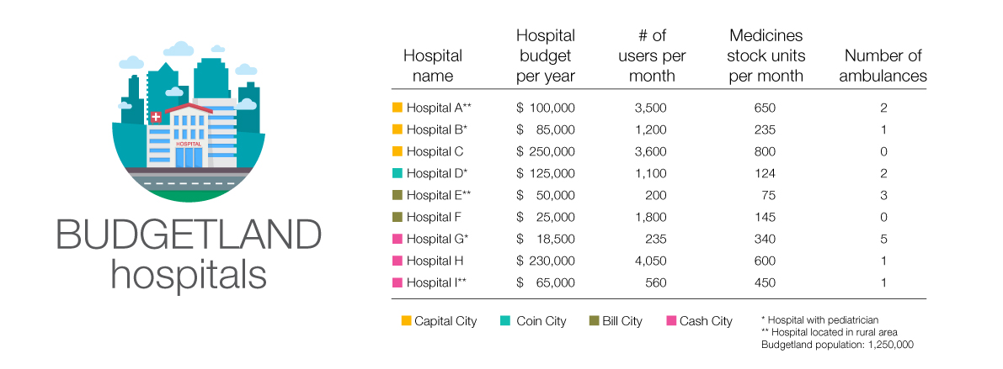
Let’s create a communication piece,
based on your persona with this information.
Choose the channel, the information to communicate from this table, the format and create the message based on the interests, daily activities, preferred channels, etc. of your persona.

Slide 109
Stay tuned!
@fiscaltrans
@fiscaltransparency
@fiscaltransparency
www.fiscaltransparency.net

