Slide 1
Open Knowledge International and GIFT
Support from GIFT has tremendously helped Open Knowledge International’s work in developing both
the [Open] Fiscal Data Package specification
the OpenSpending platform
GIFT has brought Open Knowledge International in contact with many government representatives globally
GIFT has helped greatly in providing more visibility for OFDP and OpenSpending to governments around the world
Sander van der Waal - sander.vanderwaal@okfn.org

Slide 2
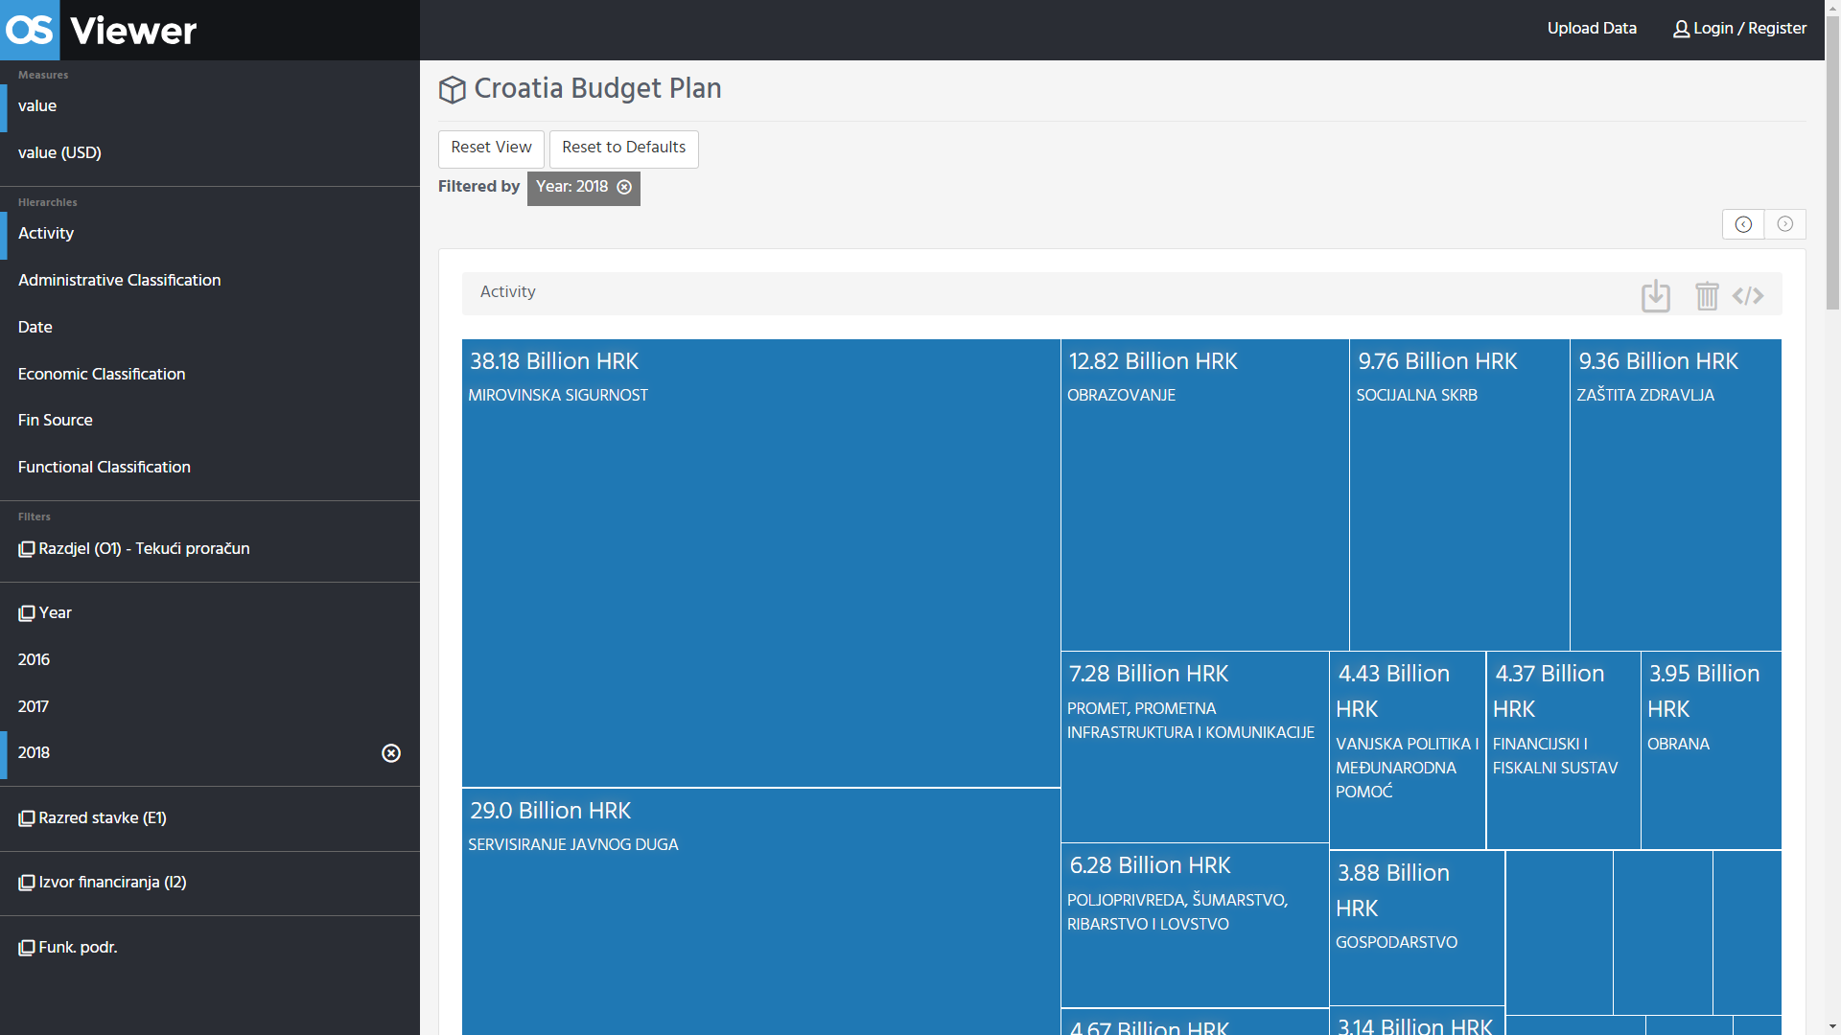
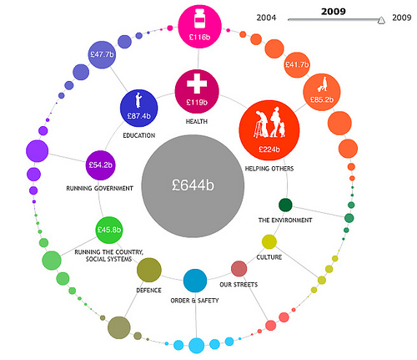
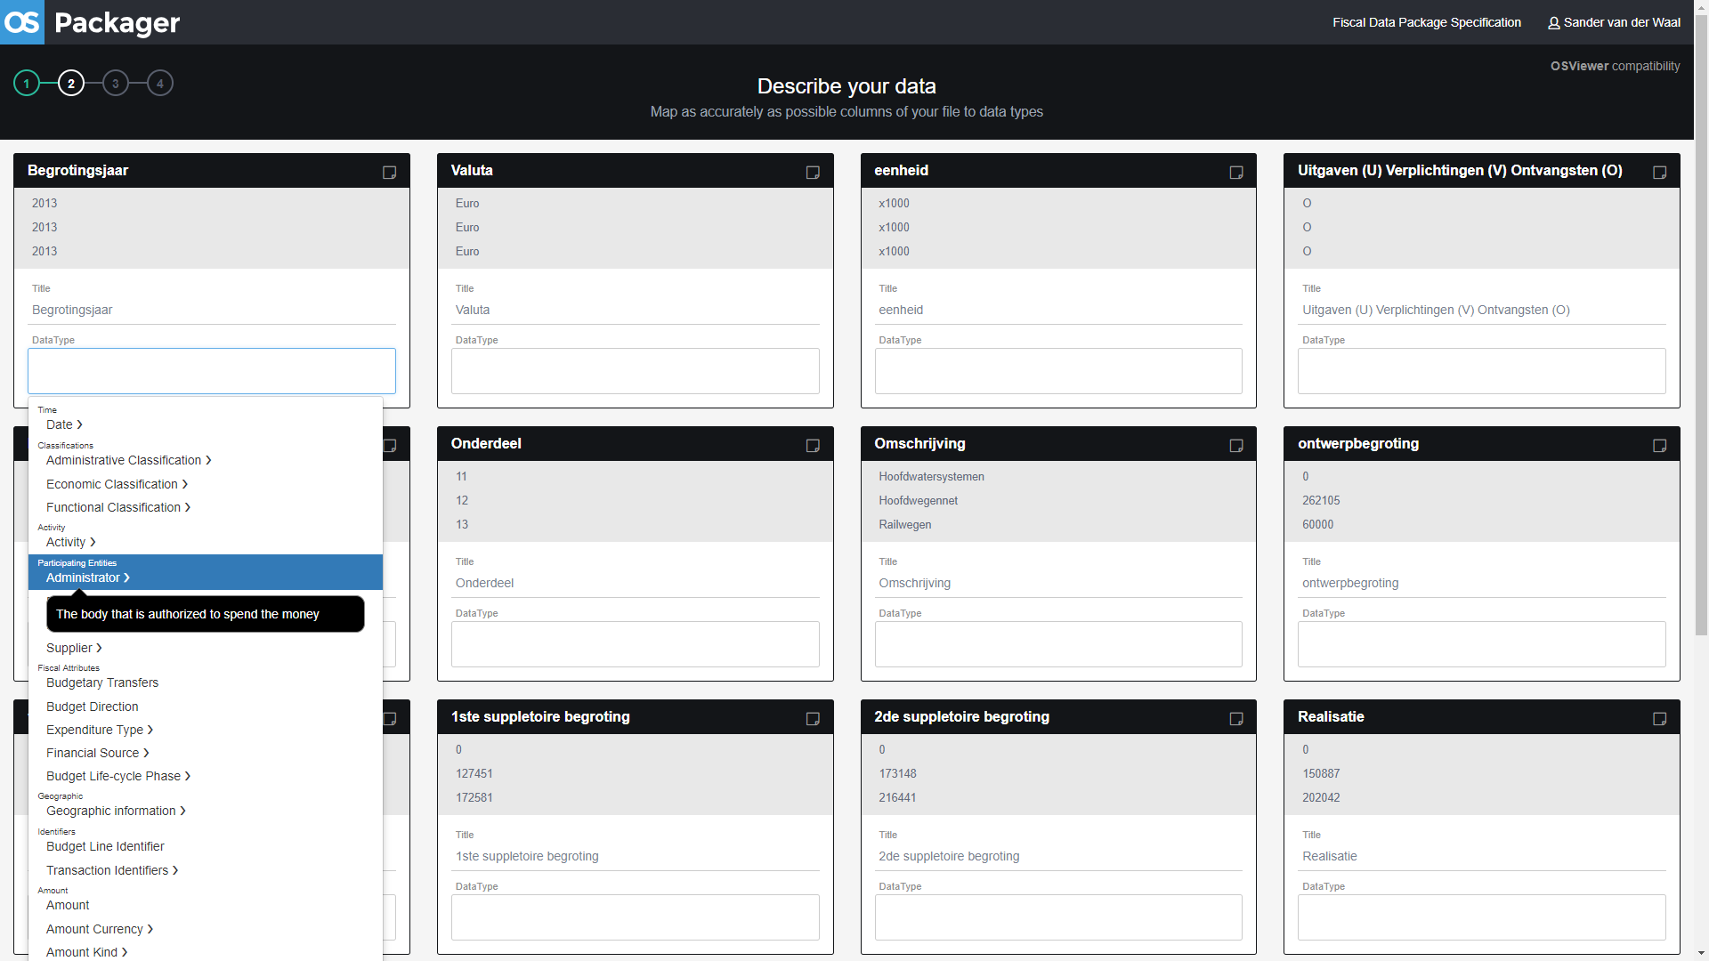
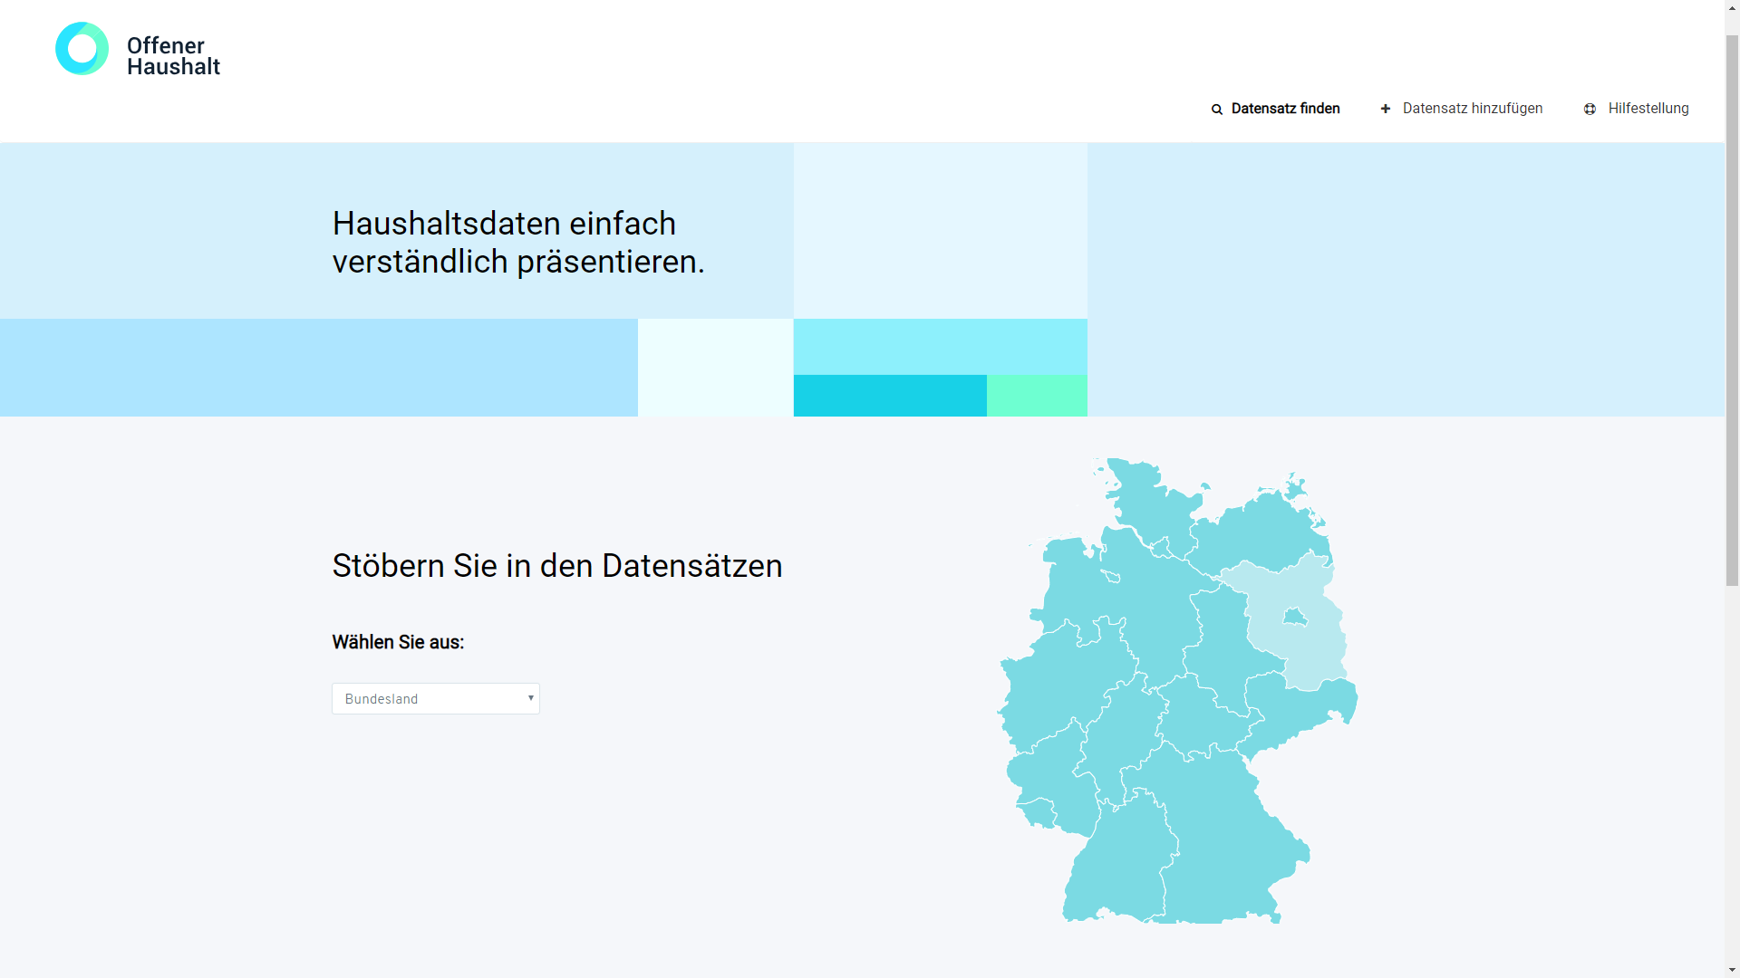
2. Reaching out to the public with technology
From ‘Where does my money go’ in 2009, to an OpenSpending Packager and OpenSpending Viewer to be used by anyone in 2018, and integrated into sites such as OffenerHaushalt in Germany and Transparencia Presupuestaria in Mexico

Slide 3
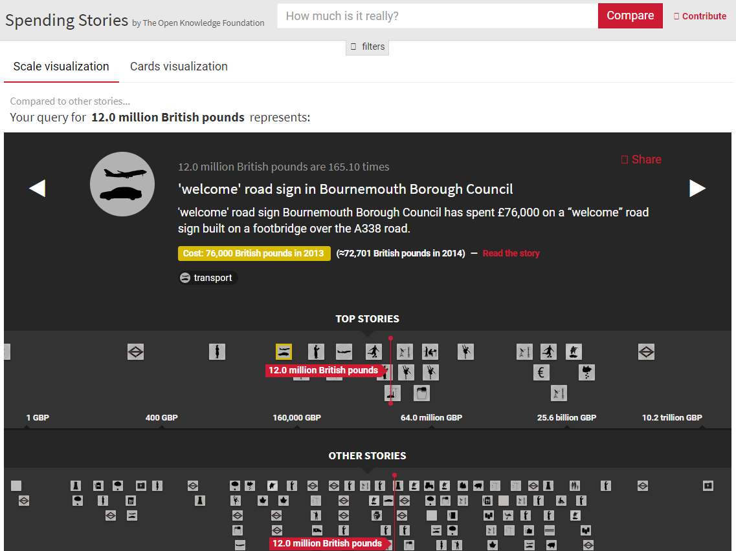
3. Motivating citizens on budgets
Our approach has been to make numbers more visual by developing and building on visualisations - see openspending.org
Another valuable approach is telling stories with budget data. OKI has worked a lot with data journalists, but another initiative worth sharing was Spending Stories
Sander van der Waal - sander.vanderwaal@okfn.org

Slide 4
4. Open Knowledge International’s gift to GIFT
We pledge to not just work with national governments to get more budget and spending data published on OpenSpending.org, or with the Open Fiscal Data Package
But also…
That we work more with Civil Society Organisations who have a need for that data. Doing more to bring supply and demand together.
Sander van der Waal - sander.vanderwaal@okfn.org

