Slide 1
Social Media Tips - do's and don’ts
Digital tools, Information Technologies and Citizen Engagement
Zagreb, Croatia, May 23, 2018
Tarick Gracida
GIFT Communications & Technology Coordinator
@fiscaltrans

Slide 2
Nowadays people
are really busy
and not only that,
we are losing
the patience

Slide 3
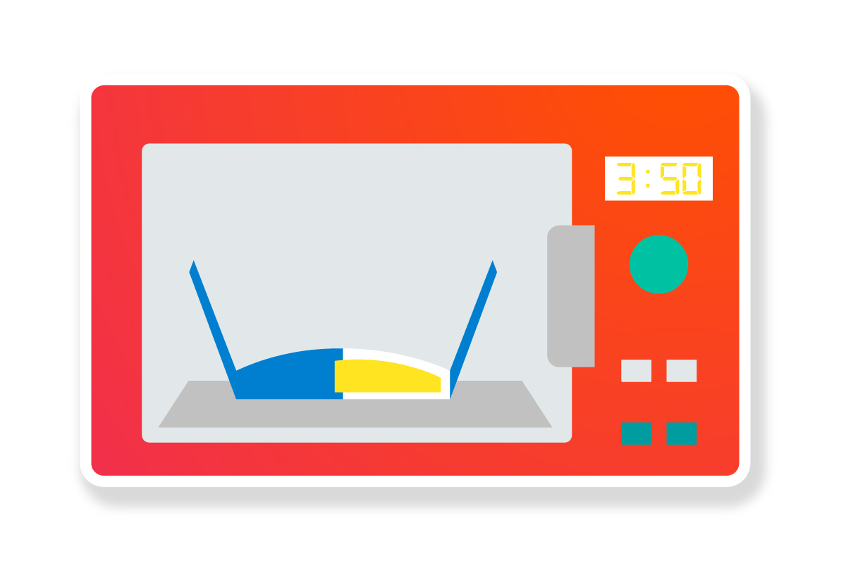

Slide 4
And in that understanding, we are still
WAITING and HOPING
that if we publish budget data
users are going to come...

Slide 5
We need to go for the citizens
instead of waiting for citizens to come
visit our transparency portals

Slide 6
And that is one of the
main goals of having
SOCIAL media CHANNELS

Slide 7
THE 10
BENEFITS
More online exposure
Showcase contents
Access to what people say
Personal touch with users
Relationship building
Worldwide coverage
More traffic to your website
Reinforcement of the engagement of users
A more searchable website and contents
Minimize cost of promoting your initiative

Slide 8
What’s first?

Slide 9
Make a plan…

Slide 10
Make a Social Media Plan

Slide 11
What do you need
IN 3 STEPS

Slide 12
1
Order your
CONTENTS

Slide 13
And why is this an important step?

Slide 14
Simple!

Slide 15
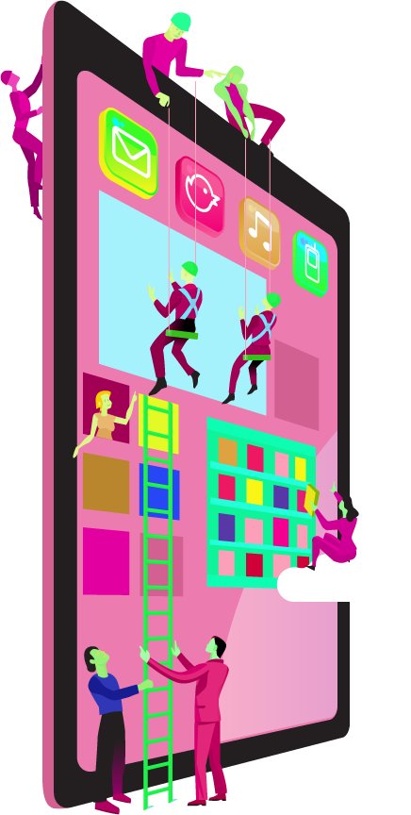
If you don’t order your contents, the people in charge of your social media channels will be just picking pieces of your work, randomly…

Slide 16
and they won’t understand the big picture of your goals and neither the big picture of your work.

Slide 17
…and your Social Media Plan won’t work as you expect it

Slide 18
Remember…
Good internal communication for good external communication

Slide 19
Maybe…
Institutional information
Budget income information
Budget spending information
Evaluation information
Open data information
Budget explanations

Slide 20
2
Find/Create
audience

Slide 21
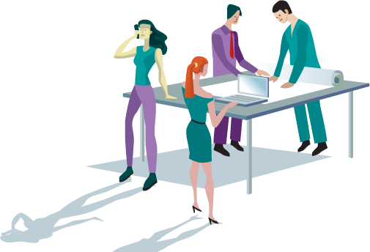
By knowing what types of information your organization has, you will have a clearer panorama

Slide 22
But, it is not only to capture your audience by budget experts, academy, press, etc…

Slide 23
But to really know what of this information could be interesting for the people, depending on their different ages, interests, lives, needs, etc.

Slide 24
But to really know what of this information could be interesting for the people, depending on their different ages, interests, lives, needs, etc.

Slide 25
But to really know what of this information could be helpful for the people, depending on their
different ages, interests, lives, needs, etc.

Slide 26
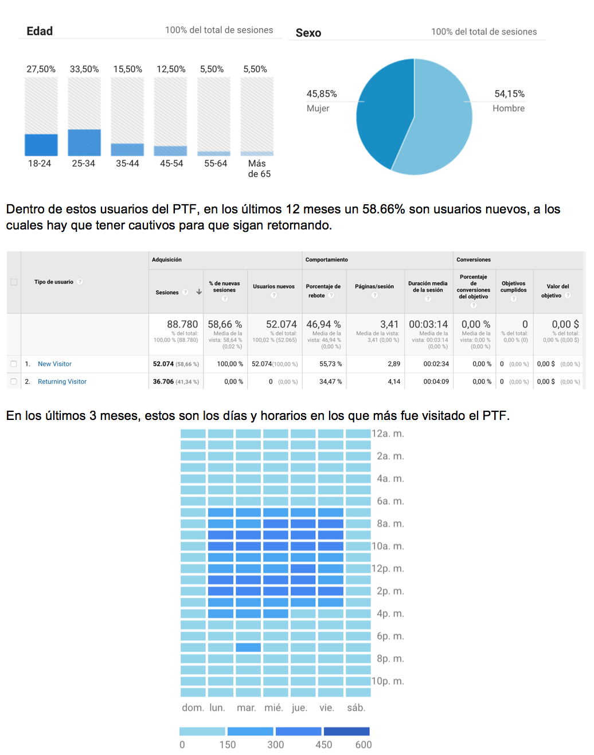
A lot of data!

Slide 27
Remember…
Different contents for different audiences but always in plain language!

Slide 28
3
Choose your
channels

Slide 29
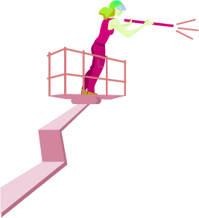
With all this data, types of contents, types of audiences, analytics, you can determine which are the social media channels that you need

Slide 30
ALERT!!!

Slide 31
The Do’s

Slide 32
The Do’s
A proper TEAM!

Slide 33
The Do’s
PARTNERSHIPS!
Think in collaborative contents, for example…

Slide 34
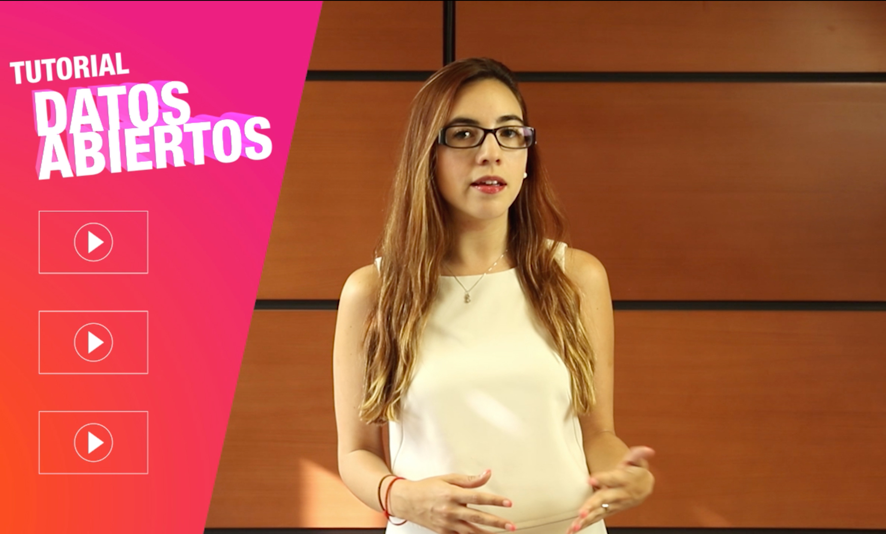
The Do’s

Slide 35
The Do’s

Slide 36
The Do’s
REVIEW and re review your analytics.
Try to follow up the interests of your audiences in order to always launch trendy contents.

Slide 37
The Do’s
Spreadsheet.
MAP your influencers, best followers, etc. by interests, topics, ages, etc.

Slide 38
The Do’s
INBOX, share posts by inbox to organizations with the same topic interests

Slide 39
The Do’s
SYNTHESIZE the information, nowadays people patience is really small.
But always leave a link to the full content.

Slide 40
The Do’s
CITIZEN social media channels?

Slide 41
The Do’s
Ministry of Finance tweet
Citizen social media channel tweet

Slide 42
The Do’s
TEST your contents, don’t be afraid of trying new visuals

Slide 43
The Do’s
RECYCLE, it’s ok to reuse valuable contents

Slide 44
The Do’s
Posts that INCLUDE photos, graphics or videos generally receive more interactions! But don't use boring stock images.

Slide 45
The Dont’s

Slide 46
The Dont’s
Is all about TRANSPARENCY, Don’t be fake, don’t buy followers or likes

Slide 47
The Dont’s
Don’t follow back everyone

Slide 48
The Dont’s
Don’t erase people posts, and don’t ignore or delete negative comments Every negative comment is an opportunity for you to turn it into a POSITIVE

Slide 49
The Dont’s
Don’t schedule messages and forget about it.
Be aware of users response on the ANALYTICS.

Slide 50
The Dont’s
Don’t post without TAGGING possibly interested accounts.
But don’t abuse tagging, never tag the same accounts everyday

Slide 51
The Dont’s
Don’t neglect the business, be aware always of what’s happening on your channels, everyday

Slide 52
The Dont’s
Don’t post just to post, it’s better to post less times a day but with valuable content

Slide 53
The Dont’s
Don't like your own posts

Slide 54
The Dont’s
Don’t use large links and hashtags.
You can always shorten the urls by using Bit.ly

Slide 55
Engage with us!
@fiscaltrans
www.fiscaltransparency.net

