Slide 1
Plain language as communication policy
How to communicate budget?
Digital tools, Information Technologies and Citizen Engagement
Zagreb, Croatia, May 23, 2018
Tarick Gracida
GIFT Communications & Technology Coordinator
@fiscaltrans

Slide 2
10,000,000,000

Slide 3
100,000,000,000

Slide 4
HOW
to communicate
budget?

Slide 5
GENERATING
GRAPHIC
DESIGN
IS NOT TO
CITIZENIZE

Slide 6
100,000,000,000

Slide 9
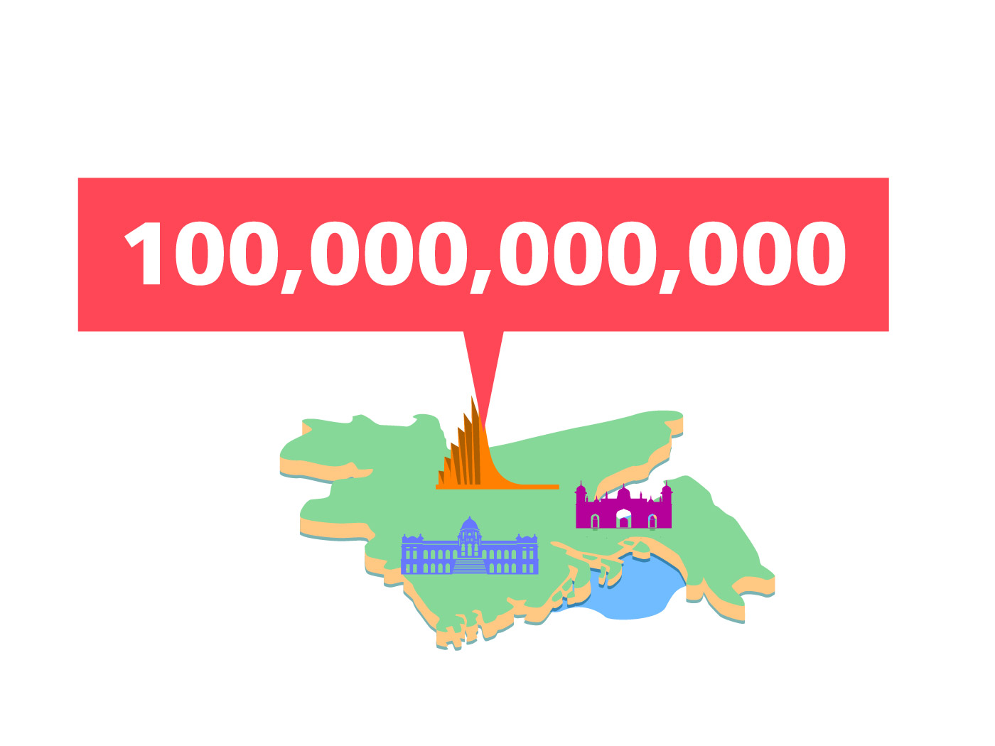

Slide 11
IT IS NOT ONLY
CREATING FORMS,
BUT CREATING
COMMUNICATIONS
Frascara

Slide 12
HOW
to communicate
budget?

Slide 13
DISINTEGRATING

Slide 14
D I S I N T E G R A T I N G

Slide 15
D I S I N T E G R A T I N G

Slide 16
D I S I N T E G R A T I N G
INFORMATION TO
MAKE IT DIGESTIBLE

Slide 18
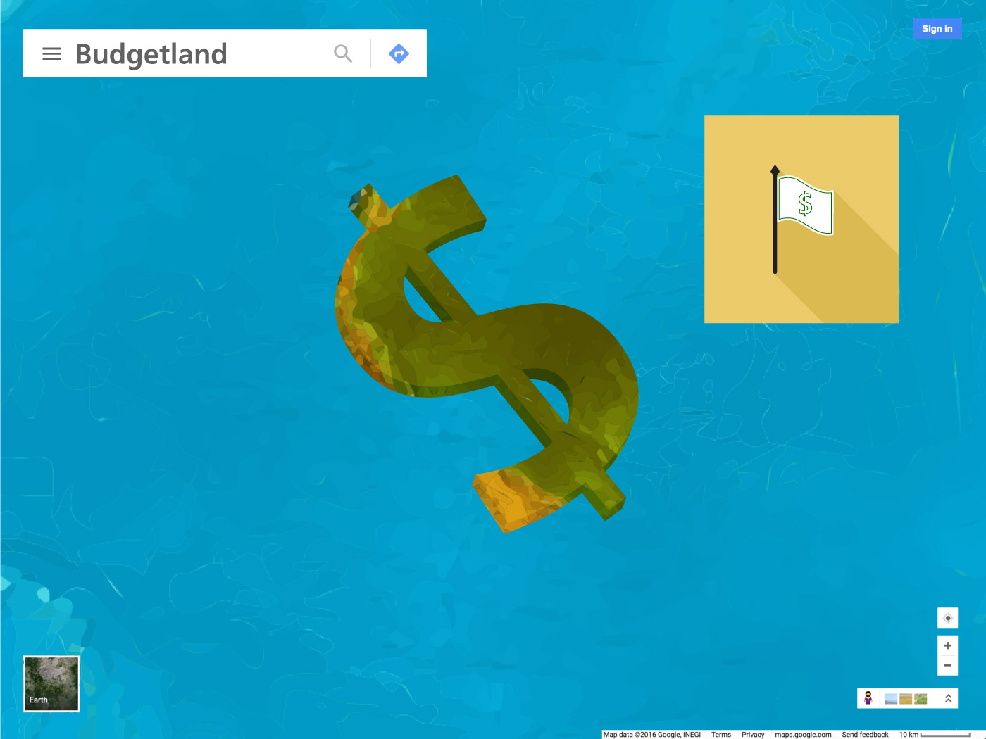

Slide 19
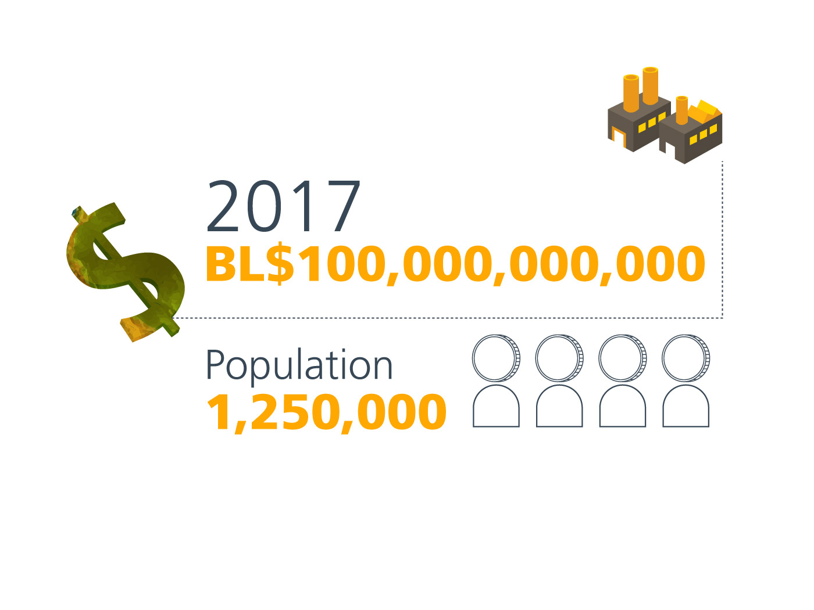
2018
BL$ 100,000,000,000

Slide 20
2018
BL$ 100,000,000,000
Bill Understood

Slide 21
2018
BL$ 100,000,000,000
Population
1,250,000

Slide 22
BL$ 80,000

Slide 23
INFORMATION
MUST BE
DESIGN TO
GENERATE CITIZEN
UNDERSTANDING

Slide 24
INFORMATION
MUST BE
DESIGN TO
GENERATE CITIZEN
UNDERSTANDING
simplicity

Slide 25
INFORMATION
MUST BE
DESIGN TO
GENERATE CITIZEN
UNDERSTANDING
text saturation?

Slide 26
INFORMATION
MUST BE
DESIGN TO
GENERATE CITIZEN
UNDERSTANDING
text saturation

Slide 27
70%
INFORMATION
MUST BE
DESIGN TO
GENERATE CITIZEN
UNDERSTANDING
30%

Slide 28
FACED WITH SO MUCH GRAPHIC ON THE STREETS,
WE LOOK THE LEAST.

Slide 29
FACED WITH SO MUCH GRAPHIC ON THE STREETS,
WE LOOK THE LEAST.
WE MUST DISINTEGRATE AND DESIGN THE INFORMATION

Slide 30
FACED WITH SO MUCH GRAPHIC ON THE STREETS,
WE LOOK THE LEAST.
WE MUST DISINTEGRATE AND DESIGN THE INFORMATION
• THE INFORMATION WILL BE INVISIBLE FOR INTERESTED PUBLIC IF GRAPHICS ARE NOT RELATED TO THE TOPIC

Slide 31
FACED WITH SO MUCH GRAPHIC ON THE STREETS,
WE LOOK THE LEAST.
WE MUST DISINTEGRATE AND DESIGN THE INFORMATION
• THE INFORMATION WILL BE INVISIBLE FOR INTERESTED PUBLIC IF GRAPHICS ARE NOT RELATED TO THE TOPIC
• UNINTERESTED PUBLIC THAT GOT HOOKED BY GRAPHICS WILL LOSE INTEREST IF THE INFORMATION IS NOT DISINTEGRATED.

Slide 32
INFORMATION
MUST BE
DESIGN TO
GENERATE CITIZEN
UNDERSTANDING
visual simplicity

Slide 33
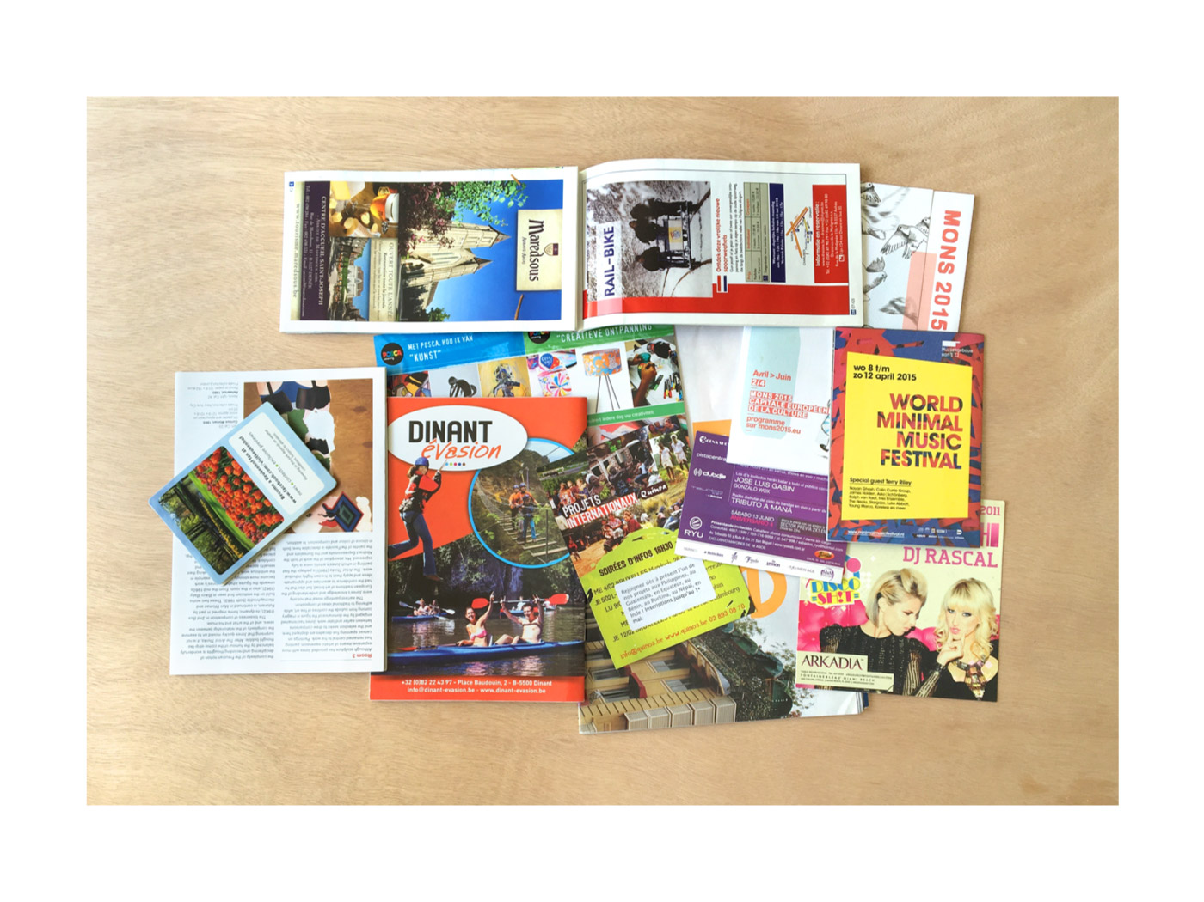

Slide 34
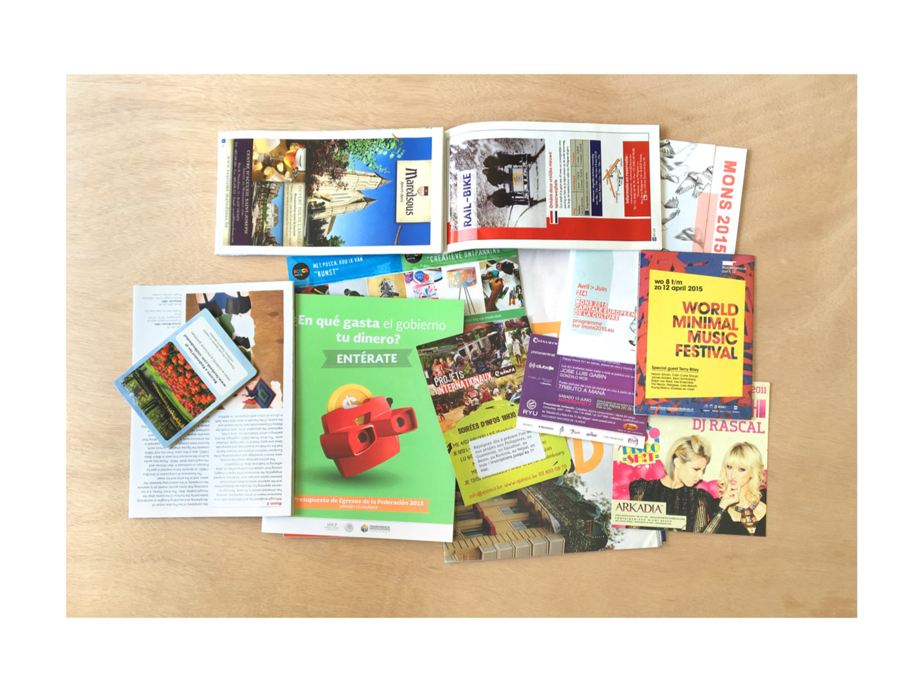

Slide 36
DON’T
IMITATE

Slide 40
LET’S TALK
POSITIVE

Slide 41
INFORMATION
MUST BE
DESIGN TO
GENERATE CITIZEN
UNDERSTANDING
war
death

Slide 43
THE FORMAT
SPEAKS
VOLUMES

Slide 44
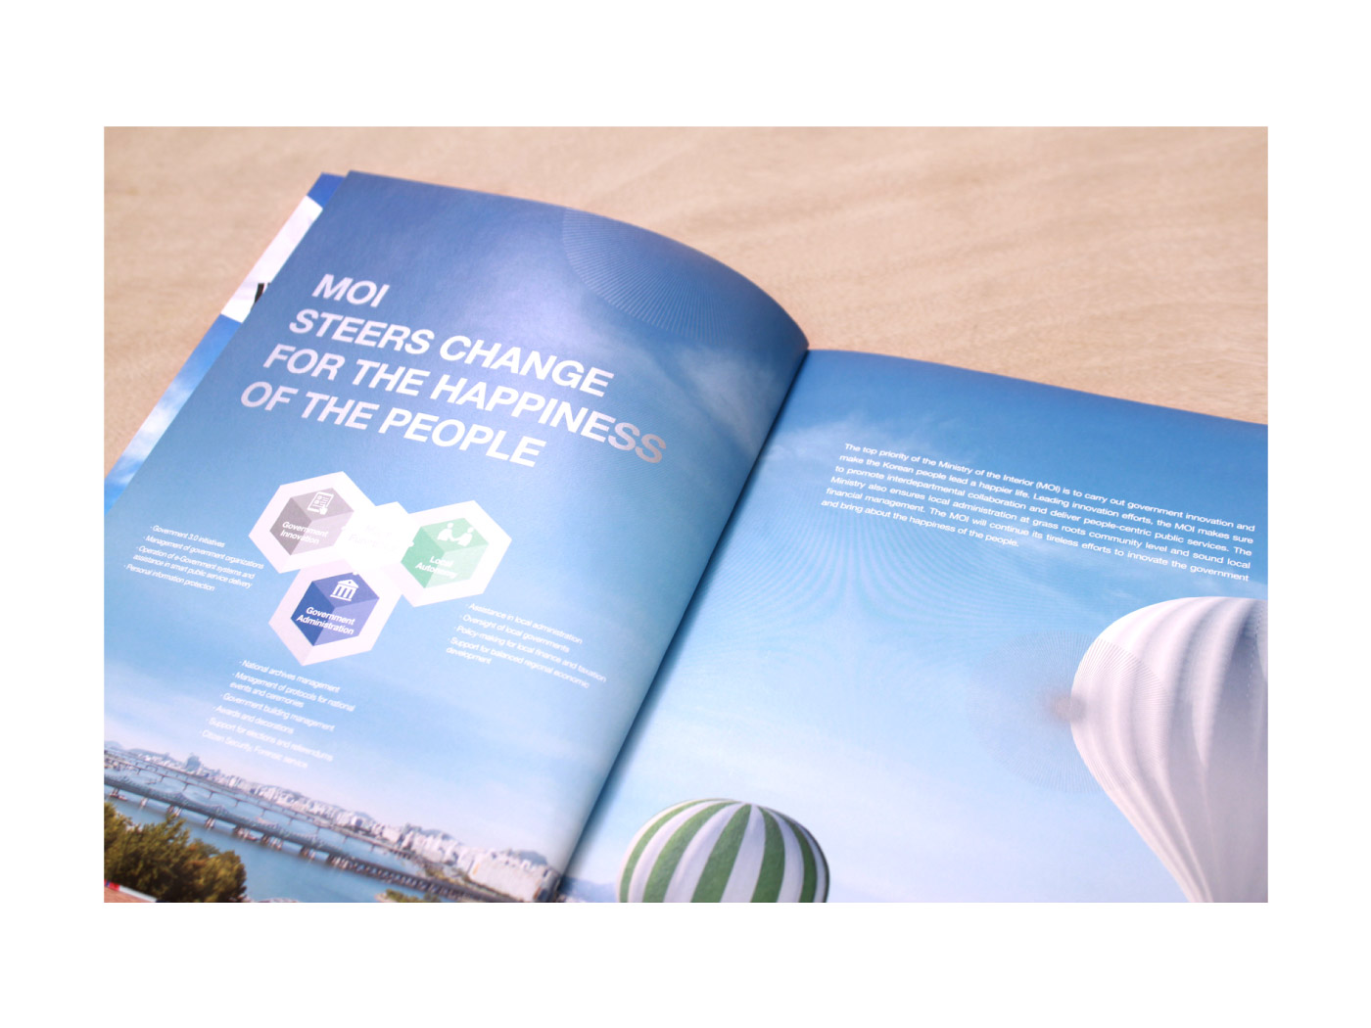

Slide 45
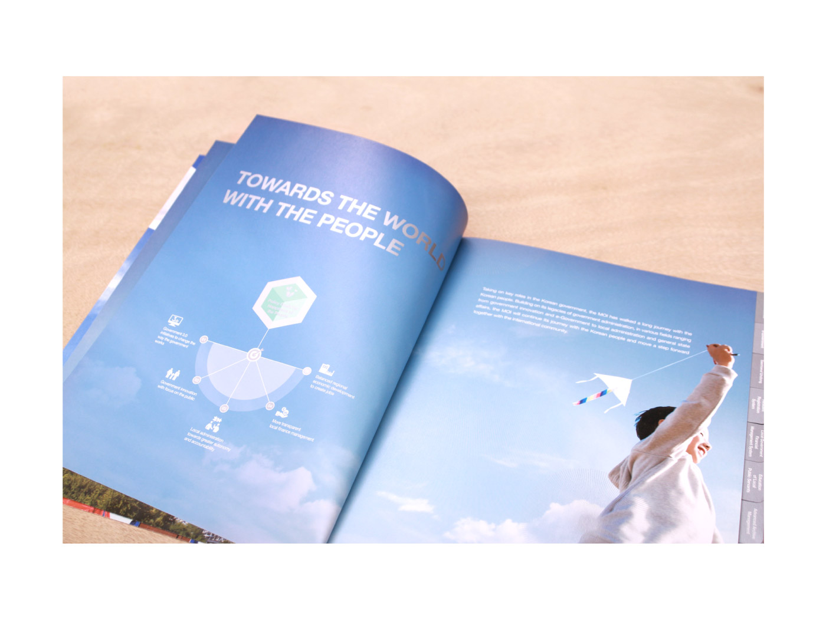

Slide 46
PROFESIONAL
TRANSPARENCY PORTALS,
WITH GRAPHIC DESIGN
THAT DON’T GENERATE
SUSPICION ON THE
NUMBERS

Slide 47
RESPECT THE
CORPORATE
IDENTITY

Slide 48
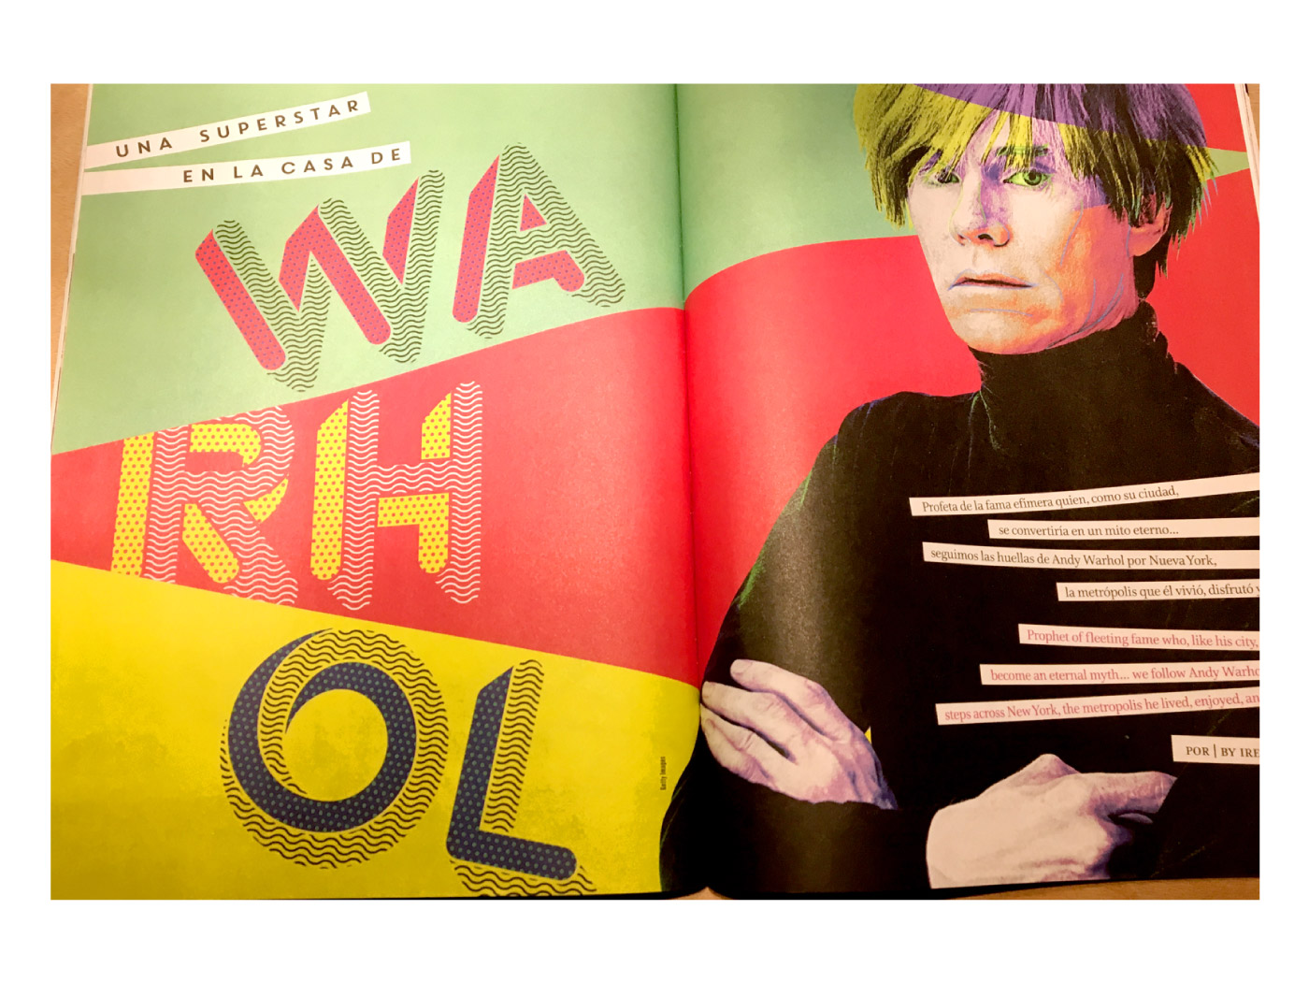

Slide 53
ORDER
=
TRUST

Slide 55
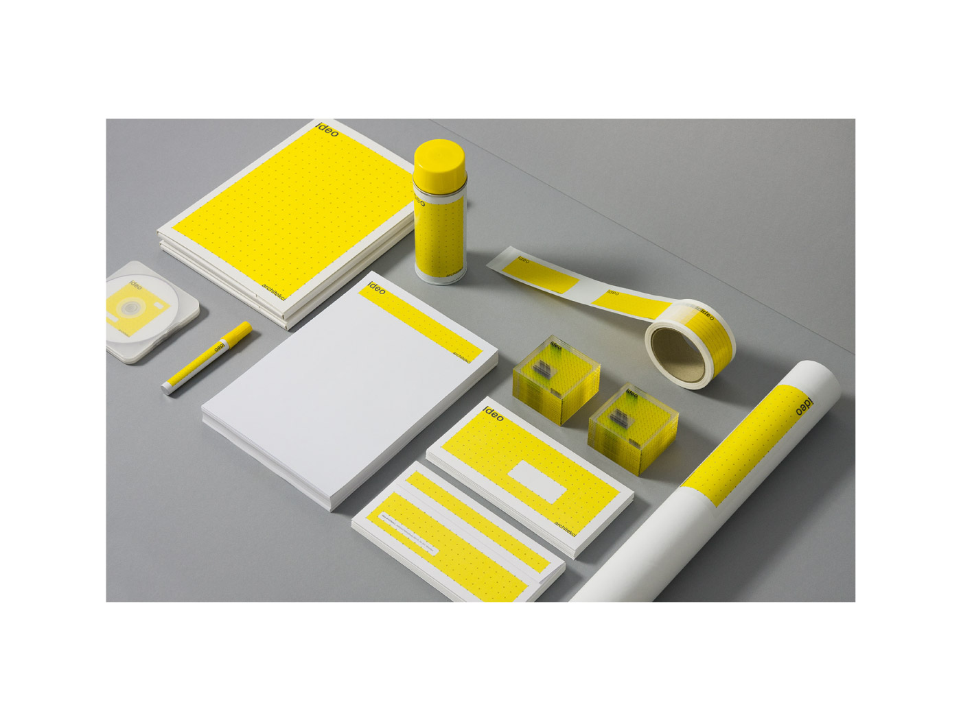

Slide 56
BUDGET

Slide 57
INTERNAL
COMMUNICATION
FOR EXTERNAL
COMMUNICATION

Slide 58
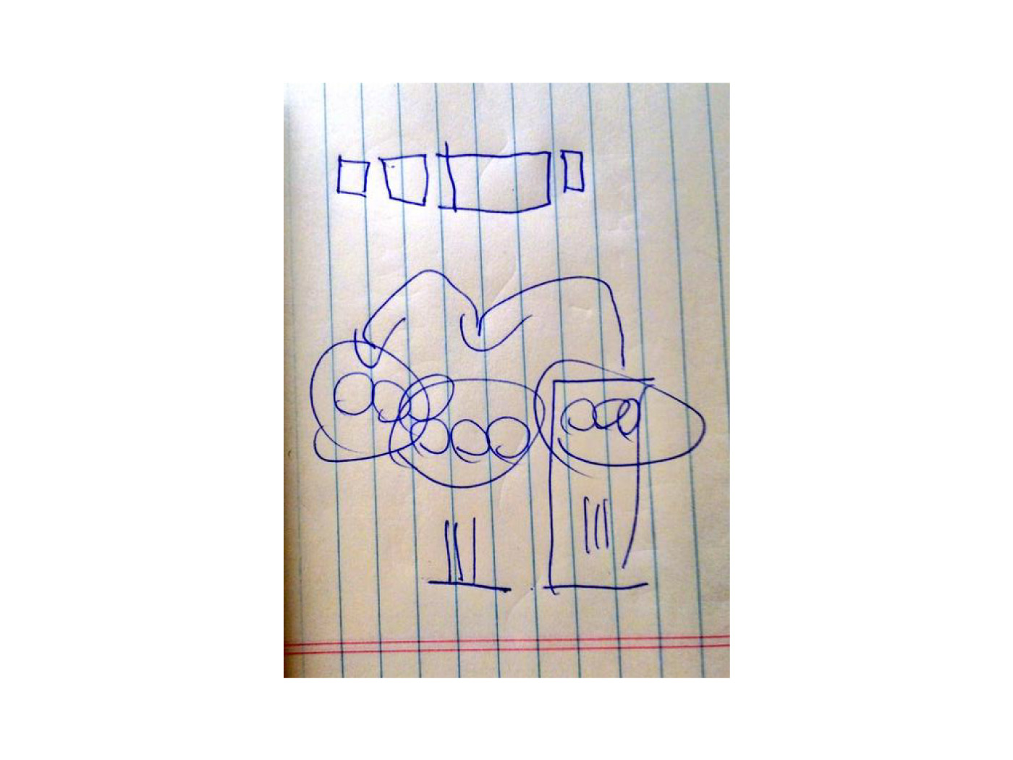

Slide 59
TESTING

Slide 60
AUDIENCE

Slide 61
SPECIALIZED
AUDIENCE
NON-SPECIALIZED
AUDIENCE

Slide 62
Enviroment
Daily life
School
Neighbourhood
NON-SPECIALIZED
AUDIENCE

Slide 63
SPECIALIZED
AUDIENCE
CSO’s
Journalist
Academia
Etc.

Slide 64
INFORMATION
MUST BE
DESIGN TO
GENERATE CITIZEN
UNDERSTANDING
You never know…

Slide 65
INFORMATION
MUST BE
DESIGN TO
GENERATE CITIZEN
UNDERSTANDING
Only text?

Slide 66
We live in a
VISUAL SOCIETY
where photo,
video, illustration,
etc. overtakes
speed transmission
over text

Slide 67
Research has shown
that the brain
processes graphics
60,000
times faster
than text

Slide 68
10 TIPS
Putting graphic design on to a number is not to citizenize it
Showing non-disintegrated information is wasting it
Don’t imitate, just be inspired
Speak positively, beware of not sounding like official advertising
The format speaks volumes
Respect the corporate identity
Budget
Good internal communication for external communication
Testing
Audience
11?

Slide 69
10 TIPS
HOW
to communicate
budget?

Slide 70
11?

Slide 71
PEOPLE LOVE
COUNTING

Slide 72
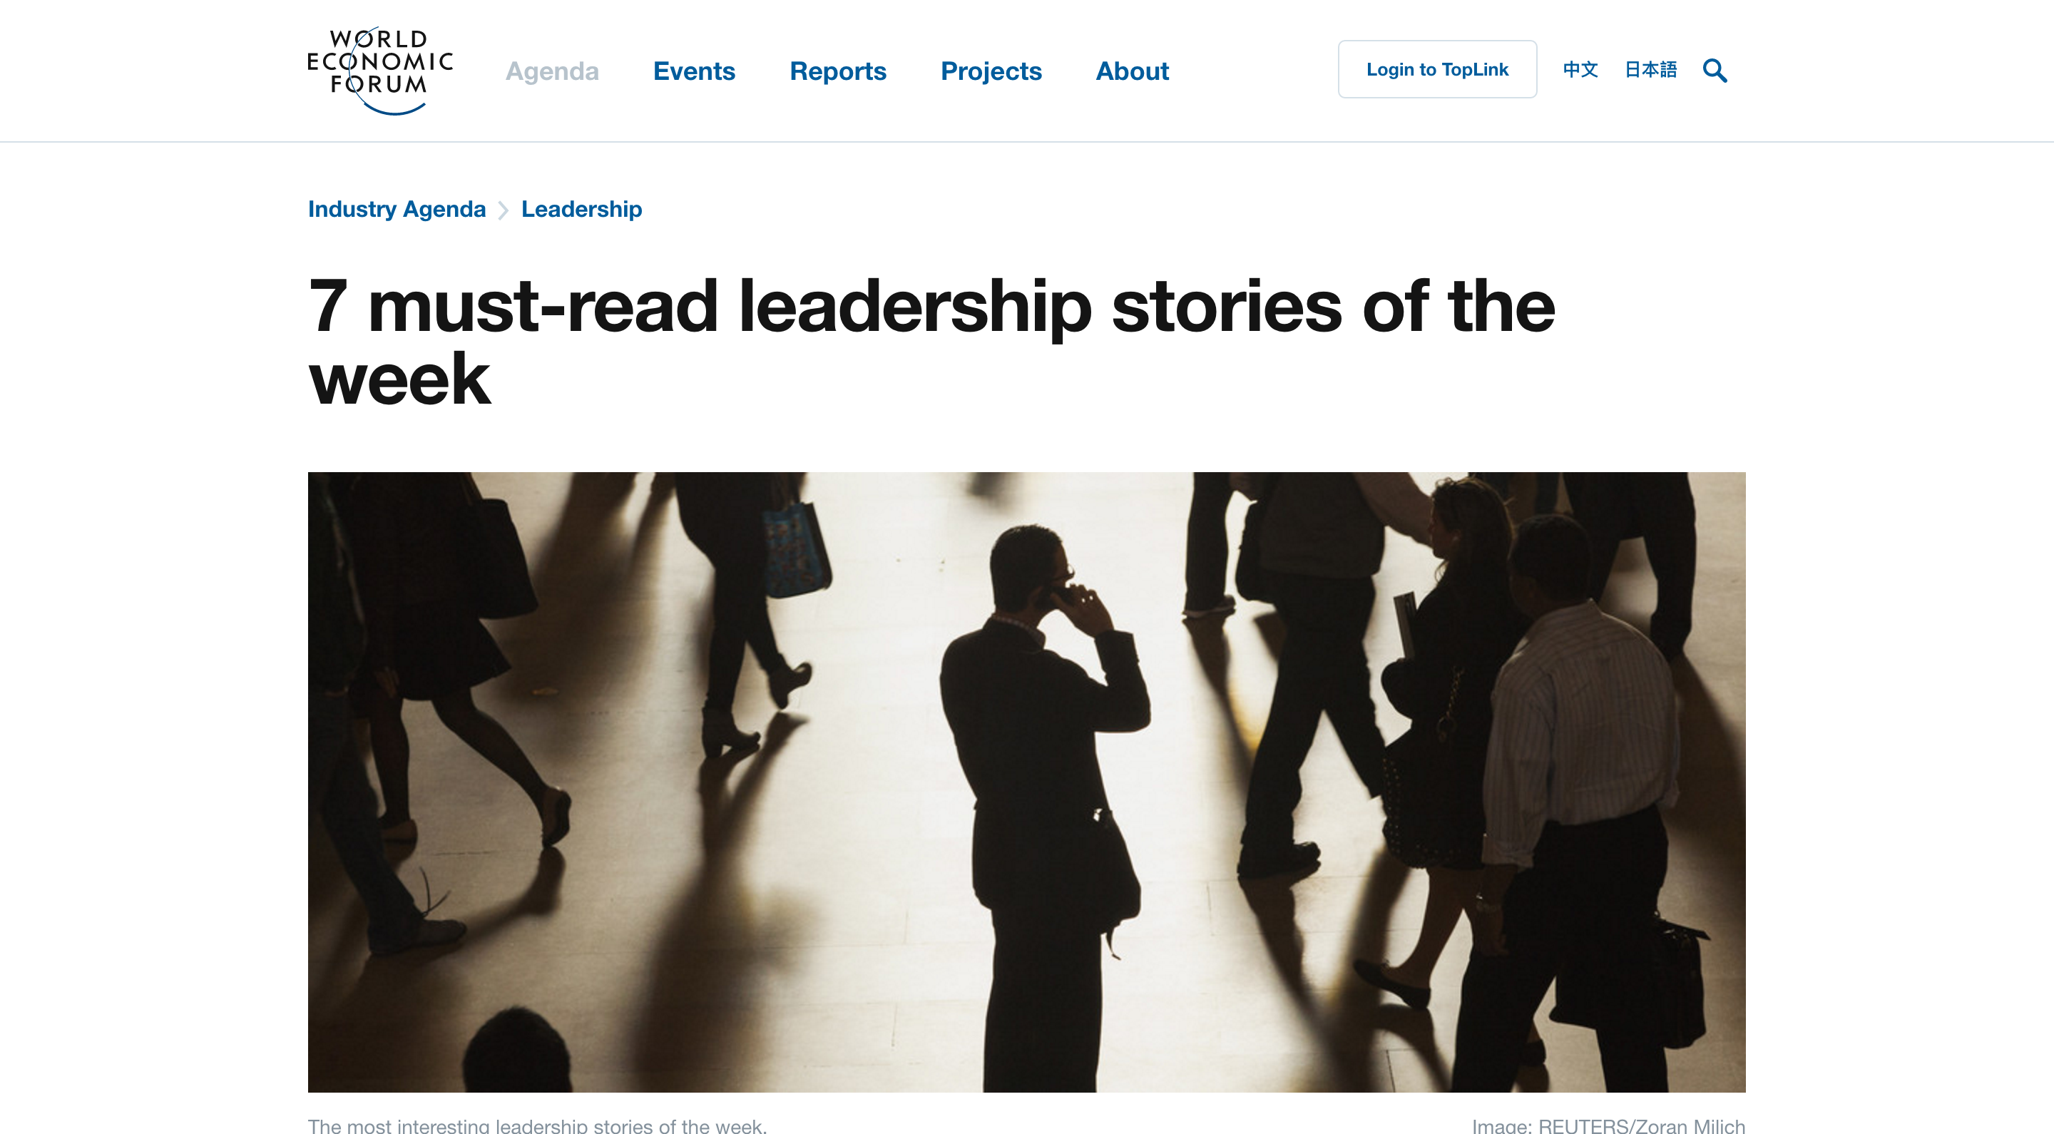

Slide 74
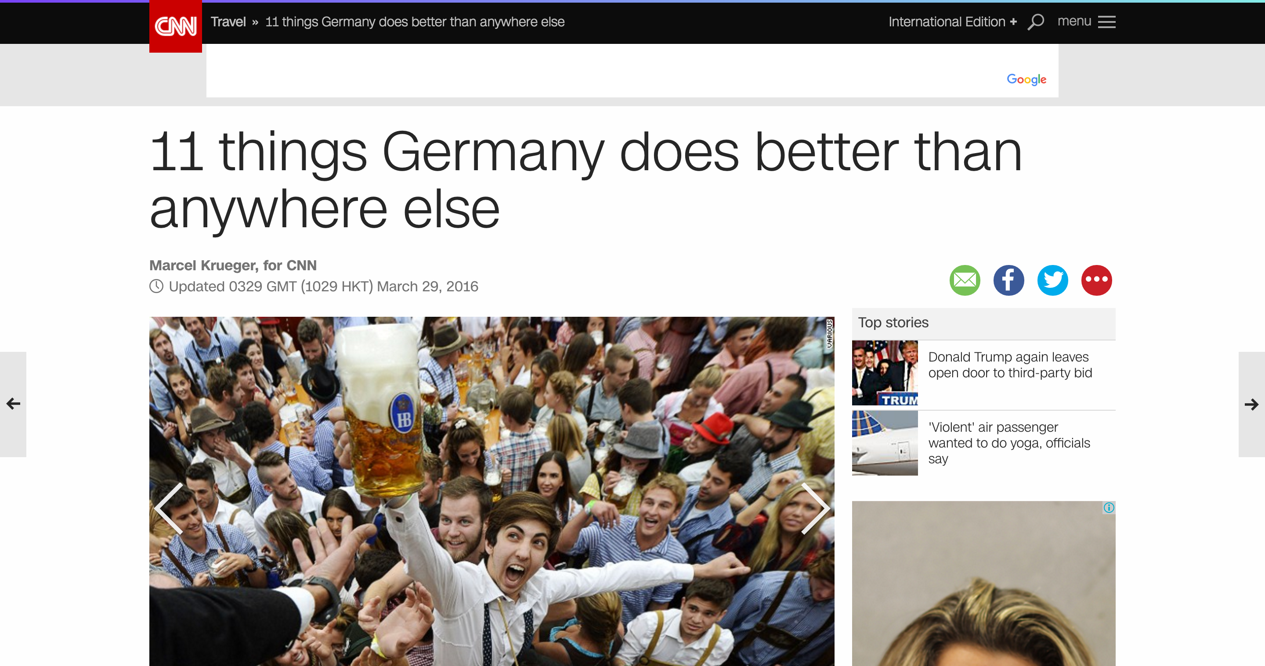

Slide 75
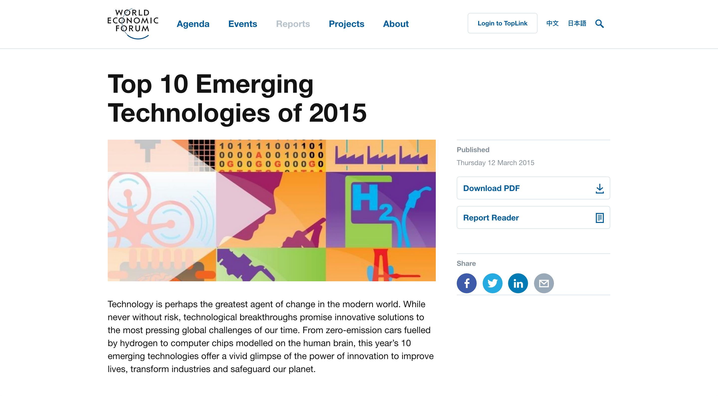

Slide 76
Engage with us!
@fiscaltrans
www.fiscaltransparency.net

