Slide 1
Engaging Citizens to Monitor Performance in Service Delivery
PEMNA Budget CoP
Seoul, South Korea. March 20, 2019
Lorena Rivero del Paso
Manager for Technical Cooperation and Collaboration
lorena@fiscaltransparency.net
@LorenaRDP

Slide 2
Shifting the discussion:
from allocations to performance

Slide 3
Examples of Engagement
to Monitor Performance
Monitoring of Public Investments: #DataOnTheStreets Rally
Engagement on performance monitoring: Better Budget Dataquest
Direct engagement to improve performance indicators

Slide 4
Engagement through Public Investment Data

Slide 5
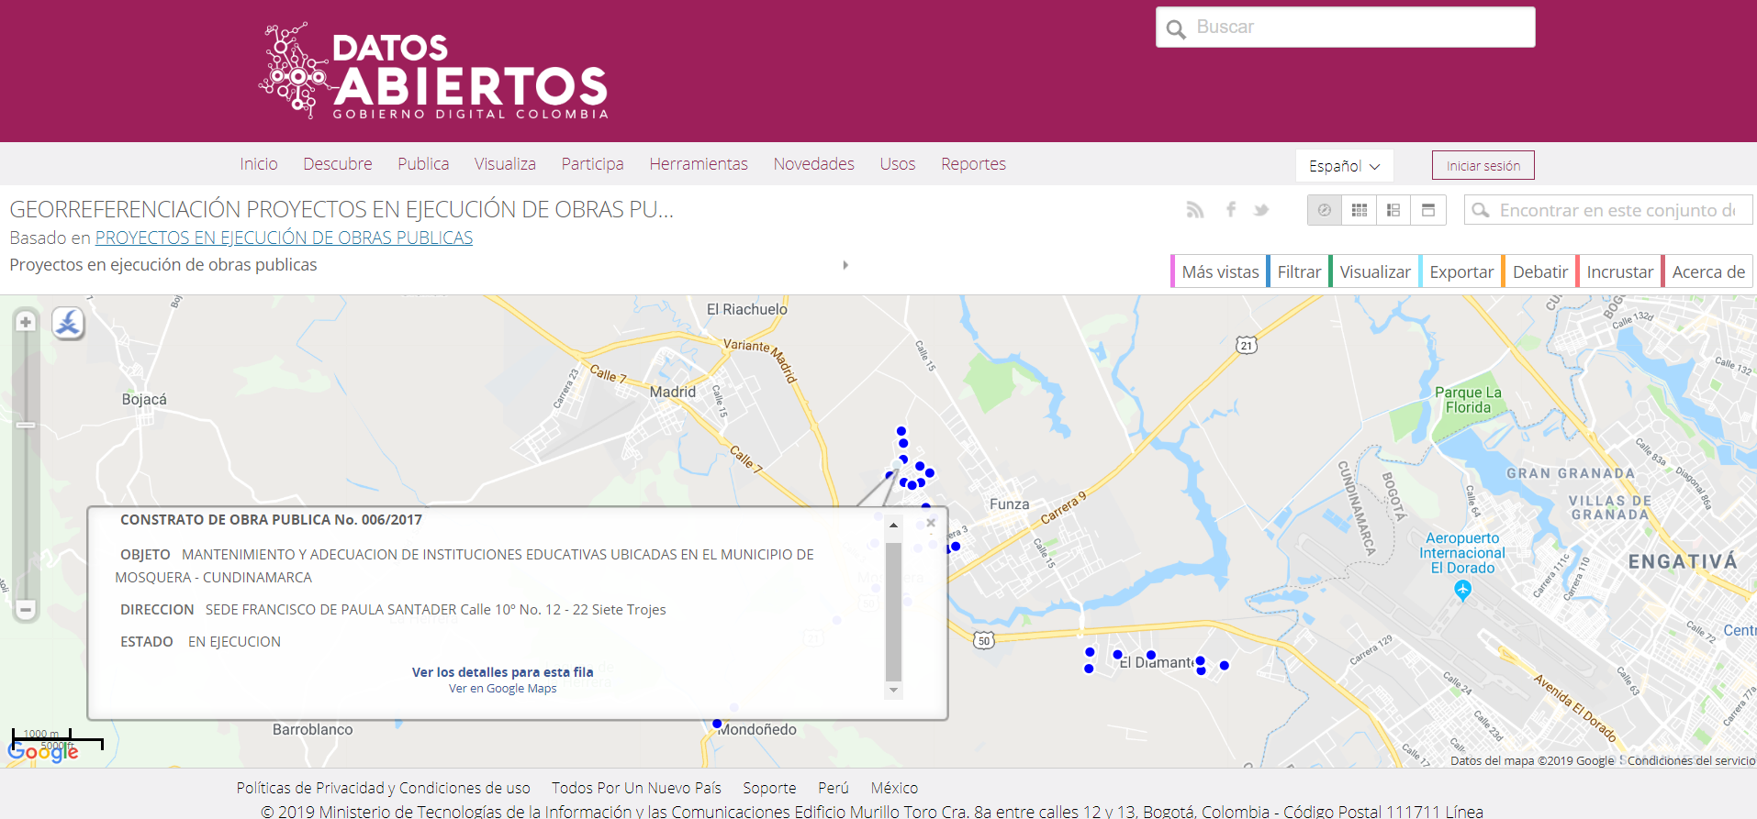
From Transparency to Participation

Slide 6
Building a bridge
Shows open data is NOT only for IT specialized users.
Open data is useful for internal and external users.

Slide 7
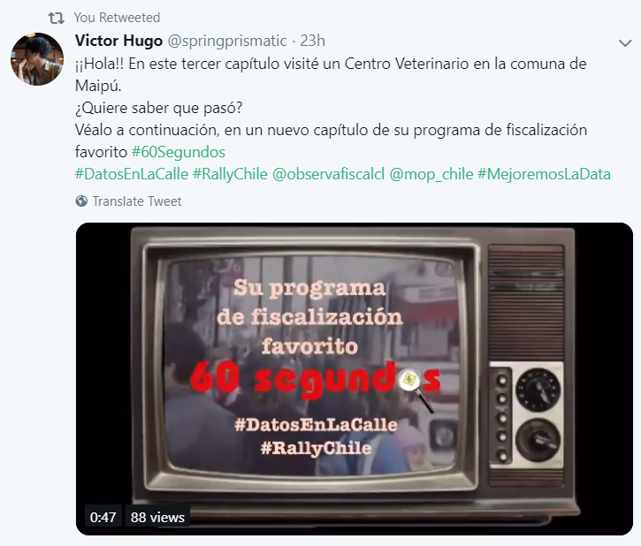
#DataOnTheStreets Rally 2019

Slide 8
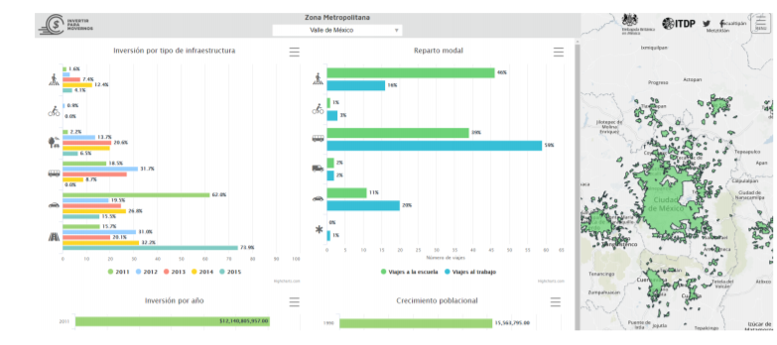
#DataOnTheStreets Results
Changes in Budget program design to incentivize sustainable urban mobility
Redesign of the Subnational Government Investment Project Reporting System

Slide 9
Engagement for Performance

Slide 10
How it Works:
The Better Budget Dataquest
Teams of up to five individuals will explore the spending dataset and by contextualizing with other data they should come up with findings for one of the following categories: gender, inequality or environment.
A multimedia piece, the start of a research project or a human story must be presented by the end of the event.

Slide 14
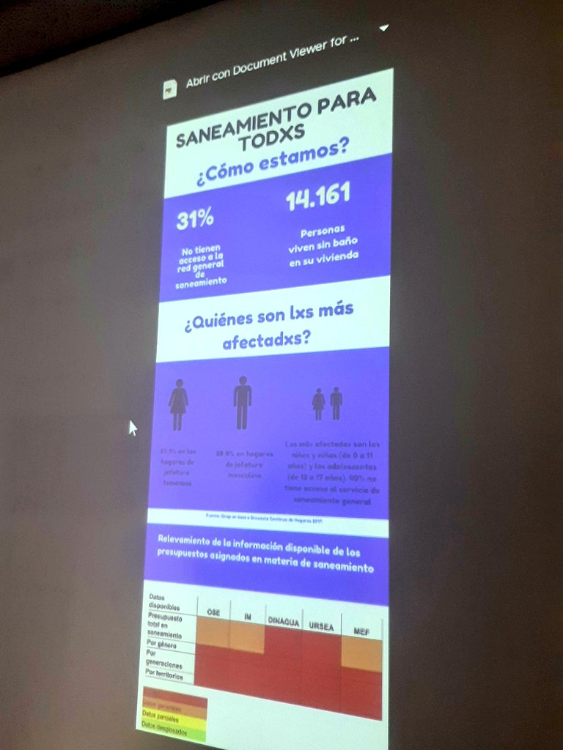
Better Budget Dataquest

Slide 15
Engagement for Performance Indicators
Mexico Federal Government

Slide 16
Open Performance Evaluation System: Open public consultation on performance indicators

Slide 17
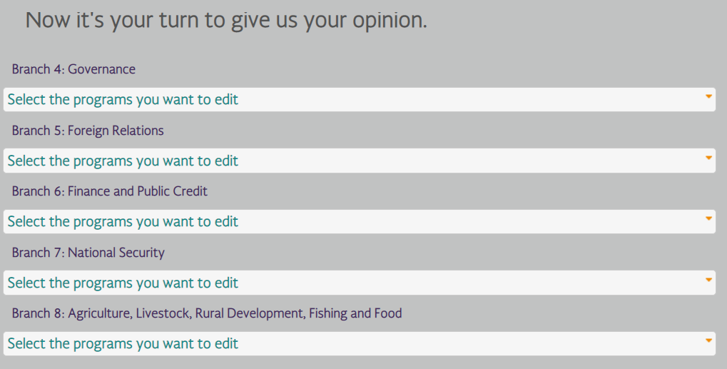
Open Performance Evaluation System: Open public consultation on performance indicators
Opinions and proposals were filtered by the Mexican MoF Performance Evaluation Unit and then reviewed with line ministries.

Slide 18
Stay tuned!
@fiscaltrans
@fiscaltransparency
@fiscaltransparency
www.fiscaltransparency.net

