Slide 1
PUBLIC PARTICIPATION Brazilian Experience
Daniel Pitangueira de Avelino
IPEA - Brazil

Slide 2
BRIEF OVERVIEW
SOME CASES
LESSONS LEARNED

Slide 3
PUBLIC PARTICIPATION
UNIVERSAL DECLARATION OF HUMAN RIGHTS (1948)
Article 21.
(1) Everyone has the right to take part in the government of his country, directly or through freely chosen representatives. (2) Everyone has the right of equal access to public service in his country. (3) The will of the people shall be the basis of the authority of government; this will shall be expressed in periodic and genuine elections which shall be by universal and equal suffrage and shall be held by secret vote or by equivalent free voting procedures.
(Source: OHCHR-UN)

Slide 4
BRIEF OVERVIEW
1964-1985: dictatorship
self-organizing civil society
1980’s: pathway to Constitution
1990’s: fiscal and political constraints
2000’s: participatory expansion
2010’s: ruptures
2020’s: ???

Slide 5
SOME CASES
Participatory budgeting
Councils
National Conferences
Integrated Platform of Ombudsmen

Slide 6
PARTICIPATORY BUDGETING
Mayor
Forum of Representatives
Local assemblies
Thematic assemblies
Council of Participatory Budgeting
Investment Plan
consultative process of Executive branch
part of budgeting process – before submission to Legislative;
methods may vary – from local assemblies to digital forums;
involves prioritizing social needs within a specific share of budget;
Porto Alegre 1989

Slide 7
COUNCILS
NATIONAL COUNCIL OF HEALTH
48 members (25% gov)
26 State councils
5,570 Local councils
36 Indigenous district councils
permanent boards of Executive branch
composed by representatives of both governmental and civil society organizations;
powers and competences may vary – from merely advisory to decision-making;
horizontality: each member shares the same amount of power.
Source: SIACS
since 1937

Slide 8
NATIONAL CONFERENCES
16th NATIONAL CONFERENCE OF HEALTH
2,994 participants
26 STATE CONFERENCES
22,839 participants
4,612 MUNICIPAL CONFERENCES (82.80%)
Free and Regional Conferences
periodic thematic consultative processes of Executive branch
hierarchical series of events organized throughout all territory;
lower level conferences send representatives and proposal to upper levels;
it results into a prioritized list of proposals or a national plan.
Source: 2019 Report
since 1941

Slide 9
INTEGRATED PLATFORM OF OMBUDSMEN
National System of Hearing Offices
manag. reports
private apps
auditing actions
open data
individal demands
public decision
services of hearing office through internet;
integration with actions of open government;
based on principles of open data;
de-fragmentation: integration of digital channels;
individual-based.
Source: Fala.BR
since 2015
1,304,921 demands
60% resolution
24.72 days answer

Slide 10
LESSONS LEARNED

Slide 11
CONNECT TO A PUBLIC DECISION
clear connection between public participation and a future public decision;
informed participation;
participants will develop strategies based on the odds and expected results;
participation is an investment of time, effort, and hope.
DECISION
Results
Reports
Methods
Channels
Participants
Public interests

Slide 12
CONSIDER EXISTING INITIATIVES
context matters;
civil society is not static or passive;
society tends to develop a diverse system of solutions for their problems on their own;
when ignored, they can generate concurrence and legitimacy disputes.
CIVIL SOCIETY
Forums
Communities
Networks
Campaigns
Assemblies
Organizations
participation
GOVERNMENT

Slide 13
COMPENSATE INEQUALITIES
do not expect to be neutral and do not pretend to be;
some groups will always have facilitated access to public decisions regardless of participation;
hence, vulnerable groups must be supported and protected;
methods can (and must) balance inequalities.
PUBLIC DECISION
OVERREPRESENTATION
PARTICIPATION

Slide 14
INSTITUTIONALIZE
PARTICIPATION
it is all about resilience;
“innovation” is as easily created as easily destroyed;
all state procedures can involve participation;
bureaucracy (sometimes) can help.
● Constitution
● Laws
● Provisional measures
● “look du jour”

Slide 15
MONITOR AND EVALUATE
how else can you know if you did it right?
tangible and intangible results;
it is the best way to correct a failure or improve a success;
attendance (public support) still is the best indicator.
● Support
● Time
● Visibility
● Cost

Slide 16
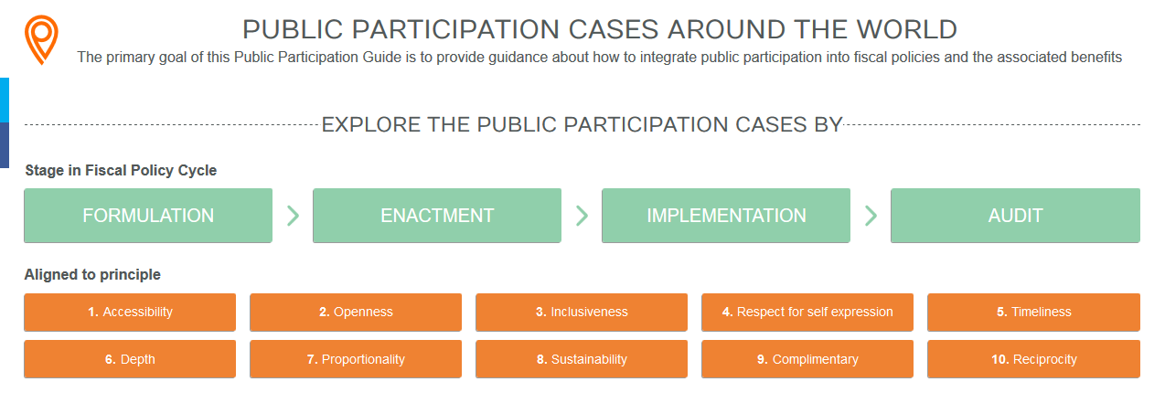
GIFT – PUBLIC PARTICIPATION CASES
guide.fiscaltransparency.net

Slide 17
obrigado!
Stay safe!
Daniel Pitangueira de Avelino
daniel.avelino@ipea.gov.br
+55 (61) 2026-5500
www.ipea.gov.br/participacao

