Slide 1
Modernization of FMIS Business continuity during COVID 19 crisis
Reunión Anual de Consejeros GIFT 2020

Slide 2
March 2020 - COVID 19 Crisis
Are the administration ready to work in “remote control mode”?

Slide 3
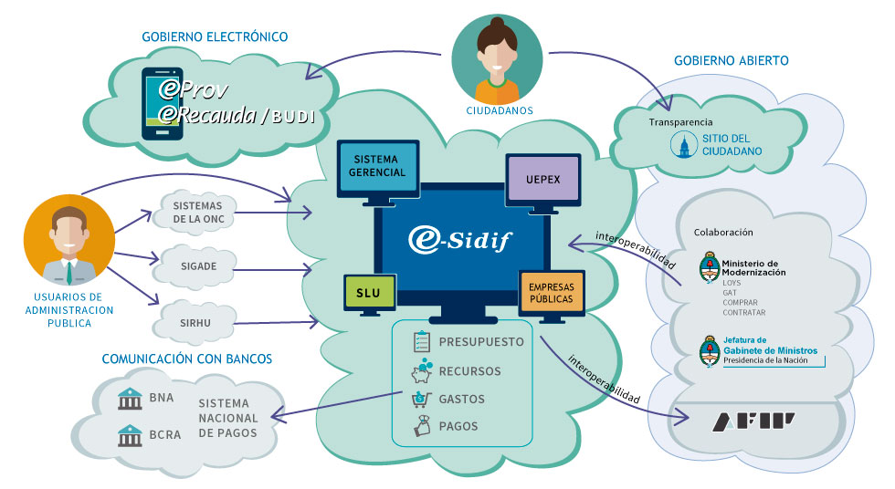
ARGENTINA – FINANCIAL MANAGEMENT INFORMATION SYSTEMS
PRESUPUESTO ABIERTO
BAPIN

Slide 4
2019 HIGHLIGHTS
BUDGET PROGRAMS
400
126
3228 Budgets activities
AGENCIES
2.300
Goals and indicators defined
21.000
NOMINAL USERS
PAYMENTS
3.000
1.270.000
Number of payments delivered through eSidif to the Bank System.
CONCURRENTS USERS

Slide 5
WHAT ABOUT THE ADMINISTRATION SYSTEMS?
Electronic documental
management system
Electronic procurement system with automatic budget allocation via web services with FMIS

Slide 6
Not so quickly!
FMIS requires access through VPN (Virtual Private Networks), the users need to install a certificate to access
Some operations need to be digitally signed with a physical token, needs a driver to operate properly
Some operations (for example sending payments to bank) need to be done in specific PCs located in the ministry
+

Slide 7
Some other issues
A lot of users requires access to local networks drives or to their pcs – We need remote access to their desks
Certains operations in Data Center should be presentials so we need to ensure access to buildings and circulation authorization to some of our workers
Our help desk needs to operate remote without changing contact information (phone numbers were derivated to personal phones)
+

Slide 8
What have we done?
Ensure critical business processes solving the most critical issues (certificates, access, etc.)
Launch a “remote work” project
Publish and distribute a guide of good practices
Organize virtual courses to support final users demands
Organice a poll to ask our workers and users about remote work conditions
Make a procurement plan with considerations in order to be well prepared for the future
Organize virtual activities and meetings with users in order to continue with our developments plans

Slide 9
Challengues and results
Solving issues and problems demand us a extreme effort but crucial operations could continue without stopping, we could pay salaries 7 days after the quarantine started and budget could be modified to deliver some new social programs in order to attend the emergency.
2019 Year End Report was delivered on time to the National Congress
2021 Budget Formulation Process is happening in remote work but on time
National Government could sent, for the very 1st time in history, a budget modification to be discuss in the National Congress
SubNational Govs which use our system could continue with business without problems

Slide 10
All core PFM business processes supported by FMIS
Non paper business process needed (electronic administrative and procurement systems)
High level commitment of the political authorities
A dedicated team with great experience (DGSIAF is an IT team dedicated only to FMIS)
Conclusions
Keys of success

Slide 11
What’s next? What about the modernization of our FMIS?
¿Why change? → IT Surveillance
Market
Products
Industry
Users
Institutions
Vendors

Slide 12
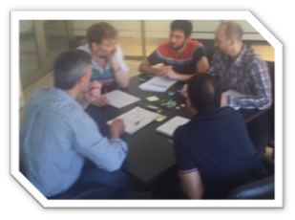
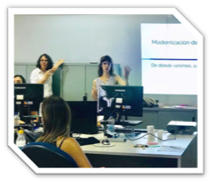
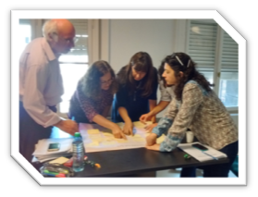
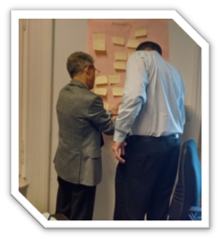
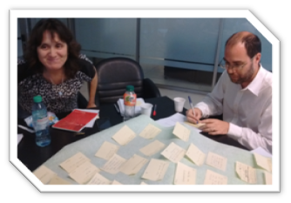
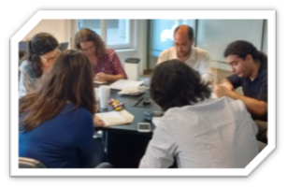
¿How do we start? → Innovation Lab

Slide 13
Four aspects to work with
Cloud Native
Process Innovation
Architecture
Data Analytics

Slide 14
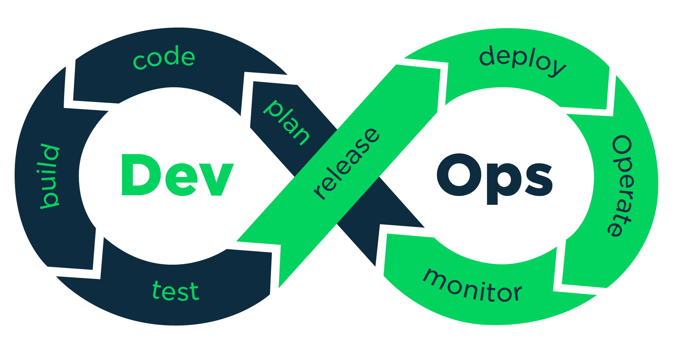
Cloud Native
La distribución de la comunidad Kubernetes que impulsa Red Hat OpenShift.

Slide 15
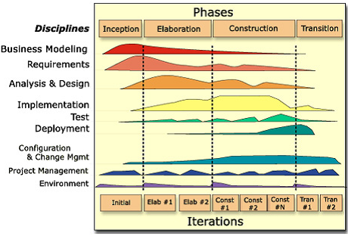
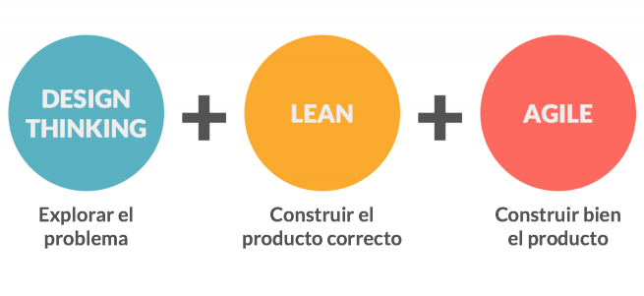
Process Innovation
eSidif
actual FMIS
What do we want

Slide 16
Problem Definition
eSidif
actualFMIS
What do we want
Notes:
Comité de usuarios vs User Experience Research

Slide 17
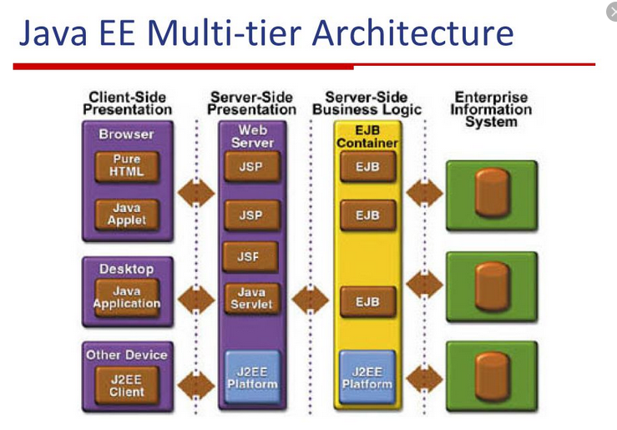
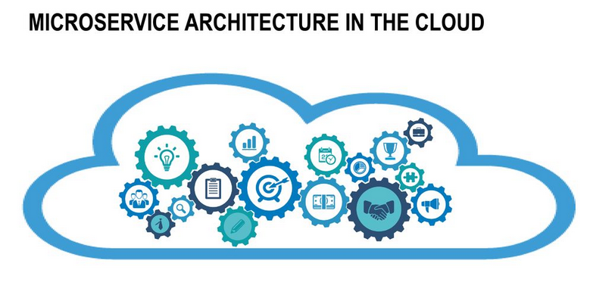
Software Architecture
eSidif
Actual FMIS
What do we want

Slide 18
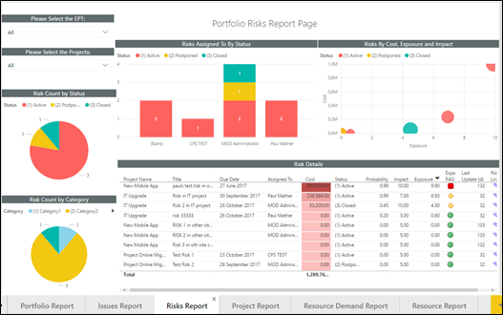
Data Analytics
eSidif Gerencial
Actual FMIS BI
What do we want

Slide 19
Modular approach
In house development with participation of consulting to help us in guiding
High level commitment of the political authorities
Innovation activities (like innovation labs) to face the innovation challenges
Conclusions
Modernization of FMIS
.

Slide 20
Thank you!

