Slide 1
FAD Fiscal Risk Analysis Tools:
SOE Health Check
October 22, 2020
Sybi Hida
Fiscal Affairs Department, IMF
Albrecht Dürer; The Four Horsemen, from the Apocalypse

Slide 2
Which central government would face larger fiscal risks from the SOE sector?
Total Liabilities of the SOE sector
(2015, Percent of GDP)

Slide 3
Which central government would face larger fiscal risks from the SOE sector? cnt
Total Liabilities and Assets of the SOE sector
(2015, Percent of GDP)

Slide 4
Agenda
  Why worry about fiscal risks from SOEs? (brief)
  Understanding fiscal risks from SOEs (brief)
  Assessing fiscal risks from SOEs (brief)
  SOE Health Check Tool
  Using the SOE Health Check Tool

Slide 5
Why Worry about Fiscal Risks from SOEs:
SOEs are significant economic players accounting for a large share of public sector activity
Globally, SOEs account for 40% of output, 20% of investment, and 5% of employment
SOEs deliver key critical services in important economic sectors
SOEs account for a significant proportion of a country’s net wealth
Many SOEs rank amongst the world’s largest companies
Underperforming SOEs have high social and economic costs
Troubled SOEs can impose large fiscal costs on the budget
Shortages of key infrastructure, often provided by SOEs, is one of the top three constraints on growth
Loss-making SOEs weaken the financial system
Poor performance can erode a country’s wealth
Underpricing of risks and crowding out of the private sector by financial SOEs can slow financial market development, reduce access to financial services, and weaken the financial system

Slide 6
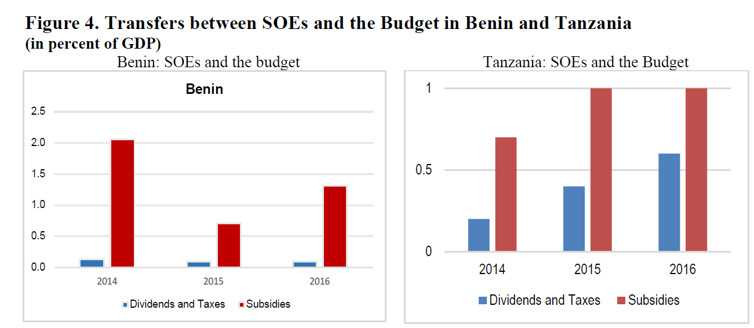
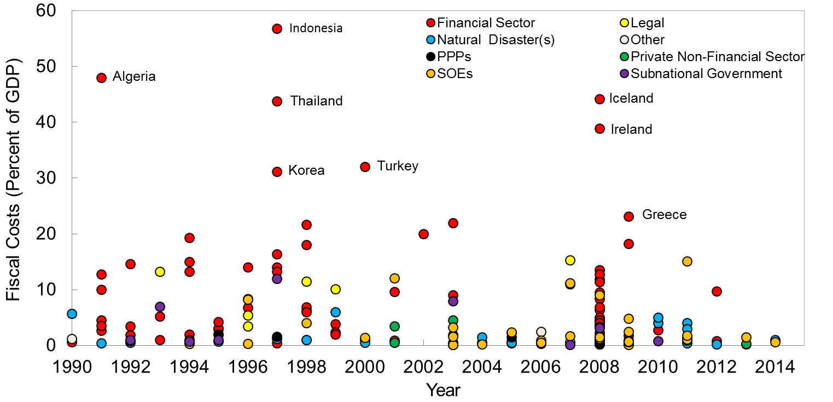
Why Worry about Fiscal Risks from SOEs:
Fiscal risks from SOEs can be substantial
Average cost of bailouts was 3% of GDP
In some cases, bailouts amounted to 10-15% of GDP
Relationship between SOEs and the budget
Source: Baum, A. and others. 2020. “Managing Fiscal Risks from State-owned Enterprises”, IMF

Slide 7
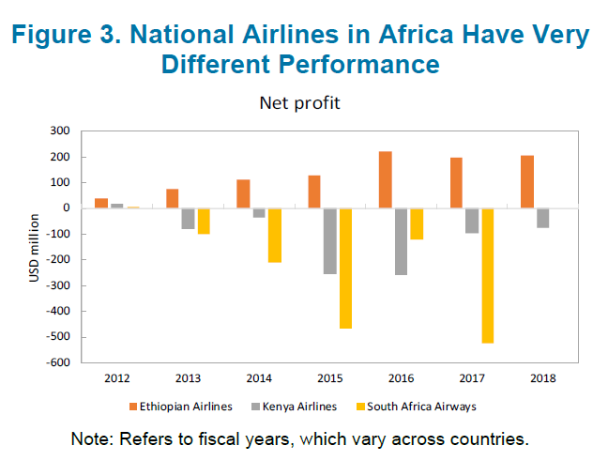
Why Worry about Fiscal Risks from SOEs:
Institutional and governance weaknesses can compound risks
SOEs used as mechanism for circumventing traditional fiscal controls
Unclear or uncompensated public policy mandates can weaken performance
Poor internal governance can reduce returns and exacerbate risks
Financial reporting systems often fall short of best practice and undermine accountability
Source: IMF, 2020, Government Support to State-Owned Enterprises: Options for Sub-Saharan Africa,

Slide 8
Fiscal risks from SOEs
Fiscal risks are factors that may cause fiscal outcomes to deviate from expectations or forecasts
Direct impact on fiscal indicators
Lower than anticipated taxes, royalties or dividends received from SOEs
Higher transfers to SOEs in the form of subsidies or grants
Larger loans or equity injections required by SOEs
Lower than planned collection on loans provided by the government
Crystallization of contingent liabilities
Indirect impact on fiscal indicators
Poor operational performance and underinvestment in infrastructure negatively impacts on economic growth
Direct impact on fiscal indicators
Impact on public sector balance sheet
Poor financial performance and negative valuation effects reduce value of SOEs

Slide 9
Understanding Fiscal Risks from SOEs:
SOE-level Risks Generate Fiscal Risks
Fiscal risks from SOEs
Economic and financial market risks
Assets and infrastructure risks
Employee risks
Demand, pricing, supply, and cost risks
Technology and environmental risks
Legal policy and regulatory risks
Other risks
SOE-level risks are more likely to have a fiscal impact in SOEs that are:
Thinly capitalized: equity serves as a cushion that enables companies to absorb shocks
Loss-making: recurring losses erode the company’s equity. Loss-making companies are not cash generative making them reliant on being able to raise debt
Low levels of liquidity: Companies may be unable to meet their obligations as they fall due

Slide 10
A range of complementary approaches for assessing fiscal risks from SOEs
Financial ratio analysis [SOE Health Check Tool]
  Assess performance and risk: profitability, solvency and liquidity
  Identify relations with government: tax and dividend inflows; subsidies, loans, equity and contingent liabilities; arrears
  Composite risk indicators (e.g. Altman Z-score)
  Forecasting and stress-testing [SOE Forecasting and Stress Test Tool[
  Used to test financial resilience of SOEs
  Baseline cash flow forecasts generated
  Forecasts subjected to a range of shocks to assess impact on performance, ability to service debts and fiscal impact
  Other quantitative analysis
  Benchmarking to peers
  Deeper analysis of key sources of risk
    Drivers of revenues and costs
    Analysis of debt composition (exchange rates, fixed/floating) and redemption profile
    Aging profile of debtors and creditors
  Qualitative analysis
  Assess factors that increase vulnerability: competitive position, industry, management, governance
  Requires judgement and knowledge of SOE and its operating environment

Slide 11
Assessing Fiscal Risks from SOEs:
Linking Fiscal Risks to Financial Ratios
Fiscal Risk | Main Sources of Risk at SOE-level | Key Financial Ratios
Lower dividends and taxes | Lower revenues Higher costs | Deteriorating profitability ratios
Higher subsidies | Higher costs of subsidized activities | Deteriorating profitability ratios
Increase to equity | Losses eroding equity Unsustainability high debt levels Write-off or impairment of assets | Deteriorating solvency ratios (debt to assets)
Increase in loans | Weak internal generation of cash (often due to poor profitability) Poor working capital management (collection from debtors and payment of creditors) Inadequate access to market financing to meet obligations as they fall due | Deteriorating liquidity or solvency ratios (interest coverage)
Crystallization of contingent liabilities | Weak internal generation of cash (often due to poor profitability) Inadequate access to market financing to meet obligations as they fall due | Deteriorating liquidity or solvency ratios (interest coverage)

Slide 12
SOE Health Check Tool

Slide 13
What does the SOE Health Check Tool do?
  Provides for the compilation of data for 40 SOEs over a period of up to 15 years
  Computes a set of financial ratios based on income statement and balance sheet information
  Assigns an overall risk rating to each SOE based on set risk thresholds and/or z-score to flag the SOEs that are at the highest risk of generating fiscal risks
  Identifies SOEs with the largest outstanding liabilities, as an indication of the government’s risk exposure
  Produces aggregate charts and indicators that allow an assessment of the financial soundness of the SOE sector as a whole
  Provides ratios and charts to enable an in-depth analysis of individual SOEs
  How can the analysis be used?
  Estimate likelihood of risk realization and associated fiscal costs
  Inform policymakers which SOEs may require more intense monitoring and remedial actions
  Basis for disclosing information relating to the SOEs
  Features
  Useful even when data may be limited – only abridged income statement and balance sheet data required
  Minimizes intensive data manipulation and automatically calculates ratios and produces charts
  Provides an interface for compilation of a Public Sector Balance Sheet

Slide 14
What does the SOE Health Check Tool not do?
  Tool is designed for the analysis of non-financial public corporations. The ratios are not appropriate for analyzing banks.
  Provides for a static analysis of both historical financial information and existing forward-looking projections. However, it does not generate forward-looking projections on which the impact of shocks can be tested.
  Starting point for analyzing SOEs using financial ratios to be complemented by other analysis, e.g. scenario analysis, sensitvity testing and stress tests or analysis of additional quantitative and qualitative information
  Risk thresholds are applied across the SOE portfolio, although the level of risk may vary by industry
  Tool can accommodate up to 40 SOEs, but the number of SOEs in the portfolio may be much larger

Slide 15
FAD has piloted the tool in several countries and is working to finalize it
Using the SOE Health Check Tool

Slide 16
Structure of the SOE Health Check Tool
Inputs
Main
Calculation Sheets
Data
Outputs
Risk Tables
Input Forms
Parameters (optional)
Companies
Ratios
Agg Ratios
Aggregates
GDP
Aggregate Level
Single SOE Level
Aggregate Balance Sheet

Slide 17
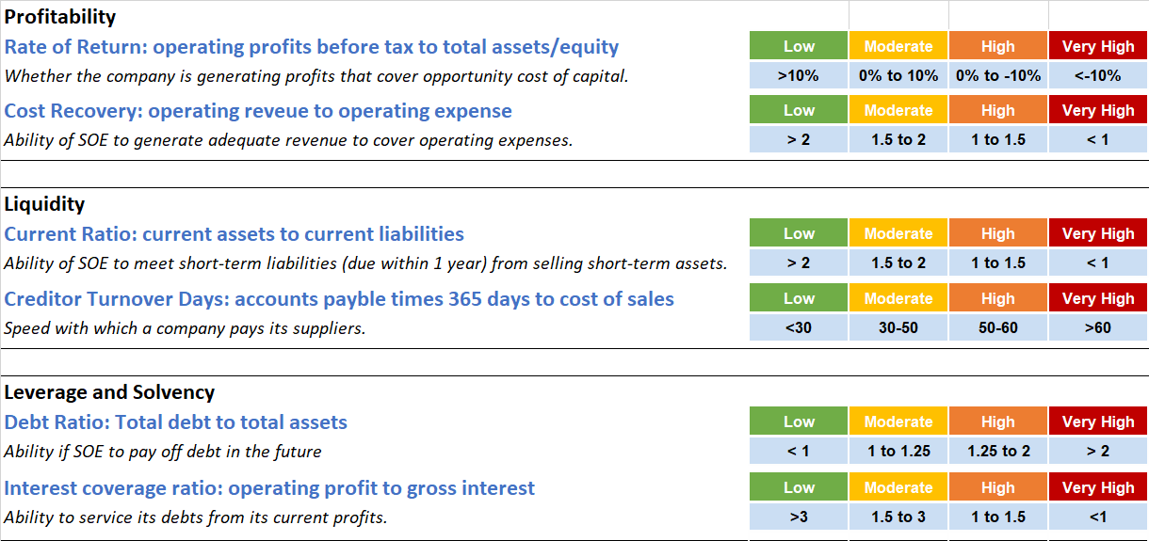
SOE Health Check Tool:
Financial Ratios

Slide 18
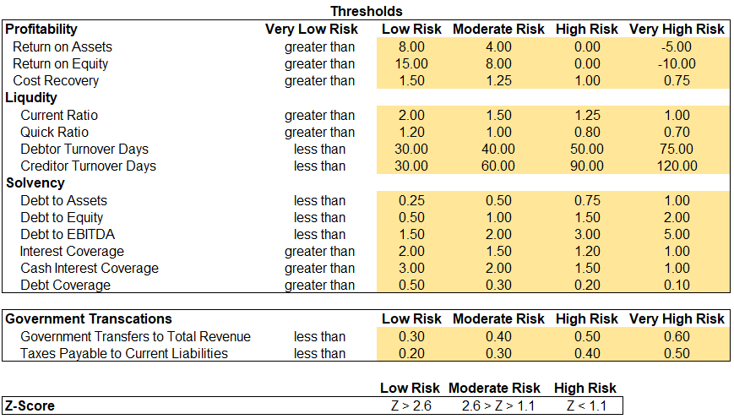
Inputs: Parameters sheet
Adjust thresholds for classification of risk ratios

Slide 19
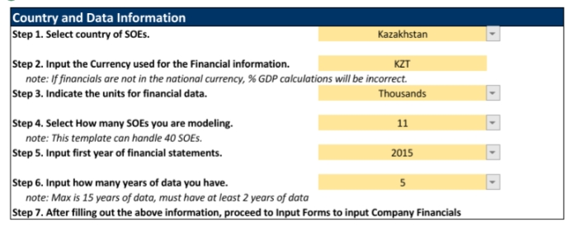
Inputs: Main sheet
  Country and currency data
  Description of the data
    Unit in which financial data will be entered
    Number of SOEs
    First year
    Number of years of data (can include years for which forecast financial data is available)

Slide 20
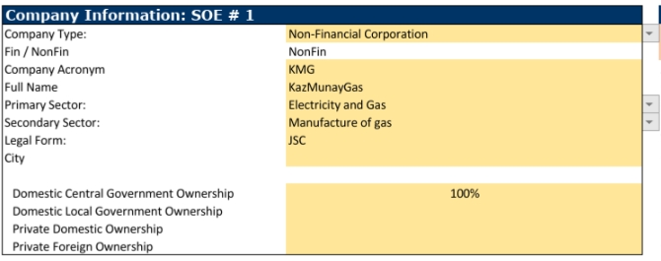
Inputs: Input Forms sheet
  Descriptive data
    SOE name
    Financial / Non-financial
    Sector in which SOE operates
    Legal form
    Ownership data
  Financial data
    Abridged income statement and balance sheet
  Government transaction data
    Guaranteed debt
    On-lending
    Loans from the government
    Capital and current transfers
    Equity injections
  Data sources
  Financial statements of SOEs
  Budget documentation
  Fiscal risk statement
  Government financial statements
  Relevant authorities (Budget department, Debt department, Treasury)

Slide 21
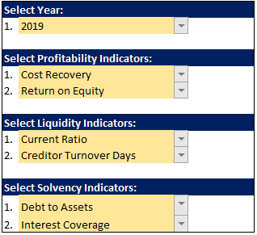
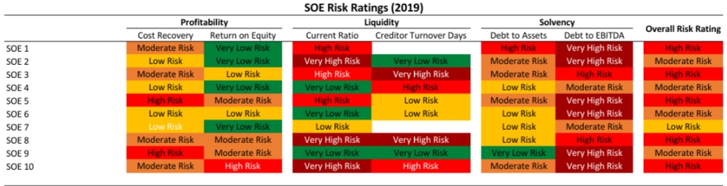
Outputs: Risk Tables
  Select ratios used to calculate SOE risk ratings
    Risk rating is calculated as the simple average of the risk ratings for each ratio
  Provides overall risk assessment for each SOE for the selected year
Insert illustration of output

Slide 22
Outputs: Aggregate Level
  Charts showing the evolution of SOE Sector over the previous 5 years (next slide)
    Profitability: return on assets, operating profit margin, net profit margin
    Solvency: debt coverage and interest coverage
    Liquidity: current ratio
  Weighted average financial ratios
  Summary financial information
  Distribution of risk ratings
  Charts comparing the SOEs for the most recent year
    Liabilities
    Net liquid assets
    Debtor and creditor turnover days

Slide 23
Outputs: Aggregate Level

Slide 24
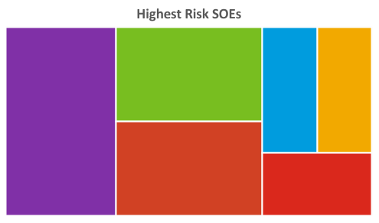
Outputs: Aggregate Level
SOE 5
SOE 6
SOE 1
SOE 2
SOE 3
SOE 4

Slide 25
Outputs: Single Company View
For the selected SOE
  Charts of financial ratios
  Financial ratios over the last 5 years (guidelines for interpretation can be found in Ratio Metadata Sheet)
  Risk ratings and z-score for each of the last 5 years
  Summary income statement and balance sheet information

Slide 26
Other output sheets
  Aggregate Balance Sheet: provides an aggregate SOE sector balance sheet and income statement both in International Financial Reporting Standards (IFRS) format in local currency as well as percent of GDP terms.
  Company Summary: Government Financial Statistics (GFS) style representation of the SOE financials is presented by year by SOE. This is a different way to represent the public sector balance sheet (PSBS) inputs that can assist toward the compilation of a PSBS. It should be noted that unlike in IFRS, under GFS the equity is classified as a liability.
  PSBS Input NFFCT: A GFS representation of the aggregated SOE financials by year is provided. It facilitates the compilation of a PSBS.
  PSBS Consolidation: Information for consolidating the SOE sector with the General Government is presented. SOE assets and liabilities are consolidated with the General Government based on user-input data in the Input Forms. Line-items in the balance sheet including short-term / long-term assets and liabilities from the government are used for this consolidation.

Slide 27
Quality of Liabilities – Health Check results
Country A (65.4 percent of GDP)
Share of Total Liabilities by SOE
(2015, Percent of GDP)
Fiscal Risk Indicators all SOEs
(2015, by financial health indicators)
SOEs classified as high risk make up to 10.5% of GDP, or 16.1% of SOE sector liabilities)

Slide 28
Quality of Liabilities – Health Check results
Country B (32.4 percent of GDP)
Share of Total Liabilities by SOE
(2015, Percent of GDP)
Fiscal Risk Indicators all SOEs
(2015, by financial health indicators)
SOEs classified as high risk make up to 23% of GDP, or 72% of SOE sector liabilities)

Slide 29
How risky the SOE sector?
Again to the first question

Slide 30
Resource Materials
How-To-Note: How to Strengthen Fiscal Oversight of Public Corporation
https://www.imf.org/en/Publications/Fiscal-Affairs-Department-How-To-Notes/Issues/2016/12/31/How-to-Improve-the-Financial-Oversight-of-Public-Corporations-44373
Working Paper: Managing Fiscal Risks from State-owned Enterprises
https://www.imf.org/en/Publications/WP/Issues/2020/09/25/Managing-Fiscal-Risks-from-State-Owned-Enterprises-49773
Chapter 3 : State-Owned Enterprises: The Other Government,
IMF, 2020. Fiscal Monitor: Policies to Support People During the COVID-19 Pandemic. April 2020
IMF, 2020, Government Support to State-Owned Enterprises: Options for Sub-Saharan Africa, FAD Special Series on COVID-19.
Country SOE report
Seychelles Public Enterprises Annual Report 2018

Slide 31
Thank you

